Slide 1
CarZone
Team Details:
Nikhil (2210990609)
Narinder Singh (2210990598)
Nipun Kumar (2210990615)
Nampreet Singh (2210990596)
Faculty Coordinator: Ms. Manisha Thakur
:
Chitkara University Institute of Engineering and Technology,
Chitkara University, Punjab

Slide 2
Table of Contents
Introduction
Problem Statement
Technical Details
Key Features
Project Highlights
Conclusion
References/Links used

Slide 3
Introduction
CarZone is a specialized e-commerce platform for automotive accessories and parts. Our platform brings together car enthusiasts and sellers in one convenient marketplace, featuring:
Secure auth. with role-based access (customers, sellers, admins)
Comprehensive product catalog with categories and search
User-friendly interface optimized for all devices
Streamlined shopping experience for automotive products

Slide 4
Problem Statement
Finding Quality Products:
Car owners struggle to find reliable accessories
Fragmented Marketplace:
Products scattered across many websites and stores
Customer Frustrations:
Time wasted searching and comparing
Uncertainty about product compatibility
Seller Challenges:
Limited ways to reach car enthusiasts
Lack of specialized selling platforms

Slide 5
Technical Details
Frontend: React.js, Redux Toolkit, Tailwind CSS
Backend: Node.js with Express.js framework
Database: MySQL with Sequelize ORM
Authentication: JWT for secure user authentication
File Handling: Multer for product image uploads
API Architecture: RESTful design with comprehensive endpoints
Development: Concurrent workflow with mock data capabilities
Deployment: Scalable architecture for cloud hosting

Slide 6
Used Modules..
Frontend:
React.js - Component-based UI library for building interactive interfaces
Redux Toolkit - State management for storing application data and user state
Tailwind CSS - Utility-first styling framework for responsive design
React Router - Client-side navigation and route management

Slide 7
Used Modules..
Backend:
Node.js - JavaScript runtime for server-side operations
Express.js - Web framework for REST API development and request handling
Sequelize ORM - Database abstraction layer for MySQL interactions
MySQL - Relational database for storing products, users, and orders

Slide 8
Used Modules..
Security & Utilities:
JWT - Token-based authentication for user sessions
Bcrypt - Password encryption for secure credential storage
Multer - File upload handling for product images
Axios - HTTP client for API communication
Validator.js - Input validation for data integrity

Slide 9
Key Features
User-Friendly Shopping:
Easy search and filter for car parts
Vehicle compatibility checker
Secure Experience:
Safe payment processing
Protected user accounts
Seller Tools:
Simple product listing and management
Order tracking dashboard
Customer Benefits:
Product reviews and ratings
Personalized recommendations

Slide 10
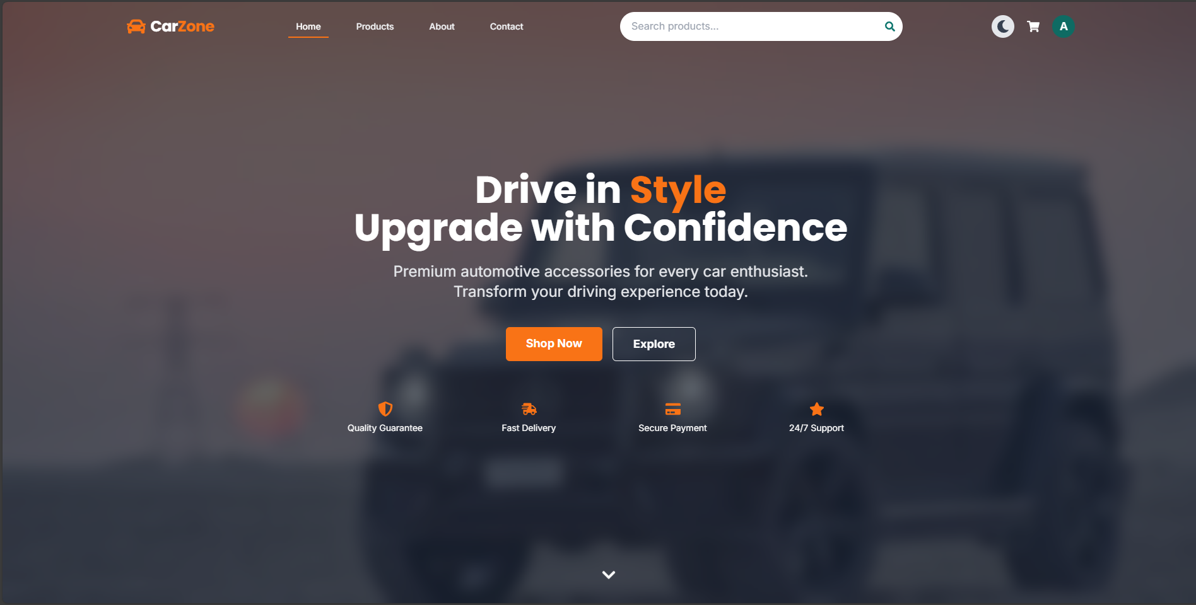
HomePage…..

Slide 11
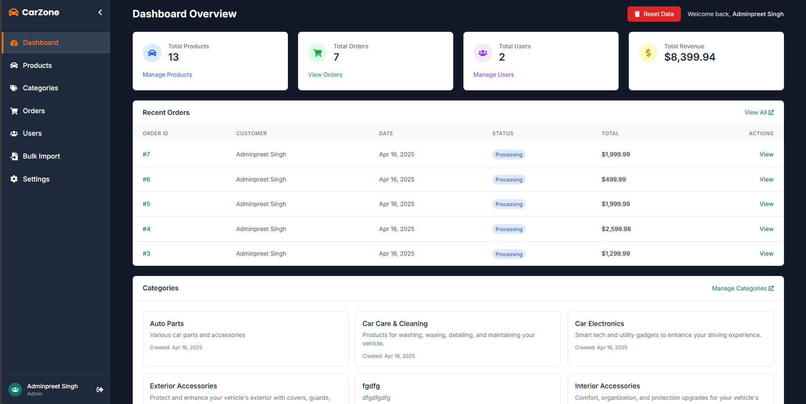
Dashboard…..

Slide 12
Conclusion
CarZone successfully connects car enthusiasts with quality accessories through our specialized marketplace. We've solved the fragmentation problem in automotive shopping by bringing products, sellers, and buyers together on one secure, user-friendly platform. Our solution makes finding compatible car parts simple and enjoyable while giving sellers direct access to their target audience.

Slide 13
References/Links used
React Documentation
Redux Toolkit
Tailwind CSS
Express.js
Sequelize ORM
JWT Authentication
MySQl

Slide 14


