Slide 1
Compilation Techniques (3)
The Lexical Analyzer
Regular Definitions
Tokens
Transitions Diagrams
Implementation

Slide 2
The Lexical Analyzer
Splits the source/input characters (from files, strings, …) in tokens
A lexical unit from the point of view of the next compiler phases is an indivisible unit of information (analogous as atoms were considered indivisible)
Some characters and symbols which are not relevant in the future phases (spaces, comments) can be discarded
Examples: numbers, identifiers, strings, …

Slide 3
Regular definitions
A regular expression with an assigned name
Most of the times a lexical unit definition is given as a regular definition (RD)
Each lexical unit has its own RD
Some RD can be fragments which help forming other lexical units , without being lexical units by themselves
Inside a RD letters can name other RD so a distinction must be made between simple characters and RD names. The names can be bold or underline, and the characters can be put in single or double quotes
Spaces are not significant inside a RD so it can be formatted for a better readability

Slide 4
Regular definitions - example
fragment LETTER: [a-zA-Z_] ;
fragment DIGIT: [0-9] ;
ID: LETTER ( LETTER | DIGIT )* ;
INT: DIGIT+ ;
REAL: INT ‘.’ INT ;
WHILE: ‘while’ ;
LINECOMMENT: ‘//’ [^\r\n\0]* ;
Many compiler tools use the convention to start lexical definitions with uppercase letters, in order to differentiate them from the syntactic definitions
For a single letter the quotes are equivalent with a character class: ‘.’ == [.]
LETTER and DIGIT are only fragments and they do not form tokens. INT is both a fragment of REAL and a token on its own
LINECOMMENT is not significant for the next phases and it will be discarded

Slide 5
Transition Diagrams (TD)
A graphical method to represent regular definitions (RD)
A directed graph where each transition consumes at most one character
For all RD there is only one initial state (state 0)
From each state only a transition can be made with a specific character (DFA). RDs with a common prefix will start on a common path for that prefix and after that they will split into distinct definitions.
Each state can have at most an “else” transition, which does not consume any character and it is always considered last
Each final state corresponds to a fully recognized RD. These states are represented with a double circle and with the RD name next to them. No transitions can originate from final states.
Error states can be placed inside TD in places where only specific characters are allowed

Slide 6


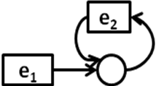

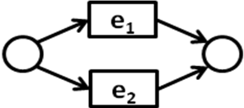

Regular definitions to transition diagrams
1
characters and characters classes
e*
e+
e₁e₂
e₁|e₂
e?
The RD which does not form meaningful tokens for the next phases of the compiler (spaces, comments) will have the final state in the initial state. In this way they can be consumed without generating tokens
If TD becomes too complicated because many RD must be added, these can be represented separately, by considering the initial state (0) as the common point. In this case also the above properties must be preserved. The lexical fragments and the identifiers which appear inside a RD must be expanded to their own constituents (they will not be put as names/references on TD).

Slide 7
Transition Diagrams – example
input characters end before the end of the comment
[^}\0]
\0
6
0-9
0-9
{
}
0-9
.
0-9
0
1
2
3
4
REAL
invalid character
5
after the decimal point a digit must follow
INT
fragment DIGIT: [0-9] ;
INT: DIGIT+ ;
REAL: INT [.] INT ;
COMMENT: { [^}]* } ;

Slide 8
Non-greedy definitions
By default a regular expression (RE) is greedy, so it tries to consume as many characters as possible. Sometimes this behavior is not desirable and we want the RE to consume a minimal number of characters.
Example: create a RE for C multi-line comments (/*…*/)
Trial 1: ‘/*’ .* ‘*/’
If we have multiple comments, this RE because of its greediness will match all the characters from the first ‘/*’ until the last ‘*/’, including all content between comments
Trial 2: ‘/*’ [^*]* ‘*/’
This RE is not greedy anymore but it does not accept comments with ‘*’ inside them
Trial 3: ‘/*’ ( [^*] | ‘*’ [^/] )* ‘*/’
This RE does not recognize comments which ends with an even number of ‘*’ (because for each inner ‘*’ another character must follow before ‘*/’)
Trial 4: ‘/*’ ( [^*] | ‘*’+ [^*/] )* ‘*/’
This RE recognizes any sequence of inner ‘*’, but it does not recognize the end of the comment in the case of multiple ending ‘*’
Solution: ‘/*’ ( [^*] | ‘*’+ [^*/] )* ‘*’+ ’/’

Slide 9
Token
A pair consisting of a token name and an optional attribute
The token name (code, type) is an abstract symbol representing a kind of lexical unit (identifier, a keyword, an integer, …). In most of the cases a token is referred by its name.
The attribute is used to differentiate between tokens with the same name but possibly with different lexemes (ex: a particular integer). The attribute can be the lexeme itself or the result of a processing.
Lexeme – the source characters which were matched by the token definition (ex: lightSpeed for an ID, “hi everybody” for a STRING)

Slide 10
Other token components
Source position – information regarding the token position in source: line and column number, file name, …
Linking fields (ex: to create a list of tokens)

Slide 11
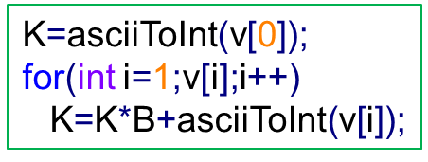
Numbers primary processing
For the tokens which represent numbers, their lexeme can be directly converted to a number. Let c₁…c_{n} the lexeme characters forming an integer K in a base B (decimal, binary, hexadecimal, …). It can be written:
K=c₁*B^{n-1}+c₂*B^{n-2}+…+c_{n}B⁰
An iterative algorithm which converts a sequence of digits in base B from a vector v in a number K:
asciiToInt is a function which converts an ASCII character to a number: ‘0’->0, ‘1’->1,… ‘a’->10, ‘F’ ->15
For real numbers the decimal digits can be multiplied with negative powers of B and added to number

Slide 12
Strings primary processing
Many languages accept inside strings (“…”) or character constants (‘.’) control characters (ESCAPE sequences) which have different meanings. For example in C ‘\t’ means a TAB and not the two characters ‘\’ and ‘t’
Other characters have different meaning in Windows or in Linux when using the standard input/output functions in text mode: ‘\n’ in Windows is translated as ASCII codes 13,10 (\r\n) and in Linux only as ASCII code 10 (\n). Inside strings in Windows ‘\n’ is kept as a single character.
These sequences must be converted according to their meaning and a final string (or character) must be formed

Slide 13
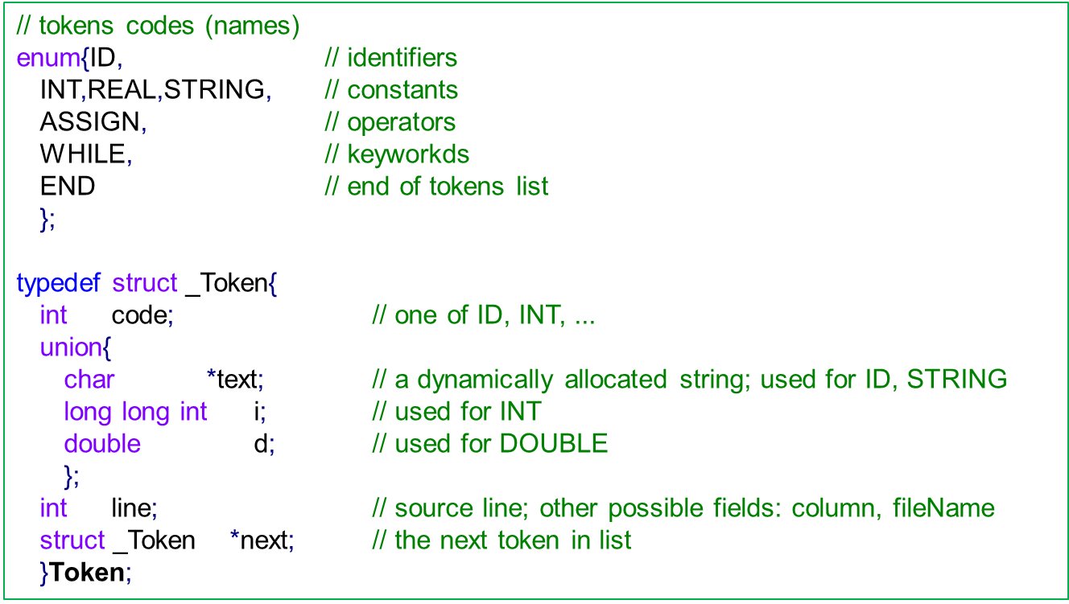
Token structure - example

Slide 14
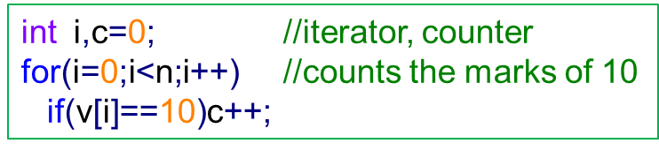
Source to tokens example
KINT, ID:i, COMMA, ID:c, ASSIGN, INT:0, SEMICOLON, KFOR, LPAR, ID:i, ASSIGN, INT:0, SEMICOLON, ID:i, LESS, ID:n, SEMICOLON, ID:i, INC, RPAR, KIF, LPAR, ID:v, LBRACKET, ID:i, RBRACKET, EQUAL, INT:10, RPAR, ID:c, INC, SEMICOLON
All spaces and comments were discarded
Tokens which can have multiple lexemes (ID, INT) must keep their specific lexeme, possibly in a processed form (an attribute)
The keyword int has the code KINT and the integer constants have the code INT

Slide 15
The implementation of the lexical analyzer
For simple compilers and programming languages the lexical analyzer can be implemented as a subroutine getNextToken() which on every call returns the code of the next token. The associated token structure is stored in a variable currentToken, if some fields are needed.
This subroutine can be called directly from the syntactic analyzer. The advantage is that less memory is needed and it is faster because no token list is constructed.
For complex languages the direct use of getNextToken() in the syntactic analyzer has significant drawbacks because sometimes it is needed to backtrace to a former token. In this case the information of (possibly multiple) currentToken must be saved and restored (or recomputed). This direct use also increases coupling between the lexical and syntactic analyzers and makes harder their debugging and development.
For the above reasons, it is preferred to call getNextToken() in a loop and make a list with all the tokens. This list will be used in the next phases. In this case getNextToken() can put in the tokens list at each call a dynamically allocated token structure.

Slide 16
getNextToken() with explicit states
Let state a variable which holds the current state. The initial state is 0.
Inside an infinite loop, at each iteration:
  For the current state check the input character against all possible transitions
  If a transition for that character is found, advance to the next character and set the new state
  If no suitable transition is found but the current state has an “else” transition, set the new state without advancing to the next character
  If the current state is a final state, create a new token, set its fields and return its code
This algorithm is straightforward to implement when a TD is available. It is quite verbose and for future developments the original TD is required to see the original states.

Slide 17
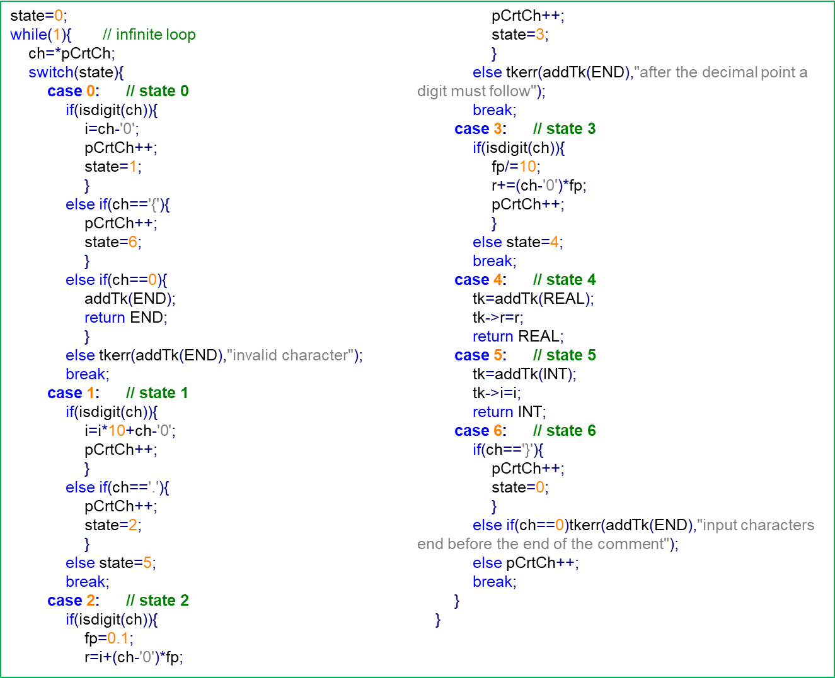
getNextToken() with explicit states

Slide 18
getNextToken() with implicit states
This method does not need an explicit TD but for cases with many common prefixes it is good to have one.
Inside an infinite loop, at each iteration:
  Read a character. Depending on this character advance inside a regular definition (RD) or on a common prefix path.
  While still in a RD, read next characters and advance more inside that RD (or inside a common prefix)
  If the end of a RD is reached and if this RD is not a prefix for another RD, create a token and return its code. If this RD is a prefix for other RD, first try to advance on that RD.
This algorithm more complex and it requires more coding effort. The code is shorter and easier to maintain. In many cases it is also easier to read.

Slide 19
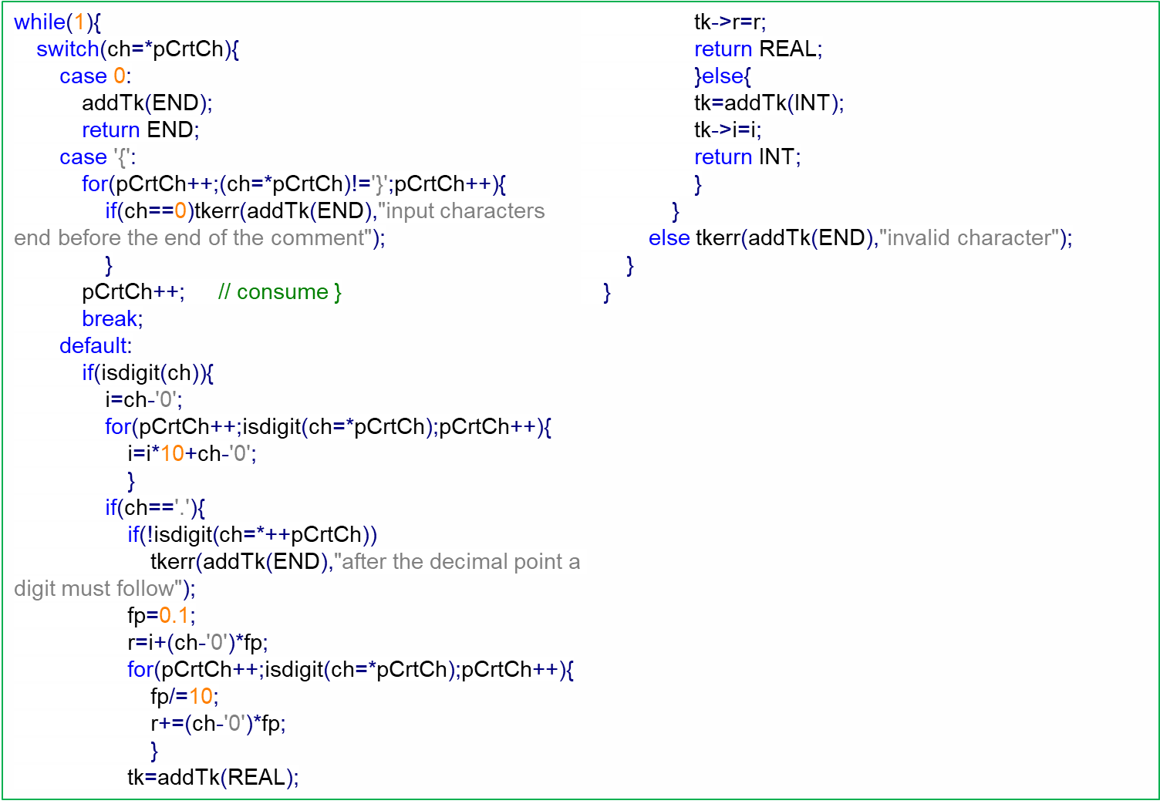
getNextToken() with implicit states

Slide 20
Bibliography reading
Compilers. Principles, Techniques and Tools
3.1, 3.4, 3.10

