Slide 1
Compilation Techniques (7)
Domain Analysis
Symbols Table
Domain Analysis for Static and Dynamic Typed Languages

Slide 2
Domain Analysis (DA)
Checks if a symbol exists and is accessible in a given domain
Symbol – the name of any declaration ( function, variable, constant, type , enum, …)
Domain or Context – a lexical or semantic region.
Examples of domains (contexts): a function body, a class definition, the global (outside) area of a program, …
DA deals only with the existence and accessibility of symbols, not with their proper usage according with their types (this is handled by the types analysis)
DA cannot be always strictly separated from types analysis. For example in the expression “pt.x=0”, DA (tests for existence, visibility, …) can be performed on “x” only after the type of “pt” is known.

Slide 3
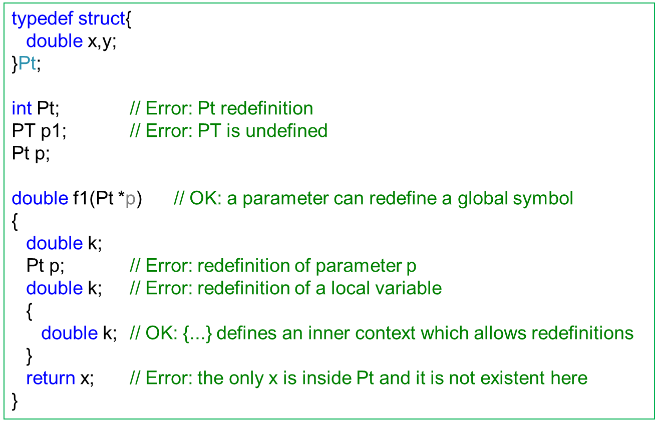
Domain Analysis Example
It can be seen that a program can be lexically and syntactically correct, but it can fail DA

Slide 4
Symbols Table (ST)
A data structure which keeps all defined or correctly used symbols
Each symbol has its own record which holds the required information: name, type, visibility, …
If a symbol can have child symbols (classes members , function arguments), these must also be kept with their defining symbol
The child symbols can be kept in any data structure which implies a traversal order (list, vector)
A child symbol (ex: function arguments) can have a dual nature:
  as a variable inside function body
  as an argument on function call
Because its dual nature a child symbol can be kept in ST in two places (ex: for function arguments):
  inside the parent symbol (its defining function) – this is required for function calls made from outside the function body
  as independent variables – this is required in function body

Slide 5
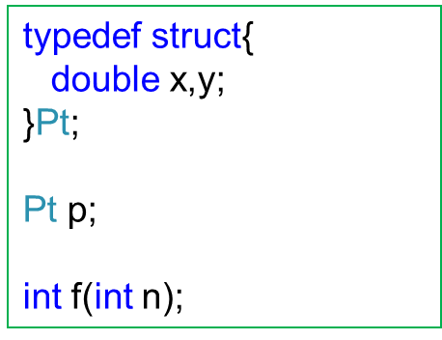
Symbols Table Example
Name | Kind | Type | Children
Pt | STRUCT |  | {x:double, y:double}
p | VAR | Pt
f | FUNC | int | {n:int}
In many cases “Children” is a list of the same type as a Symbol

Slide 6
DA for different types of languages (1)
Static Typed Languages (STL) – languages in which the symbols must be declared and they have strictly defined types ( C, C++, Java, C#, OCaml ). Sometimes the type is not explicitly given but it is automatically inferred (OCaml)
Dynamic Typed Languages (DTL) – languages in which the symbols types are determined according with their runtime usage ( JavaScript, PHP, Python, Ruby )
For Object Oriented STL languages DA can be fairly complex, because there are a lot of rules: visibility, (multiple) inheritance with different rules for classes and interfaces, templates (generics), context modifiers ( this, :: )
In some languages (Java, C#, partially C++) a symbol can be used and only later defined so it does not exist yet when it is used

Slide 7
DA for different types of languages (2)
DA for STL can be fully performed at compile time, because all definitions are available and they cannot change at runtime. This means that any symbol has its strictly defined place in memory. Different optimizations can take this into account.
DA for DTL can be performed only partially at compile time, especially because these languages allow symbols definitions at runtime (ex: eval(“a=10;”) with “a” not defined yet). In this case the symbols values (and their names) must be kept in more flexible data structures (dictionaries), which may also imply more memory used and slower execution speed. Some of these problems can be alleviated by caching the results of symbols searches in dictionaries (when a symbol is found, its location is memorized and the next access for it will try first to find it at that location)

Slide 8
DA for STL in which symbols must first be declared and only then used
Such languages: C (not C++), Pascal
ST can be implemented as a stack with the possibility of in-depth search
Each time a declaration is found, it is added to ST
When a new context is entered (ex: a function) its local declarations are added to ST as independent entries. When the context is exited, its local declarations are deleted from ST. Function arguments must remain for future checks (when the function is called), so they are also kept inside the function symbol.
When an ID is not found in ST it means it is not defined
The IDs which follow a dot (.) must be searched in ST at the child symbols of the type of the dot left side expression
If the language allows symbols redefinition in inner contexts, at a given moment can exist in ST multiple symbols with the same name but with different contexts (ex: a “x” global and a “x” local). Because of this, the search for a symbol must begin from the last added ones.

Slide 9
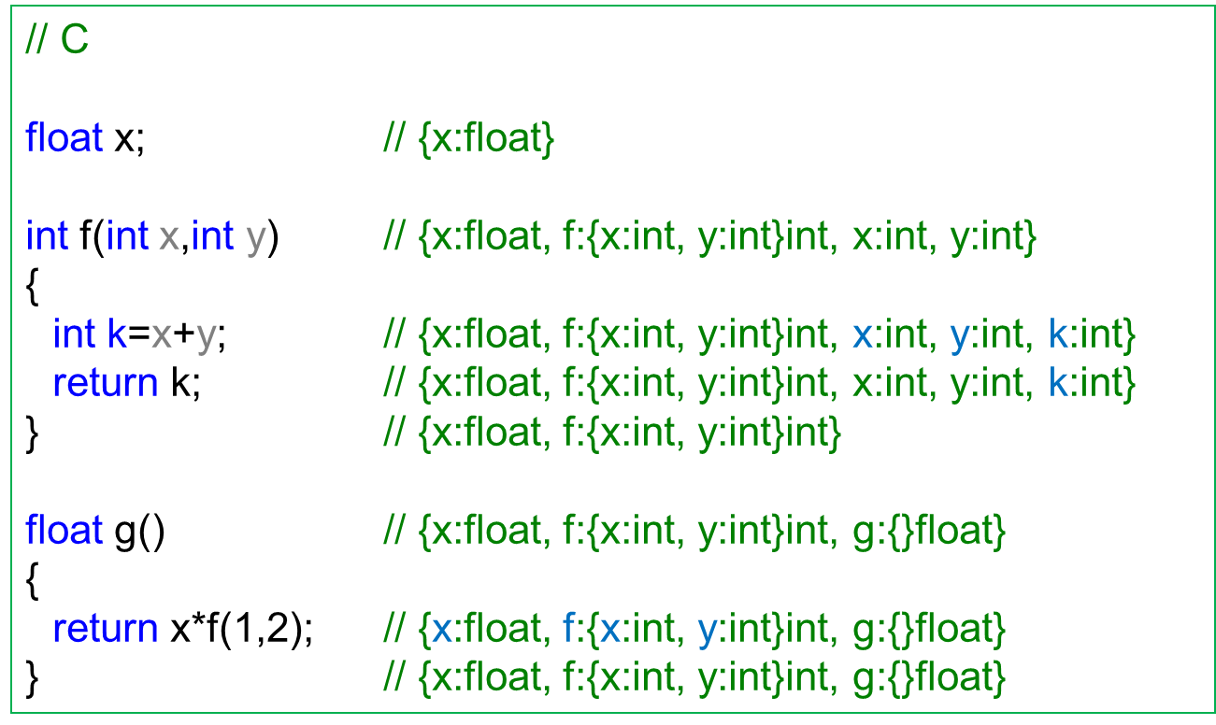
DA for STL in which symbols must first be declared and only then used

Slide 10
DA for STL which allows symbols use before declaration
Such languages: Java, C#, C++ (partially)
Because a symbol can be used before it is entered in ST, DA cannot be made in a single step, but requires two steps:
  step 1 – the program is parsed and possibly (most of the times) transformed into an intermediate representation (Abstract Syntax Tree). In this step all definitions are entered in ST.
  step 2 – the intermediate representation is walked again, now with the ST containing all the symbols available for each position in program. DA is performed.
For some situations it is needed to be able to discern which symbols were declared before/after a particular use (ex: Java does not allow a local variable to be used before its declaration but it allows a class member to be used before its declaration)
For these situations ST can be kept not as a single entity but distributed among the AST nodes, each node having a reference to a ST with the symbols available from its position

Slide 11
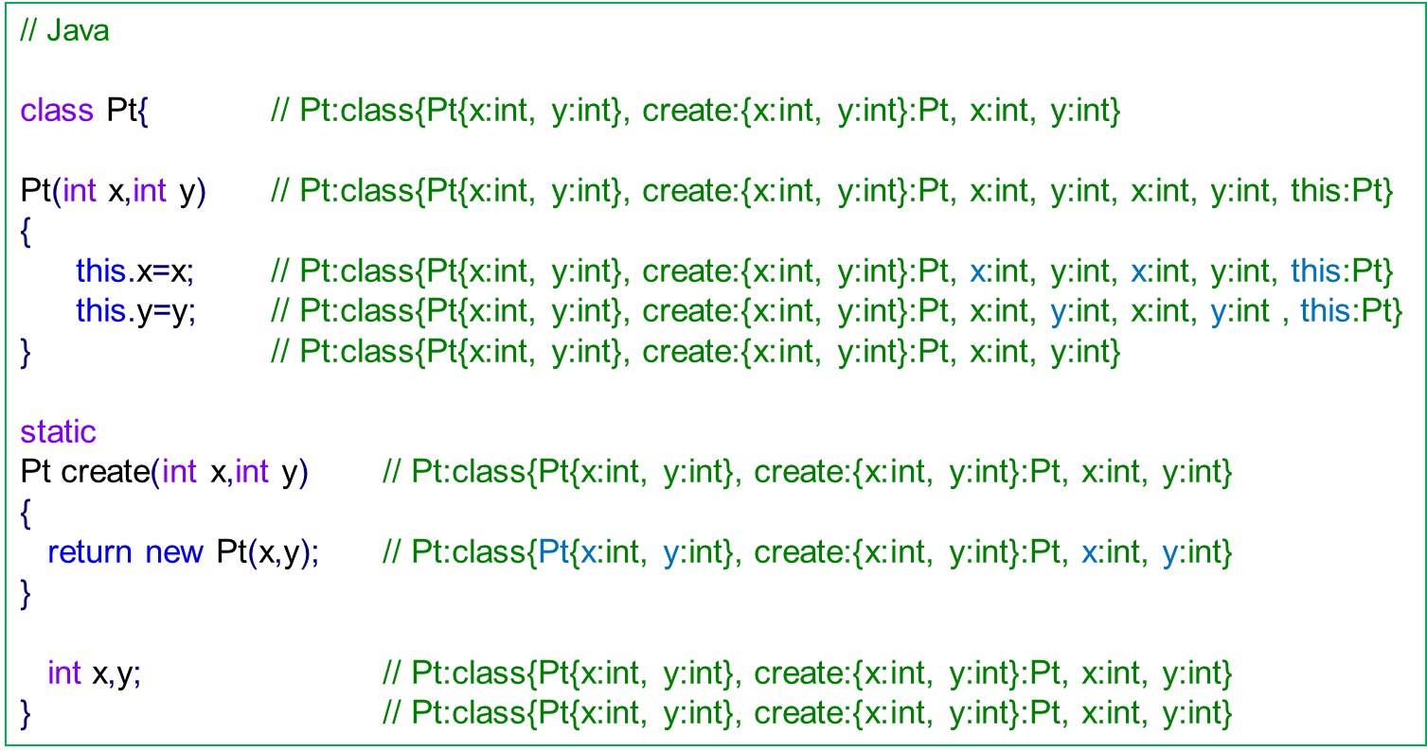
DA for STL which allows symbols use before declaration

Slide 12
DA for DTL
Such languages: JavaScript, PHP, Python, Ruby
Especially at compile time DA can be performed only in a very limited manner
Most of these languages treat an unknown ID as a newly defined symbol and add it to a dictionary. This also allows typos as new identifiers (ex: if through a program the symbol “embedded” is used but somewhere it is typed as “embeddeed”, it is considered OK and two different symbols are considered)
Some of these languages use limited forms for symbols definitions (ex: “var a,b;“ in JavaScript or “global $a,$b;” in PHP) but these are not compulsory for a symbol usage (even if their absence changes the program semantics). Also many such languages allow declarations such as classes, interfaces, functions, constants, ...
Most of these languages allow runtime definitions
Because of the above considerations, DA for DTL is mostly deferred to runtime and it takes place when an ID is encountered (possibly with different cache optimizations)
ST is fully kept at runtime and it is optimized for fast searches

Slide 13
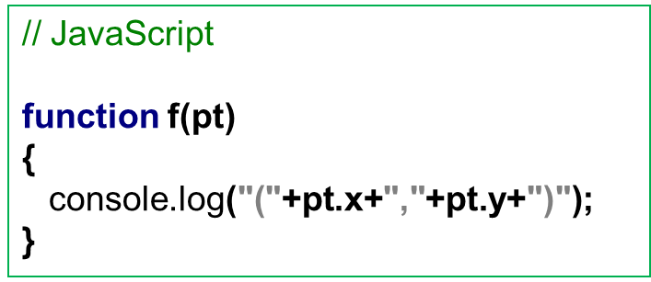
DA for DTL
When the function “f” is entered, the following actions are taken:
The symbol “pt” is searched and it must have a member “x”. The value of “x” is retrieved.
The symbol “pt” is searched and it must have a member “y”. The value of “y” is retrieved.
The values of “x” and “y” are converted to strings and added to the rest of the string
The symbol “console” is searched and must have a member “log” which is callable
The member “log” is called with a single argument

Slide 14
Bibliography reading
Compilers. Principles, Techniques and Tools
2.7

