Slide 1
A SIOP Machine Learning Competition
Learning by Doing
Dan J. Putka
April 20, 2018

Slide 2
Acknowledgments
Eli Lilly
Meghan Lowery (Eli Lilly) & Alan Colquitt
Alexander Schwall (Rhabit) and Ben Taylor (ZIFF)
SIOP Special Sessions Committee
HumRRO

Slide 3
Acknowledgments
12 teams representing 14 different institutions spanning academe and practice
Bowling Green State University
Capital One
Davidson College
DDI
Gartner
HumRRO
Korn Ferry
Old Dominion University
Rice University
Shaker Consulting
U.S. Customs & Border Protection
University of Georgia
University of Illinois
Walmart

Slide 4
Background & objectives
Idea born out of conversations after SIOP’s 2016 Big Data LEC
Host a Kaggle-like machine learning competition focused on an outcome and dataset of meaning to SIOP members
Provide an annual novel mechanism for educating SIOP members about advances in predictive modeling – learning by doing
Provide the data sponsor “free” crowd-sourced insight into a prediction problem they face
This year was a “by invite only” pilot test to clarify how the competition would work

Slide 5
The prediction problem and data
Predicting voluntary turnover at Eli Lilly
Data for 32,296 Eli Lilly employees active as of December 31, 2009
Predict who voluntary left vs. who was still active as of December 31, 2014
Criterion-related data
Primary criterion was status as of 12/31/14 (0 = Active, 1 = Voluntary Exit)
Base rate of turnover in the model training set was 18.7%
Exit date and exit reason

Slide 6

162 predictor variables
Unique ID, entry date, tenure as of 12/31/09
Demographics: Age, gender, race/ethnicity
Time varying variables captured yearly from 2004-2009
Location: City, country
Job-Related: Organizational function and sub-function, job type, pay grade, cross-functional experience
Job performance
Job performance ratings – overall and competency-level
Performance of incumbent employees’ supervisors!
HiPo indicators
Teams were also allowed to “engineer” new predictor variables
Ahh…the joys of real data
Longitudinal data
Nesting & cross-classification
Low n subgroups
Missing data
(average of 37% per variable)

Slide 7
the competition

Slide 8
Rules & process
Teams submitted up to 5 entries per week (early January – late February)
Teams developed models based on a random portion of the full sample reserved for the “training set” (n = 24,205)
Teams applied their models to random portion of the full sample reserved for the “test set” (n = 8,091)
No criterion data were provided to teams in the test set
Teams emailed entries to the competition manager for processing
Simple .csv file with ID and predicted probability for each test set case

Slide 9
Evaluation of entries
Entries evaluated on a version of the test set containing the turnover criterion
Evaluation metric: Cross-validated area under the ROC curve (AUC) statistic
AUC is commonly used to evaluate predicted probabilities when modeling a binary criterion

Slide 10
Leaderboards
Updated public leaderboards were distributed on a weekly basis
Two leaderboards were maintained for the competition
A public leaderboard based on ~50% of the test set (n = 4,046)
A private leaderboard based on ~50% of the test set (n = 4,045)
Public/private split designed to prevent teams from “learning” the test set
Final standings were based on the private leaderboard test set

Slide 11
Final judging
After the final public leaderboard was released, teams were asked to nominate up to 5 of their entries for “final judging”
Final team rankings reflect the top nominated entry from each team based on its AUC in the private leaderboard test set
The top 4 teams will present their approach today!

Slide 12
overview of results

Slide 13
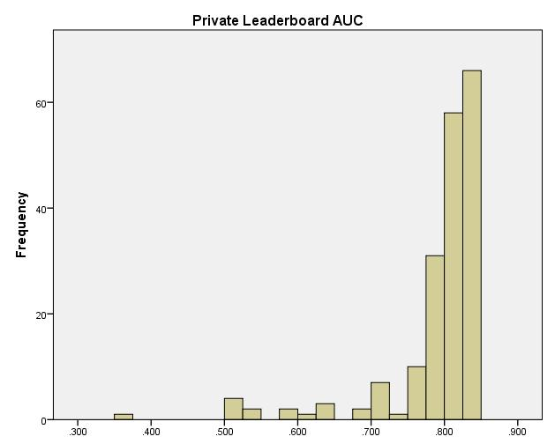
Quick summary
188
Total number of entries
15.6
Average number of entries per team
(Range 2 to 34)
.79
Average cross-validated AUC across entries
24.5
Percentage of entries reaching a cross-validated AUC > .83
.96
Average correlation among top 4 teams’ winning entries

Slide 14
Final team standings
Less than .005 separated the top 4 teams!
Less than .05 separated the first place team from the last place team!

Slide 15
drum roll please…..

Slide 16
#4 Byte Monsters Private Test Set AUC = .834379 (only .003640 > #5)

Slide 17
#3 ROC You Like a Hurricane Private Test Set AUC = .834485 (only .000105 > #4, sampling error smiles upon the ROC)

Slide 18
#2 Team DDI Private Test Set AUC = .836564 (only .002079 > #3)

Slide 19
#1 An Enriching Meal Private Test Set AUC = .839138 (only .002574 > #2)

Slide 20
Team presentations
How did your team approach the prediction problem?
Describe your winning solution.
What were the most important predictors of turnover?
What lessons did you learn?
The top 4 teams’ presentations and code are in SIOP’s Document Library!

Slide 21
team presentations

