Slide 1
Mid 2 Review
Fang Jiayi 2018.7.9
Descriptive statistics
Estimation
Simultaneous Estimation of the Mean and Variance
Fisher’s Hypothesis Test

Slide 2

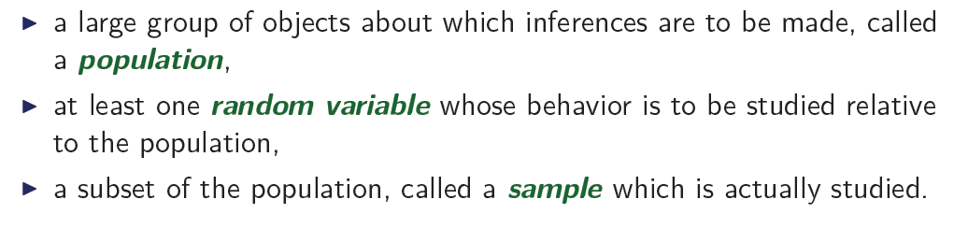
What are we doing?
1. The random variable here is usually some parameter of the distribution of the population.
2. The true value of the parameter is never known!
3. So we need a sample to estimate the true value of the parameter.

Slide 3
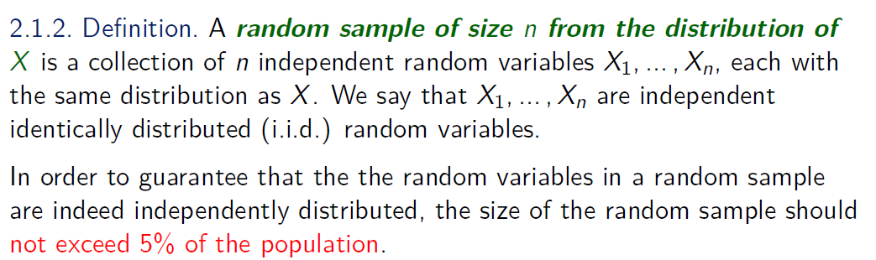
Note that in this definition, X1 … Xn are all variables, though they might take different values in a certain measurement, and they have the same distribution as X.
How to see this？
Upper case X : a variable
Lower case x : an observed value of X

Slide 4
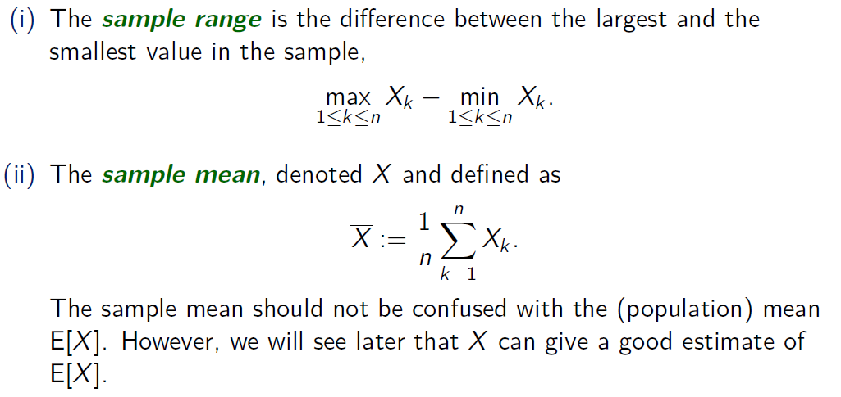

Slide 5
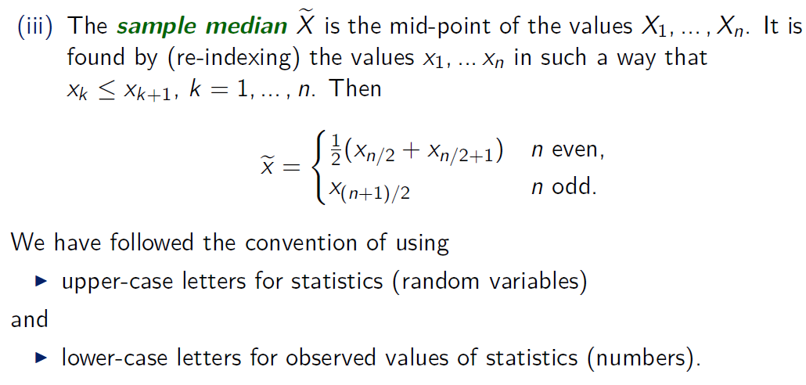

Slide 6
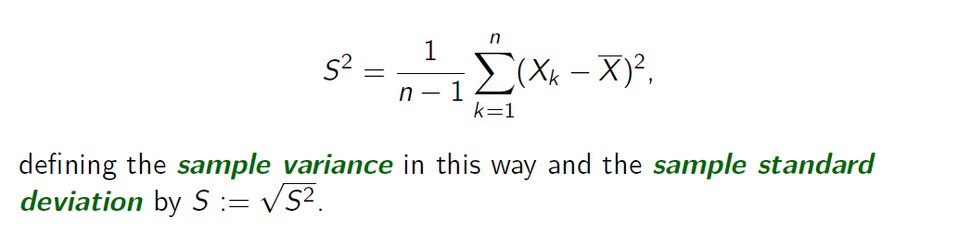
Pay attention to n-1 here.
There are two modes in 991 : sample variance vs. population variance
n-1
n

Slide 7
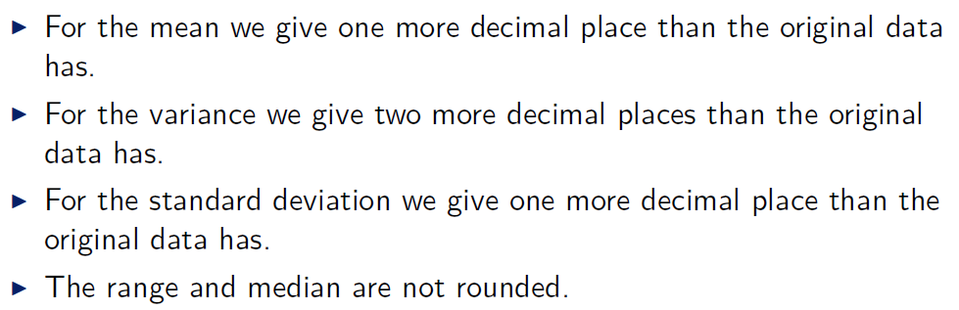
Rounding

Slide 8
Graphs
Stem-and-Leaf Diagrams
Histograms
Ogives
Boxplots
Percentiles and Quartiles
The index in percentile refers to the area to the left.

Slide 9
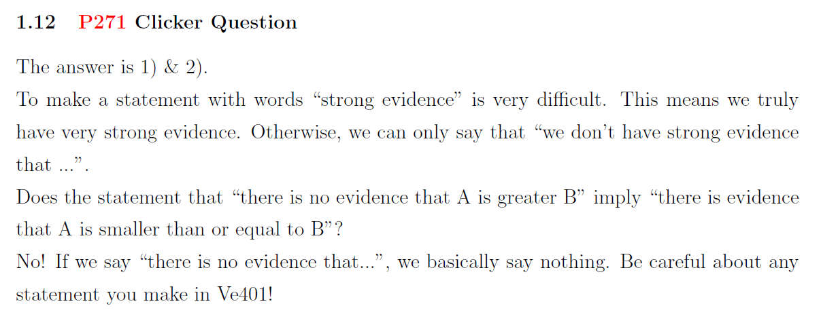

Slide 10
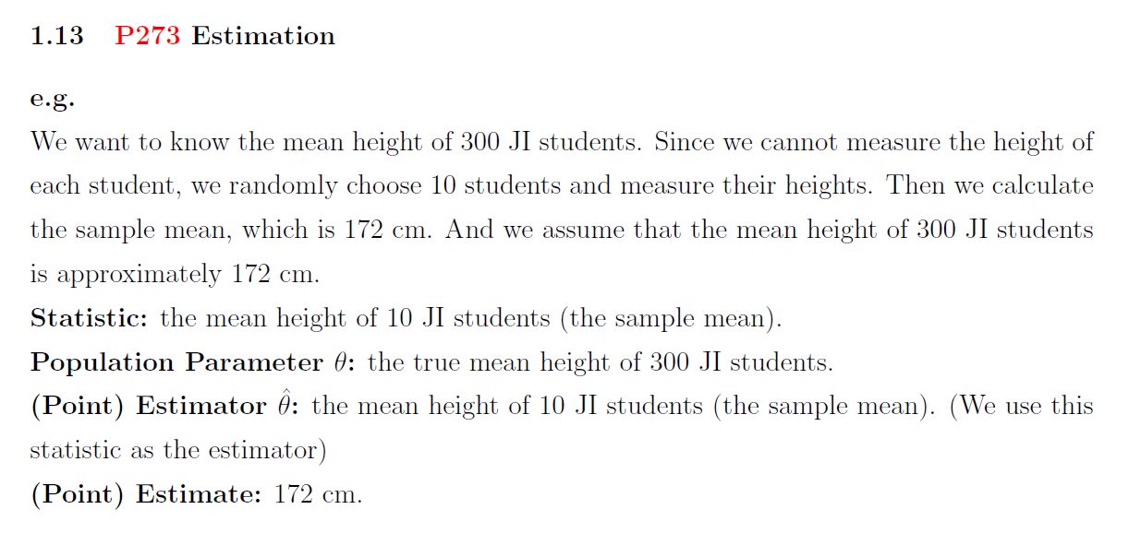
Notations

Slide 11
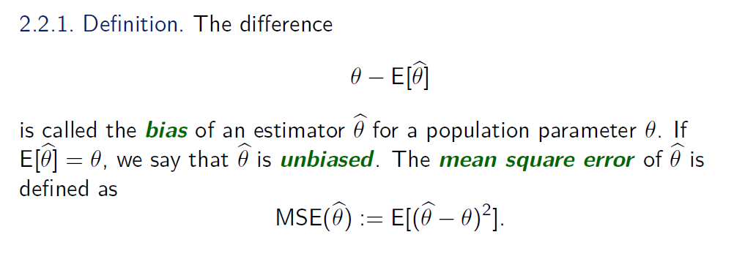


Slide 12
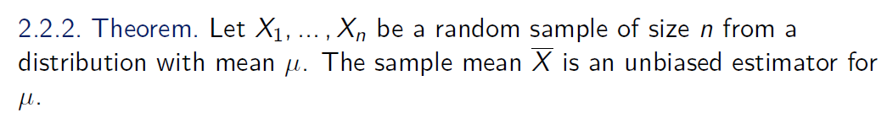
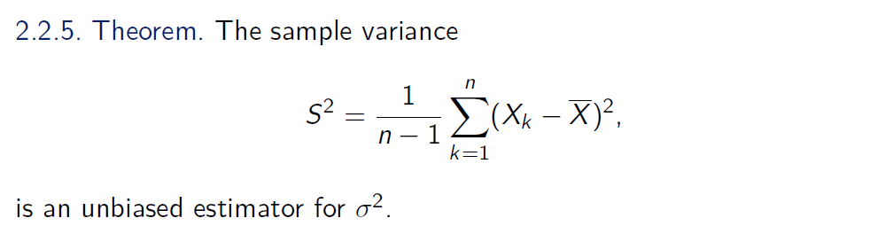
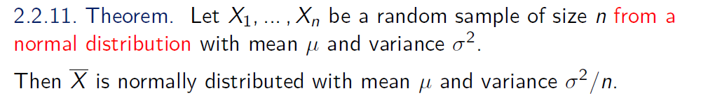
Estimator for Mean & Variance

Slide 13
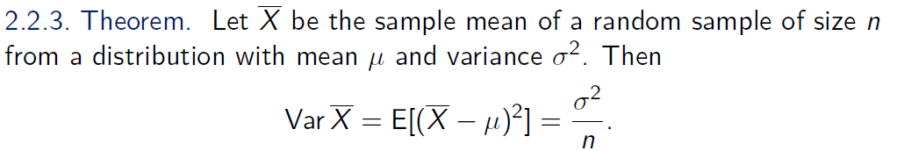
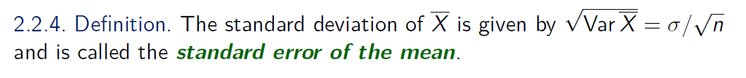
Advantage of large sample size
Again, note that \bar{X} here is variable (upper case), so it has its own distribution. Large sample size makes its own variance small. What does this mean?
Large sample size has its advantage. Does it mean that we should make sample size as large as possible?

Slide 14
Let’s know more about Poisson Distribution......
The number of neps on the wool
The number of calls the telephone office gets in a unit of time
The number of a certain kind of comic rays in the sky in a unit of time
The number of 100-bills in 1000 retail sales
Exercise 4 of your mid1
……
Poisson distribution is very useful!

Slide 15

Method of Maximum Likelihood
Exercise on the blackboard (Poisson distribution)
1. Try your best to represent the parameter(s) to be estimated by E[X^k]
2. Then replace them with Mk and give the parameter(s) hats
3. Solve for the parameter(s) with hats

Slide 16
Do these two methods always yield the same result?
No.

Slide 17
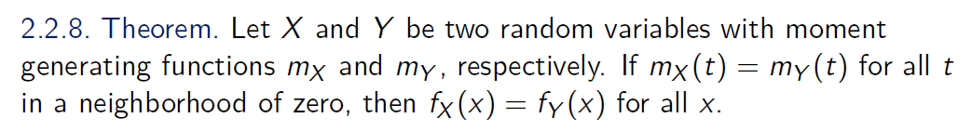
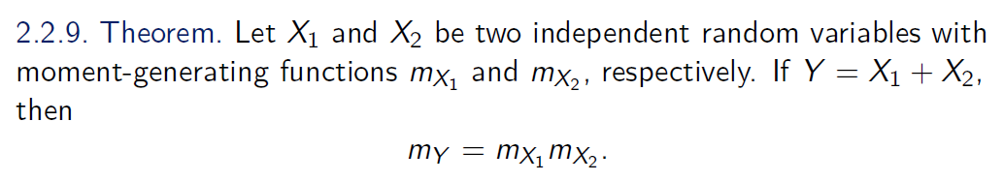
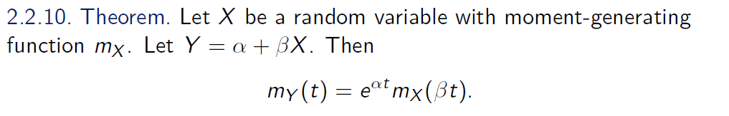

Slide 18
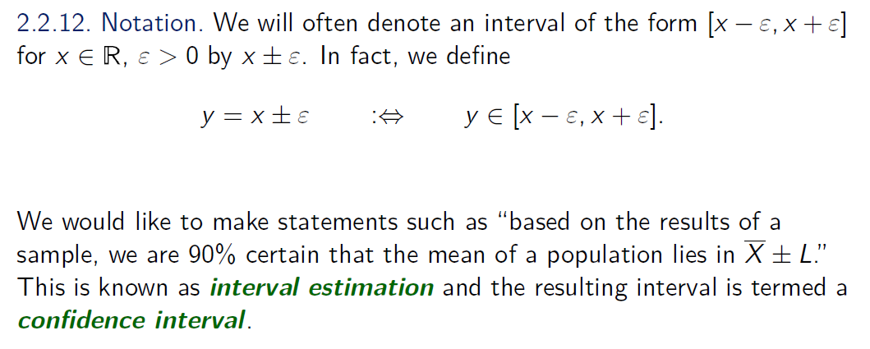
Confidence Intervals

Slide 19
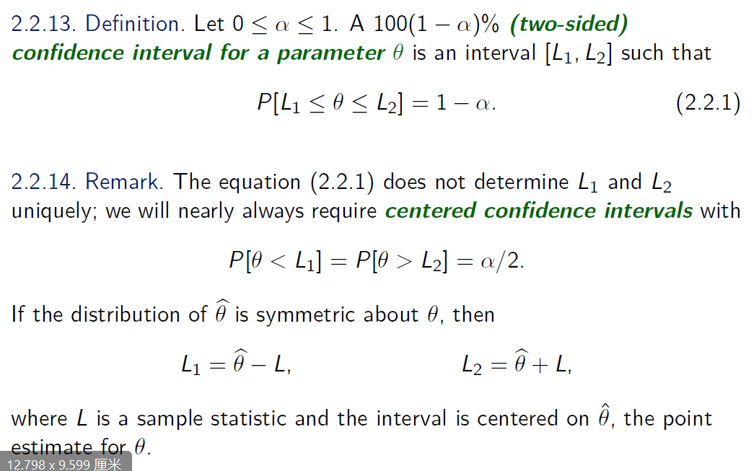
Two-Sided Confidence Intervals

Slide 20
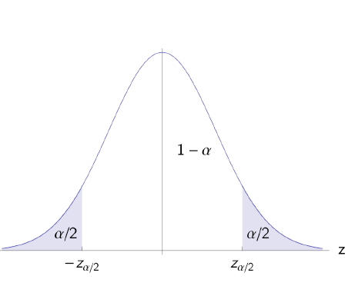
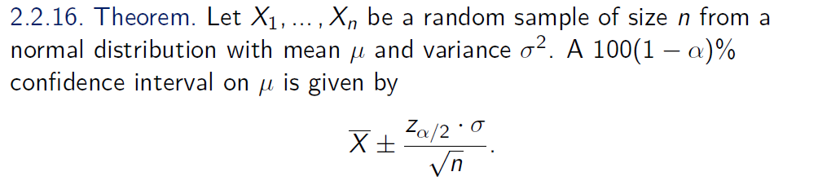
Here, the index \alpha/2 refers to the area of the region to right

Slide 21
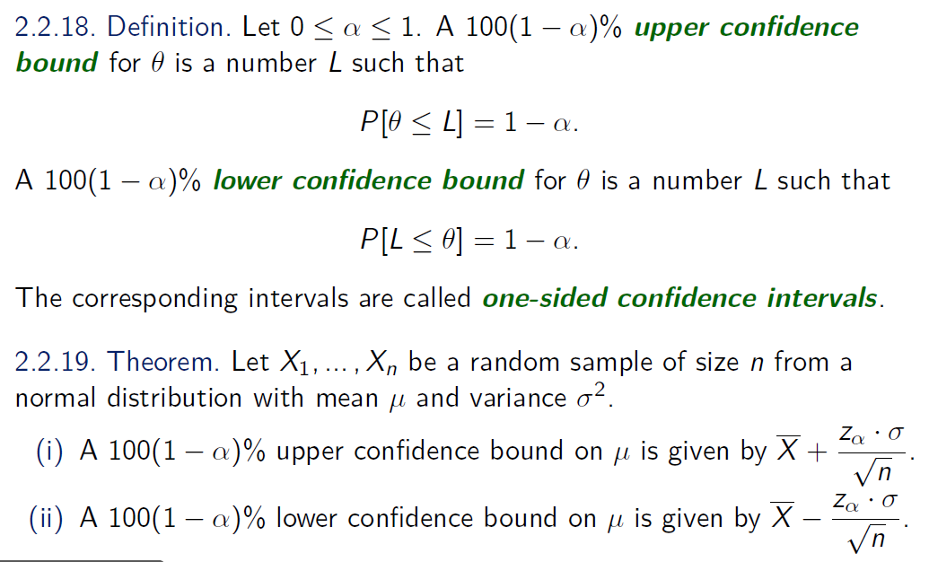
One-Sided Confidence Intervals

Slide 22
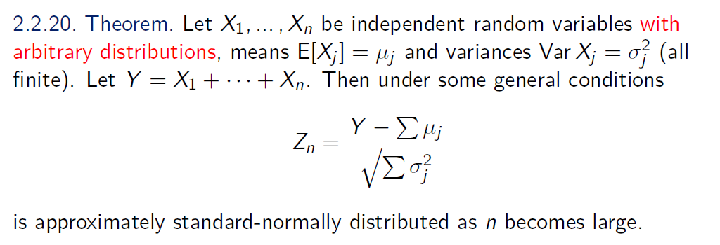
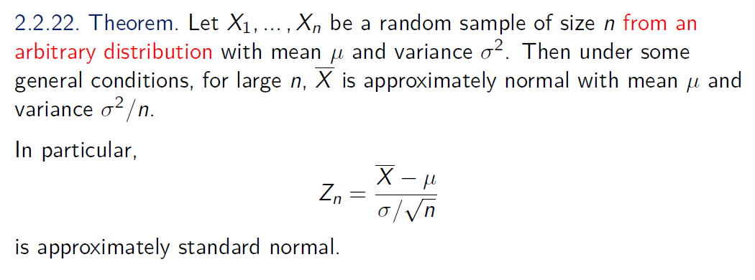
Central Limit Theorem

Slide 23
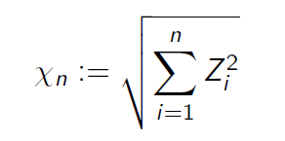

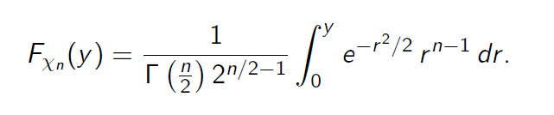
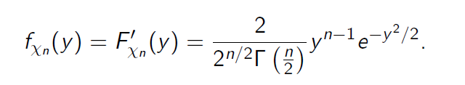

The Chi Random Variable

Slide 24
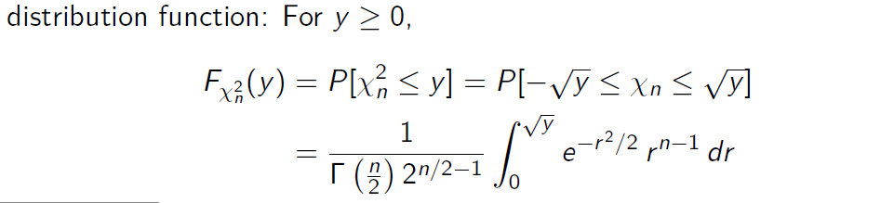
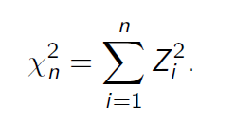
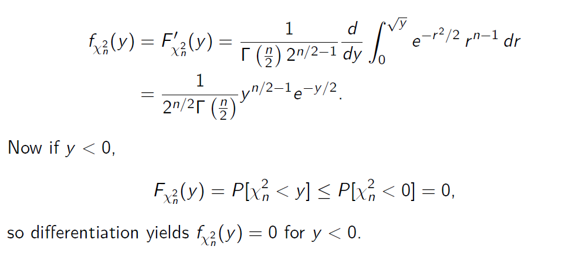
The Chi-Squared Distribution

Slide 25

The Chi-Squared Distribution

Slide 26
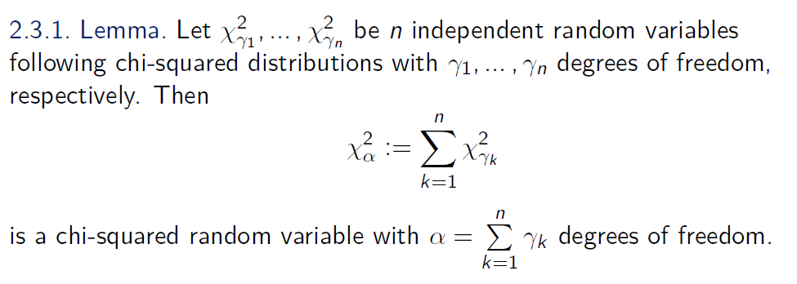
The Sum of Independent Chi-Squared Variables

Slide 27
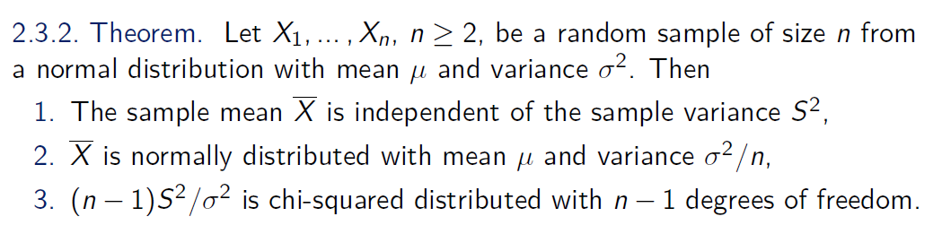
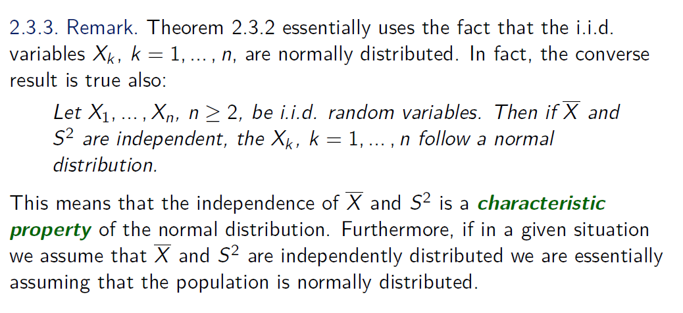

Slide 28
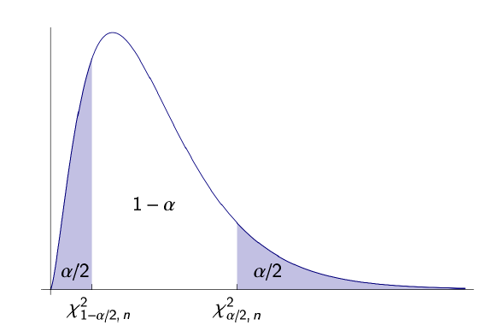
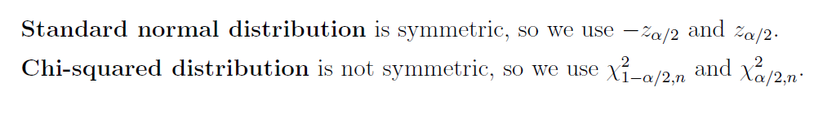
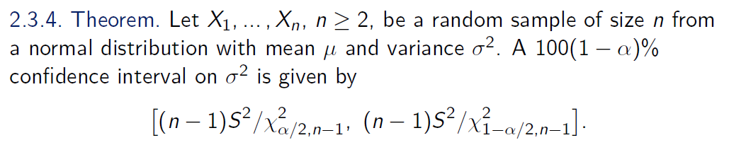

Slide 29
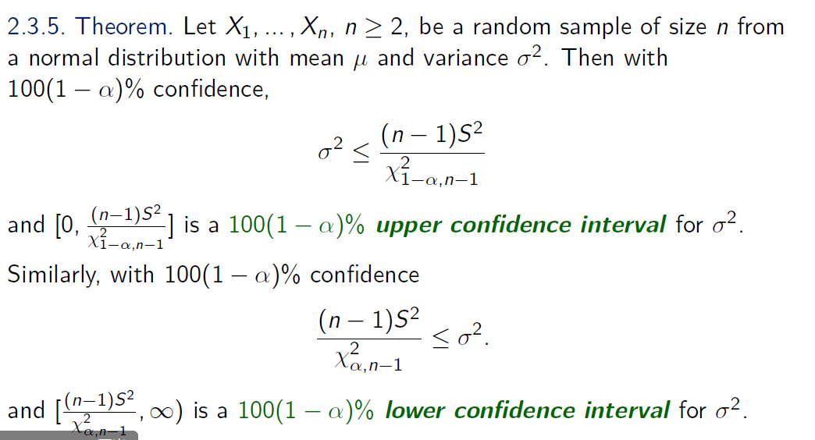
We now turn to one-sided

Slide 30
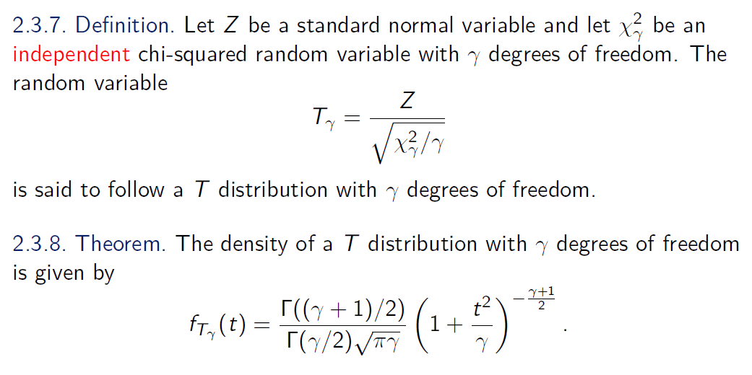
The Student T-distribution

Slide 31
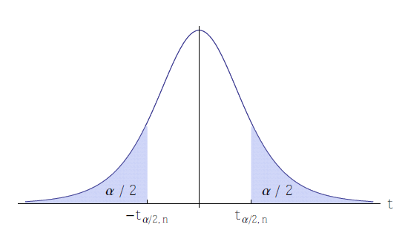

Slide 32
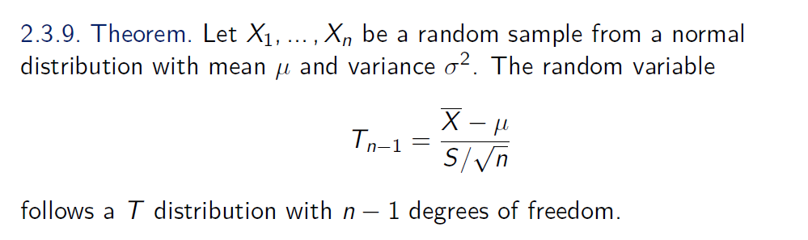
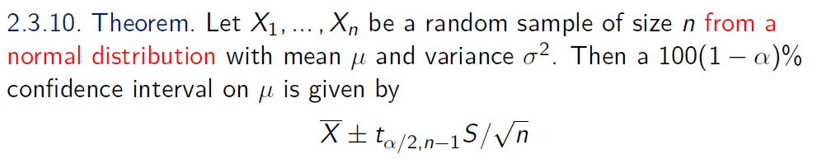


Slide 33
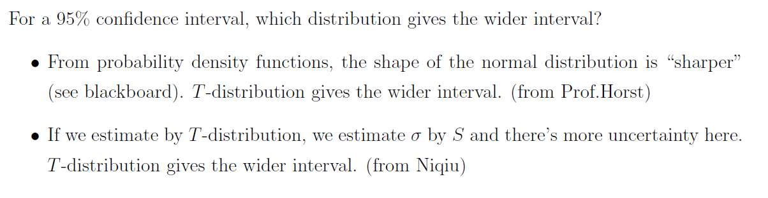

Slide 34
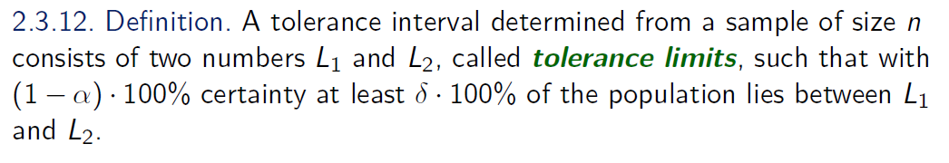
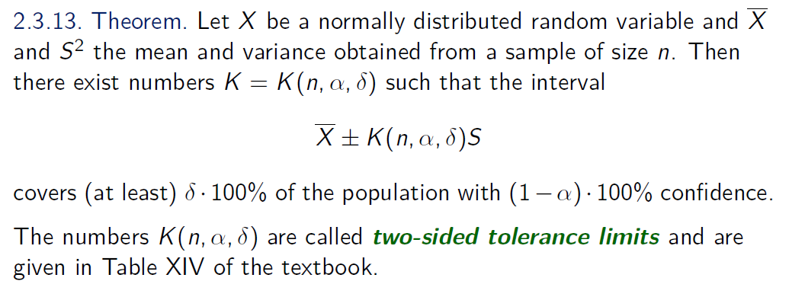
Tolerance Limits

Slide 35
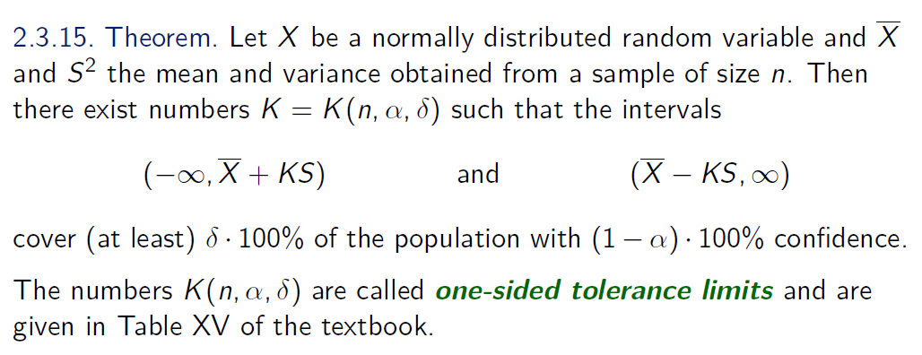
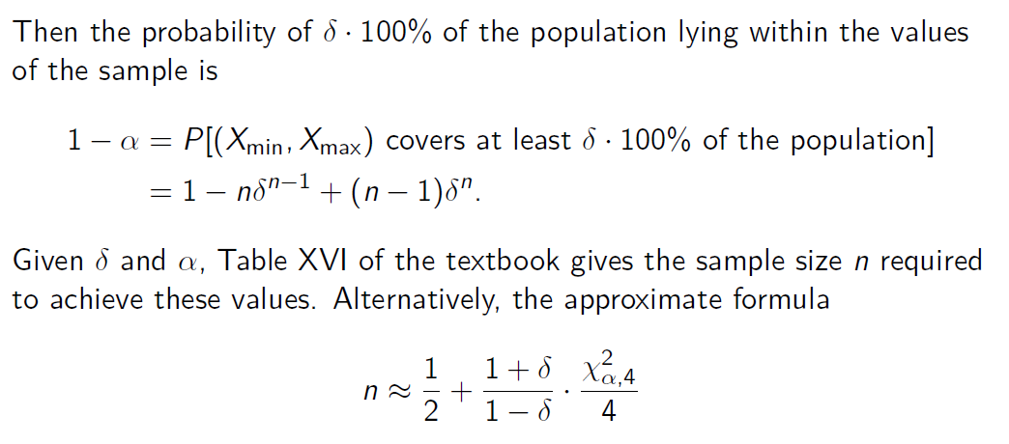

Slide 36
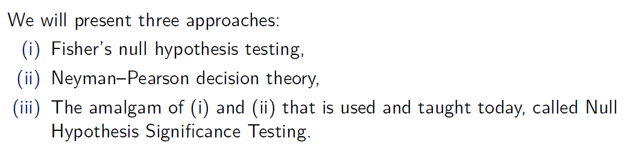
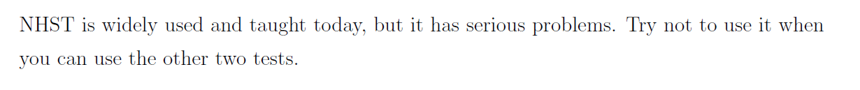
Hypothesis Tests
Given a problem, how to decide between Fisher’s null hypothesis testing & Neyman–Pearson decision theory?
If we want to find evidence to reject H0, we choose the former.
If we want to make a decision between H0 and H1, we choose the latter.

Slide 37
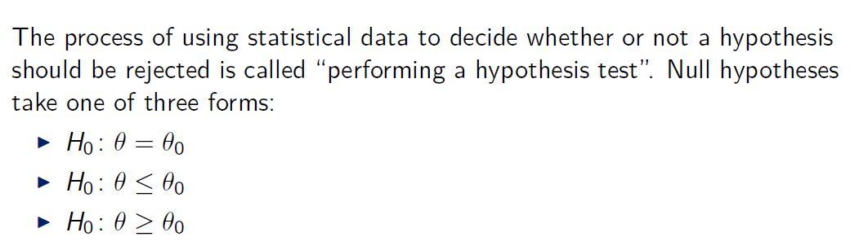

Null Hypothesis

Slide 38
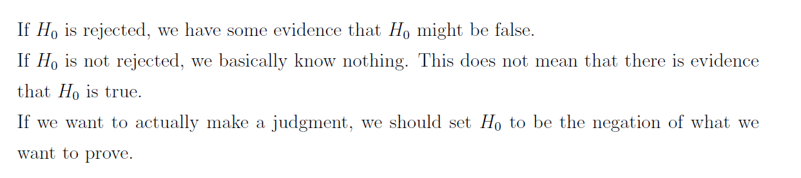

Slide 39


P-value

Slide 40



Slide 41


Two-Tailed Tests

Slide 42

A Logical Problem

Slide 43

Bayesian vs. Frequentist Statistics

Slide 44

Summary of Fisher's Hypothesis Test

