Slide 1

Entrepreneurship Basics
VX 420: Lecture 1
Introduction

Slide 2
Agenda
What is “entrepreneurship”?
Why be an entrepreneur? Why not?
Why should you be interested in this class?

Slide 3
QUESTION #1
What is entrepreneurship?
Can we define it?
What do you think?

Slide 4
Some Modern Definitions
Scott Shane (Case Western) – “Entrepreneurship is an activity that involves the discovery, evaluation and exploitation of opportunities to introduce new goods and services, ways of organizing, markets, processes, and new materials through organizing efforts that previously had not existed.”
Howard Stevenson (Harvard) – “.. The pursuit of opportunity without regard to resources currently controlled.”
W. Gibb Dyer, Jr. (BYU) – “The founding of new businesses is the essence of entrepreneurial activity.”

Slide 5
What is Entrepreneurship?
Cantillon (1700’s)
Say (1803)
Knight (1921)
Schumpeter (1934)
Kirzner (1973)
Gartner (1988)

Slide 6
Richard Cantillon (1697-1734)
The entrepreneur is a specialist in taking on risk
He “insures” workers by buying their products (or labor services) for resale before consumers have indicated how much they are willing to pay.

Slide 7
Frank Knight (1885-1972)
Entrepreneur has a two-fold function
  Exercising responsible control (directing the work of others)
  Securing the owners of productive services against uncertainty and fluctuations in their incomes
Distinguished between risk, which is insurable, and uncertainty, which is not
  Uncertainty includes things like changes affecting the marketing of consumer products (e.g., fashion trends)
Profit compensates entrepreneur for bearing uncertainty

Slide 8
Joseph Schumpeter (1883-1950)
(1934) - “implements change (‘creative destruction’) within markets through the carrying out of new combinations”.
(1942) – The entrepreneurial function “does not essentially consist in either inventing anything or otherwise creating the conditions which the enterprise exploits. It consists in getting things done.”
A lot of what an entrepreneur does on a day-to-day basis is not “entrepreneurial”

Slide 9
Israel Kirzner
Entrepreneur is an arbitrageur
He or she discovers previously unknown market opportunities
Key characteristic is entrepreneurial “alertness”

Slide 10
Synthesis of “Entrepreneurship”
In general, even entrepreneurship researchers can’t agree on what the “best” definition of entrepreneurship is
Two main camps
  Discovery, evaluation, and exploitation of opportunities
  Starting new businesses

Slide 11
Synthesis of “Entrepreneurship”
Previous economists do a nice job defining entrepreneurship
  Concerned with decisions surrounding new profit opportunities
  Concerned with assembling resources
  All in the midst of uncertainty
But they don’t address who is likely to be an entrepreneur, or even more important, a successful entrepreneur

Slide 12
The Economic View of the Entrepreneurial Decision
access to
resources
other job
opportunities
ability to
organize
resources
specialized
skills
knowledge
entrepreneurship
orientation
Expected
Performance
≥
Performance
Threshold
Source: Gimeno, Folta, Cooper, & Woo (1997). “Survival of the fittest? Entrepreneurial human capital and the persistence of
underperforming firms”. Administrative Science Quarterly, 42: 750-783.

Slide 13
Job generation
Large firms add and tend to cut back with the business cycle.
In most business cycles, small firms add relatively higher percentage of total net new jobs during the recession phase.
  During the decade of the 1980’s, the Fortune 1000 cut 3.5 million jobs
  During the same period, small firms added 10 million jobs
  In 2001, new firm births declined 5.0% and closures rose 4.5%
  the fraction of employment accounted for by business startups in the U.S. private sector over the 1980-2005 period is about 3 percent per year. This exceeds the 1.8 percent average annual net employment growth. This pattern implies that job destruction exceeds job creation at existing businesses and highlights the importance of business startups for job creation in the U.S. economy

Slide 14
Entrepreneurship is a Multi-step Process
Recognize
Opportunities
Evaluate
Exploit
See also Amar Bhide’s article “The Questions Every Entrepreneur Must Answer” in case packet.

Slide 15
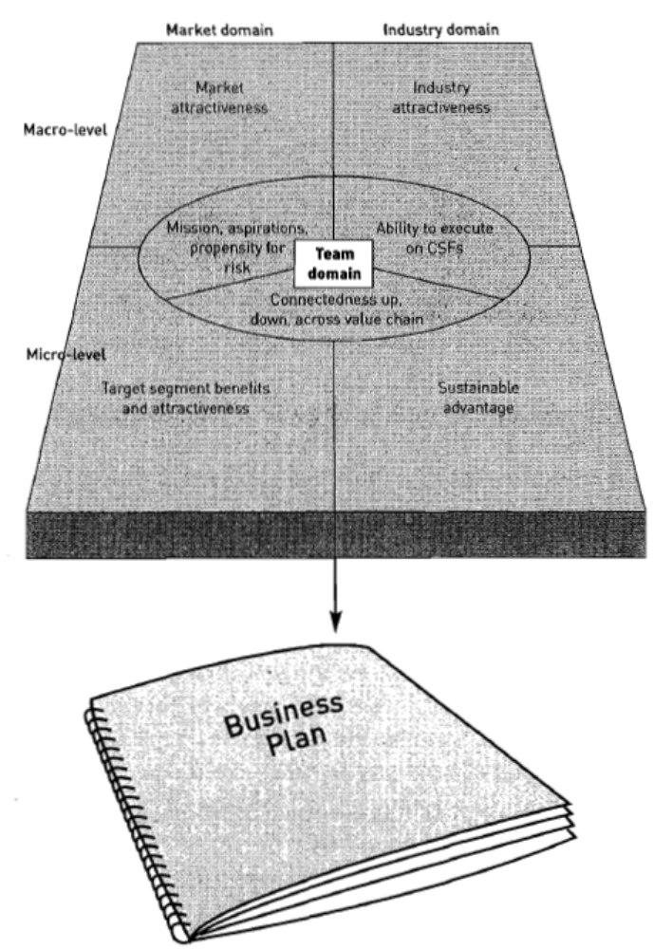
Market Attractiveness
Industry
Attractiveness
Mission
Aspiration
Propensity for Risk
Ability to Execute
On CSFs
Value Chain Connectedness
Target Segment Value Created
Sustainable
Advantage

Slide 16
QUESTION #2
Why be an entrepreneur?
What do you think?

Slide 17
Why should you be interested?
Many young people have succeeded:
  Michael Dell - Dell Computers
  Frank Carney - Pizza Hut
  Paul Orfalea - Kinko’s
  Fred DeLuca - Subway.
  Kristy Taylor - SkinCareRx.com
Opportunity to reap large profits

Slide 18
Why should you be interested ?(cont.)
Invulnerability of Youth
  Confident, resilient, and ignorant
  Minimum exposure to failure
Limited Responsibility
  Marriage, children, car, home, etc. suggest higher opportunity costs if failure
Physical and Emotional Strength
  Better ability to burn the candle at both ends

Slide 19
Why should you be interested? (cont.)
Available Resources
  Many are waiting for you to ask for help.
  Take advantage of your “harmless” appearance
Opportunity to control own destiny
Opportunity to reach your full potential
Opportunity to make a difference
  With employees – Jim Dodson, The Dodson Group
  With social concerns – Steve Row, Sun Garden Furniture

Slide 20
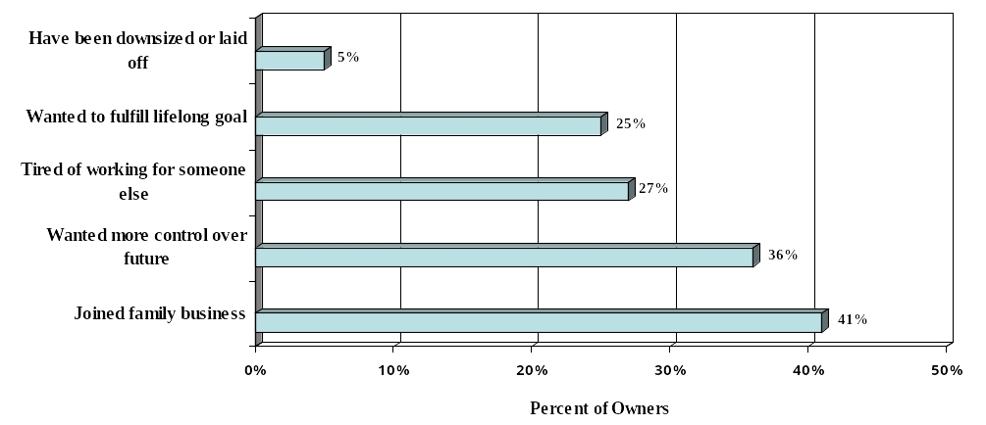
Source: Dun & Bradstreet 19th Annual Small Business Survey, 2000

Slide 21
Why should you be interested? (cont.)
Number of young entrepreneurs is increasing
  Jobless managers and execs <40 starting their own businesses surged to 36% in 2002-1.ª
  <25s are 7% of all business start-ups in England.^{b}
    44% of young entrepreneurs are women, compared to 33% of all entrepreneurs
    9% of young entrepreneurs come from non-white ethnicity
    Young entrepreneurs are better prepared – 43% prepare a business plan, compared to 39% of all entrepreneurs
^{a “}Entrepreneur numbers increase”, East Bay Business Times-May 28, 2002.
^{b} “Young Entrepreneurs: Tomorrow’s Business Leaders”, December 4, 2001, published by Barclays

Slide 22
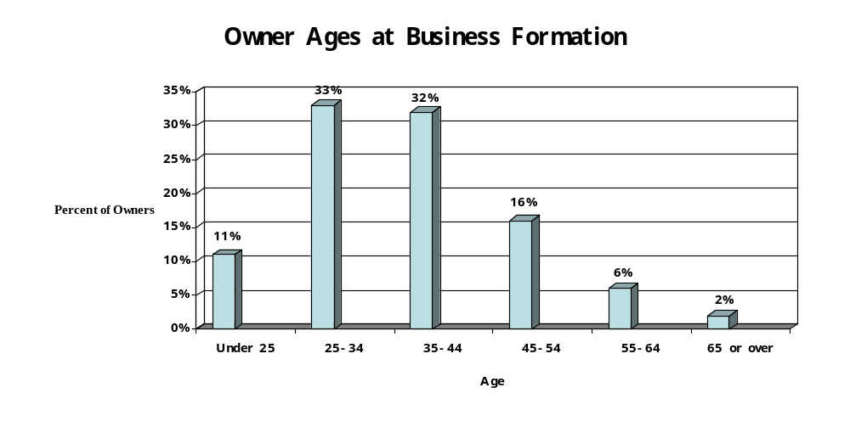
Sources: National Federation of Independent Business and Wells Fargo Bank

Slide 23
Why NOT to be an Entrepreneur
Uncertainty of income
Risk of losing entire invested capital
Lower quality of life until business gets established
High levels of stress
Complete responsibility

Slide 24
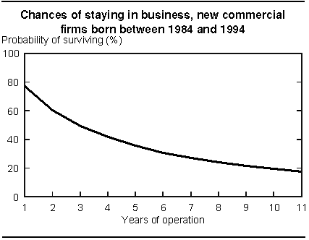
New Firm Survival Rates
According to Dun & Bradstreet study of businesses between 1989-1992:
  66% of businesses remain open at least 2 years.
  50% remain open at least 4 years.
  40% remain open at least 6 years.
Study of Canadian firms found roughly the same:

Slide 25
Why should you be interested in this class?
Help overcome high rate of failure
It is the entrepreneur, not the idea that can provide the advantage
Training in entrepreneurship becoming more commonplace
Importance of business plans
Provides a simulation experience

Slide 26
Today’s Learning Objectives
Understanding the roots of entrepreneurship.
Understanding the entrepreneurial process.
Understanding that entrepreneurial opportunities exist for a number of reasons.
Understanding many of the benefits to being an entrepreneur, and that the benefits come with risks.
Understanding that this class is designed to help protect against those risks.

Slide 27
A Definition
Entrepreneurship seeks to understand how opportunities to create something new arise and are discovered or created by specific persons who then use various means to exploit or develop them, thus producing a wide range of effects.

Slide 28

Key Activities
Identifying an opportunity
Exploiting or developing this opportunity
Running a new business successfully

Slide 29

Intrapreneurs
Persons who create something new, but inside an existing company rather than through a new venture.

Slide 30
Trend toward Entrepreneurship
Media accounts of success
Change in “employment contract”
Change in basic values

Slide 31
Foundations in Other Disciplines
Economics
Technology
Psychology, cognitive science
Behavioral science
Business and finance
Law
Sociology
Political science

Slide 32

Macro and Micro
Micro perspective—focuses on the behavior and thoughts of individuals
Macro perspective—focuses primarily on environmental factors
Both are key in understanding the entrepreneurial process

Slide 33
The Process
Recognition of an opportunity
Deciding to proceed and assembling resources
Launching a new venture
Building success
Harvesting the rewards

Slide 34

A Confluence of Factors
Social
Change
New
Markets
Opportunity
Economic
Change
Technology

Slide 35

The Essence of Entrepreneurship
The intersection of valuable opportunities and enterprising individuals is the essence of entrepreneurship.

Slide 36
To Do Good
Entrepreneur’s products and services improve the lives of countless millions of persons
Entrepreneurs are often extremely generous in their donations to worthy causes

Slide 37
Generational Demographics
DOB | Age | Defining Event | Consequence | + Characteristics | - Characteristic
1948- | 60 50 | Cultural Revolution | No/low university education | Ethical, pragmatic | Unsophisticated
1959- | 49 39 | Open Door Policy | Experienced struggle | Tough, hard working | Not international
1970- | 38 28 | Spectacular Rise of China | Expects automatic success | Educated, bi-lingual, global | Cocky
1981- | 27 17 | One Child Policy | Spoiled, focus of family pressure | Career focused, globally astute | Weak social skills
1992-2002 | 16 6 | 2008 Olympics | Electronics/Media/ Material addicted | Wide open to the whole world | Overwhelmed (by expectations)

Slide 38
Opportunity Benefits Summary
Gov’t favorite #1: Emerging West (Sichuan, ChongQing, NE, …)
Gov’t favorite #2: “Green” power, conservation, substitution
Ignored markets: 2nd tier of over 100 cities > 1 million people
Sell to the SOE’s (e.g., training – ISO, Deming, Finance, Law …)
Manage “trust” for speed and risk-capital benefits
Use “trust” instead of plans, projections, and contracts
Make universities a connections hub (copy Obama)
Tap the frustrated unemployed, talented, college graduates
Convert the enormous savings into something very secure
Alleviate the pressures or shortcomings of the Generations
Sell future success of the kids, each has 6 parents to buy/pay
Sell productivity enhancements that increase employment

Slide 39
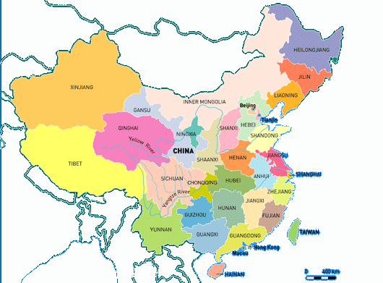
China - Five Distinct Opportunity Segments
Affluent Coastal regions: e.g., JiangSu, FuJian, GuangDong, …
Second Tier Cities: e.g., LuoYang, WeiFeng, ZiGong, …
Emerging “Western” provinces: e.g., SiChuan, ChongQing, JiLin, HLJ, …
Undeveloped provinces: e.g., GuiZhou, YuNan, GanSu, …

Slide 40
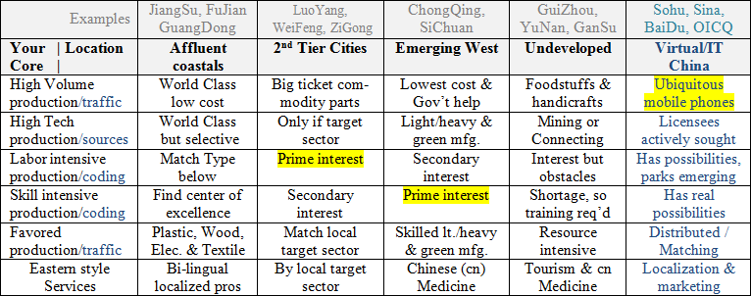
China Sourcing Template

Slide 41
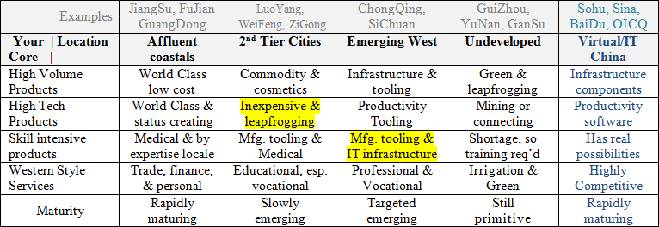
China Selling Template

Slide 42
Sourcing/Selling Summary
Emerging West for skill intensive production and selling infrastructure and second wave of upscaling (repeat of Affluent coastals of the past twenty years)
2nd Tier Cities for labor intensive sourcing and selling American product access/franchises (below the Western radar)
Gov’t favors: Emerging West (central gov’t), green technology (central gov’t), and centers of excellence (local) [Note: this “West” includes North East and Central China, too]
You can count on:
High receptivity to locating in government industrial/technology parks
Every consumer having a cell phone, credit card, and access to the internet
Typically, college graduates having had over 8 years of English schooling

