Slide 1

Entrepreneurship Basics
VX 420: Lecture 8
Legal Aspects

Slide 2
Legal Issues
Company Law
Contract Law
Franchising
IP in Product Development
  Patents
  Trade Secrets
  Trademarks
  Copyrights

Slide 3

Sole Proprietorship
One company, one owner
Require only license(s) to open
Low costs involved
Owner has total control

Slide 4
Disadvantages of Sole Proprietorship
Unlimited personal liability
Owner represents sum total of management resources
No shares to sell to investors
Financial institutions may be reluctant to assume risk of a loan

Slide 5

Partnerships
Association of two or more people who co-own a business for the purpose of making a profit
Terms are spelled out in a partnership agreement or subject to the Uniform Partnership Act

Slide 6
Uniform Partnership Act
Each partner has a right to
Share in management and operations
Share in profits
Receive interest on advances
Receive compensation for expenses
Have access to books and records
Receive formal accounting of affairs

Slide 7
Uniform Partnership Act
Each partner is obligated to
Share in losses
Work without salary
Submit differences to a majority vote or arbitration
Give complete information about business activities
Provide formal accounting of business activities

Slide 8
Partnership Advantages
Easy and inexpensive to establish
High level of flexibility
Partners bring complementary skills
Pool of financial resources is expanded
Income or losses are passed through to partners

Slide 9
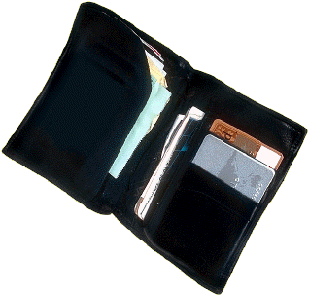
Partnership Disadvantages
Unlimited liability
Difficult to continue if one partner is unable to participate
Can’t sell shares; may experience difficulties raising capital

Slide 10
Limited Partnerships
General partners
  Manage the business
  Have unlimited liability
Limited partners
  Invest but forego right to manage
  Share in the profits according to the limited partnership agreement
  Have limited liability

Slide 11
Other Forms of Partnership
Limited liability partnership
  All partners are limited partners
  Individuals pay taxes
Master limited partnership
  Issue shares traded like stock
  Increased liquidity
  Most MLPs pay taxes

Slide 12

“Corporation: An ingenious device for obtaining individual profit without individual responsibility.”
--Ambrose Bierce, 1881

Slide 13
Corporation
Separate legal entity apart from owners
May engage in business, make contracts, own property, pay taxes, and sue and be sued
“An artificial being, invisible, intangible, and existing only in contemplation of the law.” (Supreme Court, 1819)

Slide 14
Types of Corporations
Domestic corporation—does business in the state in which it was created
Foreign corporation—does business in another state
Alien corporation—formed in other country

Slide 15

Establishing a Corporation
Registration
Articles of incorporation
Shareholders elect directors
Directors appoint corporate officers

Slide 16
Advantages of Corporations
Limited liability for stockholders
Ability to attract capital
Continue beyond lives of founders
Shares are transferable
Liquidity can be very high

Slide 17
Disadvantages of Corporations
Complex and expensive to start
Profits subject to double taxation
Subject to legal and financial requirements
  Record and report decisions and financial data
  Hold annual meetings
  Consult with board
  File reports with SEC

Slide 18
The S Corporation
All profits and losses are passed through to shareholders
If assets that have appreciated in value are sold, there is no tax to the corporation
Especially advantageous for ventures showing large losses

Slide 19

Disadvantages of S Corporations
Benefits paid to shareholders owning 2% or more of stock cannot be deducted as expenses
Marginal tax rate for individuals is high than for corporations

Slide 20
Limited Liability Company
Cross between a corporation and a partnership
Income flows through to owners who pay taxes as individuals
Can only offer two of the following:
  Limited liability
  Continuity of life
  Free transferability of interests
  Centralized management

Slide 21
The Joint Venture
Resembles a partnership without general or limited partners
Purpose is very limited
All participate in management and decision making
Taxed like a partnership

Slide 22

Professional Corporation
Preferred by many professionals
All shareholders are protected from malpractice lawsuits filed against the PC or any shareholders

Slide 23
New Ventures and the Law
Occupational Safety and Health Act
Title VII of the Civil Rights Act of 1964
Americans with Disabilities Act
Immigration Reform and Control Act of 1986

Slide 24
Immigration Reform and Control Act
Discourages illegal immigration
  Requires Form I-9 for all new hires
Strengthens national origin provision of Title VII of the Civil Rights Act
  Forbids discrimination against “foreign-sounding” and “foreign-looking” persons

Slide 25
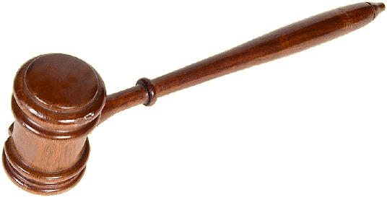
Business Contracts
Promises that are enforceable by law
Contract law—body of laws designed to assure that parties entering into contracts comply with their provisions

Slide 26
Contracts In Writing
Sale of real estate
Paying someone else’s debt
Contracts that require longer than one year to perform
Contracts that involve the sale of goods with a value of $500 or more

Slide 27
Elements of a Contract
Legality—intended to accomplish a legal purpose
Agreement—includes a legitimate offer and acceptance
Consideration—some of value must be exchanged
Capacity—persons must have capacity to enter into agreement

Slide 28
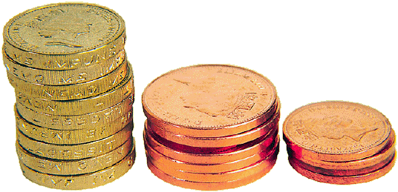
Obligations Under Contracts
Breach of contract may result in
Compensatory damages
Specific performance

Slide 29
Franchising
A system of distribution in which legally independent business owners (franchisees) pay fees and royalties to a parent company (franchisor) in return for the right to
Use its trademark
Sell its products or services
Use the business model

Slide 30

Types of Franchising
Trade-name franchising—allows sale of products under franchisor’s name and trademark
Business format franchising—provides franchisee with a complete business system

Slide 31
Benefits of Franchising
Training and support
Standardized products and services
National advertising
Buying power
Financial assistance
Site selection and territorial protection
Proven business model

Slide 32
Drawbacks of Franchising
Fees and royalties
Enforced standardization
Restricted freedom over purchasing and product lines
Poor training programs
Market saturation

Slide 33
Trends in Franchising
Smaller outlets in nontraditional locations
Co-branding franchise
International franchising
Expansion of types of businesses being franchised

Slide 34

Intellectual Property
The core ideas about a new product or service
The only advantages (most of the time) entrepreneurs have over established firms

Slide 35
The Product Development Process
A difficult and uncertain process
Solution must be produced and marketed for less that the customer is willing to pay
May result in something different than people set out to produce

Slide 36
Established Firm Advantages
Better at manufacturing
Better access to capital
Tacit knowledge from experience
Economies of scale
Better at marketing
Established reputations
Established customers

Slide 37
New Firm Advantages
Superior product development
Develop new products more cheaply and easily
No bureaucratic structures and rules in place
Better incentives for employees
Greater flexibility

Slide 38

Why New Firms Lose at Product Development
The typical unpatented process innovation can be copied at less than 50% of the cost of developing the original innovation more than 40% of the time.
(Richard Levin)

Slide 39
Why Is Imitation So Easy?
Competitors have a variety of methods for imitating intellectual property:
Reverse engineering
Hiring employees or suppliers from the entrepreneur
Assigning staff to copy the new product

Slide 40
Patents
To obtain a patent, an invention must:
Be novel
Not be obvious to a person in the field
Be useful
Be secret at the time of patent application

Slide 41
What Can You Patent?
YES
Process
Machine
Manufacture
Chemical formula
Design
Piece of software
Plants
NO
Business idea
Something that doesn’t work

Slide 42

The Patent Process
File a Provisional Patent Application
File an application with the U.S. Patent and Trademark Office
Determine prior art
Determine the set of claims

Slide 43
Advantages of Patents
Helps to raise capital by demonstrating competitive advantage
Raises the cost of imitation
Provides a monopoly right
Prevents a second party from using the invention as a trade secret

Slide 44
Disadvantages of Patents
Requires disclosure of the invention
Provides only 20 year monopoly
Can be circumvented
Difficult and costly to defend
Less effective for most types of technology
Can be irrelevant if technology is fast moving
Requires world-wide patent application

Slide 45
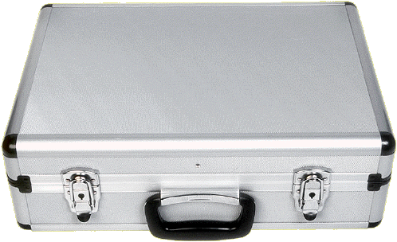
Trade Secrets
A piece of knowledge that confers an advantage on a firm and is protected by non-disclosure
Protect a competitive advantage without disclosing how an underlying technology works

Slide 46
Disadvantages of Trade Secrets
Must be kept hidden to remain valuable
Doesn’t provide a monopoly right
To enforce and claim damages in court, must show a loss of competitive advantage

Slide 47
Trademarks
A word, phrase, symbol, design that distinguishes the goods and services of one company from those of another
Obtained by using the mark or filing an application

Slide 48
Copyrights
A form of intellectual property protection provided to the authors of original works or authorship
Protect the right to reproduce, further derive, copy, or display the protected item
Extend 100 years after the death of the author

Slide 49
Will a New Company Profit?
Three factors determine whether a new company will profit from introducing a new product:
The ability to secure a strong patent
The presence of absence of a dominant design
The presence of complementary assets in marketing and distribution
(David Teece)

Slide 50
Which Is Most Important?
Complementary Assets Are More Important… | Being Innovative Is More Important…
When patents are not very effective | When patents are very effective
When a dominant design exists | Before a dominant design exists
When learning curves are shallow or not proprietary | When learning curves are steep or proprietary
When knowledge is codified | When knowledge is tacit
When products are observable | When products are not observable

