Slide 1

VG100 Summer 2017 Introduction to Engineering T2: Project 1 – Maze Robot
Yu Zheng, Ph.D. Assistant Professor
University of Michigan-Dearborn
Acknowledge: Lectures include slides prepared by Profs. Jason Daida,
Peisen Huang, Shane Johnson, Thomas Hamade, and Mian Li

Slide 2
Outline
Project Overview
Major Components Provided
Programming
Project Grading

Slide 3
Place & Time
Lab: JI General Engr. Lab 1 (4F)
Time:
Session 1: Wednesday, 16:00-17:40
Session 2: Tuesday, 12:10-13:50
Final Test: June 13, Tuesday
Game Day: June 14, Wednesday

Slide 4
Lab Schedule
Week 2: Lecture and practice on Arduino
Week 3: Sensors and motors, prototype (only Wednesday, all teams)
Week 4: Mechanical & electrical prototype
Week 5: Final test and Game day (All teams)

Slide 5
Maze Robot
Robot
Maze
Straight and curved path
Signs showing the directions
Only 90-degree turns

Slide 6
Maze Parameters
Straight
U-turn
Left-turn
Right-turn
T-junction
Round left-turn
Round right-turn
Road width: about 30 cm

Slide 7
Arrow Size
10 cm
5 cm

Slide 8
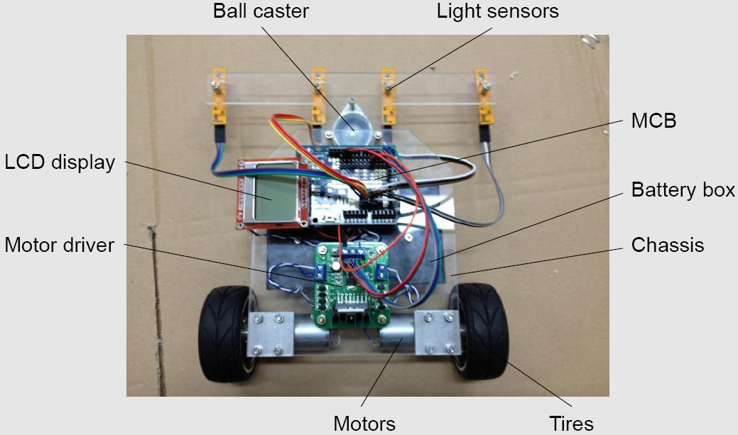
What Does the Robot look like

Slide 9
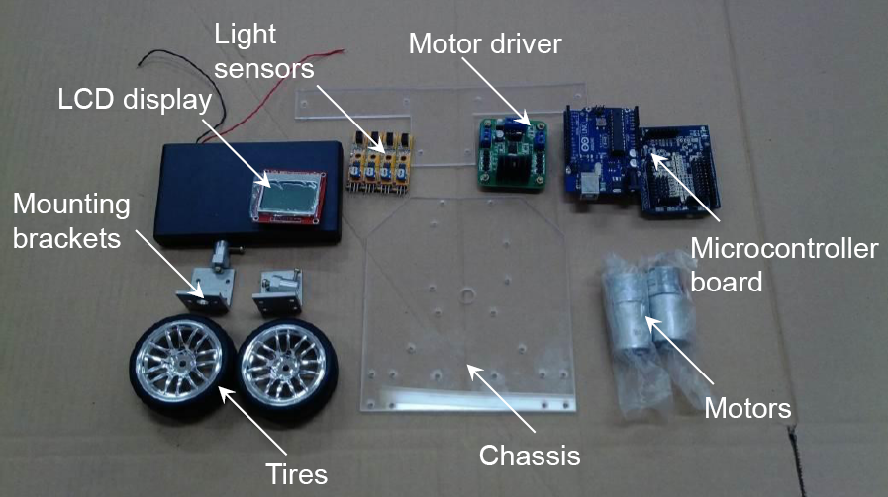
Components Provided

Slide 10
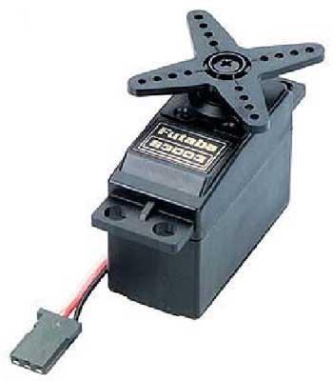
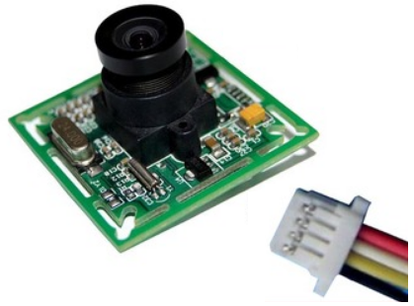
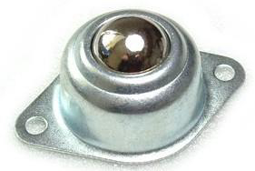
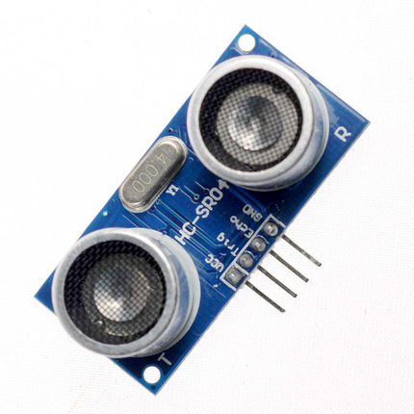
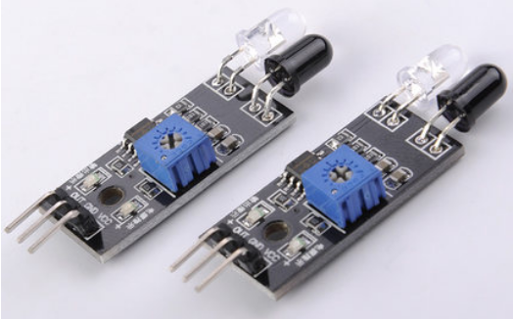
Components NOT Provided
Ball caster
Servo motor
Camera
Ultrasonic Distance Sensor
Infrared Distance Sensor

Slide 11
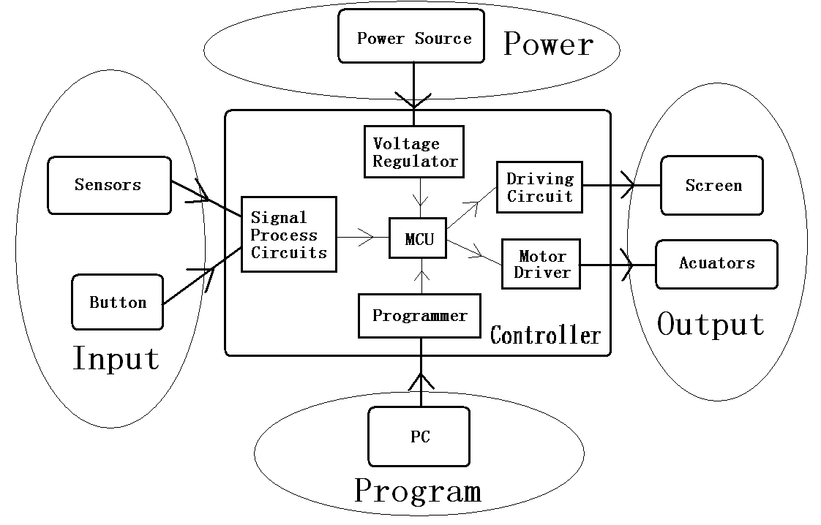
System Configuration

Slide 12
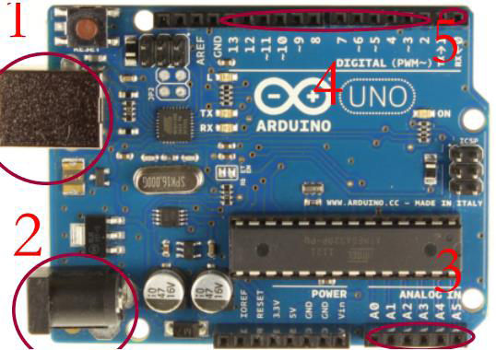
Arduino Uno
USB port
Power input
Analog in
Digital I/O
Serial port

Slide 13
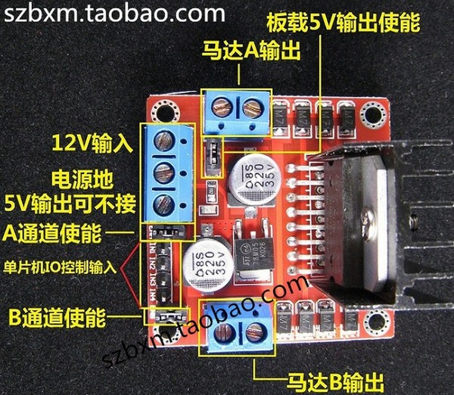
Motor Driver

Slide 14
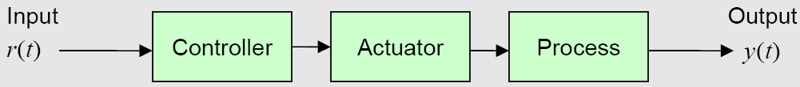
Open-Loop Control
An open-loop control system is controlled directly, without using feedback to adjust the process
Pros: simple, low cost, reliable
Cons: low accuracy, sensitive to noise and disturbance, not robust

Slide 15
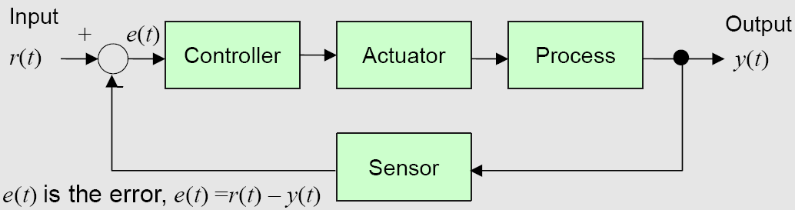
Closed-Loop (Feedback) Control
A closed-loop control system uses feedback to adjust the process for better system performance
Pros: high accuracy, robust performance, disturbance rejection, better dynamic response
Cons: higher cost, potential instability problem

Slide 16
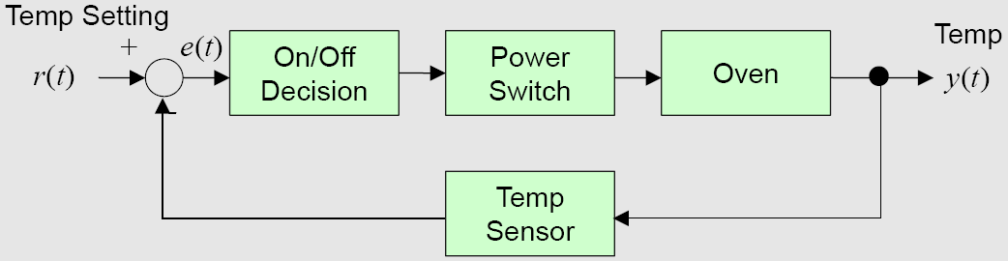
Feedback Control - Example
Temperature control in an oven
Preheat the oven to 350°F
Temperature sensor monitors the temperature in the oven
Turn the heater on if the temperature is below the set temperature
Turn it off otherwise

Slide 17
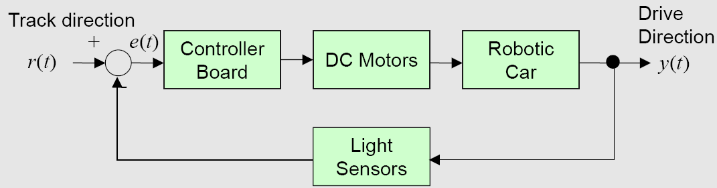
Feedback Control - Example
Mobile robot
Start the motors to drive the robot
Sensors monitor the direction
Adjust the speed and direction of the left and right motors to adjust driving direction
Robot
Sensors

Slide 18
What Does the MCB Do?
Read signals from external sensors
Send signals to control the DC motors
Execute the control program stored in the on-board memory
Display messages during program execution
Interface to the computer via USB for program download
MCB is the brain of a robot!
Microcontroller Board (MCB) - Arduino Uno

Slide 19
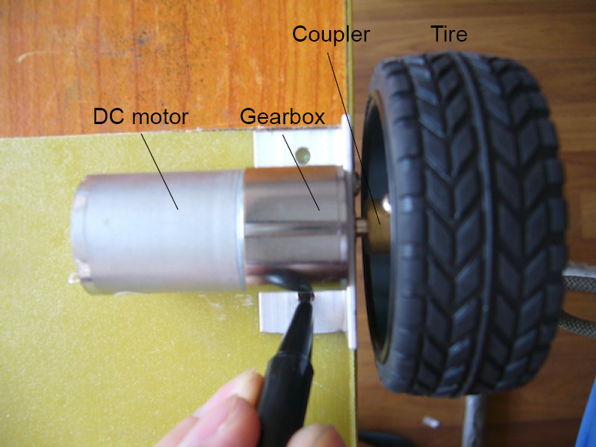
Motor, Gearbox, and Tire

Slide 20
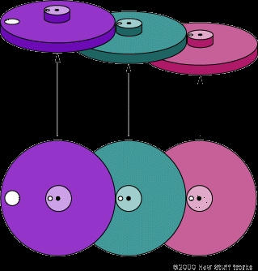
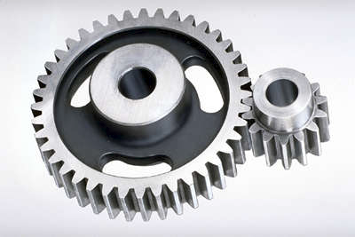
Gearbox and its Function
Connect to tire
Connect to motor

Slide 21
Distance Sensors
Measure time
Measure phase
Triangulation
Infrared Distance Sensor
Ultrasonic Distance Sensor

Slide 22
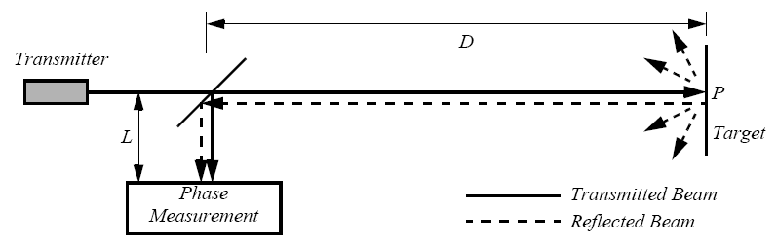
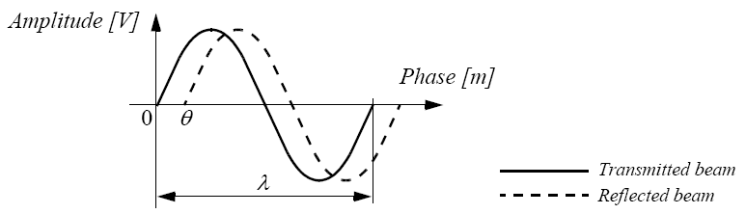

Distance Sensors (Phase)

Slide 23
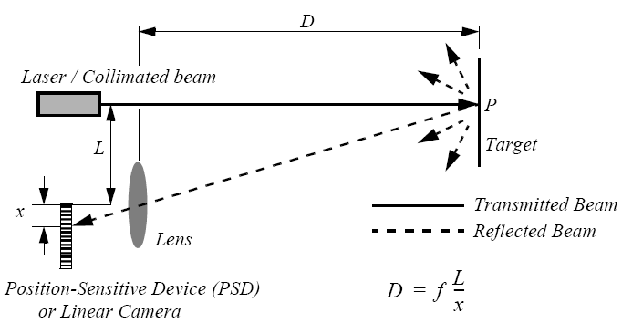
Distance Sensors (Triangulation)

Slide 24
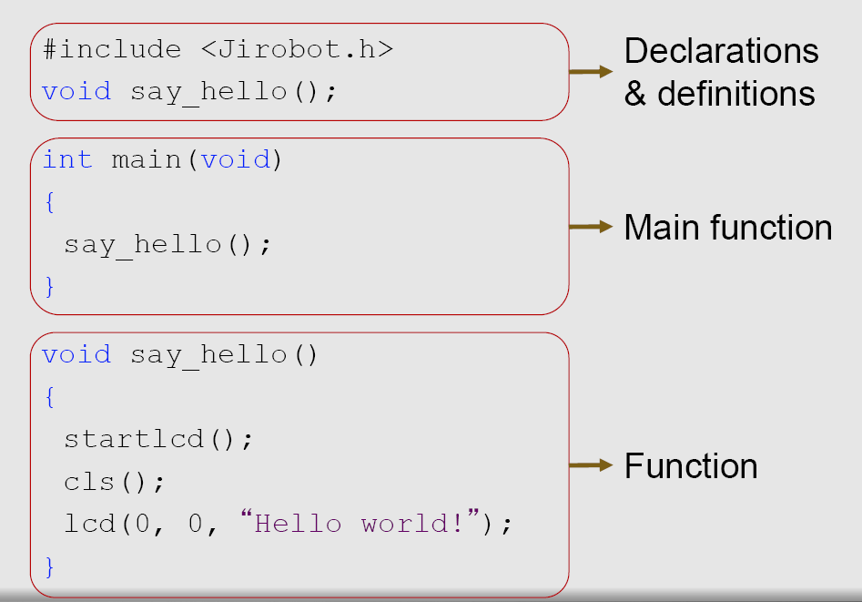
C Program Structure

Slide 25
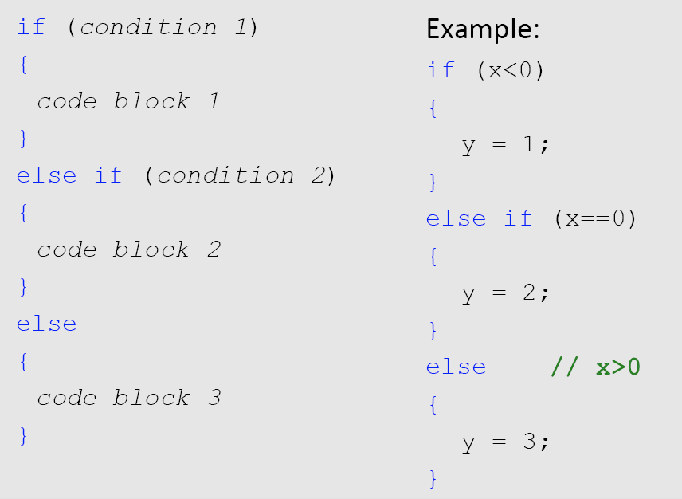
C Grammar: “if” Clause

Slide 26
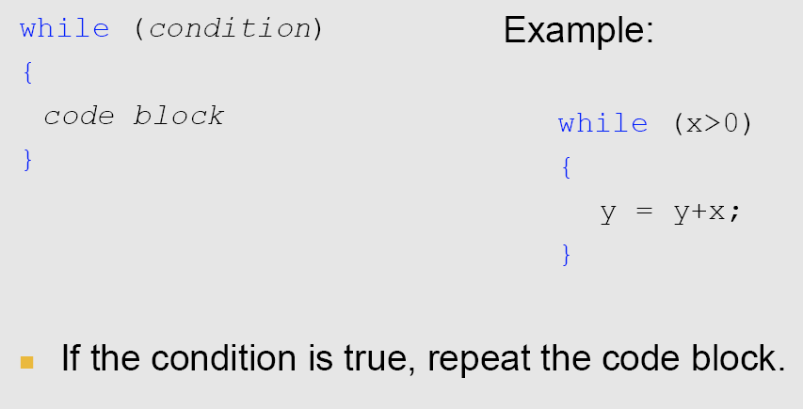
C Grammar: “while” Clause

Slide 27
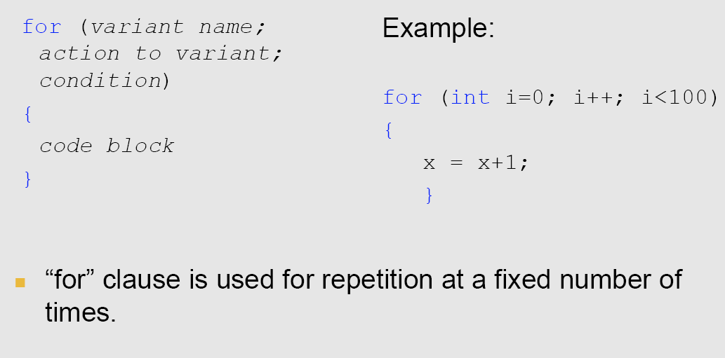
C Grammar: “for” Clause

Slide 28
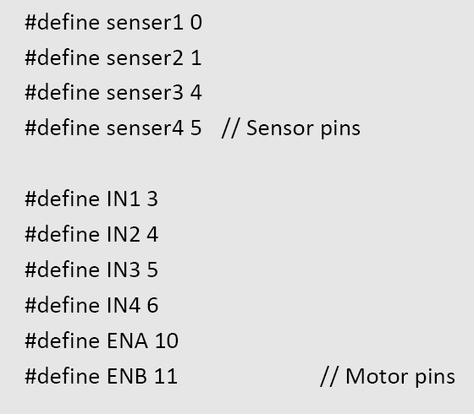
Sample Arduino Code

Slide 29
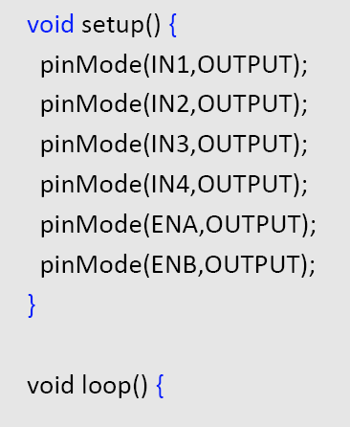
Sample Arduino Code

Slide 30
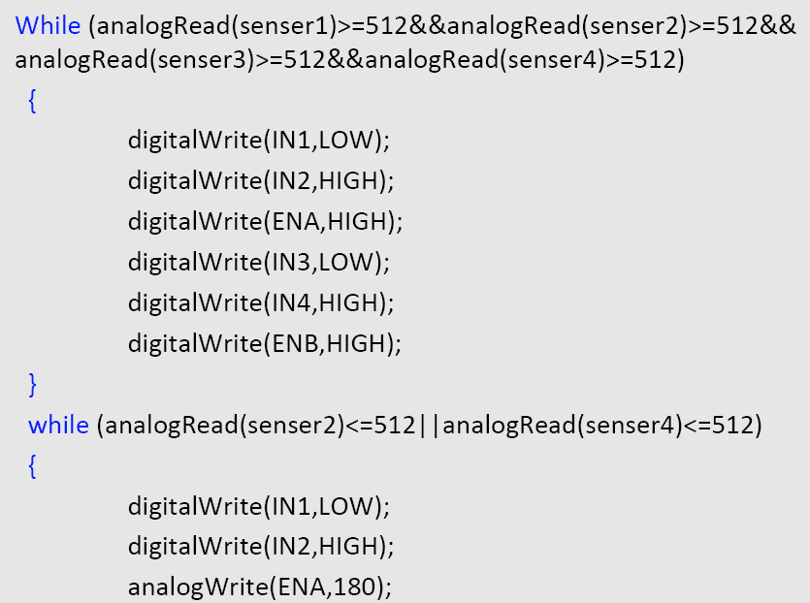
Sample Arduino Code

Slide 31
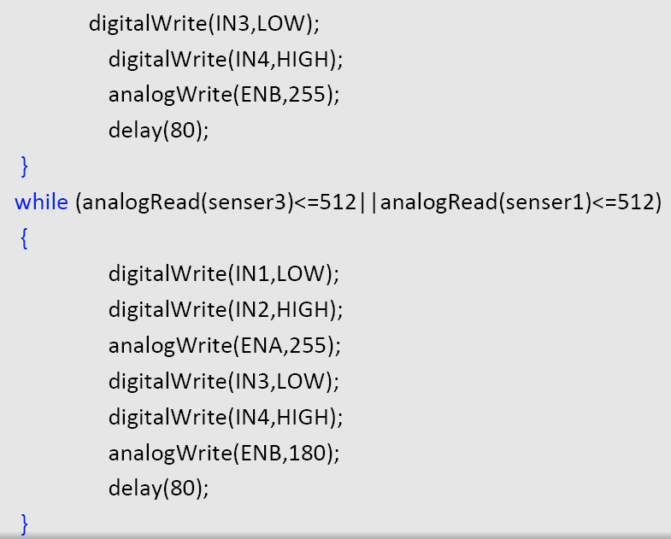
Sample Arduino Code

Slide 32
Grading
100 points, 20% towards the final grade
50 points for basic functions
Moving forward and backward (10 points)
Turning left and right (10 points)
Adjusting motion speed (10 points)
Detecting and avoiding walls and obstacles (10 points)
Recognizing signs on the wall (10 points)
50 points for going through the maze, otherwise grading based on its travel distance

