Slide 1

VG100 Summer 2017 Introduction to Engineering T4: Actuators & Sensors
Yu Zheng, Ph.D. Assistant Professor
University of Michigan-Dearborn
Acknowledge: Lectures include slides prepared by Profs. Jason Daida,
Peisen Huang, Shane Johnson, Thomas Hamade, and Mian Li

Slide 2
Outline
Actuators
Hydraulic and Pneumatic Actuators
Electrical Motors
Sensors
Position
Velocity
Acceleration
More

Slide 3
Why
Why do we need actuators?
Why do we need sensors?

Slide 4
Power-to-Weight Ratio of Actuators
Highest for hydraulic system
If all components are included, not the highest.
Power units are heavy, actuators are relatively lighter.
Medium range for electric motors (except steppers).
Lowest for pneumatic systems

Slide 5
Comparison of Actuating Systems: Hydraulic
+ Good for large robots and heavy payload
+ Highest power/weight ratio
+ Stiff system, high accuracy, better response
+ No reduction gear needed
+ Can work in wide range of speeds without difficulty
+ Can be left in position without any damage
- May leak; not fit for clean room applications
- Requires pump, reservoir, motor, hoses, and so on
- Can be expensive and noisy; requires maintenance
- Viscosity of oil changes with temperature
- Very susceptible to dirt and other foreign material in oil
- Low compliance
- High torque, high pressure, large inertia on the actuator

Slide 6
Comparison of Actuating Systems: Electric
+ Good for all sizes of robots
+ Better control, good for high precision robots
+ Higher compliance than hydraulics
+ Reduction gears reduce inertia on the motor
+ Does not leak, good for clean room
+ Reliable, low maintenance
+ Can be spark-free. Good for explosive environments
- Low stiffness
- Needs reduction gears, increased backlash, cost, weight, and so on
- Motor needs braking device when not powered; otherwise, the arm will fall.

Slide 7
Comparison of Actuating Systems: Pneumatic
+ Many components are usually off-the-shelf
+ Reliable components
+ No leaks or sparks
+ Inexpensive and simple
+ Low pressure compared to hydraulics
+ Good for on-off applications and for pick and place
+ Compliant systems
- Noisy
- Require pressurized air, filter, and so on
- Difficult to control their linear position
- Deform under load constantly
- Very low stiffness Inaccurate response
- Lowest power to weight ratio

Slide 8
Components of Hydraulic Systems
A hydraulic system consists of:
Hydraulic linear or rotary actuator.
Hydraulic pump.
Electric motor or an engine.
Cooling system.
Reservoir.
Accumulators.
Servovalves.
Check-valves.
Holding valves.
Connecting hoses.
Filtering system.
Sensors.

Slide 9
Pneumatic Devices
Very similar to hydraulic systems.
Pressurized air is used.
Lower working pressures mean lower power-to-weight ratio.
Air is compressible; hard to control.
Used for insertion purposes and ½-DOF actuation
Simple, rugged, inexpensive, safe.
Leakage is not a problem even in clean room.

Slide 10
Hydraulic Servomotor Control

Slide 11
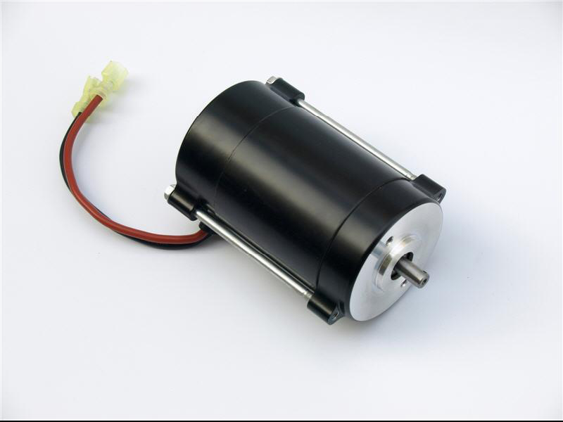
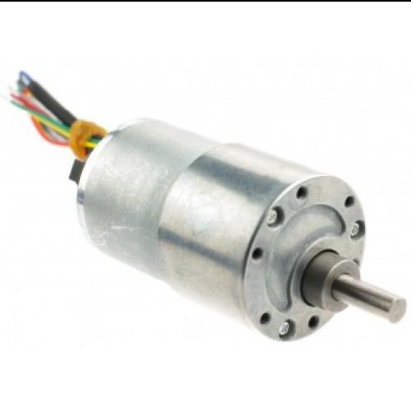
DC Motors
A DC motor is an electric motor that runs on a direct current.
DC motors can operate from batteries and provide precise position and velocity control when used with position or velocity sensors.
DC motor
DC motor with integrated encoder or angular position sensor

Slide 12
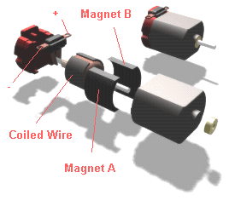
Components of a DC Motor

Slide 13
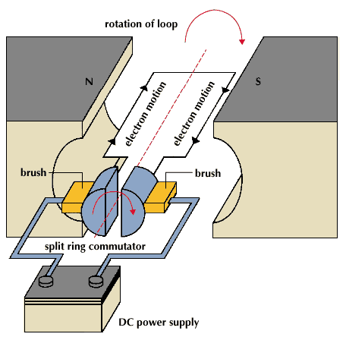
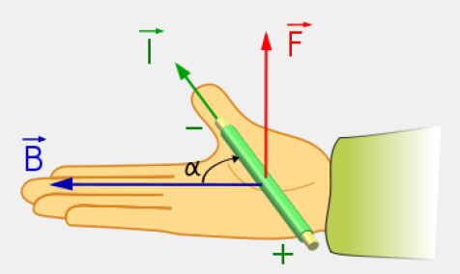
Operating Principle of a DC Motor
S
F
N
Lorentz Force Law:
B
B
F = I X B
F

Slide 14
Brushed DC Motor
Video from Youtube

Slide 15
Brushless DC Motor
Video from Youtube

Slide 16
Brushed vs. Brushless DC Motors
Both brush-type DC motors and Brushless DC motors are widely used.
Brush-type of DC motors are cheaper, but have the wear and debris problem due to the use of brushes.
Brushless DC motors have a longer lifespan and are more efficient, but they are more expensive.

Slide 17
AC Motor
Video from Youtube

Slide 18
Servo Motor
DC Motor + Encoder

Slide 19
Stepper Motor
A stepper motor divides a full rotation into a large number of steps and controls the motor position precisely without any feedback mechanism.
Major advantages
Low cost
Simplicity of design
Ruggedness
Position sensors not required
Disadvantages
Mechanical noise
Step losses

Slide 20
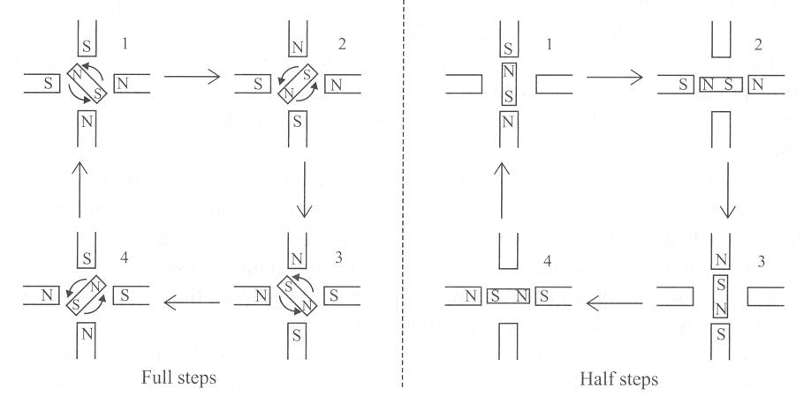
Operating Principle of a Stepper Motor
Source: S. Cetinkunt, “Mechatronics,” John Wiley & Sons, 2007.

Slide 21
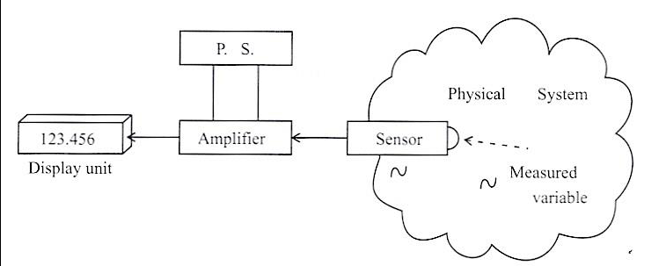
Sensors
The change of the measured variable is converted to an equivalent property change in the sensor
The change in the property of the sensor is translated into an electrical signal
This electrical signal is then amplified, conditioned, and transmitted to a processing device

Slide 22
Classification of Sensors
What:
Proprioceptive sensors
measure values internally to the system, e.g., motor speed, wheel load, heading of the robot, battery status
Exteroceptive sensors
information from the robots environment, e.g., distances to objects, intensity of the ambient light, unique features.
How:
Passive sensors
Measure energy coming from the environment; very much influenced by the environment
Active sensors
emit their proper energy and measure the reaction
better performance, but some influence on environment

Slide 23
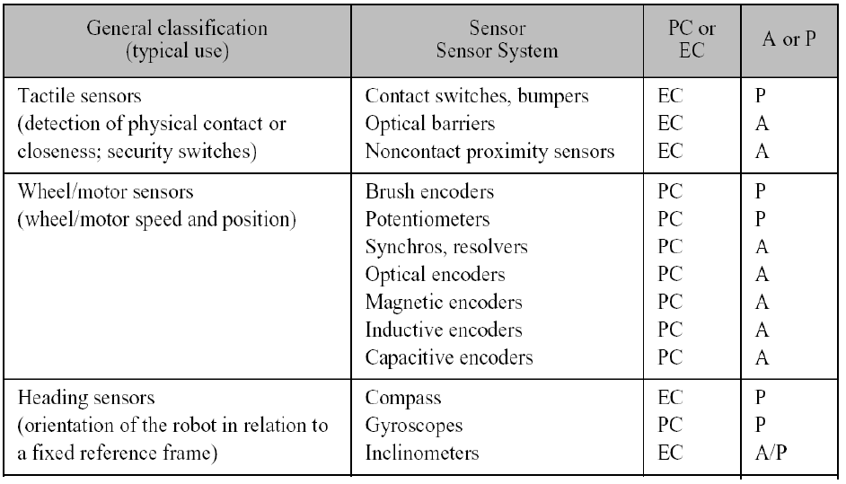
General Classification (1)
A, active; P, passive; PC, proprioceptive; EC, exteroceptive.

Slide 24
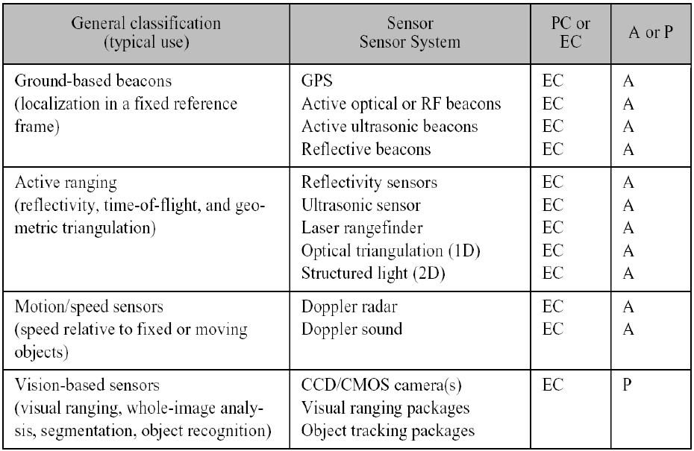
General Classification (2)
A, active; P, passive; PC, proprioceptive; EC, exteroceptive.

Slide 25
Sensor Performance
Accuracy –Difference between the actual and measured values
Resolution –Smallest change in the measured variable that can be detected by the sensor
Repeatability (precision) –Average error in between consecutive measurements of the same value
Bandwidth –Maximum frequency of the physical signal that can be measured by the sensor

Slide 26
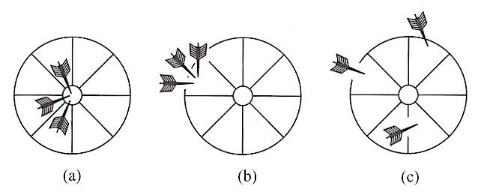
Accuracy vs. Precision
Accurate and
Repeatable (precise)
Repeatable (precise),
But not accurate
Not accurate, not
Repeatable (precise)

Slide 27
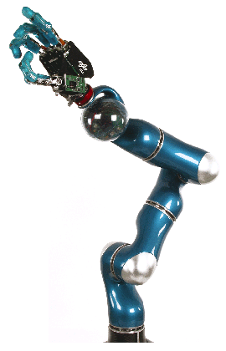
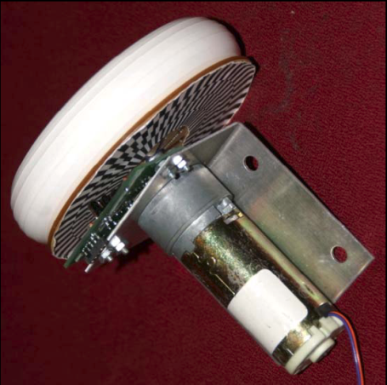
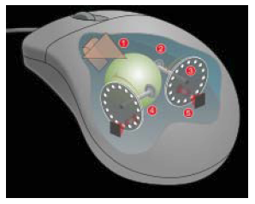
Encoders
Encoders are optical devices that convert motion into a sequence of digital pulses. They are used to measure linear or angular positions and velocities.

Slide 28
Classification of Encoders
Encoders are classified based on their configurations:
Rotary encoders
Linear encoders
Encoders can also be classified based on the nature of the measurement they make:
Absolute encoders
Incremental encoders

Slide 29
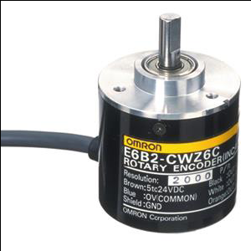
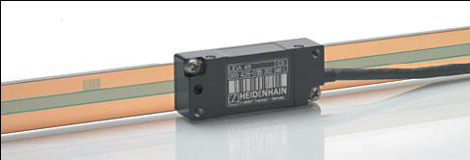
Rotary vs. Linear Encoders
A rotary encoder uses a disk with printed light and dark patterns to measure angular positions and velocities.
A linear encoder uses a linear scale with printed light and dark patterns to measure linear positions and velocities.
Linear encoder
Rotary encoder

Slide 30
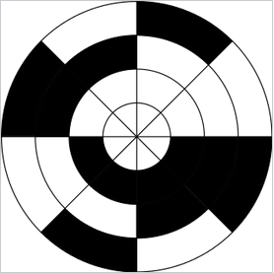
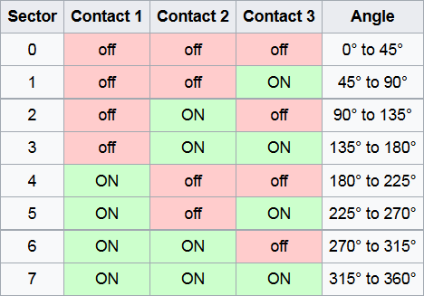
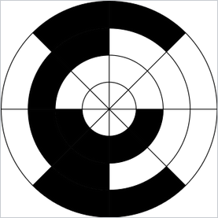
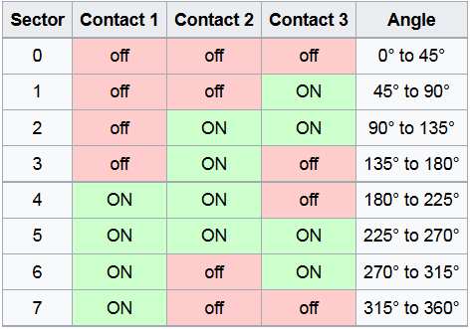
Absolute Encoder
Binary Coding
Gray Coding

Slide 31
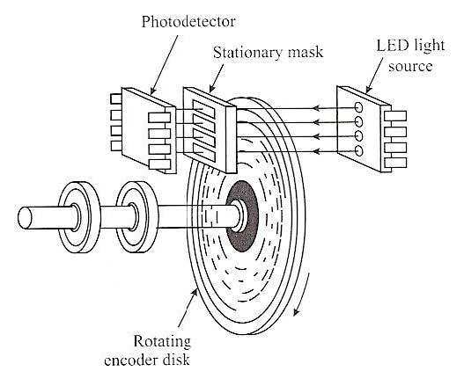
Absolute Encoder

Slide 32
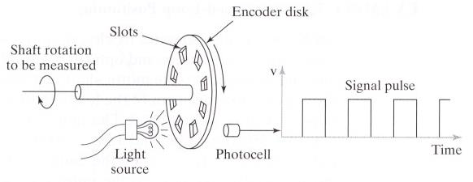
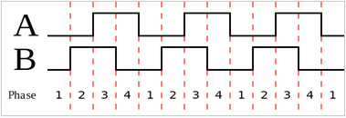
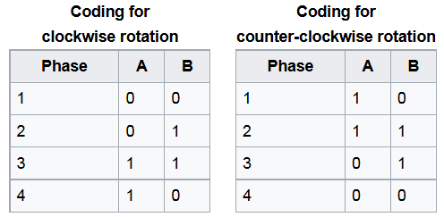
Incremental Encoder
To also measure the direction of rotation: using two outputs 90-degree out of phase

Slide 33
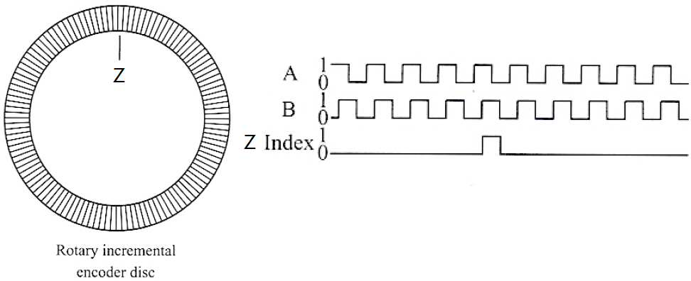
Incremental Encoder
To have a reference: using a “Z” signal

Slide 34
Heading Sensors
Definition:
Heading sensors are sensors that determine the robot’s orientation and inclination with respect to a given reference
Heading sensors can be proprioceptive (gyroscope, accelerometer) or exteroceptive (compass, inclinometer).
Allows, together with an appropriate velocity information, to integrate the movement to a position estimate. This procedure is called deduced reckoning (ship navigation).

Slide 35
Compass
Used since before 2000 B.C.
when Chinese suspended a piece of natural magnetite from a silk thread and used it to guide a chariot over land.
Magnetic field on earth
absolute measure for orientation (even birds use it for migrations (2001 discovery))
Large variety of solutions to measure magnetic or true north
mechanical magnetic compass
direct measure of the magnetic field (Hall-effect, magneto-resistive sensors)
Gyrocompass
Major drawback of magnetic solutions
weakness of the earth field (30 μTesla)
easily disturbed by magnetic objects or other sources
bandwidth limitations (0.5 Hz) and susceptible to vibrations
not suitable for indoor environments for absolute orientation
useful indoor (only locally)

Slide 36
Gyroscope
Definition:
Heading sensors that preserve their orientation in relation to a fixed reference frame
They provide an absolute measure for the heading of a mobile system.
Two categories, the mechanical and the optical gyroscopes
Mechanical Gyroscopes
Standard gyro (angle)
Rate gyro (speed)
Optical Gyroscopes
Rate gyro (speed)

Slide 37
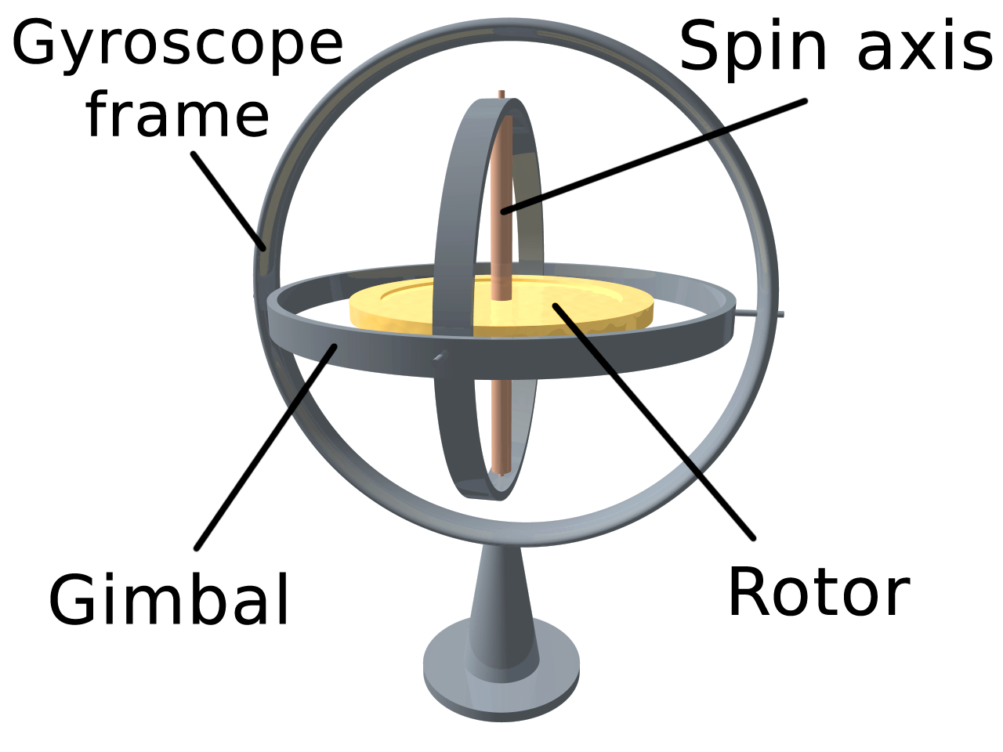
Mechanical Gyroscope

Slide 38
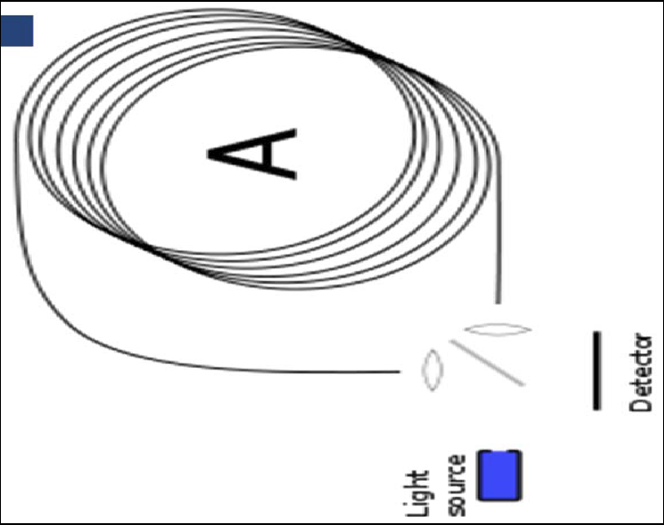
Optical Gyroscope
Optical gyroscopes are based on the Sagnac effect
angular speed (heading) sensors using two monochromic light (or laser) beams from the same source.
One is traveling in a fiber clockwise,
the other counterclockwise around a cylinder
Laser beam traveling in direction opposite to the rotation
experiences slightly shorter path
phase shift of the two beams is proportional to the angular velocity W of the cylinder
In order to measure the phase shift, coil consists of as much as 5Km optical fiber

Slide 39
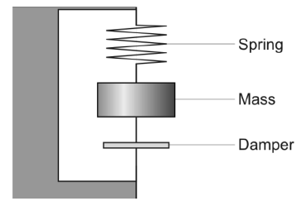

Mechanical Accelerometer
Accelerometers measure all external forces acting upon them, including gravity
Accelerometer acts like a spring–mass–damper system
at steady-state:

Slide 40
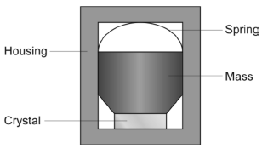
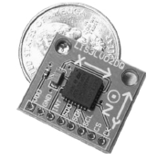
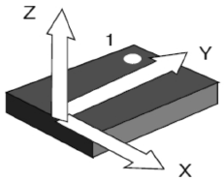
Other Accelerometers
Modern accelerometers use Micro Electro-Mechanical Systems (MEMS) consisting of a spring-like structure with a proof mass. Damping results from the residual gas sealed in the device.
In capacitive accelerometers the capacitance between a fixed structure and the proof mass is measured.
Piezoelectric accelerometers are based on the property exhibited by certain crystals to generate a voltage when a mechanical stress is applied to them.

Slide 41
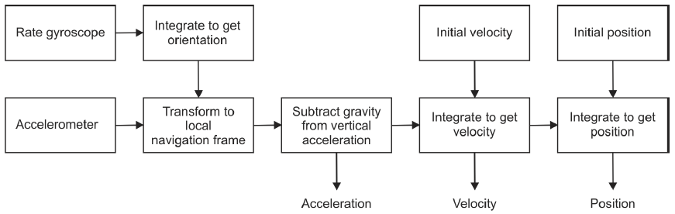
Inertial Measurement Unit (IMU)
An inertial measurement unit (IMU) is a device that uses measurement systems such as gyroscopes and accelerometers to estimate the relative position (x, y, z), orientation (roll, pitch, yaw), velocity, and acceleration of a moving system with respect to an inertial frame.

Slide 42
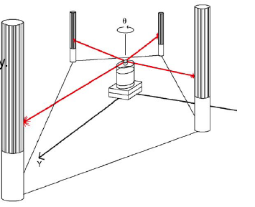
Ground Active or Passive Beacon
Beacons are signaling guiding devices with a precisely known position
used since the humans started to travel
Natural beacons (landmarks)
Artificial beacons like lighthouses
The recently introduced Global Positioning System (GPS) revolutionized modern navigation technology
Key sensors for outdoor mobile robotics
For indoor robots GPS is not applicable,
Major drawback with the use of beacons in indoor:
Beacons require changes in the environment -> costly.
Limit flexibility and adaptability to changing environments.

Slide 43
Range Sensors
Sonar
Light and laser
Camera

Slide 44
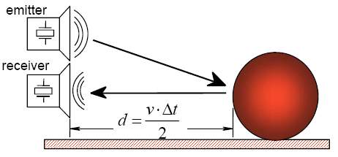
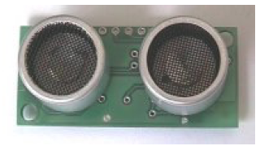
Time of Flight Range Sensors

Slide 45
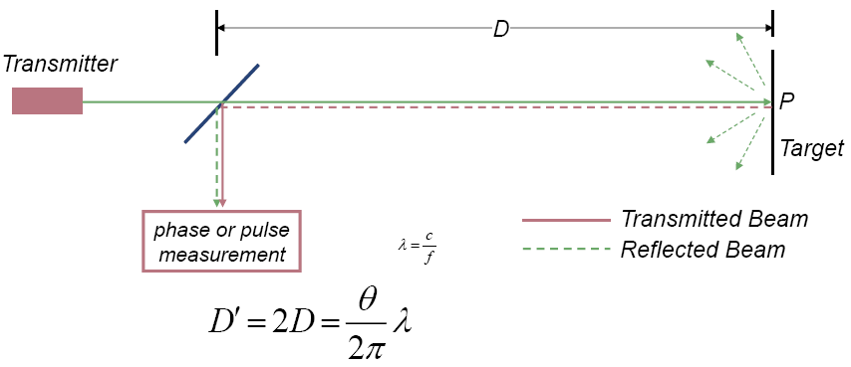
Laser Range Sensor (Phase-Shift)

Slide 46
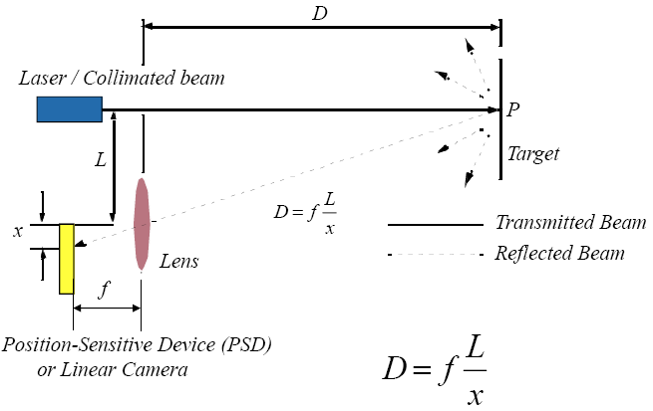
Laser Triangulation

Slide 47
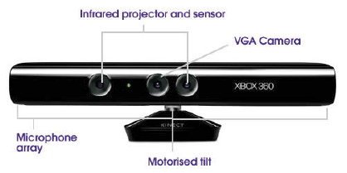
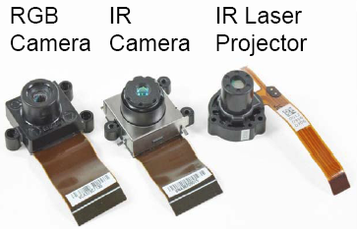
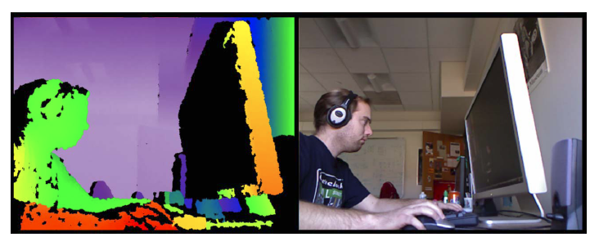
Microsoft Kinect
Major components
IR Projector
IR Camera
VGA Camera
Microphone Array
Motorized Tilt

