Slide 1

Healthcare Telepresence Robot
UM-SJTU Joint Institute Capstone Project
TEAM 14
Fernando Boaro
Chongdan Pan
Niyiqiu Liu
Ruixing Zhou
Tianyu Qiu

Slide 2








What pills should I take today？
I want to talk to someone.
I don’t know how to use electronic devices.
How’s my parent?
Does he feel lonely or bored?
What if he is in trouble?
At Home
Remote Control
At Work

Slide 3
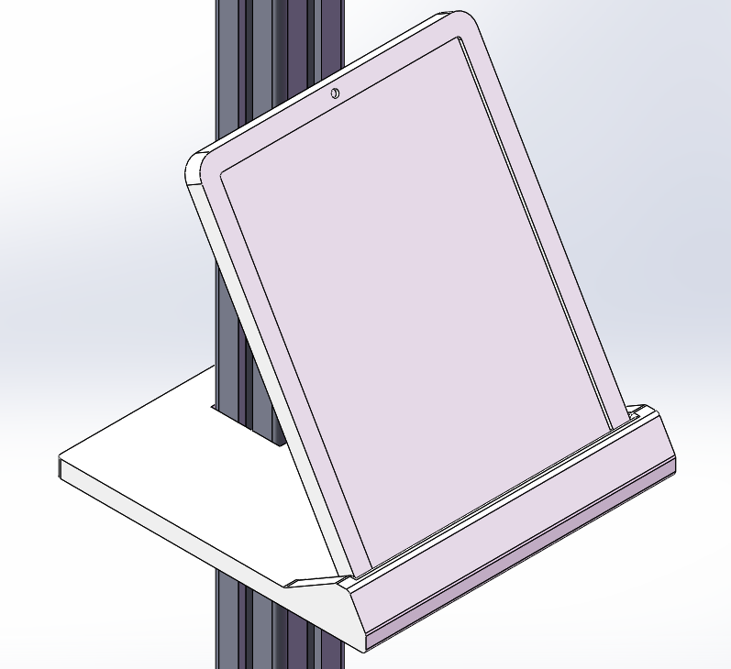
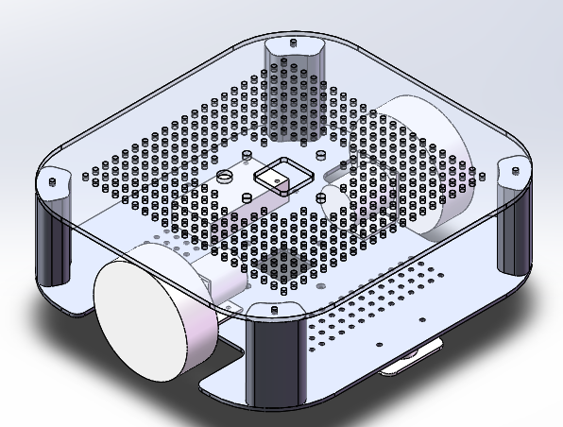
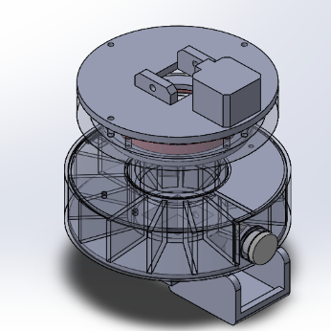
I need to give you video call
I need to give you medicine,
I also need some way to keep it
I need move to you by myself
Medicine Dispenser
A screen with camera
A Moving Chassis

Slide 4
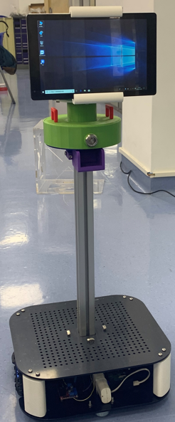
Cheap
Stable
Cost less than 3000 RMB
Made through 3D printing
Don’t worry for the operation
Caregiver will be on top of everything
All movement of robot is controlled by caregivers.

Slide 5
Thank you for watching~

