Slide 1
Siemens Business Analysis
VX402-Individual Presentation
Pan chongdan

Slide 2
Background of Siemens
A Germany integrated company mainly focus on electrical and energy area.
Objective
Discuss Siemens business functions and analyze its problem through data.

Slide 3

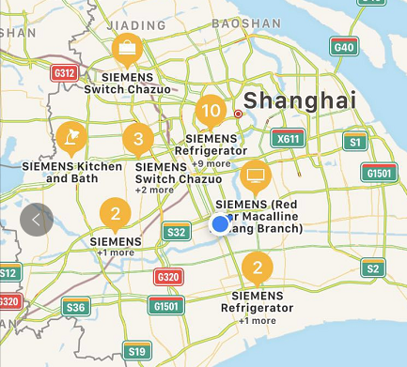

Business Functions Marketing
4Ps of marketing
Products Electrical related Energy related Health Service | Price Pay after receive products Pay through Internet or credit card
Promotion Slogan on Internet Uniform style | Place Offline store Internet

Slide 4

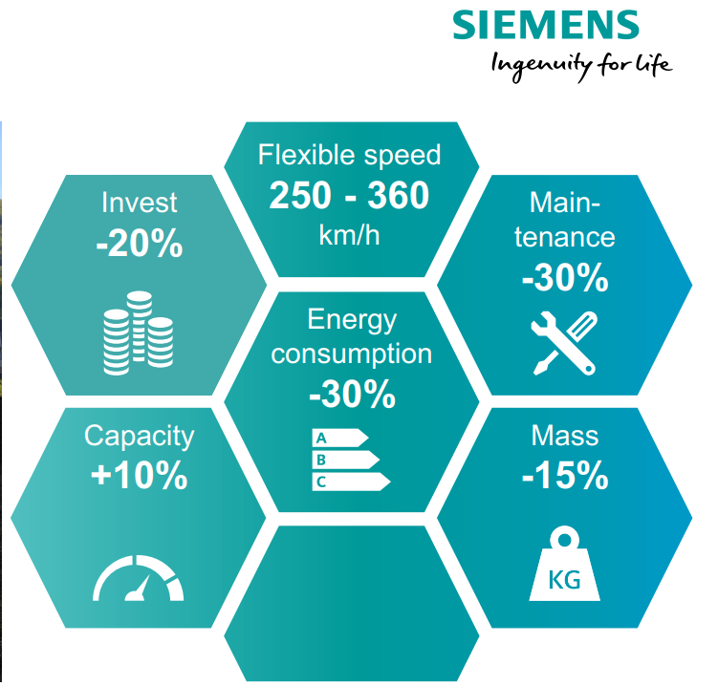
Business Functions Marketing
Market Strategy:
Create a worldwide market and develop in all aspects.
Targeted marketing according to regional development level.
Product development:
Test inside the company
Emphasize the difference between new products and old ones

Slide 5

Business Functions Operations & HR
Production:
Total integrated automation
Integrated drive system
Digital enterprise platform
Service:
For customers and employees
Healthcare
Safety service
Learning exchange

Slide 6
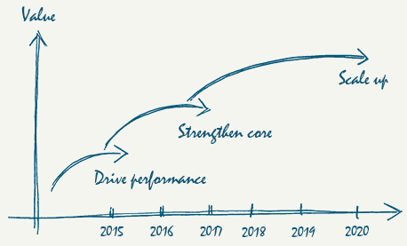
Business Functions Finance, Accounting & Strategy
Finance & Accounting :
A special financial group as an internal bank
A large amount property
Gain profit every year
Strategy
Clear mission
Lived ownership culture
Consistent strategy

Slide 7
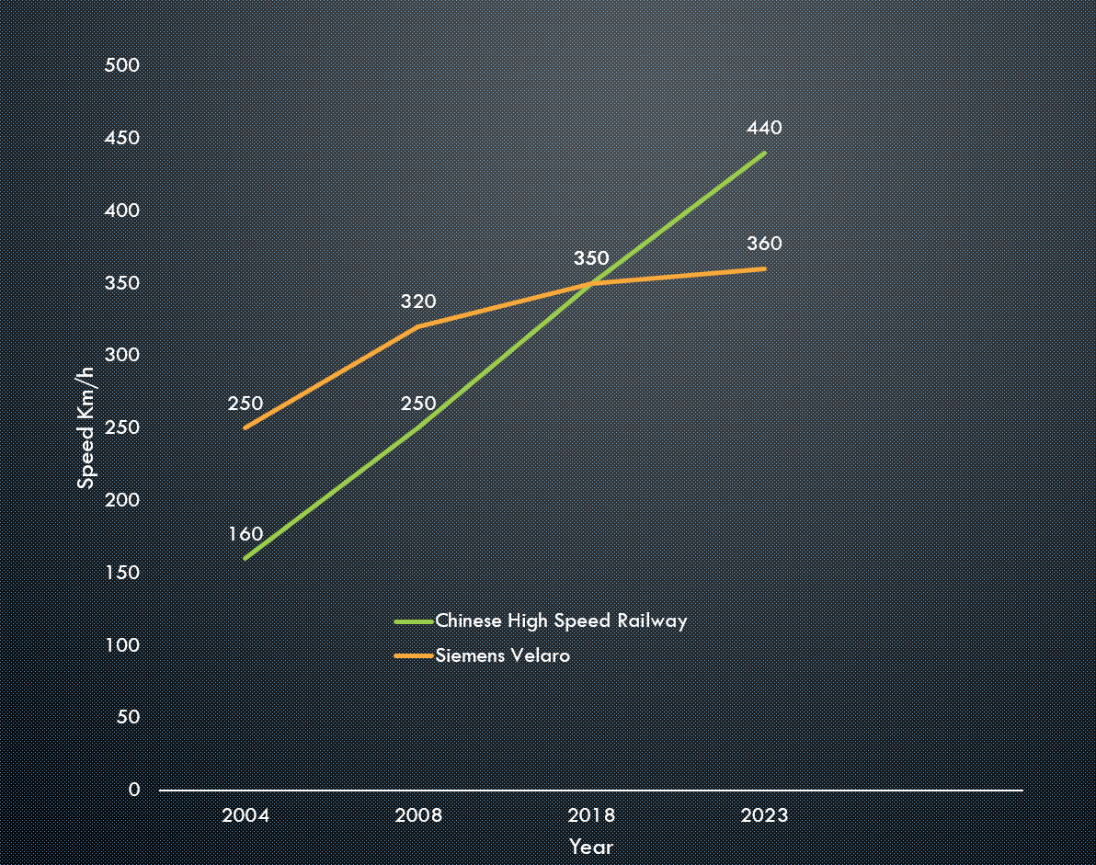
Siemens Railway Problem Analysis
Problem Background
Negotiation failure with Chinese Government about high speed railway
Late delivery of high speed railway for German Government
Loss of high speed railway market

Slide 8
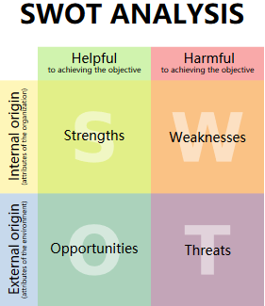
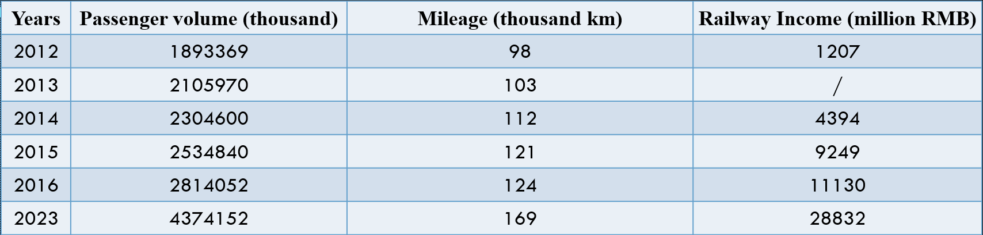
Siemens Railway Problem Analysis
Reason Analysis
Marketing: Ignorance of Chinese Market Unreasonable Price | Operations: Faulty quality control Production problem | Strategy: Lack of threat analysis

Slide 9
Thank you!

