Slide 1
Theory X – Theory Y
Management Theory

Slide 2

Theory X
Assumes employees are naturally unmotivated and dislike working
Encourages an authoritarian style of management.
Usually the minority
In mass organizations, such as large scale production environment, theory X is unavoidable.

Slide 3

Theory Y
A participative style of management that is de-centralized
Assumes employees are happy to work, self-motivated, etc.
More widely applicable
People at lower levels of the organization are involved in decision making and have more responsibility

Slide 4
Comparing Theory X and Theory Y
 | Theory X | Theory Y
Motivation | Assumes people dislike work | Assumes people are self-motivated
Management Style and Control | Authoritarian Centralized control | Participative, employees can join in decision making Managers retain the power to implement decisions
Work Organization | Specialized and often repetitive work | Wider areas of skill or knowledge Employees can develop their expertise and make suggestions

Slide 5
Comparing Theory X and Theory Y
 | Theory X | Theory Y
Rewards and Appraisals | ‘Carrot and stick’ | Separate from organizational controls Frequent promotion opportunities
Application | Widely considered inferior to theory Y Large-scale production operation and unskilled production line work Blue collar work | Widely adopted by types of organization that value and encourage participation Suitable for knowledge work and professional services White collar work

Slide 6
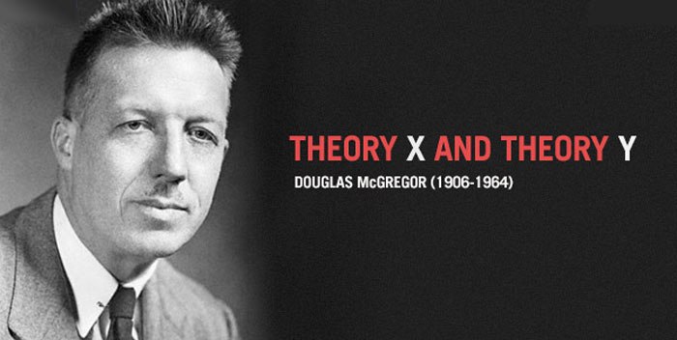
Origin
Social psychologist Douglas McGregor of MIT expounded two contrasting theories in the 1960s
Theories are about human motivation and management
McGregor personally promoted Theory Y more than Theory X

Slide 7
‘Theory X’
‘Theory Y’
Management
Staff
Theory X - authoritarian, repressive style, tight control, no development, produces limited, depressed culture
Theory Y - liberating and developmental, control, achievement and continuous improvement achieved by enabling, empowering and giving responsibility
staff
management
© alan chapman 2001-4 based on Douglas McGregor's X-Y Theory. More free online learning materials are at www.businessballs.com.
Not to be sold or published. Sole risk with user. Author accepts no liability.

