Slide 1
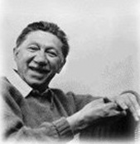
Abraham Maslow (1908-1970)
Humanistic-Existential Paradigm
Self-actualization Theory

Slide 2
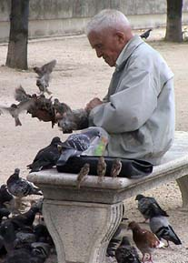
Maslow’s Assumptions
Human nature is basically good, not evil
Normal human development involves the actualization of this inherent goodness

Slide 3

Central Human Motive
Self-Actualization

Slide 4
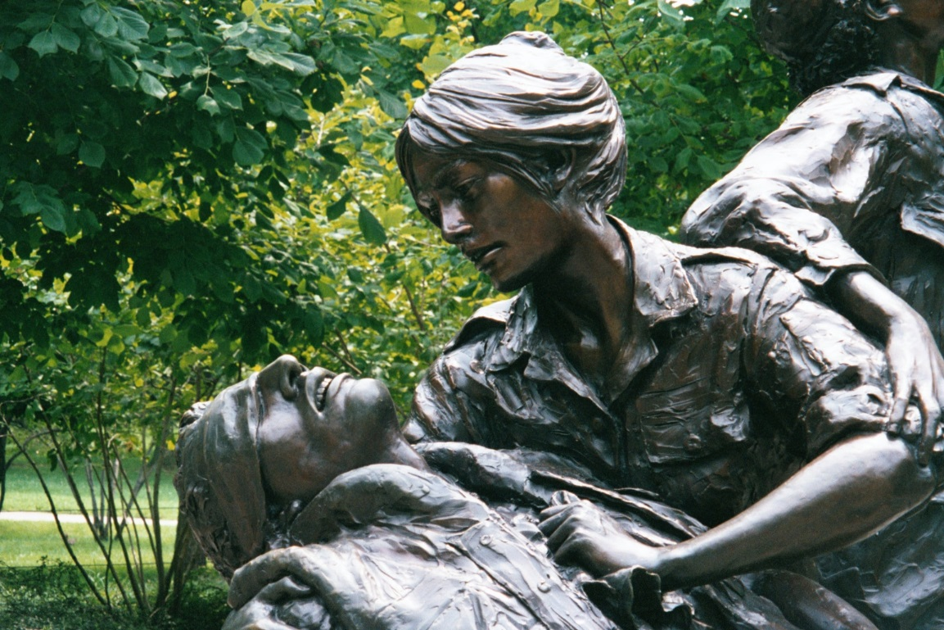
Maslow’s Assumptions...
Psychopathology results from the frustration of a human being’s essential nature

Slide 5
Maslow’s Hierarchy of Needs
Self-Actualization
Esteem
Love
Safety
Physiological

Slide 6
Maslow’s Hierarchy of Needs
MOST NEEDS HAVE TO DO WITH
SURVIVAL PHYSICALLY AND
PSYCHOLOGICALLY
PHYSIOLOGICAL OR SURVIVAL NEEDS
Notes:
5

Slide 7
Maslow’s Hierarchy of Needs
ON THE WHOLE AN INDIVIDUAL
CANNOT SATISFY ANY LEVEL
UNLESS NEEDS BELOW ARE
SATISFIED
SAFETY NEEDS
PHYSIOLOGICAL OR SURVIVAL NEEDS

Slide 8
Maslow’s Hierarchy of Needs
LOVE, AFFECTION, AND
BELONGINGNESS NEEDS
SAFETY NEEDS
PHYSIOLOGICAL OR SURVIVAL NEEDS
Notes:
7

Slide 9
Maslow’s Hierarchy of Needs
ESTEEM NEEDS
LOVE, AFFECTION, AND
BELONGINGNESS NEEDS
SAFETY NEEDS
PHYSIOLOGICAL OR SURVIVAL NEEDS
Notes:
8

Slide 10
Maslow’s Hierarchy of Needs
NEED
FOR
SELF-
ACTUALIZATION
MASLOW EMPHASIZES NEED FOR SELF
ACTUALIZATION IS
A HEALTHY INDIVIDUAL’S PRIME
MOTIVATION
Notes:
9

Slide 11
Maslow’s Hierarchy of Needs
NEED
FOR
SELF-
ACTUALIZATION
MASLOW EMPHASIZES NEED FOR SELF
ACTUALIZATION IS
A HEALTHY INDIVIDUAL’S PRIME
MOTIVATION
SELF-ACTUALIZATION MEANS ACTUALIZING
ONE’S POTENTIAL BECOMING ALL ONE IS
CAPABLE OF BECOMING
Notes:
10

Slide 12
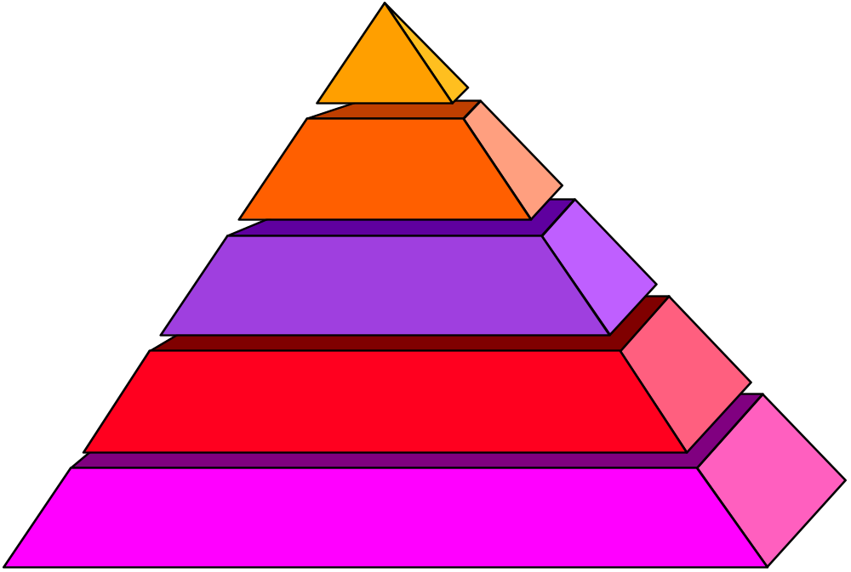
Maslow’s Hierarchy of Needs
NEED
SELF-
ACTUALIZATION
ESTEEM NEEDS
LOVE, AFFECTION, AND
BELONGINGNESS NEEDS
SAFETY NEEDS
PHYSIOLOGICAL OR SURVIVAL NEEDS
Notes:
11

Slide 13

Nobody can do everything,
but we can nearly all do more than we think we can

Slide 14
Maslow’s Definition of a
Self-actualized Person
Has no mental illness
Satisfied in basic needs
Fully exploited talents
Motivated by values

Slide 15
Some Characteristics of
Self-actualizing persons
Superior perception of reality
Increased acceptance of self, of others, and of nature
Increased spontaneity
Increased detachment and desire for privacy
Greater freshness of appreciation and richness of emotional reaction

Slide 16
Some Characteristics of
Self-actualizing persons.....
Increased autonomy and resistance to conformity
Higher frequency of peak experiences
Increased identification with the human species
Improved interpersonal experiences
More democratic character structure
High levels of creativity

Slide 17
