Slide 1
VX402: Managing a Business Summer 2018
Lecture 1
OVERVIEW
What is a Business

Slide 2
Learning Goals
Define what a business represents and why businesses exist.
Define essential business concepts including products, services, profits, and stakeholders.
Describe the major functions of business.
Discuss the role of management in business success.
Differentiate between performance effectiveness and efficiency.
Describe the enterprise system and how it relates to business.
Differentiate between internal and external stakeholders.
Discuss key market concepts such as specialization, uncertainty, and risk.
Compare and contrast economic and opportunity costs.
Describe the differences between financial and managerial accounting.

Slide 3
Business Basics
PRODUCT: a good that has tangible characteristics and that provides satisfaction or benefits.
SERVICE: an activity that has intangible characteristics and that provides satisfaction or benefits.
PROFIT: the basic goal of most businesses. Profit is the difference between what it costs to make and sell a product or service and what the customer pays for it.
STAKEHOLDERS: groups of people who have a vested interest (a “stake”) in the actions a business might take. There are four major groups of stakeholders: (1) owners, (2) employees, (3) customers, and (4) society. The specific interests of each of these stakeholder groups may sometimes conflict with each other.

Slide 4
Business functions and functioning
MARKETING is all the activities designed to provide the goods and services that satisfy customers. These activities include market research, development of products, pricing, promotion, and distribution.
PRODUCTION refers to the activities and processes used in making products or delivering services. These activities involve designing the production processes (investments in facilities and equipment) and the efficient management and operation of those processes.
ACCOUNTING is the process that tracks, summarizes, and analyzes a company’s financial position.
FINANCE refers to the activities concerned with funding a company and using resources effectively.

Slide 5
Managing a Business
PLANNING: Determining what the organization needs to do and how to get it done.
ORGANIZING: Arranging the organization’s resources and activities in such a way as to make it possible to accomplish the plan.
LEADING: Enacting the plan, including guiding and motivating employees to work toward accomplishing the necessary tasks.
CONTROLLING: Measuring and comparing performance to expectations established in the planning process and adjusting either the performance or the plan.

Slide 6
The Big Picture: The Enterprise System
Businesses operate within an overall economic system. There are at least three key terms to understand when thinking about overall economic systems.
MARKET: a mechanism that facilitates the exchange of goods and services between buyers and sellers.
DEMAND: the quantity of goods and services that consumers are willing to buy at different prices.
SUPPLY: the quantity of goods and services that businesses are willing to provide at those prices.

Slide 7
The Big Picture: The Enterprise System
Economic systems are typically, but not always, embedded in a framework of activities that are carried out by mostly democratic elected representatives (the government) of a society within its geographic boundaries.
public enterprises
Activities that serve the society by fulfilling basic needs (e.g. roads, defense, security) or needs that no other business can serve (e.g. judicial branches) are performed by public enterprises.
private enterprise
In private enterprise systems individual citizens (rather than governments) own and operate the majority of businesses.

Slide 8
Private Enterprise
Private enterprise systems require four essential conditions:
Private property
Freedom of choice
The right to keep profits
An environment where fair competition can occur

Slide 9
Internal and External Stakeholders
The key internal stakeholders
owners (stockholders/shareholders), who derive economic benefits when the business makes a profit, and whose investments lose value when it doesn’t
employees, who also derive economic benefits through wages but can experience additional benefits (such as training and experience) or disadvantages (exposure to toxins/accidents)

Slide 10
Internal and External Stakeholders
The key external stakeholders
customers (stockholders/shareholders), who want the best product or service possible for the lowest possible price
the society, at large that may also be benefited (more jobs for more people leading to more tax revenue) or disadvantaged (toxic waste in the water system/market failures).

Slide 11
Markets
A market – according to our definition – is a mechanism that facilitates the exchange of goods and services between buyers and sellers.
Markets terms
Specialization
Uncertainty
Risk

Slide 12
Decision making – the critical skill
Decision making also involves comparing the economic and opportunity rewards (benefits) and sacrifices (costs) involved in a course of action and committing to the one that best meets your goals.
Costs:
An economic cost is the money spent implementing the decision.
An opportunity cost is the cost of what you gave up doing when you committed to the course of action you chose.

Slide 13
Accounting – keeping track of financial outcomes
Accounting is a set of rules applied to a company’s financial records that allows owners and managers to monitor, analyze, and plan the finances of the business. In short, accounting deals with the business resource of “money”
FINANCIAL ACCOUNTING
MANAGEMENT ACCOUNTING

Slide 14



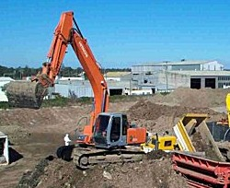
Management’s Responsibilities
The Manager’s Resources
Human
Financial
Physical
Informational

Slide 15
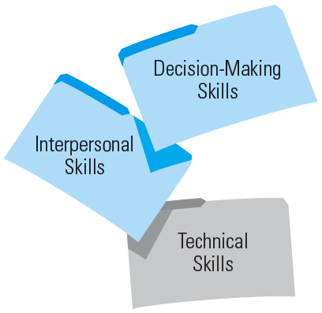
●Management Skills
Conceptual skills
Diagnostic, analytical, and critical-thinking skills
Quantitative reasoning skills
Time management skills
Communication skills
Team skills
Diversity skills
Power, political, negotiation, and networking skills
Motivation skills
Conflict management skills
Ethics skills
Familiarity and competence in the use of business skills required for success on the job.

Slide 16
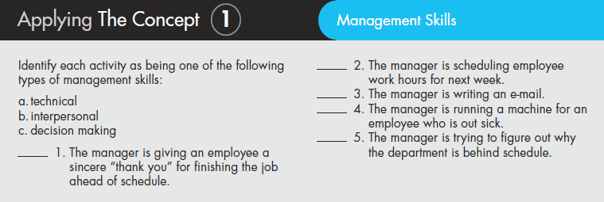

Slide 17
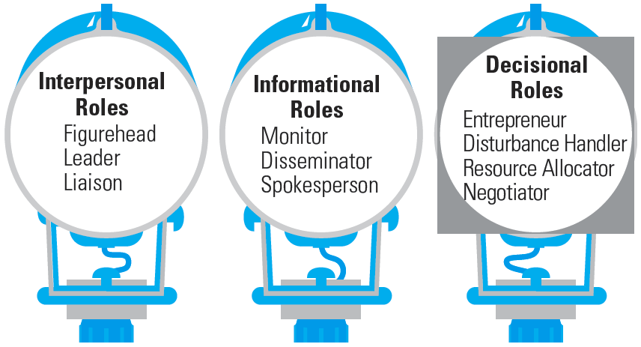
Management Roles

Slide 18
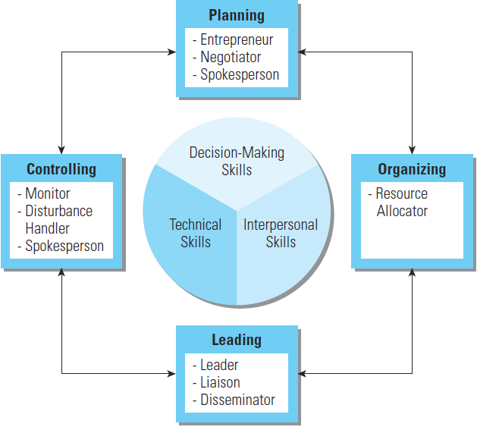
Management Skills, Functions, and Roles

Slide 19
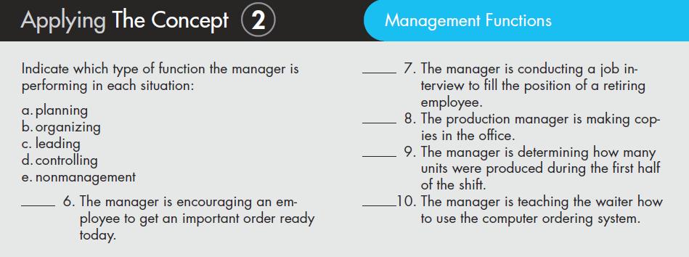

Slide 20
Differences Among Managers
The Three Levels of Management
Top managers
CEO, president, or vice president
Middle managers
Sales manager, branch manager, or department head
First-line managers
Crew leader, supervisor, head nurse, or office manager
Nonmanagement operative employees
Workers in the organization who are supervised by first-line managers

Slide 21
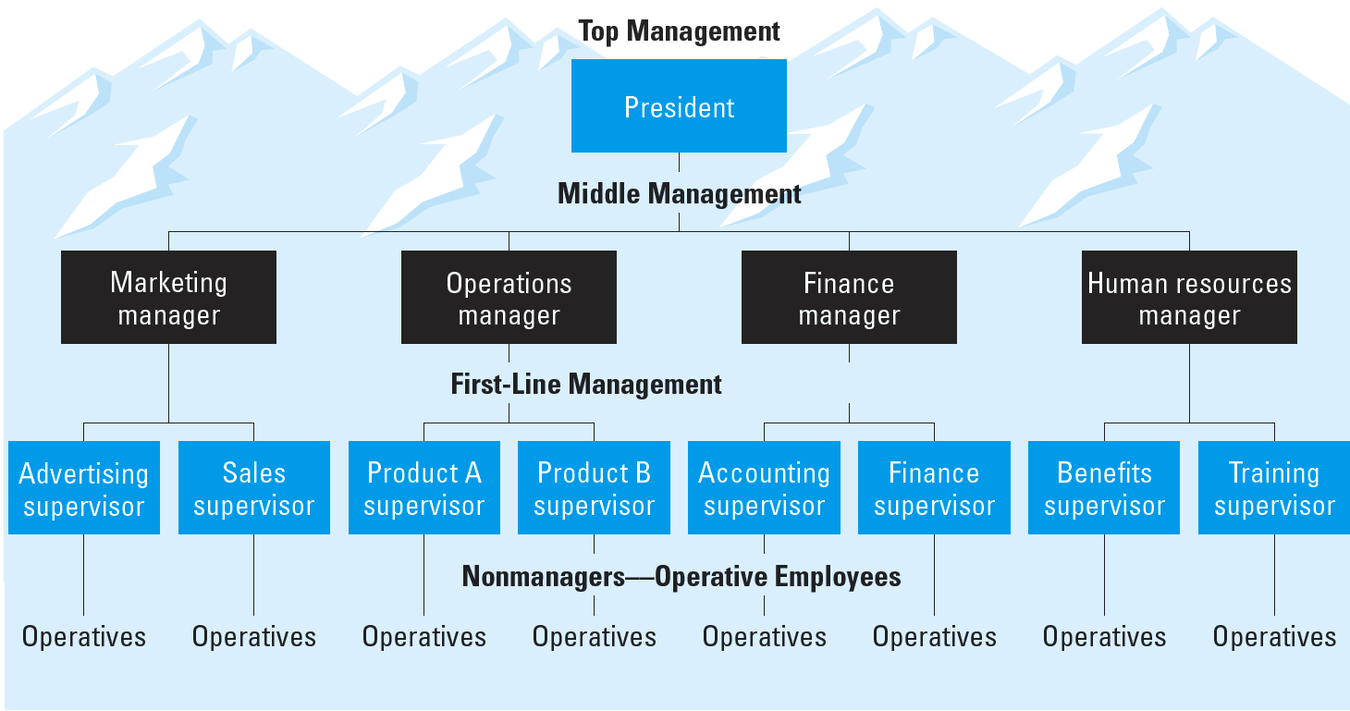
●Management Levels and Functional Areas

Slide 22
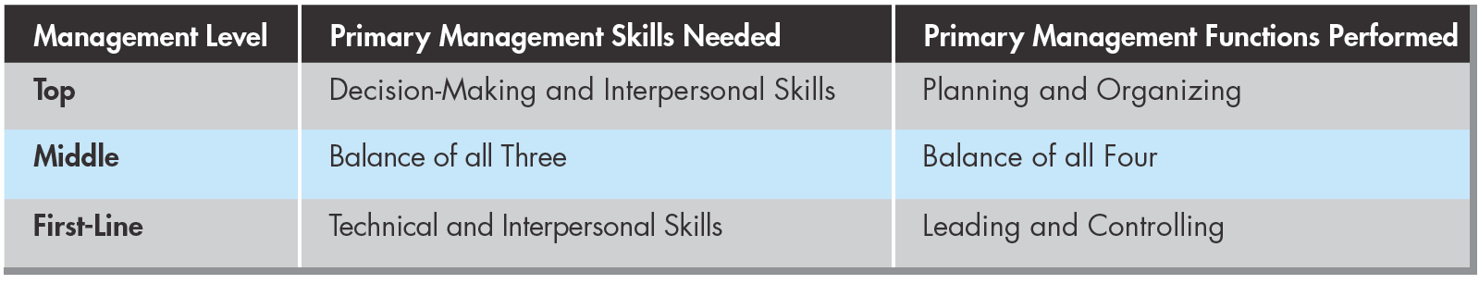
Skills/Functions performed at the different Management levels

Slide 23
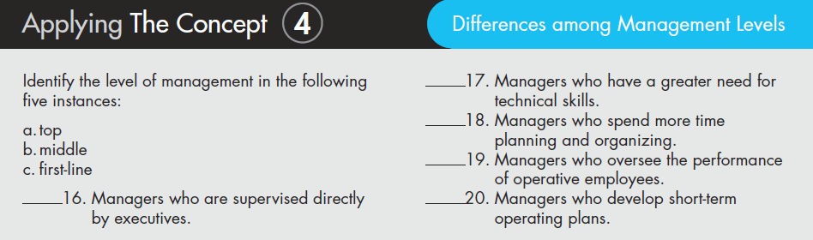

Slide 24
Chapter 1 Case Study
Innovation sparks growth [P10]
Stakeholders’ changing needs and demands [P12]
Stakeholders in an oil spill [P13]

Slide 25
Review Questions
Business Basics
What are the four main business stakeholder groups?
What are the primary functions of business?
What are the four major activities involved in managing a business?
The Private Enterprise System
How would you define supply?
How would you define demand?
How would define a market?
What are the four conditions that must exist for the free enterprise system to exist?

Slide 26
Review Questions
The Private Enterprise System (Continued)
What are the implications of the relationship between supply and demand?
What are the differences between internal and external stakeholders?
What is specialization?
How would you illustrate the concept of “uncertainty”?
How would you illustrate the concept of “risk”?
Decision Making
What is the difference between an economic cost and an opportunity cost?
What is the main purpose of the accounting function of a business?
What are the differences between financial and managerial accounting?

