Slide 1
VX402: Managing a Business Summer 2018
Lecture 2
MARKETING
How do we identify, entice and add value for customers?

Slide 2
Learning Goals
After reading this chapter you will be able to:
Describe the role of a marketing manager.
Describe the key activities of marketing research.
Discuss the seven steps of information gathering for market research.
Define and differentiate the “4P’s” of marketing.
Discuss the importance of market segmentation.
Describe the purposes and goals of marketing strategy.
Define “diminishing returns” and discuss why this matters to marketing.
Compare and contrast the concepts of risk, ambiguity, and conformance with regard to marketing.

Slide 3
Overview of Marketing Basics
The Marketing Manager’s Role
To clearly define, describe and forecast the needs of its customers by using data (Market Research),
To determine how to select specific markets and satisfy customer needs through balancing products, services, and benefits (Marketing Mix), and
To analyze its competitive advantages, plans, and actions (Marketing Strategy).

Slide 4
Market Research
Information gathering
Identify problems and potential problems in your current market that you can solve in a unique manner
Acquire facts about your market to develop a strategy and implement action plans
Assist you in making better decisions and correcting problems as needed
Reduce implementation risks
Discover unknown opportunities

Slide 5
Market Research
A more formal information gathering or research process may include the following seven steps:
Defining the problem or opportunity
Assessing available information
Reviewing internal records and files; interviewing employees
Collecting outside data (primary research)
Organizing and interpreting data
Making a decision and taking action
Assessing the results of the action

Slide 6
The Marketing Mix
The 4Ps of Marketing
Product
Price
Promotion
Place, or distribution channel

Slide 7
The 4 Ps of Marketing
Product
What are you selling and how can you manipulate it to deliver better value for your customers? Does the business concentrate on a narrow product line, developing highly specialized products or services? Does it offer different versions of its products or services to different types of customers? Adjustments to the offerings – through research and development, revised designs, new packaging, etc. – are all a key part of the marketing mix.

Slide 8
The 4 Ps of Marketing
Price
Price and pricing policies are vital to business revenues. Each product or service must be priced to satisfy customers and deliver on the company’s profit target. But pricing also includes determining a credit policy: Do you allow your customer to pay for the product after they receive it, or do they need to pay for it when they receive it? The timing of payment by customers will have an impact on the cash available to the business at any given time.

Slide 9
The 4 Ps of Marketing
Promotion
No business can expect customers to just stumble across their offering and buy. Each business needs to create awareness for the value proposition they are offering. This can be done by taking advantage of resources such as the Internet, advertising campaigns, sales efforts, special financing deals, or any other creative promotional or sales activities the company can imagine and implement. The cost of these activities, however, also has to be factored into the price of the products or services.

Slide 10
The 4 Ps of Marketing
Place, or distribution channel
The way you get your product or service into your customers’ hands or lives is equally important. Businesses need to make their value propositions accessible. A manufacturer might work through established distributors or agents, for example, to get their products to the right place. A retailer has to consider cost vs traffic flow for their store – a high-traffic location will have higher rent but a low- cost, low-traffic location will require more expenditure on promotions to bring people in. Online retail requires search engine optimization. Making the product accessible is critical to the marketing mix.

Slide 11
New-Product Development Process
Concept Development and Testing
Product idea is an idea for a possible product that the company can see itself offering to the market
Product concept is a detailed version of the idea stated in meaningful consumer terms
Product image is the way consumers perceive an actual or potential product

Slide 12


New-Product Development Process
Concept Development and Testing
Concept testing refers to testing new-product concepts with groups of target consumers
Notes:
Note to Instructor
This Web link ties to a concept testing survey at Questionpro. It is helpful to point out to students that there are many online Web survey sites, which offer free surveys for market research. In this example, they supply a template for concept testing.

Slide 13
New-Product Development Process
Marketing Strategy Development
Marketing strategy development refers to the initial marketing strategy for introducing the product to the market
Marketing strategy statement includes:
Description of the target market
Value proposition
Sales and profit goals

Slide 14
New-Product Development Process
Marketing Strategy Development
Business analysis involves a review of the sales, costs, and profit projections to find out whether they satisfy the company’s objectives

Slide 15
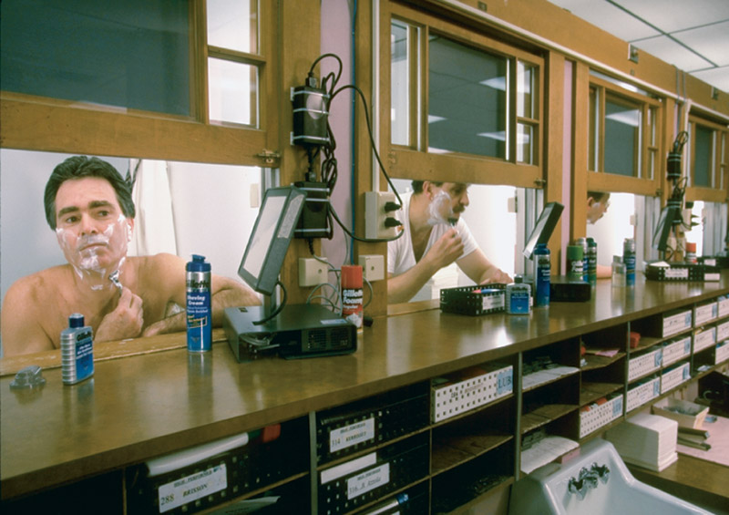
New-Product Development Process
Marketing Strategy Development
Product development involves the creation and testing of one or more physical versions by the R&D or engineering departments
Requires an increase in investment
Notes:
Note to Instructor
Many companies use their employees for product testing. Students might have worked at various consumer packaged goods companies, perhaps Quaker Oats, where they had to test cereal every day at lunch.
The text gives the example:
At Gillette, almost everyone gets involved in new-product testing. Every working day at Gillette, 200 volunteers from various departments come to work unshaven, troop to the second floor of the company’s gritty South Boston plant, and enter small booths with a sink and mirror. There they take instructions from technicians on the other side of a small window as to which razor, shaving cream, or aftershave to use. The volunteers evaluate razors for sharpness of blade, smoothness of glide, and ease of handling. In a nearby shower room, women perform the same ritual on their legs, underarms, and what the company delicately refers to as the “bikini area.” “We bleed so you’ll get a good shave at home,” says one Gillette employee.

Slide 16
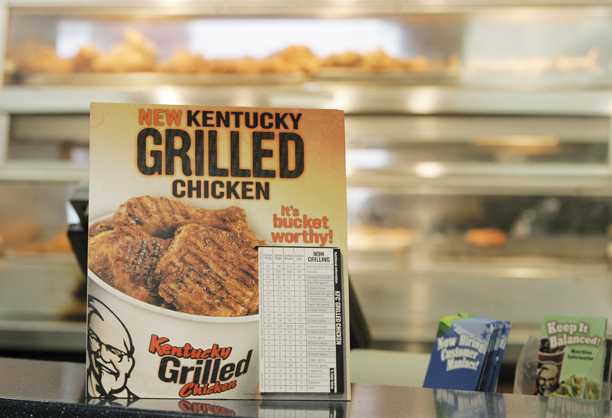
New-Product Development Process
Marketing Strategy Development
Test marketing is the stage at which the product and marketing program are introduced into more realistic marketing settings
Provides the marketer with experience in testing the product and entire marketing program before full introduction
Notes:
Note to Instructor
Here is a list of the top 10 test markets
1. ALBANY—SCHENECTADY—TROY, NY
2. ROCHESTER, NY
3. GREENSBORO—WINSTON—SALEM—-HIGH POINT, NC
4. BIRMINGHAM, AL
5. SYRACUSE, NY
6. CHARLOTTE—GASTONIA—ROCK HILL, NC/SC
7. NASHVILLE, TN
8. EUGENE—SPRINGFIELD, OR
9. WICHITA, KS
10. RICHMOND—PETERSBURG, VA
Source: Acxiom Corp., June 2004

Slide 17
________ is a review of the sales, costs, and profit projections for a new product to find out whether these factors satisfy the company’s objectives.
Market strategy development
Product development
Business analysis
Forecasting

Slide 18
When a concept moves into a physical product to insure that the product idea can be turned into a workable product, this is referred to as ___________.
market strategy
product development
business analysis
commercialization

Slide 19
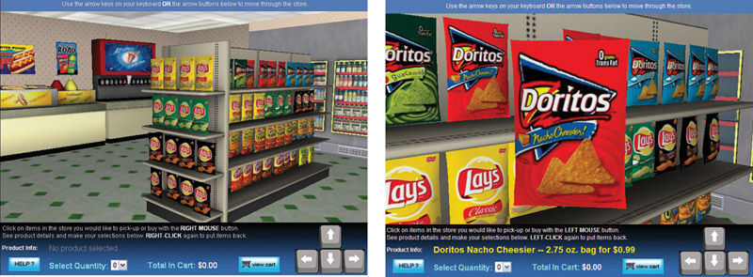
New-Product Development Process
Types of Test Markets
Simulated test markets
Standard test markets
Controlled test markets
Notes:
Note to Instructor
Standard test markets are small representative markets where the firm conducts a full marketing campaign and uses store audits, consumer and distributor surveys, and other measures to gauge product performance. Results are used to forecast national sales and profits, discover product problems, and fine-tune the marketing program.
Controlled test markets are panels of stores that have agreed to carry new products for a fee. In general they are less expensive than standard test market, faster than standard test markets, but competitors gain access to the new product.
Simulated test markets are events where the firm will create a shopping environment and note how many consumers buy the new product and competing products. Provides measure of trial and the effectiveness of promotion. Researchers can interview consumers.

Slide 20
New-Product Development Process
Marketing Strategy Development
Advantages of simulated test markets
Less expensive than other test methods
Faster
Restricts access by competitors
Disadvantages
Not considered as reliable and accurate due to the controlled setting

Slide 21

New-Product Development Process
Marketing Strategy Development
When firms test market
New product with large investment
Uncertainty about product or marketing program
When firms may not test market
Simple line extension
Copy of competitor product
Low costs
Management confidence
Notes:
Note to Instructor
This Web link takes you to Decision Insight—a company involved with online market testing. You can click at many examples they offer of clients as well as their virtual shopping testing products.

Slide 22

New-Product Development Process
Marketing Strategy Development
Commercialization is the introduction
of the new product
When to launch
Where to launch
Planned market
rollout

Slide 23
The systematic search for new-product ideas is called ________.
idea generation
idea search
idea screening
concept development

Slide 24
Once the new product ideas have been screened, the next step in the new product development process is ________.
marketing strategy
concept development and testing
product development
none of the above

Slide 25
The final stage in new product development is referred to as ________.
new product penetration
commercialization
consumer initiation
idea screened

Slide 26
Managing New-Product Development
Successful new-product development should be:
Customer centered
Team centered
Systematic

Slide 27

Managing New-Product Development
New-Product Development Strategies
Customer-centered new product development focuses on finding new ways to solve customer problems and create more customer satisfying experiences
Begins and ends with solving customer problems

Slide 28
Managing New-Product Development
New-Product Development Strategies
Sequential new-product development is a development approach where company departments work closely together individually to complete each stage of the process before passing it along to the next department or stage
Increased control in risky or complex projects
Slow

Slide 29
Managing New-Product Development
New-Product Development Strategies
Team-based new-product development is a development approach where company departments work closely together in cross-functional teams, overlapping in the product-development process to save time and increase effectiveness

Slide 30

Managing New-Product Development
New-Product Development Strategies
Systematic new-product development is an innovative development approach that collects, reviews, evaluates, and manages new-product ideas
Creates an innovation-oriented culture
Yields a large number of new-product ideas

Slide 31
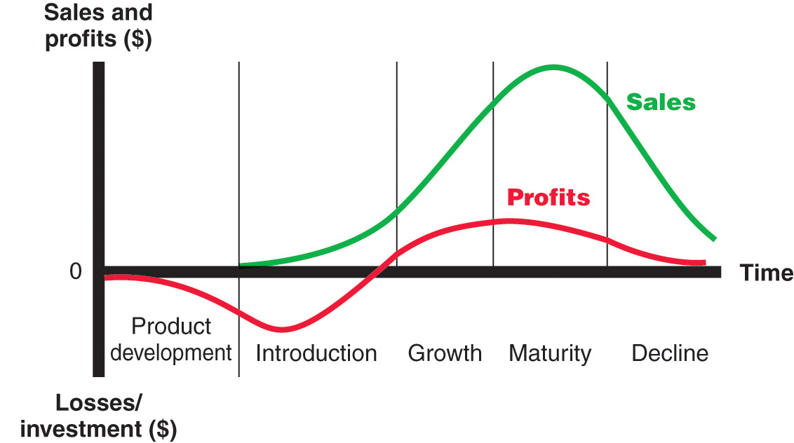
Product Life-Cycle Strategies
Product Life Cycle
Notes:
Note to Instructor
Discussion Question
Name a product at each stage of the PLC.
This concept is very new to students. See if they can identify products or product categories that are in each stage of the model. Introduction might include online movie viewing software, growth might include MP3 players, maturity might include bottled water, and decline could include soda (actually in a decline) or videotape players.

Slide 32
Product Life-Cycle Strategies
Product development
Sales are zero and investment costs mount
Introduction
Slow sales growth and profits are nonexistent
Growth
Rapid market acceptance and increasing profits.
Maturity
Slowdown in sales growth and profits level off or decline
Decline
Sales fall off and profits drop

Slide 33
Which of the following is not a stage in the product life cycle (PLC)?
Idea screening
Growth
Maturity
Decline

Slide 34
Which stage of the product life cycle (PLC) is characterized by slow growth because the product has achieved acceptance by most of its potential buyers?
Introduction
Growth
Maturity
Decline

Slide 35
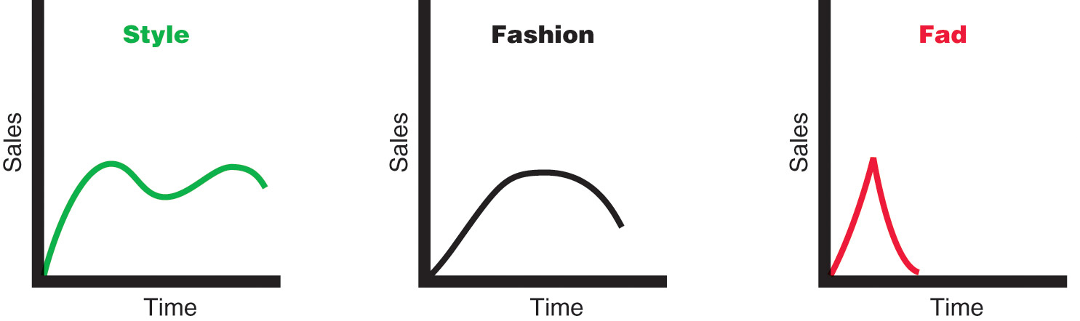
Product Life-Cycle Strategies
Notes:
Note to Instructor
Style is a basic and distinctive mode of expression.
Fashion is a currently accepted popular style in a given field.

Slide 36
________ tend to grow slowly, remain popular for a while, and then decline slowly.
Fads
Styles
Fashions
Designs

Slide 37
Product Life-Cycle Strategies
Introduction Stage
Slow sales growth
Little or no profit
High distribution and promotion expense

Slide 38
Product Life-Cycle Strategies
Growth Stage
Sales increase
New competitors enter the market
Price stability or decline to increase volume
Consumer education
Profits increase
Promotion and manufacturing costs gain economies of scale

Slide 39
Product Life-Cycle Strategies
Maturity Stage
Slowdown in sales
Many suppliers
Substitute products
Overcapacity leads to competition
Increased promotion and R&D to support sales and profits
Notes:
Note to Instructor
Cars are very mature products so companies are always coming up with new models and features. This is a link to a very funny YouTube ad about a new car product.

Slide 40
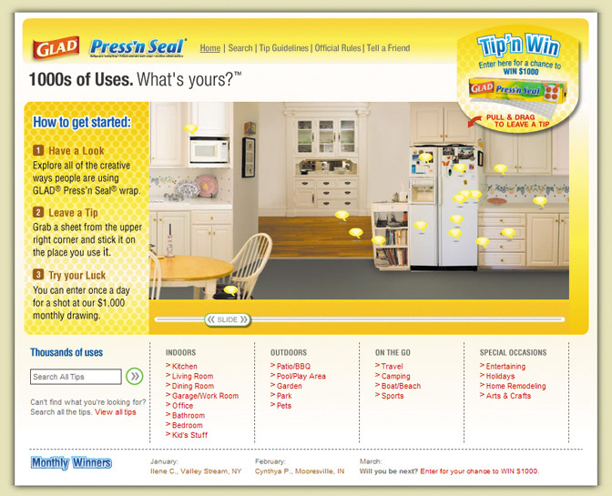

Product Life-Cycle Strategies
Maturity Stage Modifying Strategies
Market modifying
Product modifying
Marketing mix modifying
Notes:
Note to Instructor
This link is for 1000 Uses of Glad Web site. It is described below, and in the book, as a way to modify the product.
In modifying the market, the company tries to increase the consumption of the current product. It may look for new users and new market segments. The manager may also look for ways to increase usage among present customers. The company might also try modifying the product—changing characteristics such as quality, features, style, or packaging to attract new users and to inspire more usage. It can improve the product’s styling and attractiveness. It might improve the product’s quality and performance—its durability, reliability, speed, taste.

Slide 41
Product Life-Cycle Strategies
Decline Stage
Maintain the product
Harvest the product
Drop the product

Slide 42
In the ________ stage, sales start climbing quickly and competition often enters the market.
introduction
growth
maturity
decline

Slide 43
Product Life-Cycle Strategies
Summary of Product Life Cycle

Slide 44
Marketers should consider public policy issues involving product safety, environment, and warranties. This is referred to as ________.
social responsibility
positioning
marketing mix
commercialization

Slide 45

Additional Product and Service Considerations
International Product and
Service Marketing—Challenges
Determining what products and services to introduce in which countries
Standardization versus customization
Packaging and labeling
Customs, values, laws

Slide 46
Target Marketing
Markets can be segmented in several ways:
GEOGRAPHIC: Focusing on understanding the needs of customers in a particular geographical area.
DEMOGRAPHIC: Focusing on the attributes of the market based upon gender, age, income, education, or other measurable factors.
PSYCHOGRAPHIC: Identifying and promoting to people most likely to buy the product based on lifestyle and behaviors. This may be based on interests, fears, behaviors, or actions that can be categorized into groups, e.g., young health-conscious professionals, retired couples on fixed incomes, families with new babies, etc.
Target marketing enables you to identify, access, communicate with, and sell to those who are most likely to purchase your products.

Slide 47
Marketing Strategy
Marketing Reality
Ambiguity – what do our customers really want?
Risk – will our envisioned offerings be successful?
Conformance – can we deliver what we promised?
In summary, the key questions to determine marketing performance include:
Do the products and services the company is offering provide value to customers?
Are existing and potential customers aware of the products and services available from the company?
Is it easy for the customer to purchase what he or she wants and at a competitive price?

Slide 48
The Sales Forecast
Will consumers make decisions on the same basis they have in the past?
At what level will our competitors perform?
Will existing competitors introduce new products, and if so, when?
Will there be new competitors, or will existing competitors drop out of the market?
At what price can we sell our products given the many alternative product choices available?

