Slide 1
VX402: Managing a Business Summer 2018
Lecture 4
OPERATIONS: Services / Production
how does a business create goods and services to sell?

Slide 2
Production Management
After reading this chapter you will be able to:
Differentiate between operations and production.
Describe the purpose of production schedules.
Discuss the importance of inventory control.
Describe an economy of scale.
Discuss the five components of supply chain management.
Discuss why it is important to manage quality.
Describe how to measure productivity.
Define the accounting equation.
Discuss the typical types of managerial accounting reports
Describe how to calculate contribution margins and why these are valuable.

Slide 3
Production basics
production: creating something to sell at a cost and level of quality that allows the company to satisfy customer needs and make a profit.
OPERATIONS describe the full range of management activities that enable a company to be profitable and sustainable.
PRODUCTION involves the actual process of creating goods and services.

Slide 4
Core functions in production management
HUMAN RESOURCES: employees and their skills as applied to the production process.
RAW MATERIALS: the cost of all the goods needed to create the products or services.
CAPACITY: the annual production capabilities of the facilities, technology, machinery, and equipment.

Slide 5
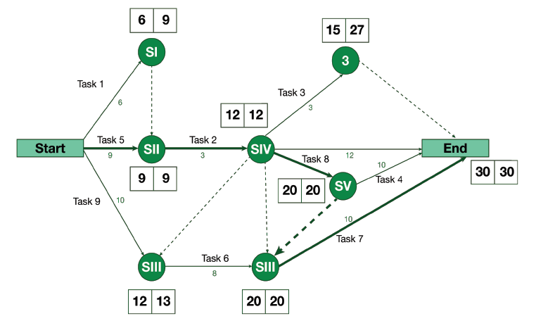
Scheduling production
PERT Chart stands for “Program Evaluation and Review Technique.”

Slide 6
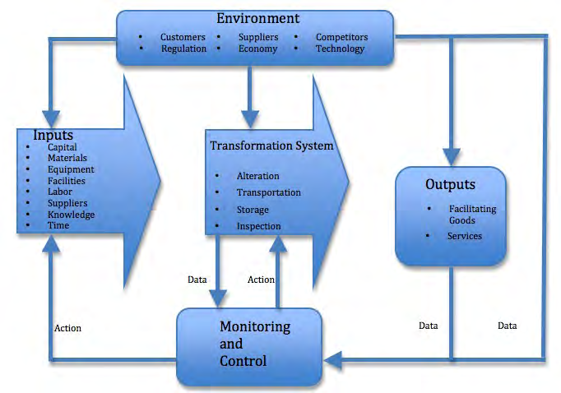
Transformation Process

Slide 7
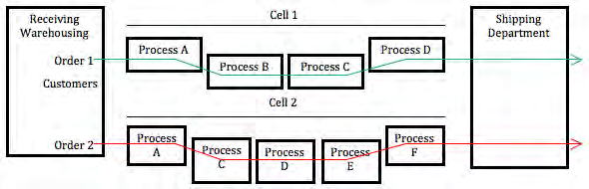
Production Process

Slide 8
Inventory control
work-in-process inventory
just-in-time (JIT) inventory system
materials requirement planning system or MRP

Slide 9
Economies of scale
An economy of scale occurs when the cost of each good produced decreases as the volume produced increases.
Economies of scale are particularly critical in industries with high fixed costs such as manufacturing.

Slide 10
Supply chain management
PLAN: The strategic plan to manage all of the resources needed to meet customer demand for your product or service
SOURCE: The selection of the supplies that will deliver goods and services
MAKE: The manufacturing step involving scheduling, testing, packaging, and preparing for delivery
DELIVER: The logistics and timing of getting products and/or services through the relevant channels to the customer
RETURN: The “soft” link in the chain that supports customers who are returning products or have had problems with their product/service experience.

Slide 11
Quality control and Total Quality Management
National or international authorities often set standards in business.
The International Organization for Standardization (ISO)
the Food and Drug Administration (FDA)
the Consumer Products Safety Council (CPSC)

Slide 12
Quality control and Total Quality Management
Many firms create teams of employees to assess quality and to offer suggestions for improvement.
Benchmarking
Technology
Improving Productivity

Slide 13
Interrelationship between production and accounting
FINANCIAL ACCOUNTING
MANAGERIAL ACCOUNTING
The Accounting Equation
Assets = Liabilities + Equity
Managerial Accounting
Companies typically use managerial accounting reports that fall into two broad categories:
BUDGET REPORTS
COST ANALYSIS REPORTS

Slide 14
Contribution Margin
Contribution margin = Price – Variable costs
To improve your contribution margin, you can:
Raise prices
Lower material costs
Reduce labor costs
Economies of scale

Slide 15
Chapter 3 Case Study
A new season for BlackBerry? [P37]
Inventory management is critical to prevent stockouts and have smooth flow of product from your company to your customers. Production, however, is based on sales forecasts - and if the forecasts are not met?

Slide 16
Chapter 3 Case Study
Can Tesla achieve economies of scale and keep its promise? [P38]
Whispers from the supply chain suggest a bullwhip [P40]
3D printers changing the production paradigm? [P44]

Slide 17
Chapter 3 Review Questions
Production basics:
What is the difference between production and operations?
What are the primary resources used in the production process?
What does “economies of scale” mean, and why is that concept relevant in the production process?
What benefits does TQM offer an organization?
What does benchmarking accomplish?
How does supply chain management impact the production process?
What are the potential benefits of effectively managing quality control?

Slide 18
Chapter 3 Review Questions
Linking Production to Accounting :
8. Who relies on accounting information?
9. What is the accounting equation?
10. What is cost analysis?
11. What are some ways to increase your contribution margin?

Slide 19
SERVICE
In national economic statistics, the service sector is often defined as whatever is not agriculture or manufacturing (service sector – tertiary sector of the economy (Colin Clark)). Intuitively, services are processes, performances, or experiences that one person or organization does for the benefit of another – such as custom tailoring suit, cooking a dinner to order, driving a limousine, mounting a legal defense, setting a broken bone, teaching a class, or running a business's information technology infrastructure and applications. In all cases, service involves deployment of knowledge, skills, and competences that one person or organization has for the benefit of another (Lusch & Vargo), often done as a single, customized job. And in all cases, service requires substantial input from the customer or client (Sampson) – how else could your steak be customized for you unless you tell you waiter how you want it prepared? In general there are so-called front-stage and back-stage activities in any business transaction – front stage being the part that comes in contact with the customer and back stage being the part that does not (Teboul). Service depends on having a high degree of front-stage activities to interact with the customer, whereas traditional manufacturing requires very little customer input to the production process and depends almost entirely on back-stage activities.

Slide 20
Two views of a Service
Service as a Support
offered with a tangible product e.g., service of cars, televisions, computers
Service important for the success of the product business
Service as a Product
offered on its own e.g., airline travel, banking, Internet Service

Slide 21
Definition of Service Management
Service management is concerned with the specification, design, implementation and evaluation of services, and related processes.
Since services are an important part of a business, service management is highly dependent on the type of business
This session focuses on the application of Information and Communication Technologies in services and consulting

Slide 22
Key Principles of Service Design and Management
Involve the customer in all stages of a service process that consistently and reliably meets customer expectations
Derive the specifications of the design from the customers and not only from previous designs
Derive the technical aspects of the design from above customer specifications. In other words technology should NOT dictate the design
Design and evaluate the service as a cooperative work between people from all relevant organizations
Provide Service at a cost that keeps the company profitable

Slide 23
Eight Stage Service Design and Management Model
Defining
Design
Attributes
-1
Performance
Standards/
Agreements
-2
Generating/
Evaluating
Concepts
-3
Developing
Design
Detail
- 4
Improving
Performance
-8
Assessing
Satisfaction
-7
Measuring
Performance
-6
Implementing
Design
-5

Slide 24
Stage-1: Customer Needs Assessment
Identify the key customers and their service needs
Prioritize the needs in order of importance
Specify the design attributes required by a service that meets these needs
Create quantitative measures for attributes
Establish relationship between needs and attributes
Determine the most important attributes

Slide 25
Stage 1 Illustration: Telemedicine Service
Hospitals with networked computing environment, and staff willing to use them
Needs: Online diagnosis with scan images, pathology test results, patient records, communication amongst medical staff
Attributes: Picture quality, response time, Ease of use
Relationship: Online diagnosis requires right picure quality, right response time

Slide 26
Stage-2: Specifying Performance Standards
Identify the customers’ desired performance level for each attribute
Analyze the performance of competitors
Determine the Relationship between performance and satisfaction
Specify design performance Standards/Agreements for each attribute

Slide 27
Stage-2 Illustration: Telemedicine Service
Online diagnosis requires response time less than 30 sec
How does telemedicine perform in comparison with face to face consultations
Even though the doctor can diagnose remotely, patient needs doctor’s healing touch!
To fire a screen, user key strokes<n

Slide 28
Stage-3: Generating and Evaluating Concepts
Define the key functions needed to provide the service
Assemble these functions into processes
Document these processes using a graphical notation
Create alternate design concepts for service
Evaluate and select a concept for design

Slide 29
Stage-3 Illustration: Telemedicine Service
Updating patient records, storage and retrieval of images based on some index
Involves both human and machine actions; data entry by receptionist, followed by timed update of remote files
In-house information system versus outsourced service
Cost-benefit analysis (payback period)

Slide 30
Stage-4: Developing Design Details
Partition concepts into process-level design components
Generate design alternatives for each component
Predict performance of each alternative
Evaluate and select alternatives for each component
Evaluate and select design for implementation
Test performance of overall service design
Make any necessary modifications in the design
Specify detailed functional requirements

Slide 31
Stage 4 Illustration: Telemedicine Service
Image storage and retrieval process could use different types of databases, and client-server designs
Simulate the performance of each design alternative for different traffic conditions
Select Oracle7-based design over Internet
Tune database configuration and access protocols to suit the performance needs

Slide 32
Stage-5: Implementing the Design
Develop Implementation project plan
Develop service construction plan
Develop a pilot testing plan
Develop a communication plan
Develop a rollout and transition plan
Develop a service management plan
Implement all plans

Slide 33
Stage 5 Illustration: Telemedicine Service
Implementation timeframes
Establishing hardware, software and procedures for the service
Making arrangements for operations to continue in case of failures
Communication with all related people
Service management plan foresees troubles and solutions during operation

Slide 34
Stage-6: Measuring Performance
Select Key attributes to be anlyzed
Measure performance attributes relative to standards/agreements
Measure capability of attributes
Measure efficiency of key processes
Develop reporting and analysis procedures
Identify attributes whose performance does not meet standards/agreements
Analyze root cause of poor performance
Perform any corrective action, if necessary

Slide 35
Stage 6 Illustration: Telemedicine Service
Key attributes: Picture quality, response time
Service Level Agreements based on these attribute values
Increased variability of picture quality causes alarm
Measure operating costs and resource utilization levels
Problem could be because of network traffic increase

Slide 36
Stage 6 Tools and Techniques
Management Platforms
Performance Management Applications
Network Management Tools
Systems Management Tools
Integration of Network, Systems and Service Management
Subject of the Lecture on Service Management Architecture

Slide 37
Stage-7: Assessing Satisfaction
Measure Customers’ Satisfaction with Performance of Service
Measure Satisfaction relative to Customers’ Expectations
Measure Satisfaction relative to the Competition
Validate these Results against those from Stage 2

Slide 38
Stage 7 Illustration: Telemedicine Service
Measure satisfaction levels of various interactions in a process
Measure satisfaction relative to face-to-face situation
Measure satisfaction relative to other service providers
Compare with original expectations

Slide 39
Stage 7 Tools and Techniques
Surveys and Market Research
Group Interviews
Personal Interviews
Observation
Contextual Interviews

Slide 40
Stage-8: Improving Process Performance
Estimate relationship between financial objectives and overall satisfaction
Set Strategic Satisfaction Targets
Estimate Relationship between satisfaction and attribute performance
Select one or more attributes for improvement, and set targets
Estimate Relationship between service-level and process-level attributes
Select process-level improvement alternatives
Select and Implement process improvement initiatives

Slide 41
Stage 8 Illustration: Telemedicine Service
More satisfied a medical staff, less cost of providing manual records
Complete online patient record system
Relationship between satisfaction level and attributes, e.g. picture quality
Quality of Service parameters can be categorized into different hierarchical levels
Improvement may involve providing a digital medicine infrastructure to hospitals

Slide 42
References
Pradeep Ray, Integrated Management from E-Business Perspective, Springer/International Kluwer Academic/, Plenum Publishers,ISBN: 0-306-47485-9, Jan 2003 (Chapter 4)
Rohit Ramaswamy, Design and Management Service Processes: Keeping Customers for Life, ISBN: 0201633833, 1996
http://www.qfdonline.com/qfd-tutorials/house-of-quality-tutorial/
Cengiz Haksever, Barry Render, Service Management: An Integrated Approach to Supply Chain Management and Operations (FT Press Operations Management) [Kindle Edition], 2013

