Slide 1
VX402: Managing a Business Summer 2018
Lecture 5
ACCOUNTING
how do we keep track of the money?

Slide 2
Learning Goals
After reading this chapter you will be able to:
Describe the three categories of cash in a cash flow statement.
Discuss the types of activities that add or subtract cash flow from operating activities.
Define working capital and the working capital cycle.
Discuss the importance of managing the working capital cycle.
Differentiate between production cycle, accounts payable lags, and accounts receivable lags.
Calculate accounts receivable.
Discuss the importance of a credit policy for a company’s cash flow.
Discuss the importance of managing inventory for a company’s cash flow.
Calculate inventory turnover rates, inventory turnover days, and ideal inventory.
Describe the kind of information found on a company’s income statement

Slide 3
Accounting basics
Cash is King
three key financial statements
Cash Flow Statements
Income Statements
Balance Sheets
Cash ≠ Profit

Slide 4
The Cash Flow Statement
CASH FROM OPERATING ACTIVITIES:
your day-to-day business activities.
CASH FROM INVESTING ACTIVITIES:
selling or buying plant and equipment, for example.
CASH FROM FINANCING ACTIVITIES:
from stock transactions, loan repayments etc.

Slide 5
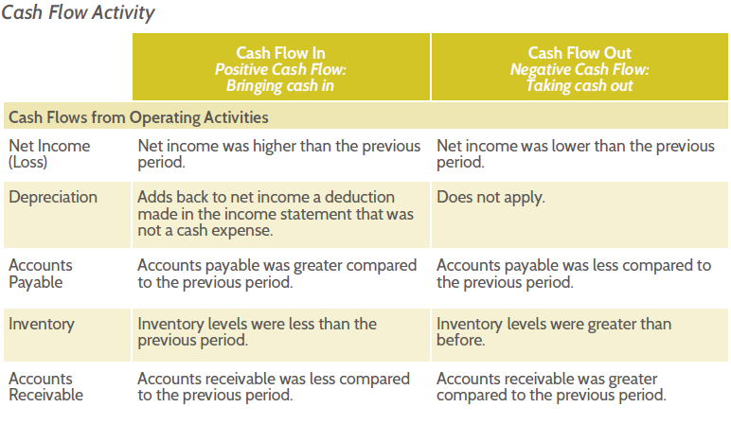
Cash Flow Activity

Slide 6
Cash and the Working Capital Cycle
Working capital is the cash that is available to run day-to-day business operations.
The working capital cycle – also called the cash flow cycle – is a concept based on the time cash is tied up (in raw materials, for example) and therefore unavailable for other uses by the business.

Slide 7
Working Capital Cycle: the Importance of time and timing
1. PRODUCTION CYCLE refers to the length of time from the purchase of raw materials, through the production of the goods or service, and to the sale of the finished product
2. ACCOUNTS PAYABLE (A/P) LAG is the time between the purchase of raw materials on credit and the cash payments made for the resulting ac-counts payable.
3. ACCOUNTS RECEIVABLE (A/R) LAG is the time between the sale of the final product on credit and collection of cash payments for the accounts receivable.

Slide 8
Managing Accounts Receivable and Accounts Payable
Accounts Receivable = Credit sales per day x Length of collection period
Four factors must be considered in establishing an effective credit policy:
1. Creditworthiness standards
Can your customers pay you back?
2. Credit period
How long do they have to pay?
3. Collection policy
What will you do if they do not pay?
4. Early payment discount
Do you give them a discount if they pay early?

Slide 9
Managing Inventory
Inventory Turnover Rate = Cost of goods sold / Inventory
Inventory Turnover Days = Number of days in a period / Inventory turnover rate
Ideal Inventory = Cost of goods sold/ Industry average turnover rate

Slide 10
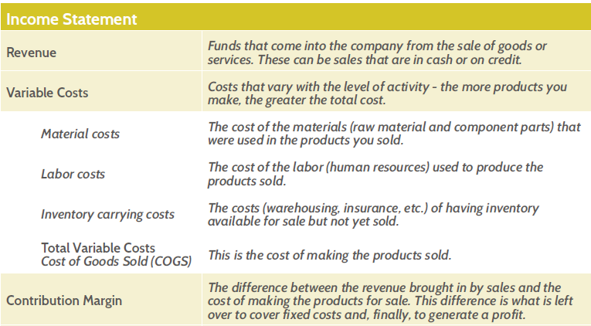
The Income Statement

Slide 11
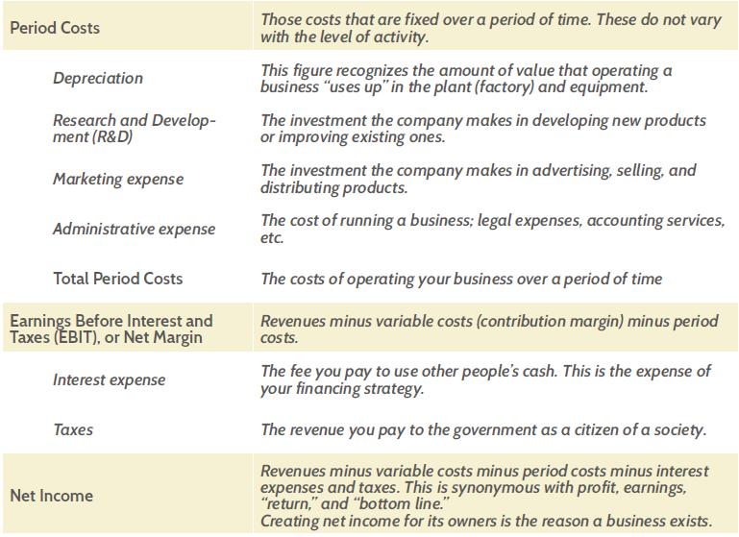
The Income Statement

Slide 12
Chapter 4 Case Study
Doing deals with accounting, a recipe for disaster [P58]
What are the problems of Groupon concerning accounting?

Slide 13
Chapter 4 Review Questions
Cash and The Cash Flow Statement
Describe the difference between profit and cash.
What are the differences between cash from operating activities, cash from investing activities, and cash from financing activities?
What is depreciation and what does it do to cash flow?
Cash and the Working Capital Cycle
Why is it important to understand working capital?
How does working capital relate to the Cash Flow Statement?
What is the working capital cycle and why does it matter?

Slide 14
Chapter 4 Review Questions
Cash and the Working Capital Cycle
What might be the ramifications, financially and from a marketing perspective, of increasing the accounts receivable lag time?
What are the tradeoffs of selling products on credit?
What is the Inventory Turnover Rate and how is it measured?
The Income Statement
What is the benefit of separating Period and Variable costs on the Income Statement?
What does a Contribution Margin represent?
What is the relationship between Revenue and Net Income on the Income Statement?

