Slide 1
VX402: Managing a Business Summer 2018
Lecture 6
FINANCE
How do we raise funds, reward shareholders, and manage our assets?

Slide 2
Learning Goals
After reading this chapter you will be able to:
Discuss the importance of a financing strategy to a company’s performance.
Define the role of risk with regard to investment decisions.
Differentiate between the two types of transactions used to gain access to additional funds.
Describe the similarities and differences between loans and bonds.
Describe how the bond market impacts bond value.
Discuss how to evaluate the quality of bonds.
Differentiate between common stock and preferred stock.
Discuss why a company would choose to pay dividends.
Describe the purpose of the Balance Sheet.
Discuss the kinds of information found on the Balance Sheet.
Differentiate between assets and liabilities.

Slide 3
Cash does not equal net profit
How much cash does a business need?
As an alternative to holding large cash balances, many companies hold part of their liquid funds in short-term marketable securities, such as
TREASURY BILLS (T-BILLS)
COMMERCIAL PAPER
CERTIFICATES OF DEPOSIT (CDS)

Slide 4
Investment Financing: getting cash to grow your business
Two kinds of transactions that allow you to get access to additional funds:
(1) taking on debt (loans or bonds)
(2) taking on new owners (stockholders)
Risk
The higher the risk, the greater the expected return.

Slide 5
The Balance Sheet: documenting assets and liabilities
Financial snapshot
Balance Sheet
the company’s Assets
Current Assets
Long-Term Assets
Liabilities
Balance Sheet ‘Infrastructure’
Loans

Slide 6
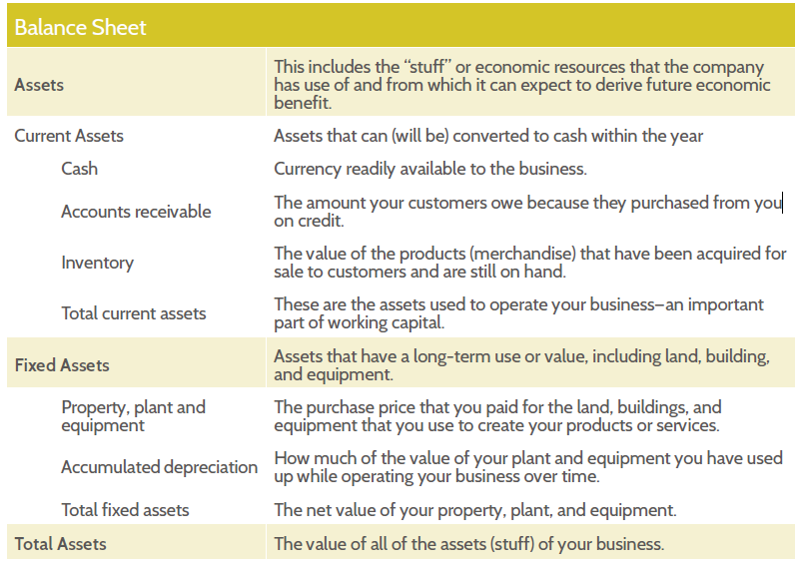
Balance Sheet

Slide 7
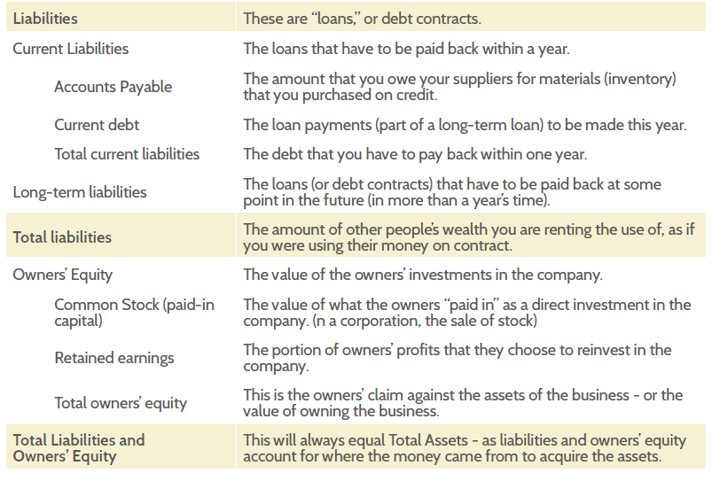
Balance Sheet

Slide 8
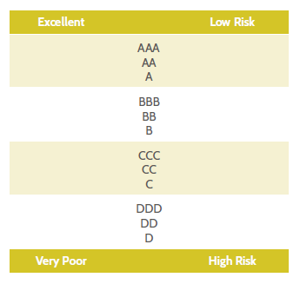
Bonds and the bond market
A bond is a form of long-term financing.
A bond is an investment whose return is specified in the debt contract.
Bond ratings progress from a rating of “excellent” to “very poor” in the order indicated in the table below.

Slide 9
The Balance Sheet: documenting assets and liabilities
Stocks and dividends
Stock market
Initial Public Offering (IPO)
Common stock
Preferred stock
Paying dividends
Value and stock claims
1. The value of the stock‘s claim against the assets of the company
2. How much profit the company makes per share of stock
3. How much of that profit is distributed to owners (as a dividend)

Slide 10
Recap: cash flows, financials and company performance
Financial Ratios
ROE (return on equity)
ROE = Profits / Equity
ROA (return on assets)
ROA = Profits Assets
ROS (return on sales)
ROS = Profits Sales
Asset Turnover
Asset Turnover = Sales Assets

Slide 11
Recap: cash flows, financials and company performance
Market ratios
Earnings per share
Price to earnings
Dividend yield

Slide 12
Chapter 5 Case Study
The hope and the risk of new cancer treatments [P63]
What are the hope and the risk in the case?

Slide 13
Chapter 5 Review Questions
How does a company’s financing strategy impact its operations and performance?
What is risk and how does it affect decisions about investment?
What is the primary difference between financing through loans versus stock?
What is a loan and how do interest rates affect a company that takes out a loan?
In what ways are bonds different than loans?
How can we tell the difference in the quality of different bonds?

Slide 14
Chapter 5 Review Questions
How are common stocks different from preferred stocks? Why would a company offer preferred stocks?
Why would a company choose to pay dividends?
What is the purpose of the Balance Sheet?
What is the difference between assets and liabilities?
What are the accounts that make up Shareholder’s Equity on the Balance Sheet?
What are the main profitability ratios? What are the main market ratios?

