Slide 1
VX402: Managing a Business Summer 2018
Lecture 7
STRATEGY

Slide 2
Learning Goals
After reading this chapter you will be able to:
Discuss the factors that influence strategic choices.
SWOT analysis: Describe the components of a SWOT analysis and the common questions that are asked in each component; Explain how a SWOT analysis informs business strategy.
Describe the linkages between goals and strategy.
Goal Setting: Discuss the five characteristics of effective goals.
Compare and contrast operational effectiveness and strategic positioning.

Slide 3
Learning Goals
After reading this chapter you will be able to:
Competitive Advantage: Define competitive advantage and the kinds of business resources that create it.
Compare and contrast the two generic strategies of cost leadership and differentiation;
Discuss ways a company can pursue a cost leadership strategy;
Discuss ways a company can pursue a differentiation strategy.
Balanced Scorecard: Describe the four quadrants of the Balanced Scorecard.

Slide 4
Alignment, coordination and Evaluation – critical factors
Managing Resources under Pressure
Searching for alternatives
Making strategic choices: where are we now?
INTERNAL FACTORS: Strengths (Pros) and Weaknesses (Cons)
EXTERNAL FACTORS: Opportunities (Pros) and Threats (Cons)
Setting goals: how do we get there?

Slide 5
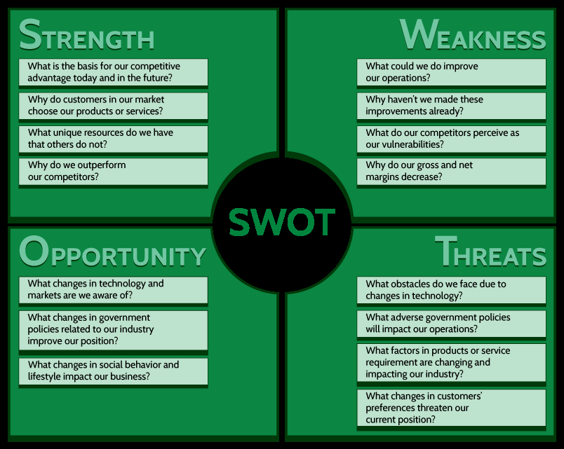
SWOT Analysis

Slide 6
Setting Goals
For any goal to be most effective and useful it should have the following “SMART” characteristics:
S — Specific (clearly described and detailed)
M — Measurable (includes aspects that can be assessed)
A — Achievable (challenging, but attainable)
R — Relevant (important to the chosen strategy)
T — Time-bound (linked to a certain deadline and milestones)

Slide 7
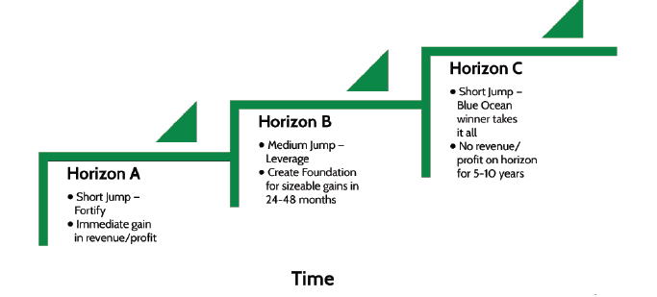
Growing the Business: How do we sustain the momentum?
In theory, growth is quite simple: Increase both “topline” (revenue) and “bottomline” (profit)
In practice, it can’t be that simple

Slide 8
Operational effectiveness versus strategic positioning
Operational Effectiveness means performing similar activities better than your rivals.
Strategic Positioning means performing different or similar activities from your competitors in different ways.

Slide 9
Trading off costs and benefits
Opportunities and options, constraints and choices – these are the forces that affect business strategy. And no matter what course of action we choose, there will be trade-offs – costs and benefits that result from our choices.
four buckets of a CEO’s responsibilities:
PLANNING PROCESS
BUSINESS MODELS
COMPETITIVE ADVANTAGE
STRATEGIC CHOICE

Slide 10
Creating Competitive Advantage
Competitive Advantage – 护城河 (Moat)
Sustainable competitive advantage ultimately comes from how the company’s management coordinates and aligns the firm’s resources:
RARE? Meaning that it is unique in the marketplace; you have it and no other companies (or very few) do.
NOT EASILY IMITATED? Meaning that it is not easily copied or replicated by others.
NON-SUBSTITUTABLE? Meaning that something else cannot be used or substituted in its place.

Slide 11
Creating Competitive Advantage
Competitive Advantage – 护城河 (Moat)
Think about…
What are we best at today and in the future?
What can our organization do better than any other organization today and in the future??
How do we reach our customers today and in the future?
What skills or capabilities make our organization unique today and in the future?
Where do our profit margins come from today and what about in the future?

Slide 12
Generic Competitive Strategies

Slide 13


Generic Competitive Strategies
Cost Leadership
Such a company gains competitive advantage by keeping R&D, production, material, and labor costs to a minimum. Lower costs enable the company to compete on the basis of price and volume. Consequently, the prices of their products and services will typically be below the industry average.

Slide 14

Generic Competitive Strategies
Differentiation
Companies seek to provide customers a very different, and often extremely unique, experience in order to differentiate their products or services. Sometimes the experience is considered a luxury in and of itself. Other times the unique experience could be derived from technology.

Slide 15
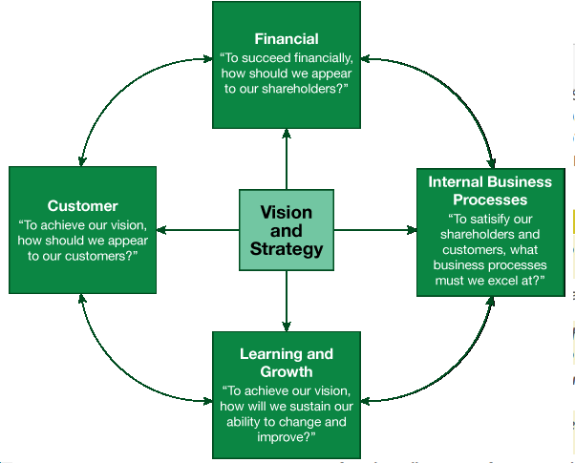
Measuring success: the importance of a balanced approach
The Balanced Scorecard
The Quadrants of the Balanced Scorecard

Slide 16
The Balanced Scorecard
CUSTOMER
“How well are we satisfying our customers’ needs?”
INTERNAL BUSINESS
“What do we need to correct within our own business to ensure we deliver the value propositions the market needs and expects?”

Slide 17
The Balanced Scorecard
LEARNING AND GROWTH
“How do we develop and grow in order to continue to create value?”
FINANCIAL PERSPECTIVE
“Are we making a profit in the activities in which we are engaged and therefore growing the company/increasing shareholder value?”
“Do we have the appropriate levels of cash to operate both in the short term and the long term?”

Slide 18
Chapter 6 Case Study
Closing the gap on the cheap seats [P91]
Cost leadership
Puttin’ on the Ritz [P92]
Differentiation

Slide 19
Chapter 6 Review Questions
What factors influence the strategic choices a company will face?
What does S.W.O.T. stand for and how does a SWOT analysis matter to business strategy?
What are the common questions that are asked in each of the components of a SWOT analysis?
What is the importance of goal setting to business strategy?
What are the characteristics of effective goals?
What are the differences between the existing, overserved, and non-customer categories? How does one grow or sustain a business in relation to each of these categories?
What is operational effectiveness?
What is strategic positioning?

Slide 20
Chapter 6 Review Questions
What four basic decisions are generally the responsibility of the CEO?
What is competitive advantage and what kinds of question can we ask to help identify sources of it?
What are the characteristics of business resources that promote competitive advantage?
What are the “five forces” that drive competition in an industry?
What are some ways to create “barriers” in the CapsimCore Simulation?
What are the differences between the two generic strategies of cost leadership and differentiation? What are the goals and actions that are associated with each?
What makes the Balanced Scorecard “balanced”?
What are the four quadrants of the Balanced Scorecard? What is the central question that is asked in each perspective of the Balanced Scorecard?

