Slide 1
Wayfinding Base
Vx420 Pitch
Pan Chongdan 516370910121

Slide 2
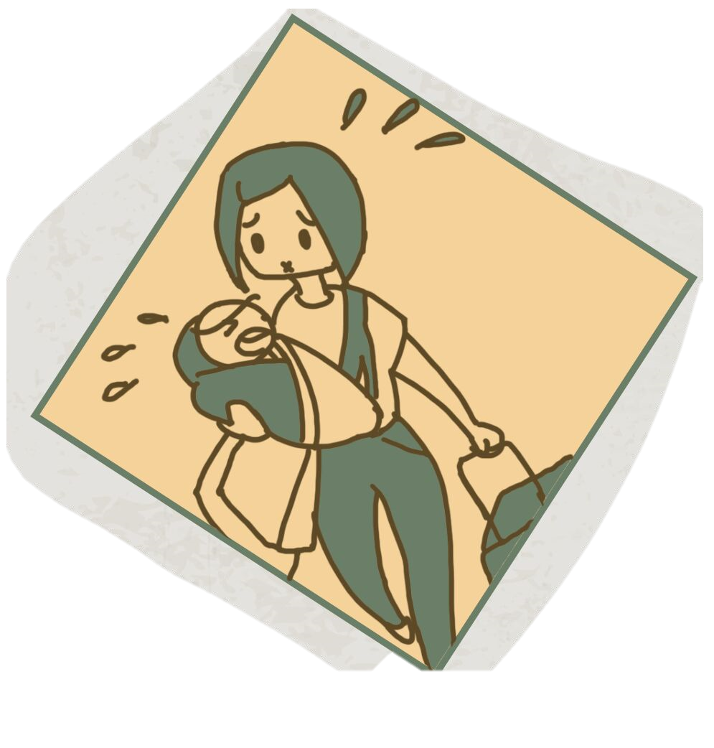

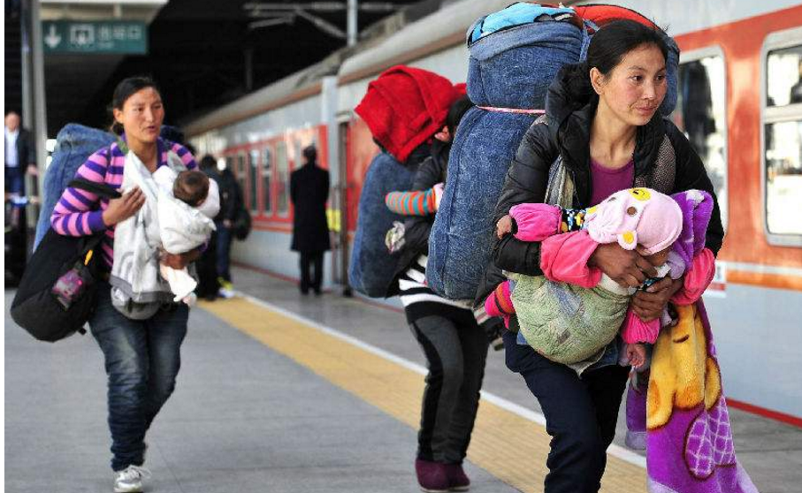
Problem

Slide 3
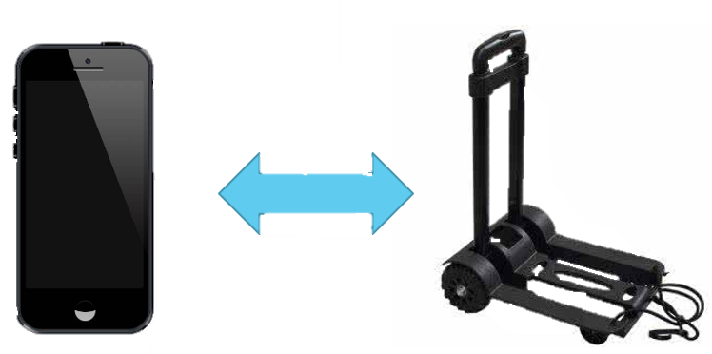
Solution
A base where you can put all your burdens and it’ll follow you if you pair it with your smartphone.

Slide 4
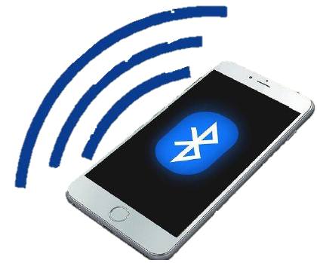
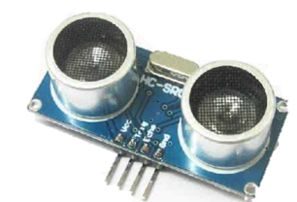
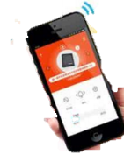
How to realize it?
Using Bluetooth to locate and follow the owner
Obstacle avoidance through sensors
Automatic alarm

Slide 5

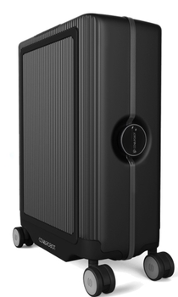
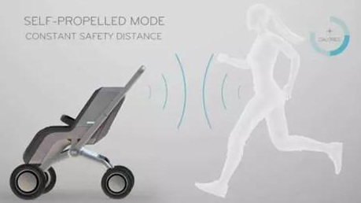
Trolley
The base and its technology can be applied to any products having wheels!
Suitcase
Baby Stroller
These manufacturers can be our partner and customers!

Slide 6
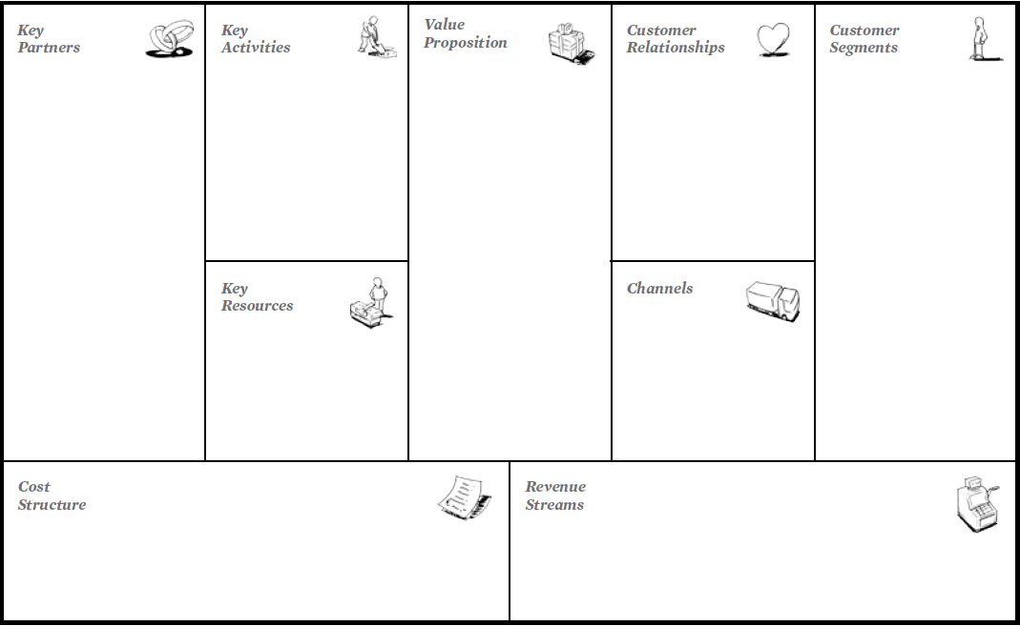
Manufactures
Department stores
Government
Production
Cooperate with other company and design specific version
Create new products improving the mobility of customers’ baggage
Self-service
Co-creation
Individual customers
Mall operators
Transportation junction operators
Luggage manufacturers
Technology
Human
Physical
Website
Own stores
Attach to other products
Variable costs
Asset sale
Lending
The Business Model Canvas

Slide 7
Let’s change the future!

