Slide 1

How to create a 5-minute Pitch
Guest Lecturer: Jerry Zhu
For VX420 – Business Basics for Entrepreneurship
June 13th 2017
© 2017 JERRY ZHU ALL RIGHTS RESERVED

Slide 2
The “8 second rule”
Most people decide within 8 seconds whether a speaker is worth listing to

Slide 3
What do 99% people say in their 8 seconds?
“It is a pleasure to be here today. I would like to talk about …”
What do you want to say in your 8 seconds?

Slide 4
Today: This workshop will help you create a 5-minute pitch that grab the attention of your audience, express your idea clearly and convince your audience;
Tonight – Tomorrow: Work with your group to conduct a pitch and practice tomorrow (14th June) and receive feedback;
Next Week: Individual assignment: your own 5-minute pitch (20th & 21st June)
After the 2-week Pitching Workshop: Use pitches in every important presentation for the rest of your life, and be successful!

Slide 5
The Framework
The “Hook”
The “8 Building Blocks”
The “One Sentence”
The “Call for Action”
15 sec
15 sec
4 min
30 sec

Slide 6
The “Hook”
The most important factor in any opening is to get the attention of your audience!
To make the audience excited about the solution and want to hear more!

Slide 7
Classical Opening “Hook”
Question: directed at the audience (actual or rhetorical)
Factoid: a striking statistic, little-known fact, or a quirky fact
Retrospective: a look into the past, define the past to reveal change
Prospective: project into the future
Anecdote: a short human interest story
Quotation: from a respected source (current better then historical)
Aphorism: a familiar saying
Analogy: a comparison between two seemingly unrelated things that helps illuminate a complex topic
The “Hook” should be directly relevant to your recommendations and interesting

Slide 8
More…
The Grabber: say or do something surprising or shocking
Curiosity Arousal: start with an unusual thought
The Problem: identify an important/interesting problem that needs a solution
“Hey Yeh”: Telling an audience something they hadn’t thought of before but recognize as truth once it is point out
The “Whoa” Intro: a surprising bit of info
The Room Reference: relate your topic to something directly relevant in the room
The Movie Preview: Promise them an insight later
The “Hook” should be directly relevant to your recommendations and interesting

Slide 9

Example
Early Childhood Education in the Slum

Slide 10
Example 1: Factoid type
Around the globe more than 100 million children under the age of 6 are living in the slums. They do not get quality early education. Which does not properly prepare them for primary school and does not allow them to be competitive in society.

Slide 11
Example 2: Question type
What is your first childhood memory? Mine is of my parents sitting me down at three years old at a piano for the first time. I started playing with it furiously and this passion is still with me today. For more than 100 million children each year, this memory is not possible. Children under 6 living in slums do not receive quality education and are not competitive later on in life. Government NGO’s and private sectors efforts are not enough to resolve this issue. Most parents and caregivers are unable to provide adequate early childhood education. We believe early education is a right and should be available for all children. Right in their own homes.

Slide 12
Example 3: The Problem Type
Imagine sitting in a year 1 classroom, 1/5 of your classmates have never sang a song in the lives. They are unable to count as high as you and they’ve never seen a story book. For 1/5 of children under 6 worldwide this is their reality. We are changing this today.

Slide 13
Example 4: The Grabber Type
Close your eyes. Now open them. You are now in Nairobi, Kenya in front of a baby care center. Take off your shoes, open the first door and go into the darkness. It is hot, and there a strong stench of urine. It is crowded, you can see 30 maybe even more babies on the floor and all you can hear is silence. This is early childhood education in the slums and for over 100 million children under 6 each year this is their reality. We are changing this today.

Slide 14
Exercise
Design your own “Hook”
(10 minutes)

Slide 15
The “One Sentence”
Tell me what you do in one sentence…
It should be your Value Proposition

Slide 16
Value Proposition
The unique value a business offers to its customers
A statement that helps convince customers that your product or service will add more value or better solve a problem than others

Slide 17
“One Sentence” – Value Positioning
Template
For ____________ (target customer)
who ____________ (statement of the need or opportunity)
Our (product/service name) is ____________ (product category)
that (statement of benefit) ____________.
Example
For non-technical marketers…
who struggle to find return on investment in social media expenditures…
our product is a web-based analytics software…
that helps them improve the management of their social media campaigns.

Slide 18
“One Sentence” – XYZ
Template
“We help X to do Y by doing Z”.
Example
We help non-technical marketers discover return on investment in social media by providing them with powerful yet simple analysis tools.

Slide 19
“One Sentence” – Elevator Ride
Template
Short, simple, memorable
3-5 keywords or phrases
KISS (no expert jargon)
Example
"Mint.com is the free, easy way to manage your money online."

Slide 20
Exercise
Design your own “One Sentence”
(10 minutes)

Slide 21
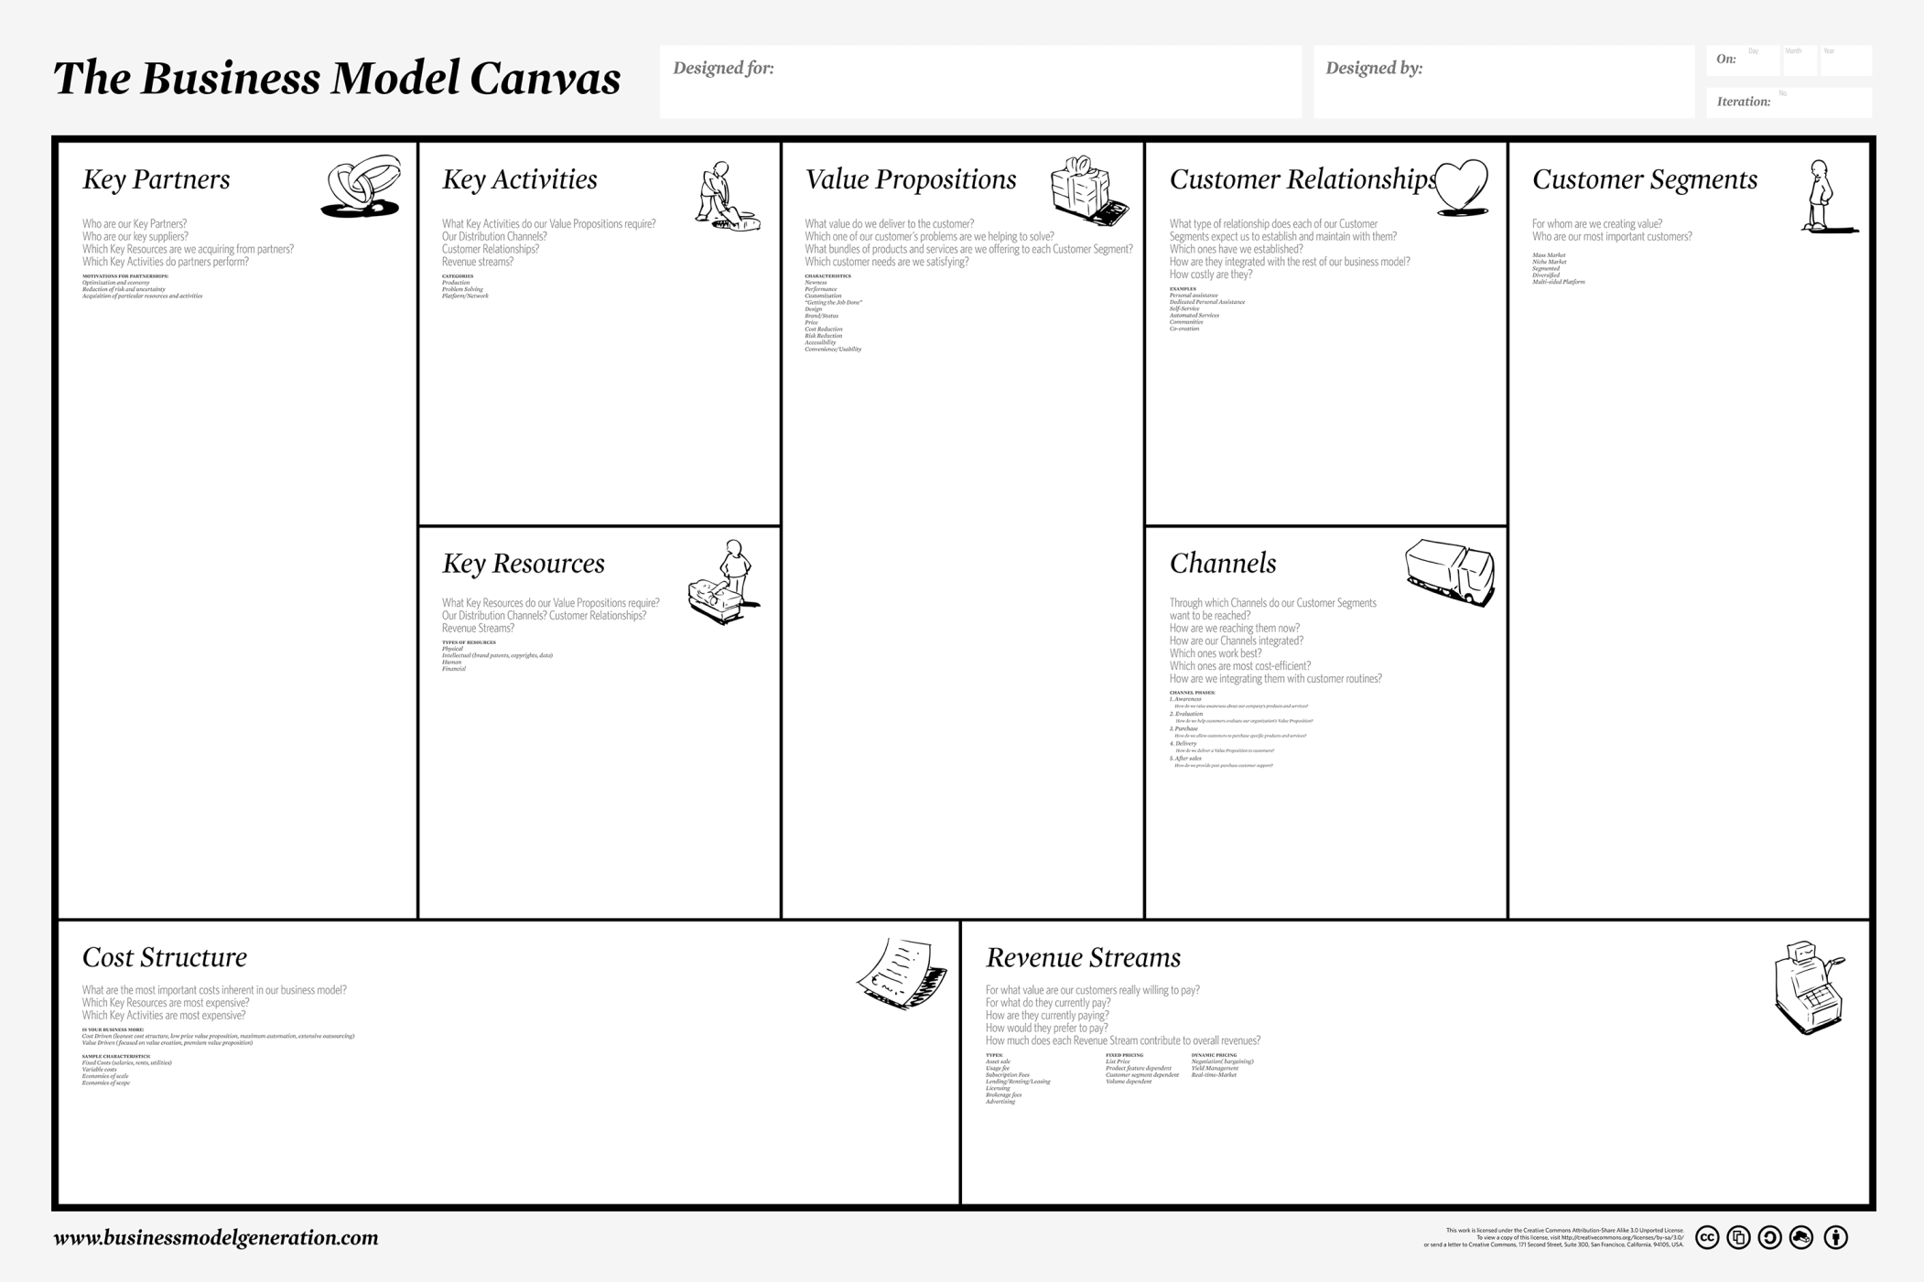
The “8 Building Blocks”

Slide 22
The “Call for Action”
Re-emphasize your Value Proposition, plus…
Highlights, plus…
Now or Never!

Slide 23
Workshop Recap
The “Hook”
The “8 Building Blocks”
The “One Sentence”
The “Call for Action”
15 sec
15 sec
4 min
30 sec

Slide 24
Next Steps
Tonight
Work with your group to conduct a pitch
Tomorrow
Continue working with your group to finalize your pitch
(First 20 minutes)
Present your pitch (practice exercise, will not be marked) and receive feedback from Professor Pradeep Ray and Jerry Zhu
Next Tue & Wed
Present your own pitch (individual assignment, will be marked)

Slide 25
Thanks!
Jerry Zhu | jerry.zyn@gmail.com

