Slide 1

Entrepreneurship Basics
VX 420: Lecture 8
Marketing Strategy

Slide 2
Real Need
Successful products and services are based on real customer needs.
A real need exists when customers have a problem that needs to be solved and no existing products or services can do this.

Slide 3

Determining Need
Look for a customer problem.
Define a true solution.
Evaluate economics.
Identify alternatives offered by competitors.

Slide 4
Overview of Marketing Basics
The Marketing Manager’s Role
  To clearly define, describe and forecast the needs of its customers by using data (Market Research),
  To determine how to select specific markets and satisfy customer needs through balancing products, services, and benefits (Marketing Mix), and
  To analyze its competitive advantages, plans, and actions (Marketing Strategy).

Slide 5
Market Research
Evaluate target market.
Determine the type of new product or service you’re developing.
Is your solution to customer needs already understood? Or is it a novel solution?

Slide 6
Market Research
A more formal information gathering or research process may include the following seven steps:
Defining the problem or opportunity
Assessing available information
Reviewing internal records and files; interviewing employees
Collecting outside data (primary research)
Organizing and interpreting data
Making a decision and taking action
Assessing the results of the action

Slide 7

For a Known Target
Market or Solution
Use traditional market research methods:
Surveys
Focus groups

Slide 8
For Novel Markets and Solutions
Talk with industry experts
Create future scenarios
Extrapolate trends to determine product and service features

Slide 9
For a New Market or Solution
When either the target market or solution is known, but the other is not, blend traditional market research with futurist approaches.
  Anthropological expeditions
  In-depth interviews with early adopters
  Partnerships with customers to develop products

Slide 10
The Market Determines Research Techniques
 | EXISTING MARKET | NEW MARKET
Philosophy of market research | Deductive data analysis | Intuition
Techniques for gathering customer information | Focus groups, surveys, mall studies | Industry experts, trend extrapolation, future scenarios

Slide 11
The Entrepreneur’s Disadvantage
When markets or new products are known, existing companies have the advantage with
An existing customer base
A large amount of information about customer preferences

Slide 12
The Entrepreneur’s Advantage
When the market or solution is novel, existing companies face three major disadvantages:
Core rigidities
Tyranny of the current market
User myopia

Slide 13

The Lesson
Entrepreneurs do better when they launch products based on novel solutions to customer needs in new markets.

Slide 14
The Marketing Mix
The 4Ps of Marketing
  Product
  Price
  Promotion
  Place, or distribution channel

Slide 15
Choosing Target Customers
Customers have a compelling reason to buy if the product or service
Improves their productivity
Reduces their costs
Gives them something they couldn’t have before

Slide 16

Dominant Design
All companies producing a product choose a common way of bringing together the different parts of a product or service.
New firms have an advantage in periods of radical breakthrough.

Slide 17
Timing the Market
Implications of the S-Curve:
Capital is required to sustain early product development
New product development is a function of effort, not time
Point of acceleration is critical for future planning

Slide 18
Setting the Technical Standard
Discount prices when product is introduced
Build relationships with producers of complementary products
Get to the market quickly

Slide 19

Personal Selling
Generate customer interest
Identify customer requirements
Overcome customer objections
Close the sale

Slide 20
Pricing New Products
Determine fixed and variable costs to set a price that generates a profit
Assess market conditions to ensure the price isn’t too high or low
Understand how customers trade off attributes and price
Factor in hidden costs or discounting

Slide 21
Market Dynamics
All markets are not equal. They vary in
Size
Rate of growth
Evolution (stage in life cycle)

Slide 22
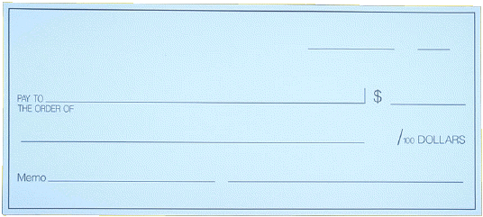
Market Size
The size of the market determines:
Ease of recouping start-up costs
Ability to go in “under the radar”

Slide 23
Market Growth
The rate of market growth determines:
Ease of capturing new customers
Potential volume of customers
Benefits of volume purchasing and scale economies

Slide 24
The S-Curve
Improvements
slow down
again
Improvements
come faster
Initially,
improvement
is slow

Slide 25
Adoption Patterns
Innovators
Early adopters
Early majority
Late majority
Laggards

Slide 26

Marketing Strategy
Build a complete customer solution to customer needs
Focus on a single niche
Communicate clearly to customers

Slide 27
Competitive Advantage
Precludes others from imitating the business idea perfectly
Allows the entrepreneur to capture the profits from exploiting the opportunity

Slide 28
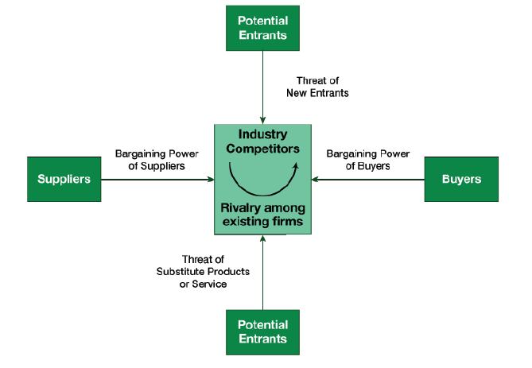
The driving forces of competition (Porter’s Model)

Slide 29
The driving forces of competition
1. Threat of new entrants to a market
2. Bargaining power of suppliers
3. Bargaining power of customers
4. Threat of substitute products
5. Degree of competitive rivalry

Slide 30
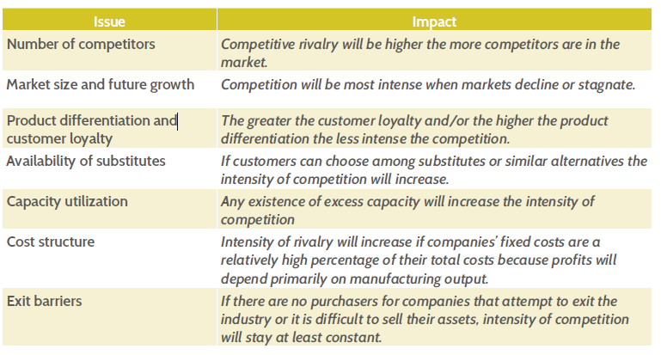
The driving forces of competition

Slide 31
Barriers to Competition
Maintain secrecy
Control resources
Establish legal barriers to imitation
Exploit the idea on a large scale
Establish a reputation
Innovate

Slide 32

It’s a Secret
Trade secret—piece of intellectual property
Causal ambiguity—knowing how to exploit the opportunity
Tacit knowledge—knowledge that isn’t codified

Slide 33

Legal Monopolies
Patents
Government permits

Slide 34
Opportunity Exploitation
Licensing—contract to use a business idea in return for a fee
Franchising—right to provide an existing firm’s product or service to end customers

Slide 35
Options for Exploitation
Market-based mode
  Best when different parts of the business are owned by different entities and connected by contractual relationships
Hierarchical mode
  Best when one party owns all parts of the operation

Slide 36
Factors in Selecting a
Market-Based Mechanism
Cost
Speed to market
Market-Based Mechanism
Capabilities
Information

Slide 37
Minimizing Cost
A market-based mode allows an entrepreneur to
Invest less capital in comparison to hierarchical modes
Tap franchisees as a source of capital
License ideas to finance development

Slide 38
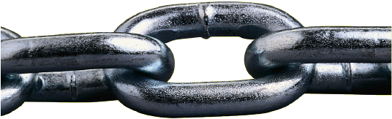
Getting to Market
A market-based mode allows an entrepreneur to
Assemble the entire value chain in time to exploit it
Be the first mover
Leverage network externalities

Slide 39
Managing Information
A market-based mode allows an entrepreneur to
Use patents to mitigate the disclosure problem
Codify a business idea in a contract

Slide 40

Managing Uncertainty and Information Asymmetry
Growth from small scale
Forming alliances and partnerships with established firms
Creating legitimacy for the opportunity and the new venture

Slide 41
Finding Allies
Alliances and partnerships can provide:
The assets needed to pursue short-lived opportunities
The capital required to purchase needed resources
A brand name to give the business idea value

Slide 42
It’s Legit
Entrepreneurs demonstrate the legitimacy of their ideas by
Showing conformity to existing rules and norms
Imitating the routines and procedures of existing firms
Engaging in collective actions
Obtaining certification

