Slide 1
GROUP 10 HOUSEHOLD HEALTHCARE ROBOTS
VE496
JIANG Nanjia
PAN Chongdan
QIU Tianyu
WANG Zibo

Slide 2
CONTENTS
Introduction ---------------------------------------------- JIANG Nanjia
Existing Examples ----------------------------------- PAN Chongdan
Social Influences ------------------------------------------ QIU Tianyu
Conclusion ------------------------------------------------- WANG Zibo
Sources

Slide 3
Introduction
/01
JIANG Nanjia

Slide 4
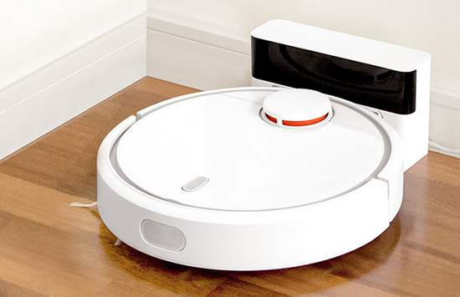


Robots in Life

Slide 5


New Technologies
Autonomous Service
Remote Information Exchange

Slide 6
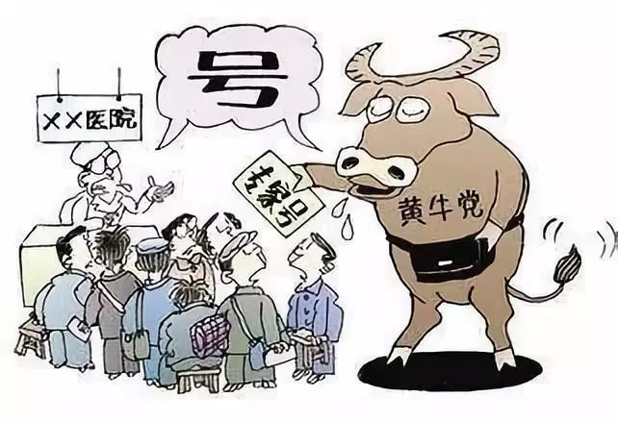
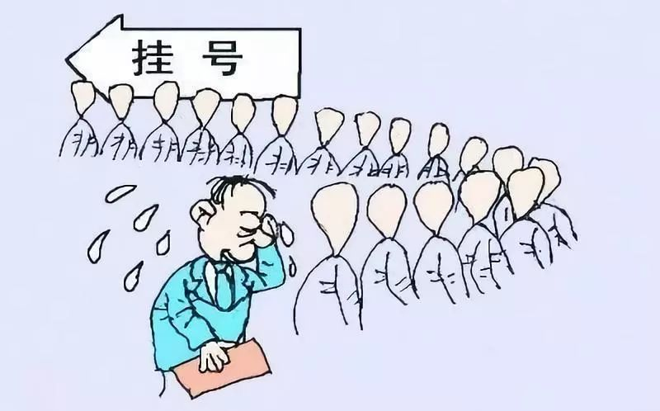
Pain Points

Slide 7
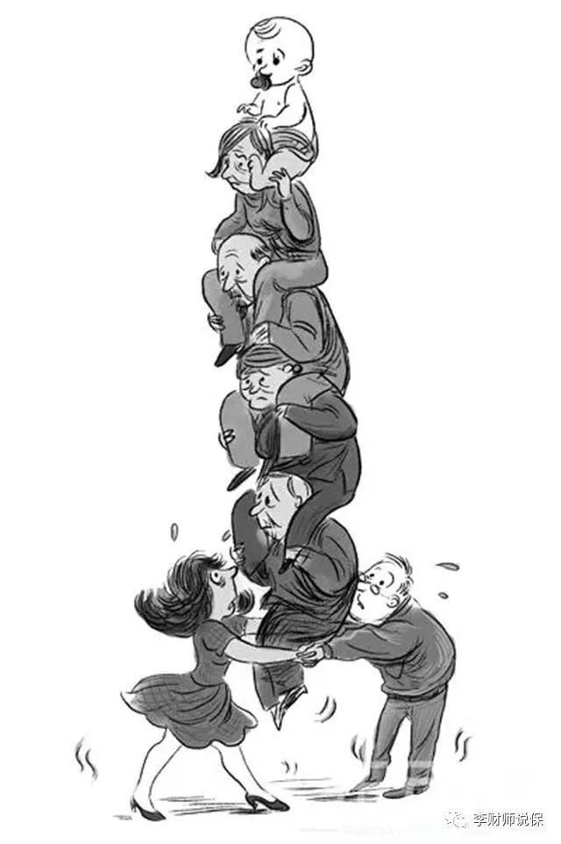
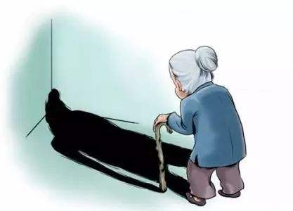
Pain Points

Slide 8
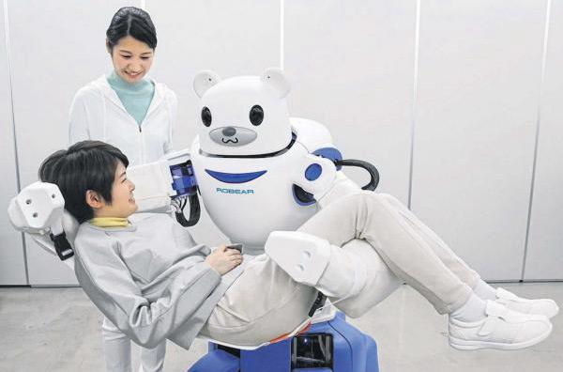
New Solutions
Household Healthcare Robots

Slide 9
Existing Examples
/02
PAN Chongdan

Slide 10
Healthcare Robot variety

Slide 11
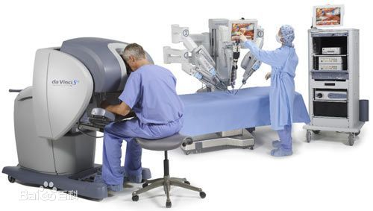
Surgical Robot
Da Vinci
The most advanced medical robot in the world
Solved more than 500 million of operations

Slide 12
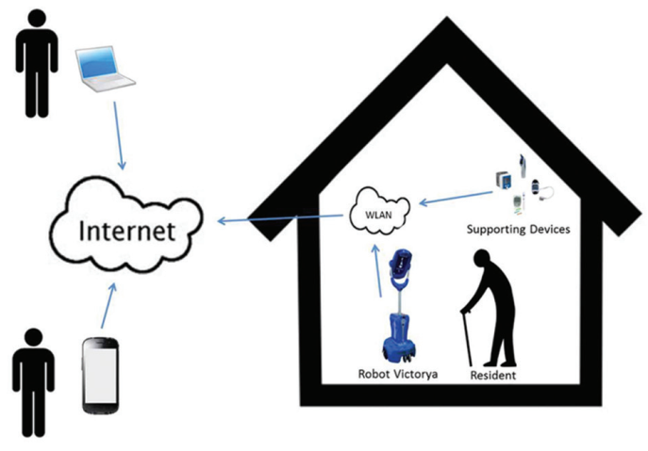
Remote Control Telepresence Robot
Giraffe
A bridge between caregivers and receivers

Slide 13
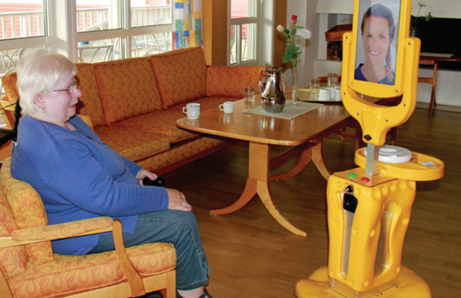
Remote Control Telepresence Robot
Giraffe
A bridge between caregivers and receivers

Slide 14
Future of Healthcare Robots

Slide 15
Social Influences
/03
QIU Tianyu

Slide 16
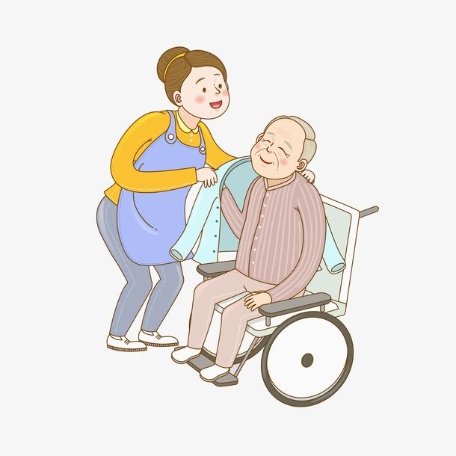
For Family Members of Patients
No need to stay accompany
No expense for hiring caregivers

Slide 17
For Patients
Loneliness?
Happiness!
Notes:
In-time video contact with family members/doctors
Reduction of the sense of loneliness

Slide 18

For Medical Practitioners
Efficiency
Timeliness

Slide 19

For Medical Practitioners
Unemployment

Slide 20
Conclusion
/04
WANG Zibo

Slide 21
Thriving Industry
Healthcare Robot
Transportation
Remote Control
Surgical
Mental Rehabilitation

Slide 22

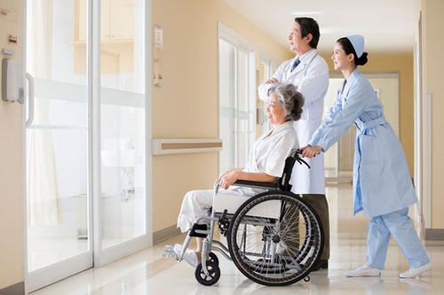
Engineering and Society
Need
Technological

Slide 23
Engineering and Society
Response
Social
Positive and Negative

Slide 24
Sources
https://www.cn-healthcare.com/article/20190927/content-524152.html
https://www.sciencedirect.com/science/article/abs/pii/0921889089900493
https://baike.baidu.com/item/%E5%8C%BB%E7%94%A8%E6%9C%BA%E5%99%A8%E4%BA%BA/3321806?fr=aladdin
Donald Kerr, J Artur Serrano, Pradeep Ray, “The role of a disruptive digital technology for home‑based healthcare of the elderly: Telepresence robot", Digital Medicine, Year 2018, Volume 4, Issue 4 [p. 173-179]

Slide 25
Thanks Group10
VE496
JIANG Nanjia, PAN Chongdan,
QIU Tianyu, WANG Zibo

