Slide 1

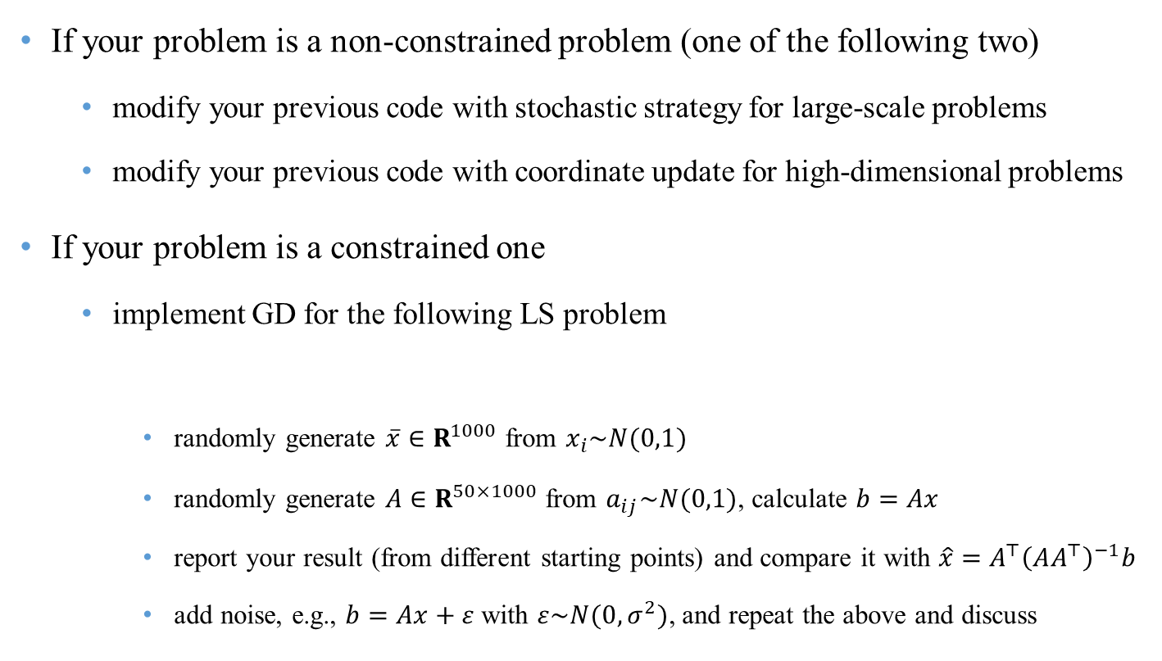
Home Work
If your problem is a non-constrained problem (one of the following two)
modify your previous code with stochastic strategy for large-scale problems
modify your previous code with coordinate update for high-dimensional problems
If your problem is a constrained one
implement GD for the following LS problem
randomly generate $\overline{x}∈R^{1000}$ from $x_{i}\sim N(0,1)$
randomly generate $A∈R^{50×1000}$ from $a_{ij}\sim N(0,1)$, calculate $b=Ax$
report your result (from different starting points) and compare it with $\hat{x}=A^{⊤}{\left(AA^{⊤}\right)}^{−1}b$
add noise, e.g., $b=Ax+ε$ with $ε\sim N(0,σ^{2})$, and repeat the above and discuss
$$\min_{x}{ \left\|Ax−b\right\|}$$

