Slide 1
THE THREE QUANTUM NUMBERS
The principal quantum number, “n”, describes the energy level on which the orbital resides. The values of “n” are integers≥ 1.
The angular momentum number, “l”.
The magnetic quantum number, “m_{l}”.

Slide 2
Principal Quantum Number (n)
The principal quantum number, n, describes the energy level on which the orbital resides. Orbital with the same value of n form a shell.
Different orbital types within a shell are subshells (i.e. s, p, d, f are subshells, each containing orbitals. s has 1 orbital, p has 3 orbitals, d has 5 orbitals, and f has 7 orbitals. Each orbital can hold no more that two opposite spinning electrons).
The values of n are integers ≥ 1.
n is like a shell number where electrons orbit the nucleus (n=1 K-shell, n=2 L-shell, n=3 M-shell, n=4 L-shell etc.) in a position which describes electrons in terms of probabilities to likely to be confined within its orbital.

Slide 3
It is not the same as Bohr orbit model that visualizes the electron moving in a physical orbit, like a planet around the sun.
The quantum mechanical model does not refer to orbits because the motion of electron in an atom cannot be precisely determined (Heisenberg uncertainty principle that shows exact motion and position cannot be found precisely at the same moment, one disturbs the other).
Bohr model introduced single “n” quantum number that describes the orbit, while quantum mechanical model uses three quantum numbers:
n = Principal quantum number
l = Angular Momentum Number
m_{l} = Magnetic Quantum Number

Slide 4
Angular Momentum Quantum Number (l = n - 1)
This quantum number (l) defines the shape of the orbital (each orbital can hold two electrons, spin up & down).
Allowed values of (l ) are integers ranging from 0 to n − 1.
We use letter designations to communicate the different values of (l ) and, therefore, the shapes and types of orbitals.

Slide 5
Angular Momentum Quantum Number (l)
Value of l | 0 | 1 | 2 | 3
Type of orbital | s | p | d | f

Slide 6
Magnetic Quantum Number (m_{l})
The magnetic quantum number describes the three-dimensional orientation of the orbital.
Allowed values of m_{l} are integers ranging from −l to l:
−l ≤ m_{l} ≤ l
Therefore, on any given energy level, there can be up to 1 s orbital, 3 p orbitals, 5 d orbitals, 7 f orbitals, and so forth (note then that the number of orbitals is equal n²).

Slide 7
SUMMARY OF THE THREE QUANTUM NUMBERS
number of orbitals is equal n²
K-Shell (One s-orbital): n=1, for “s” l=0, m_{l} = 0
L-Shell (4 orbitals: One s-orbital, three p-orbitals):
n=2, for “s” l=0 & for “p” l=1, so l=0,1 & m_{l} for “s”= 0, m_{l} for “p” = -1, 0, +1
M-Shell (9 orbitals: one s-orbital, three p-orbitals, five d-orbitals): n=3, for “s” l=0 & for “p” l=1, for “d” l=2, so l=0,1, 2 & m_{l} for “s”= 0, m_{l} for “p” = -1, 0, +1 & for “d” m_{l} = -2,-1,0,1,2
N-Shell (16 orbitals: one s-orbital, three p-orbitals, five d-orbitals, seven f-orbitals ): n=4, for “s” l=0 & for “p” l=1, for “d” l=2, for “f” l=3, so l=0,1, 2, 3 & m_{l} for “s”= 0, m_{l} for “p” = -1, 0, +1 & for “d” ml = -2,-1,0,1,2 & for “f” m_{l} = -3,-2,-1,0,1,2,3
Each shell has n² orbitals
BEST EXAMPLE TO STUDY THE NEXT TABLE

Slide 8
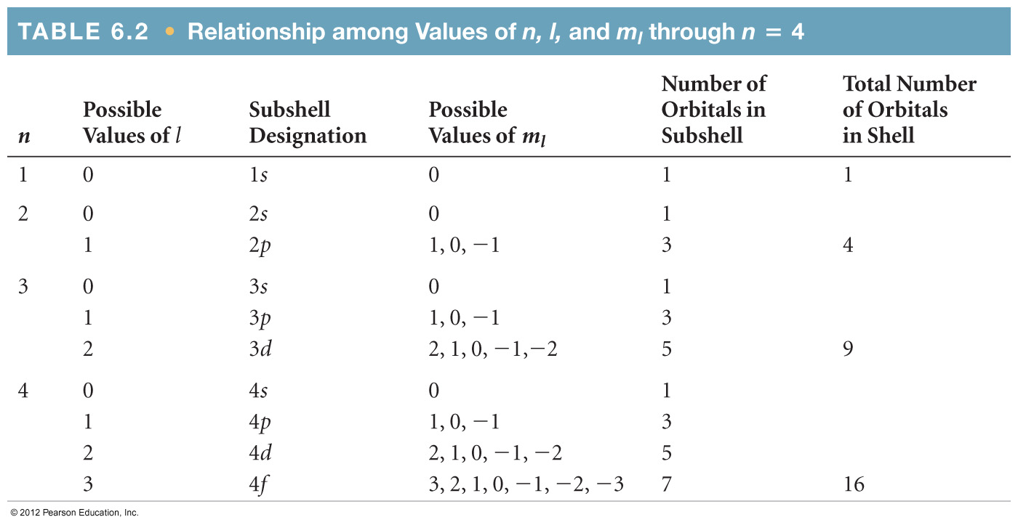
THREE QUANTUM NUMBERS DESCRIBING ELECTRON ORBITAL (e- CLOUD) SHAPE: n, l, m_{l}
Orbitals with the same value of n form a shell: K, L, M, …
Different orbital types within a shell are subshells.
SUBSHELL: (s,p,d,f) & ORBITALS in SHELL
Shell
No.e-
K
L
M
N
2
8
18
32

Slide 9
Summary: n, l, m_{l}
The principal quantum number, “n”, describes the energy level on which the orbital resides. The values of “n” are integers≥ 1.
n is like a shell number where electrons most likely to orbit the nucleus (n=1 K-shell, n=2 L-shell, n=3 M-shell, n=4 L-shell etc.)
The shell with Principal Quantum Number “n” has exactly “n” subshells of designated orbitals s, p, d, f. [K-shell has 1-subshell 1s (1-orbital)], [L-shell has 2subshells 2s,2p (4-orbitals)], [M-shell has 3subshells 3s,3p,3d (9-orbitals)], [N-shell has 4-subshells 4s,4p,4d,4f (16-orbitals)]. Each shell has n² orbitals. Subshells are set of orbitals that have same“n” & “l” values (ie n = 1 has one “s” orbital, n=3 has 9 orbitals of one “s” three “p” & 5 “d” orbitals).

Slide 10
Each subshell has at least 1 orbital in order of 2l+1 where “l” varies between 0 & n-1. Then the number of orbitals for each type of: “s” 1-orbital or l=0, “p” 3-orbitals or l=1, “d” 5-orbitals or l=2, “f” 7-orbitals or l=3.
*Each “l” defines the shape of the s,p,d,f as shown next few slides
m_{l} defines the orientation of the subshell [ i.e. “p” subshell has 3 orbitals (p_{x}, p_{y}, p_{z}) in cartesian coordinates] (see next few slides). [s: l=0, m_{l}=0 or 1orbital)], [p: l=1, m_{l}=-1,0,1 3orbitals(p_{x}, p_{y}, p_{z})], [d: l=2, m_{l}=-2,-1,0,1,2 5-orbitals(d_{xy}, d_{xz}, d_{yz},dx²-y² , dz²)], [f: l=3, m_{l}=-3,-2,-1,0,1,2,3 7-orbitals (see book)]
Spin magnetic quantum number m_{s} (4th quantum number). Each orbital can be occupied by 1 or 2 electrons (spin up or spin down).
Pauli Exclusion Principle: No 2 electrons in same atom can have the same set of 4 quantum numbers

Slide 11
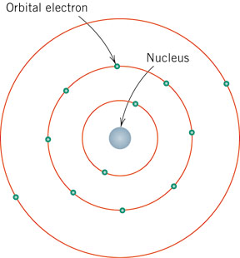
● Principal Quantum No.:
n = 1, 2, 3, etc.
●Angular Momentum
No.:
l = n-1
For s: l = 0
For p: l = 1
For d: l = 2
For f: l = 3
●Magnetic Quantum
No.: −l ≤ m_{l} ≤ l
● Each shell has n²
orbitals
● Each subshell has
at least 1 orbital in
order of 2l+1
L-Shell
n=2
n=1
M-Shell
1s²
K-Shell
2s²3p⁶
n=3
3s²
Mg: Magnesium Atomic Structure
Notes:
f01_02_pg18.jpg

