Slide 1
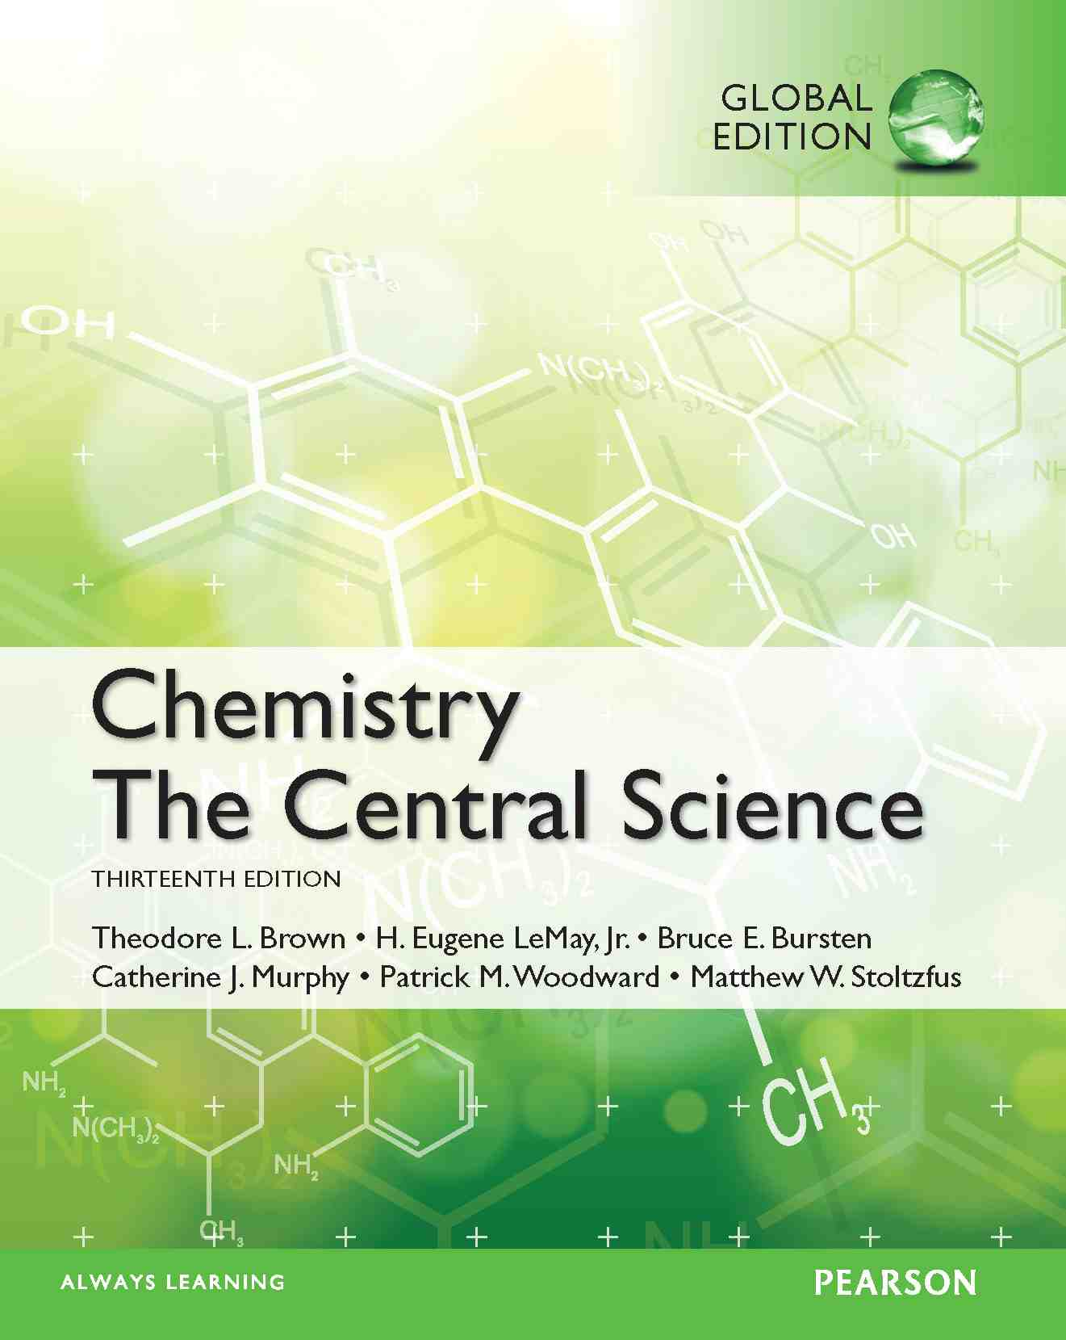
Lecture Presentation
Chapter 15 Chemical Equilibrium
James F. Kirby
Quinnipiac University
Hamden, CT

Slide 2
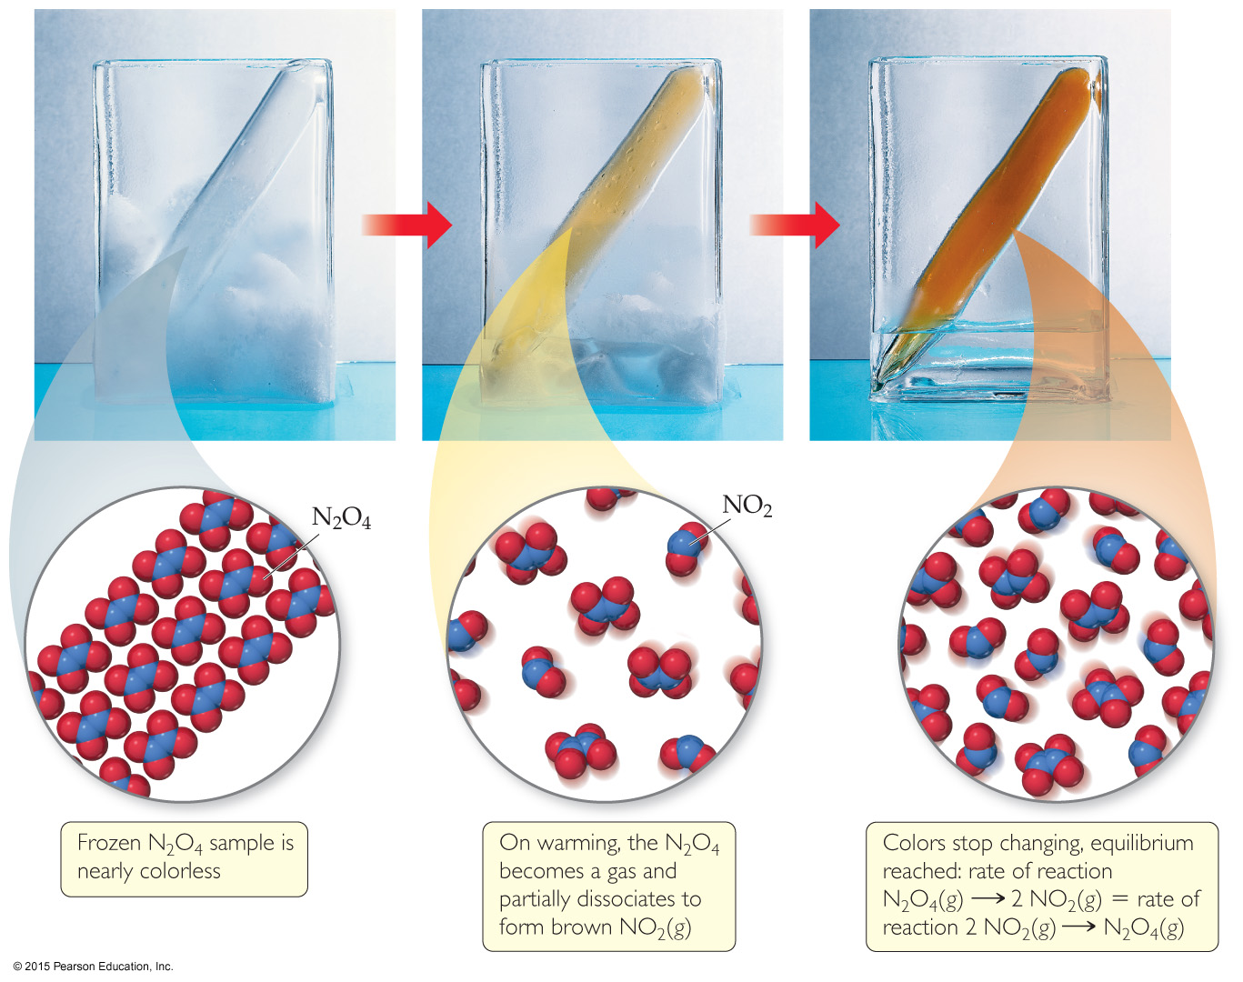
The Concept of Equilibrium
Chemical equilibrium occurs when a reaction and its reverse reaction proceed at the same rate. In the figure above, equilibrium is finally reached in the third picture.

Slide 3
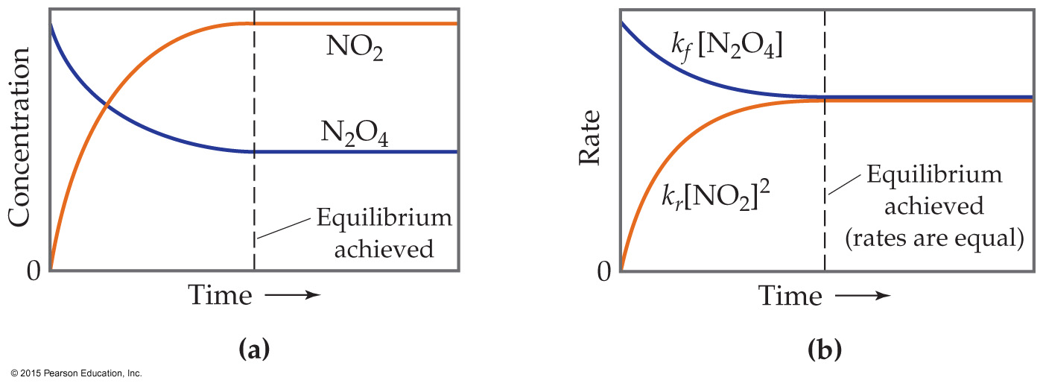
The Concept of Equilibrium
As a system approaches equilibrium, both the forward and reverse reactions are occurring.
At equilibrium, the forward and reverse reactions are proceeding at the same rate.
Once equilibrium is achieved, the amount of each reactant and product remains constant.

Slide 4
Writing the Equation for an Equilibrium Reaction
Since, in a system at equilibrium, both the forward and reverse reactions are being carried out, we write its equation with a double arrow:
N₂O₄(g) ⇌ 2 NO₂(g)

Slide 5
Comparing Rates
For the forward reaction N₂O₄(g) → 2 NO₂(g)
The rate law is Rate = k_{f} [N₂O₄]
For the reverse reaction 2 NO₂(g) → N₂O₄(g)
The rate law is Rate = k_{r} [NO₂]²

Slide 6
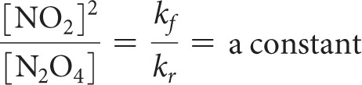
The Meaning of Equilibrium
Therefore, at equilibrium
Rate_{f} = Rate_{r}
k_{f}[N₂O₄] = k_{r}[NO₂]²
Rewriting this, it becomes the expression for the equilibrium constant, K_{eq}.

Slide 7
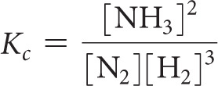
Another Equilibrium— The Haber Process
Consider the Haber Process, which is the industrial preparation of ammonia:
N₂(g) + 3 H₂(g) ⇌ 2 NH₃(g)
The equilibrium constant depends on stoichiometry:

Slide 8
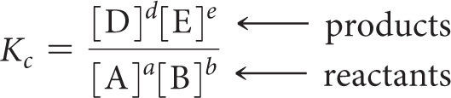
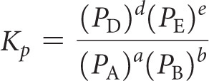
The Equilibrium Constant
Consider the generalized reaction
a A + b B ⇌ d D + e E
The equilibrium expression for this reaction would be
Also, since pressure is proportional to concentration for gases in a closed system, the equilibrium expression can also be written

Slide 9

More with Gases and Equilibrium
We can compare the equilibrium constant based on concentration to the one based on pressure.
For gases, PV = nRT (the Ideal Gas Law).
Rearranging, P = (n/V)RT; (n/V) is [ ].
The result is
where

Slide 10
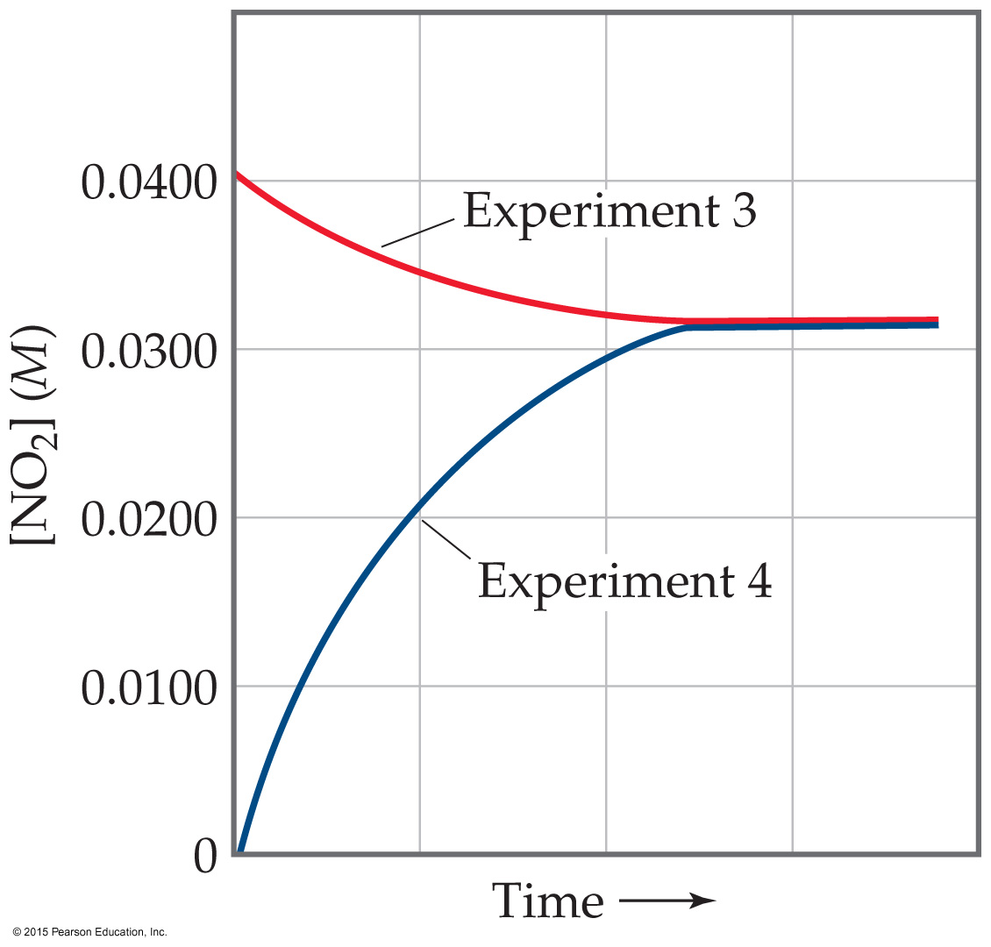
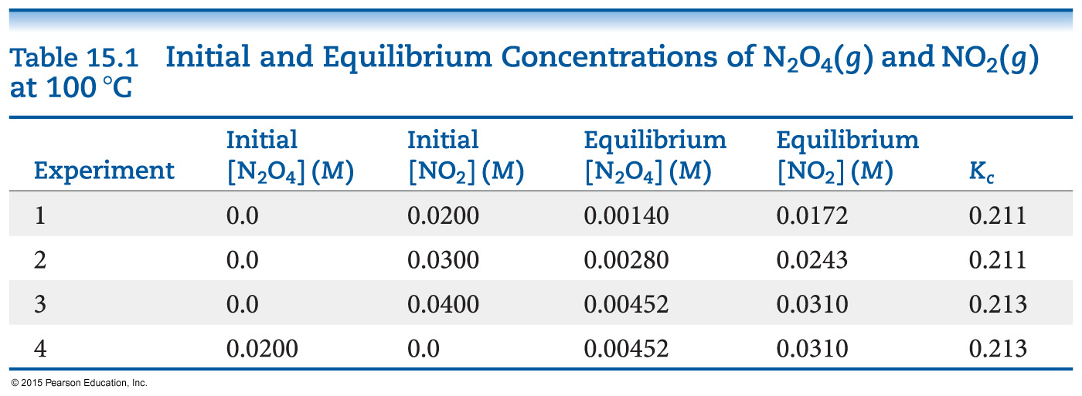
Equilibrium Can Be Reached from Either Direction
As you can see, the ratio of [NO₂]² to [N₂O₄] remains constant at this temperature no matter what the initial concentrations of NO₂ and N₂O₄ are.

Slide 11
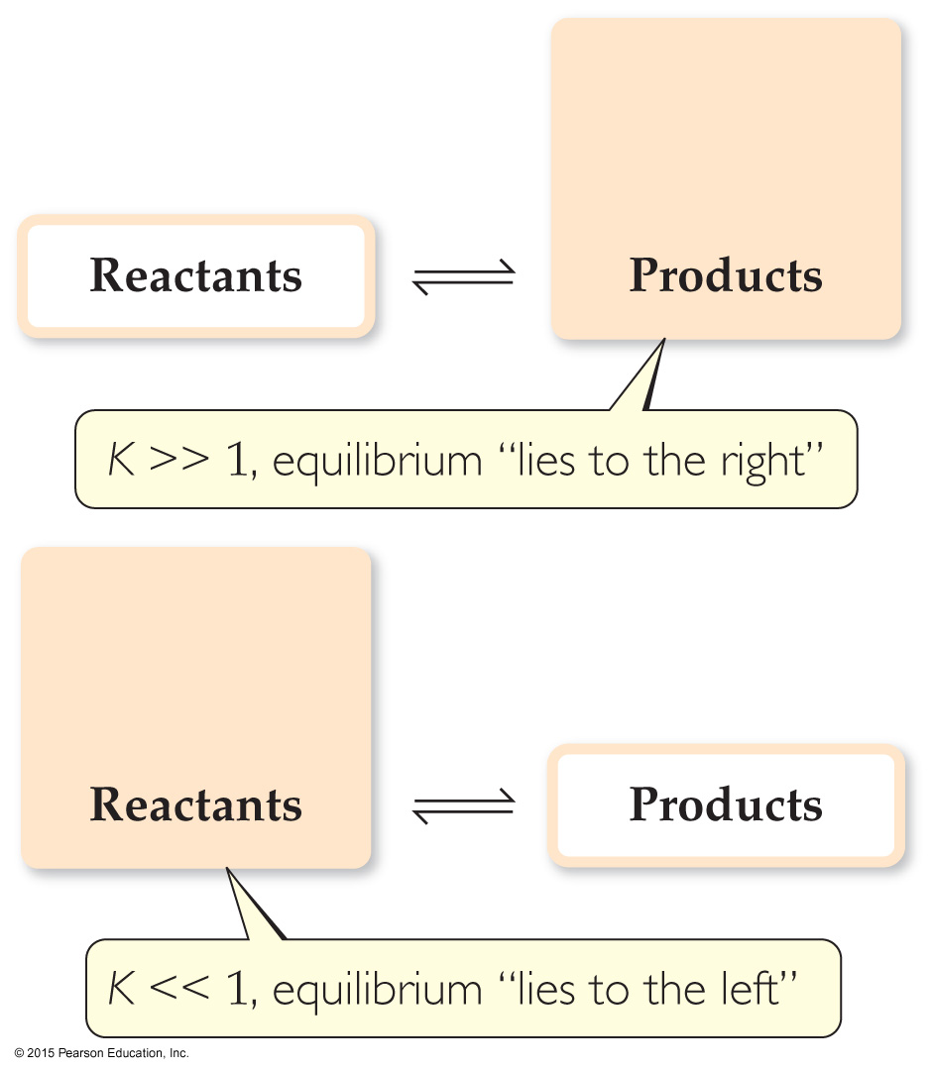
Magnitude of K
If K>>1, the reaction favors products; products predominate at equilibrium.
If K<<1, the reaction favors reactants; reactants predominate at equilibrium.

Slide 12
The Direction of the Chemical Equation and K
The equilibrium constant of a reaction in the reverse reaction is the reciprocal of the equilibrium constant of the forward reaction:
[NO₂]²
[N₂O₄]
N₂O₄(g)
2 NO₂(g)
K_{c} = = 0.212 at 100 °C
⇌
2 NO₂(g)
⇌
N₂O₄(g)
[N₂O₄]
[NO₂]²
K_{c} = = 4.72 at 100 °C

Slide 13
Stoichiometry and Equilibrium Constants
To find the new equilibrium constant of a reaction when the equation has been multiplied by a number, simply raise the original equilibrium constant to that power. Here, the stoichiometry is doubled; the constant is the squared!
[NO₂]²
[N₂O₄]
N₂O₄(g)
⇌
2 NO₂(g)
K_{c} = = 0.212 at 100 °C
[NO₂]⁴
[N₂O₄]²
2 N₂O₄(g)
⇌
4 NO₂(g)
K_{c} = = (0.212)² at 100 °C

Slide 14
Consecutive Equilibria
When two consecutive equilibria occur, the equations can be added to give a single equilibrium.
The equilibrium constant of the new reaction is the product of the two constants:
K₃ = K₁ × K₂
Example
2 NOBr ⇌ 2 NO + Br₂ K₁ = 0.014
Br₂ + Cl₂ ⇌ 2 BrCl K₂ = 7.2
2 NOBr + Cl₂ ⇌ 2 NO + 2 BrCl
K₃ = K₁ × K₂ = 0.014 × 7.2 = 0.10

Slide 15
Homogeneous vs. Heterogeneous
Homogeneous equilibria occur when all reactants and products are in the same phase.
Heterogeneous equilibria occur when something in the equilibrium is in a different phase.
The value used for the concentration of a pure substance is always 1.

Slide 16
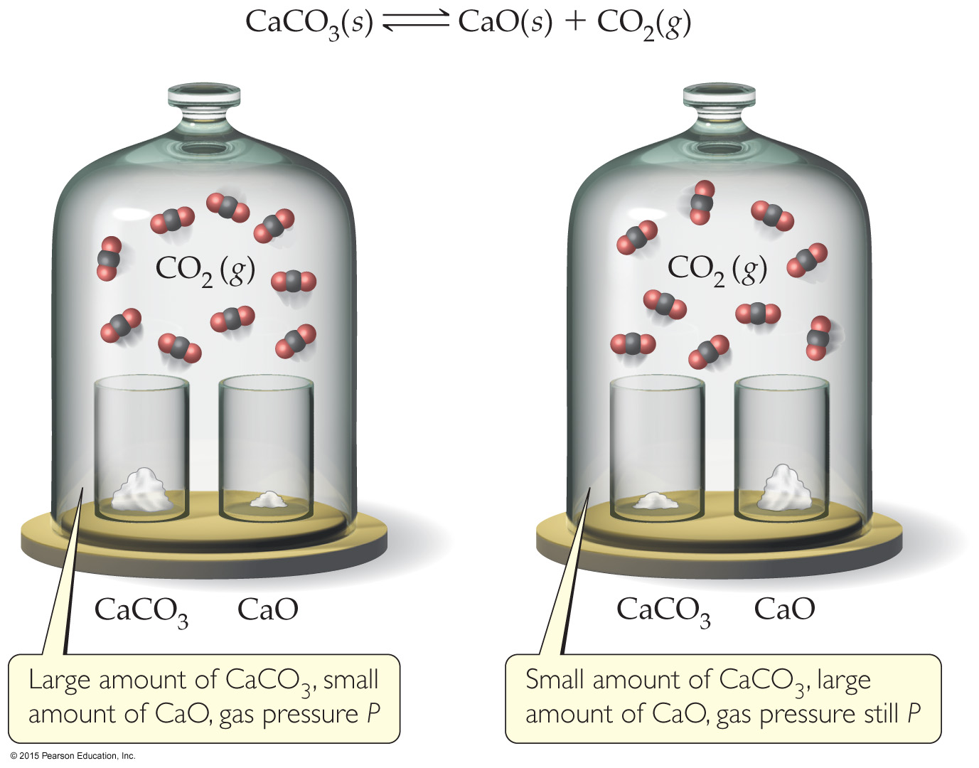
The Decomposition of CaCO₃— A Heterogeneous Equilibrium
The equation for the reaction is
CaCO₃(s) ⇌ CaO(s) + CO₂(g)
This results in
K_{c} = [CO₂]
and
K_{p} = P_{CO2}

Slide 17
Deducing Equilibrium Concentrations
Tabulate all known initial and equilibrium concentrations.
For anything for which initial and equilibrium concentrations are known, calculate the change.
Use the balanced equation to find change for all other reactants and products.
Use initial concentrations and changes to find equilibrium concentration of all species.
Calculate the equilibrium constant using the equilibrium concentrations.

Slide 18
An Example
A closed system initially containing 1.000 × 10^{–3} M H₂ and 2.000×10^{–3} M I₂ at 448 °C is allowed to reach equilibrium. Analysis of the equilibrium mixture shows that the concentration of HI is 1.87 × 10^{–3} M. Calculate K_{c} at 448 °C for the reaction taking place, which is
H₂(g) + I₂(g) ⇌ 2 HI(g)

Slide 19
What Do We Know?
 | [H₂], M | [I₂], M | [HI], M
Initially | 1.000 × 10^{–3} | 2.000 × 10^{–3} | 0
Change
At equilibrium |  |  | 1.87 × 10^{–3}

Slide 20
[HI] Increases by 1.87 × 10⁻³ M
 | [H₂], M | [I₂], M | [HI], M
Initially | 1.000 × 10^{–3} | 2.000 × 10^{–3} | 0
Change |  |  | +1.87 × 10⁻³
At equilibrium |  |  | 1.87 × 10^{–3}

Slide 21
Stoichiometry tells us [H₂] and [I₂] decrease by half as much.
 | [H₂], M | [I₂], M | [HI], M
Initially | 1.000 × 10^{–3} | 2.000 × 10^{–3} | 0
Change | −9.35 × 10⁻⁴ | −9.35 × 10⁻⁴ | +1.87 × 10^{–3}
At equilibrium |  |  | 1.87 × 10^{–3}

Slide 22
We can now calculate the equilibrium concentrations of all three compounds.
 | [H₂], M | [I₂], M | [HI], M
Initially | 1.000 × 10^{–3} | 2.000 × 10^{–3} | 0
Change | –9.35 × 10^{–4} | –9.35 × 10^{–4} | +1.87 × 10^{–3}
At equilibrium | 6.5 × 10⁻⁵ | 1.065 × 10⁻³ | 1.87 × 10^{–3}

Slide 23
And, therefore, the equilibrium constant…
[HI]²
[H₂] [I₂]
K_{c} =
(1.87 × 10^{–3})²
(6.5 × 10^{–5})(1.065 × 10^{–3})
=
= 51

Slide 24
Is a Mixture in Equilibrium? Which Way Does the Reaction Go?
To answer these questions, we calculate the reaction quotient, Q.
Q looks like the equilibrium constant, K, but the values used to calculate it are the current conditions, not necessarily those for equilibrium.
To calculate Q, one substitutes the initial concentrations of reactants and products into the equilibrium expression.

Slide 25
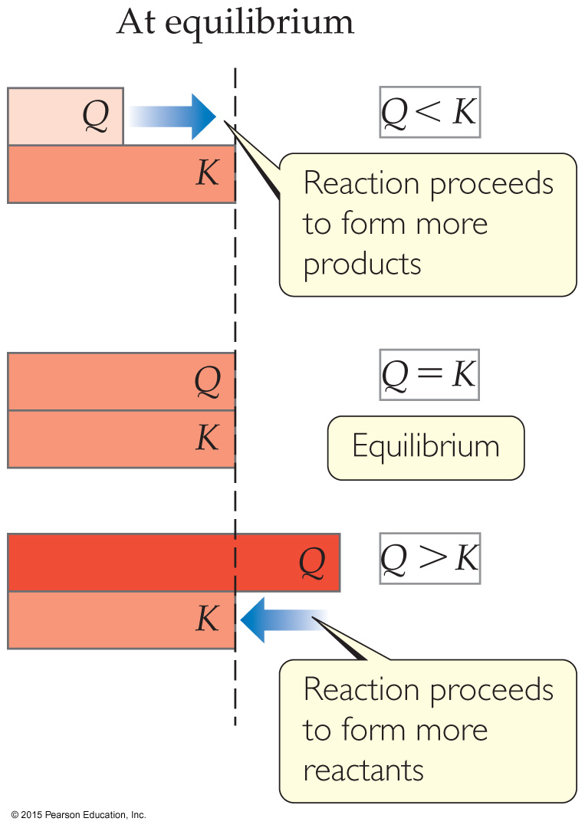
Comparing Q and K
Nature wants Q = K.
If Q < K, nature will make the reaction proceed to products.
If Q = K, the reaction is in equilibrium.
If Q > K, nature will make the reaction proceed to reactants.

Slide 26
Calculating Equilibrium Concentrations
If you know the equilibrium constant, you can find equilibrium concentrations from initial concentrations and changes (based on stoichiometry).
You will set up a table similar to the ones used to find the equilibrium concentration, but the “change in concentration” row will simple be a factor of “x” based on the stoichiometry.

Slide 27
An Example
A 1.000 L flask is filled with 1.000 mol of H₂(g) and 2.000 mol of I₂(g) at 448 °C. Given a K_{c} of 50.5 at 448 °C, what are the equilibrium concentrations of H₂, I₂, and HI?
H₂(g) + I₂(g) ⇌ 2 HI(g)
initial concentration (M) | 1.000 | 2.000 | 0
change in concentration (M) | –x | –x | +2x
equilibrium concentration (M) | 1.000 – x | 2.000 – x | 2x

Slide 28

Example (continued)
Set up the equilibrium constant expression, filling in equilibrium concentrations from the table.
Solving for x is done using the quadratic formula, resulting in x = 2.323 or 0.935.

Slide 29
Example (completed)
Since x must be subtracted from 1.000 M, 2.323 makes no physical sense. (It results in a negative concentration!) The value must be 0.935.
So
[H₂]_{eq} = 1.000 – 0.935 = 0.065 M
[I₂]_{eq} = 2.000 – 0.935 = 1.065 M
[HI]_{eq} = 2(0.935) = 1.87 M

Slide 30
LeChâtelier’s Principle
“If a system at equilibrium is disturbed by a change in temperature, pressure, or the concentration of one of the components, the system will shift its equilibrium position so as to counteract the effect of the disturbance.”

Slide 31
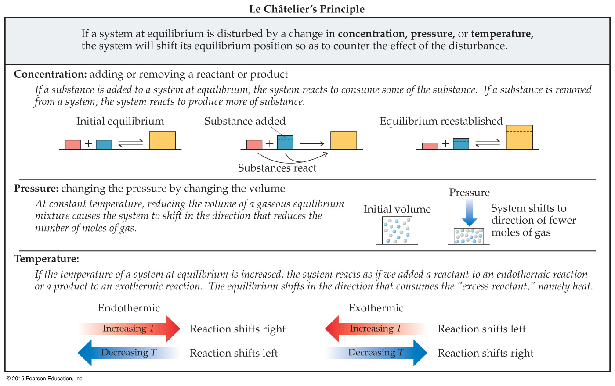
How Conditions Change Equilibrium
We will use LeChâtelier’s Principle qualitatively to predict shifts in equilibrium based on changes in conditions.

Slide 32
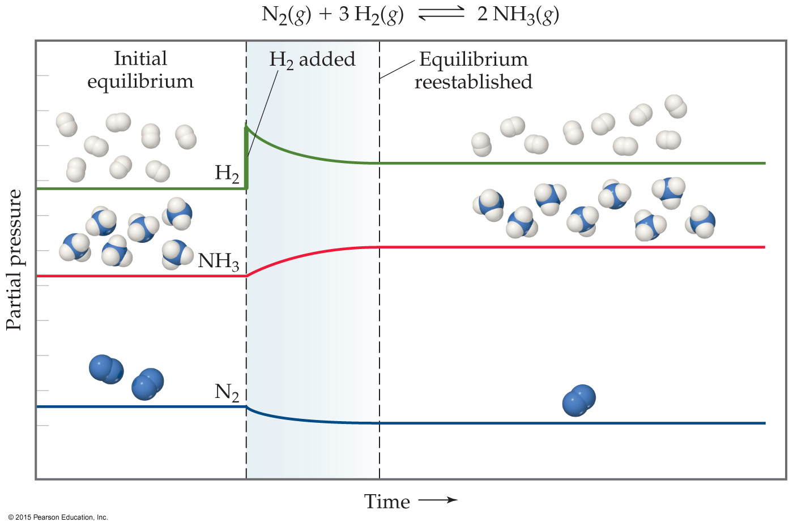
Change in Reactant or Product Concentration
If the system is in equilibrium
adding a reaction component will result in some of it being used up.
removing a reaction component will result in some if it being produced.

Slide 33
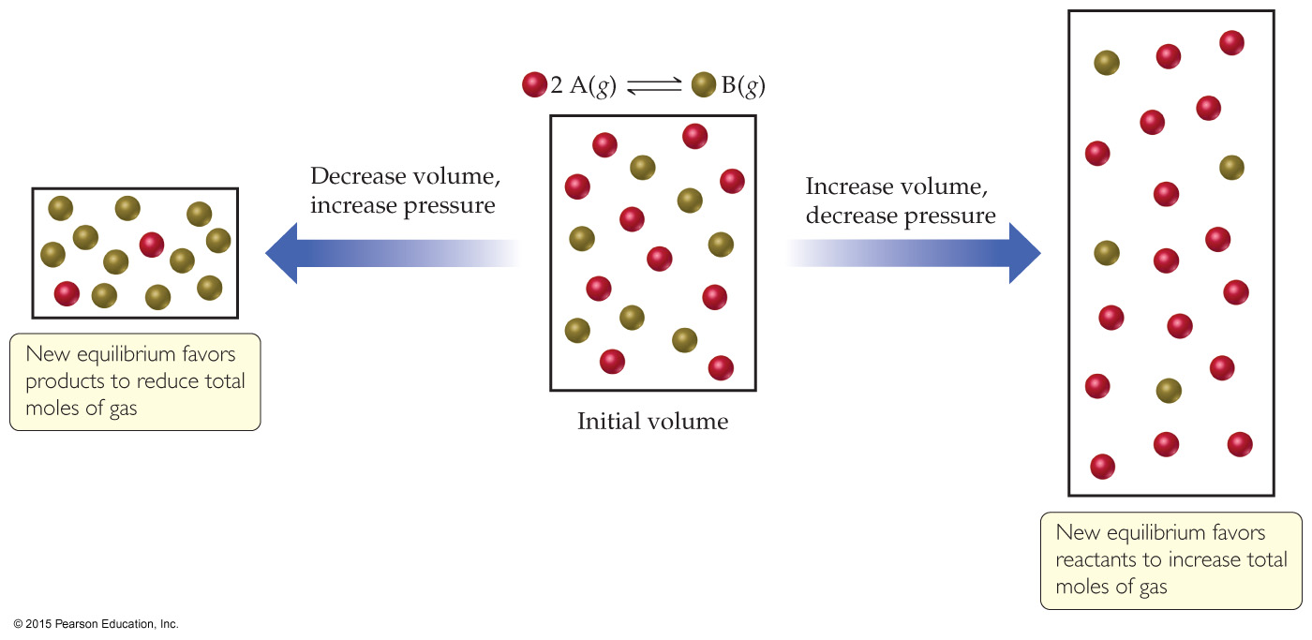
Change in Volume or Pressure
When gases are involved in an equilibrium, a change in pressure or volume will affect equilibrium:
Higher volume or lower pressure favors the side of the equation with more moles (and vice-versa).

Slide 34
Change in Temperature
Is the reaction endothermic or exothermic as written? That matters!
Endothermic: Heats acts like a reactant; adding heat drives a reaction toward products.
Exothermic: Heat acts like a product; adding heat drives a reaction toward reactants.

Slide 35
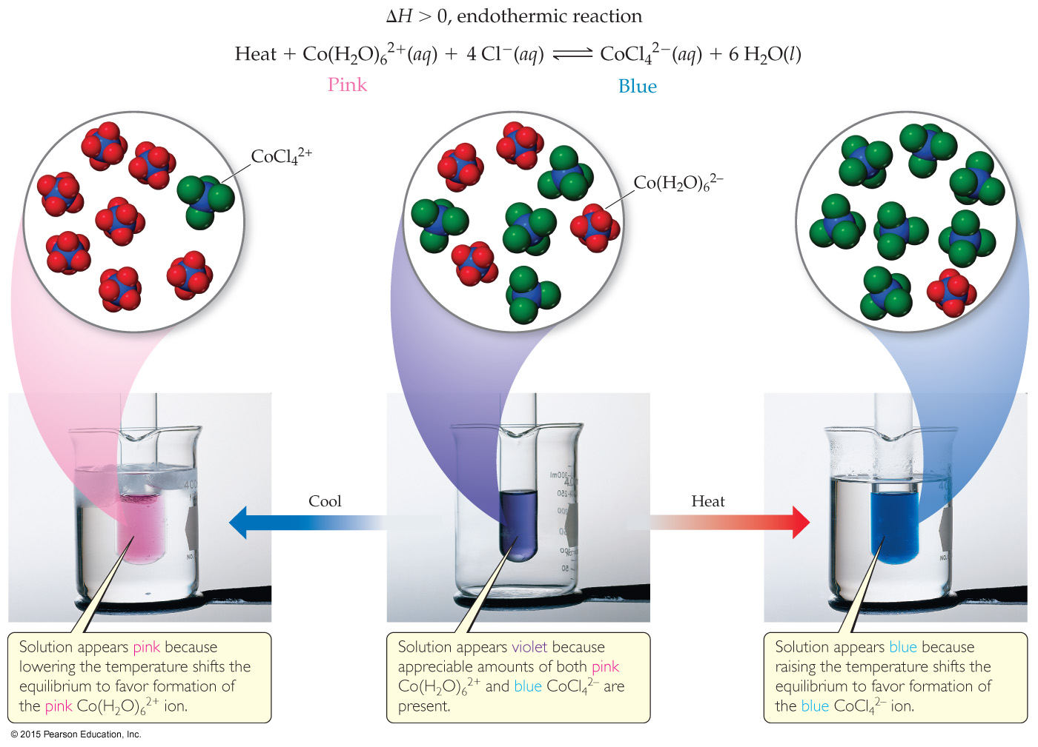
An Endothermic Equilibrium

Slide 36
An Exothermic Equilibrium
The Haber Process for producing ammonia from the elements is exothermic.
One would think that cooling down the reactants would result in more product.
However, the activation energy for this reaction is high!
This is the one instance where a system in equilibrium can be affected by a catalyst!

Slide 37
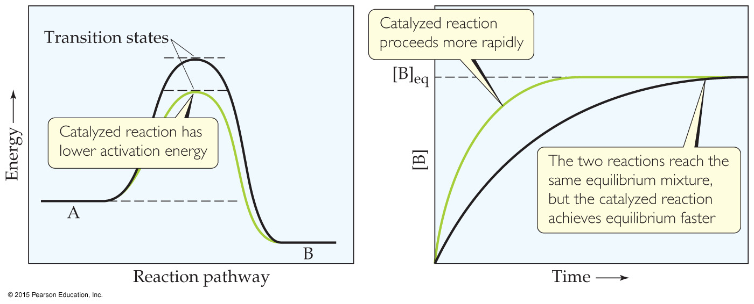
Catalysts
Catalysts increase the rate of both the forward and reverse reactions.
Equilibrium is achieved faster, but the equilibrium composition remains unaltered.
Activation energy is lowered, allowing equilibrium to be established at lower temperatures.

