Slide 1
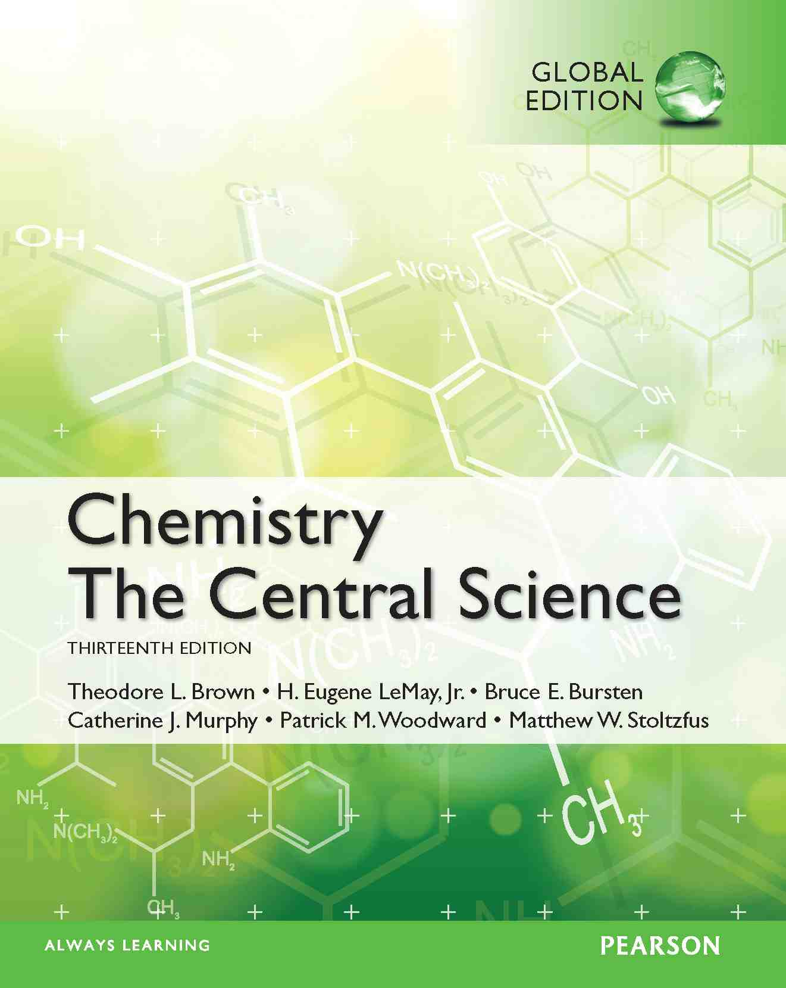
Lecture Presentation
Chapter 16 Acid–Base Equilibria
James F. Kirby
Quinnipiac University
Hamden, CT
© 2015 Pearson Education, Inc.

Slide 2
Some Definitions
Arrhenius
An acid is a substance that, when dissolved in water, increases the concentration of hydrogen ions.
A base is a substance that, when dissolved in water, increases the concentration of hydroxide ions.
Brønsted–Lowry
An acid is a proton donor.
A base is a proton acceptor.

Slide 3
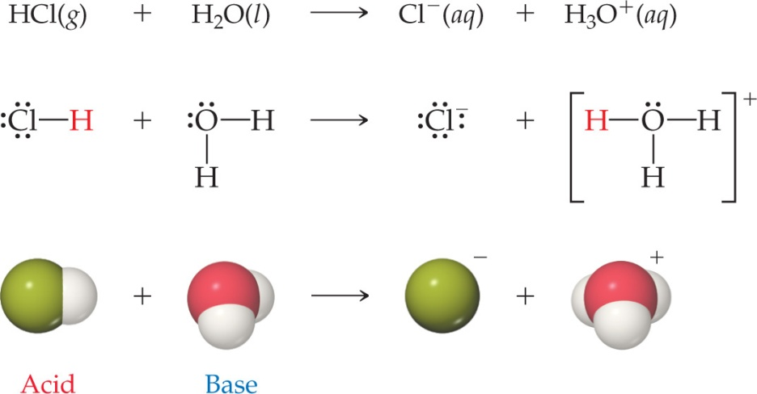
Brønsted–Lowry Acid and Base
A Brønsted–Lowry acid must have at least one removable (acidic) proton (H⁺) to donate.
A Brønsted–Lowry base must have at least one nonbonding pair of electrons to accept a proton (H⁺).

Slide 4
What Is Different about Water?
Water can act as a Brønsted–Lowry base and accept a proton (H⁺) from an acid, as on the previous slide.
It can also donate a proton and act as an acid, as is seen below.
This makes water amphiprotic.

Slide 5
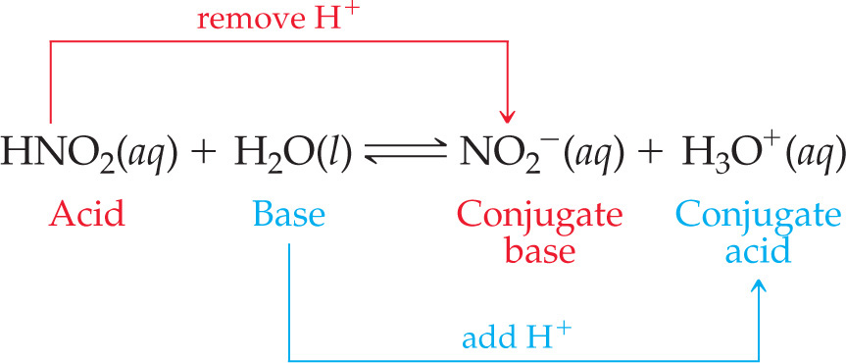
Conjugate Acids and Bases
The term conjugate means “joined together as a pair.”
Reactions between acids and bases always yield their conjugate bases and acids.

Slide 6
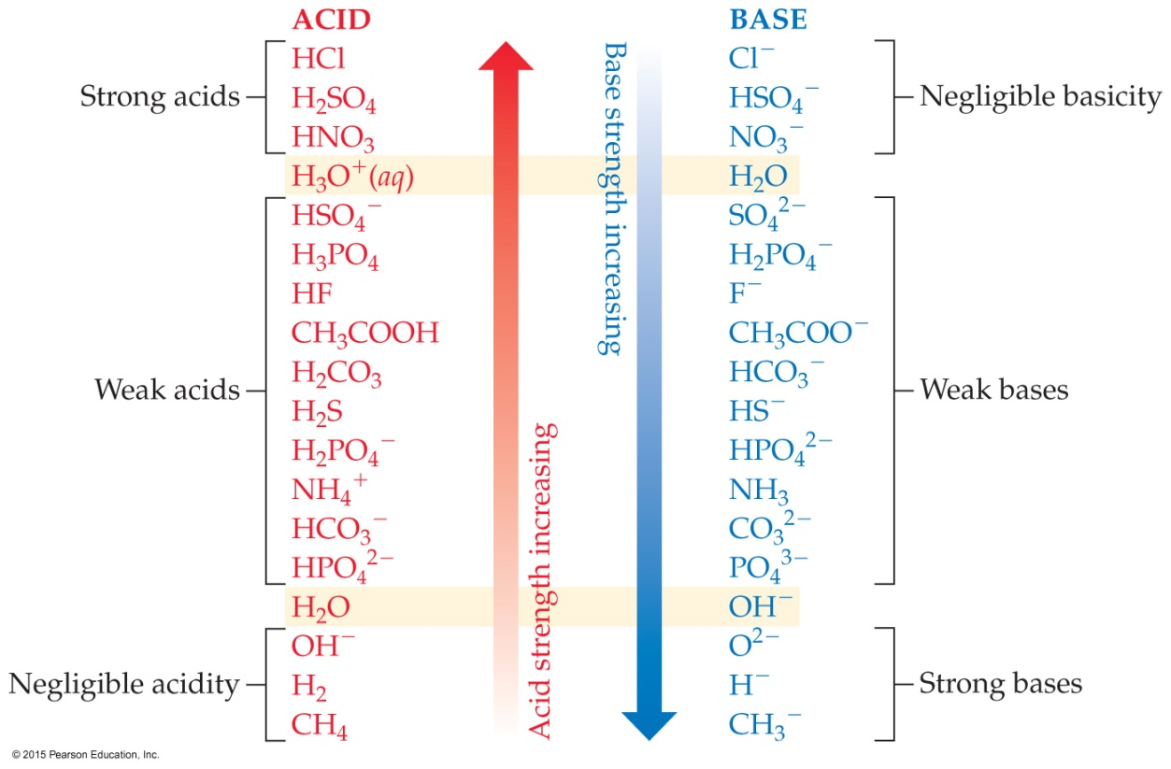
Relative Strengths of Acids and Bases
Acids above the line with H₂O as a base are strong acids; their conjugate bases do not act as acids in water.
Bases below the line with H₂O as an acid are strong bases; their conjugate acids do not act as acids in water.
The substances between the lines with H₂O are conjugate acid–base pairs in water.

Slide 7
Acid and Base Strength
In every acid–base reaction, equilibrium favors transfer of the proton from the stronger acid to the stronger base to form the weaker acid and the weaker base.
HCl(aq) + H₂O(l) → H₃O⁺(aq) + Cl⁻(aq)
H₂O is a much stronger base than Cl⁻, so the equilibrium lies far to the right (K >> 1).
CH₃COOH(aq) + H₂O(l) ⇌ H₃O⁺(aq) + CH₃COO–(aq)
Acetate is a stronger base than H₂O, so the equilibrium favors the left side (K < 1).

Slide 8
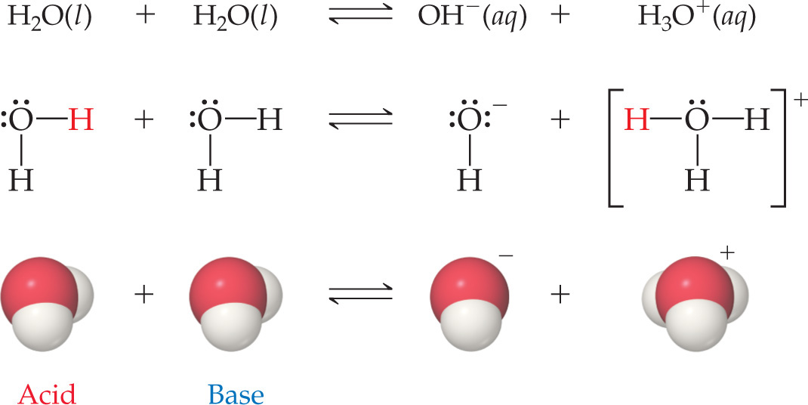
Autoionization of Water
Water is amphoteric.
In pure water, a few molecules act as bases and a few act as acids.
This is referred to as autoionization.

Slide 9
Ion Product Constant
The equilibrium expression for this process is
K_{c} = [H₃O⁺][OH⁻]
This special equilibrium constant is referred to as the ion product constant for water, K_{w}.
At 25 °C, K_{w} = 1.0 × 10⁻¹⁴

Slide 10
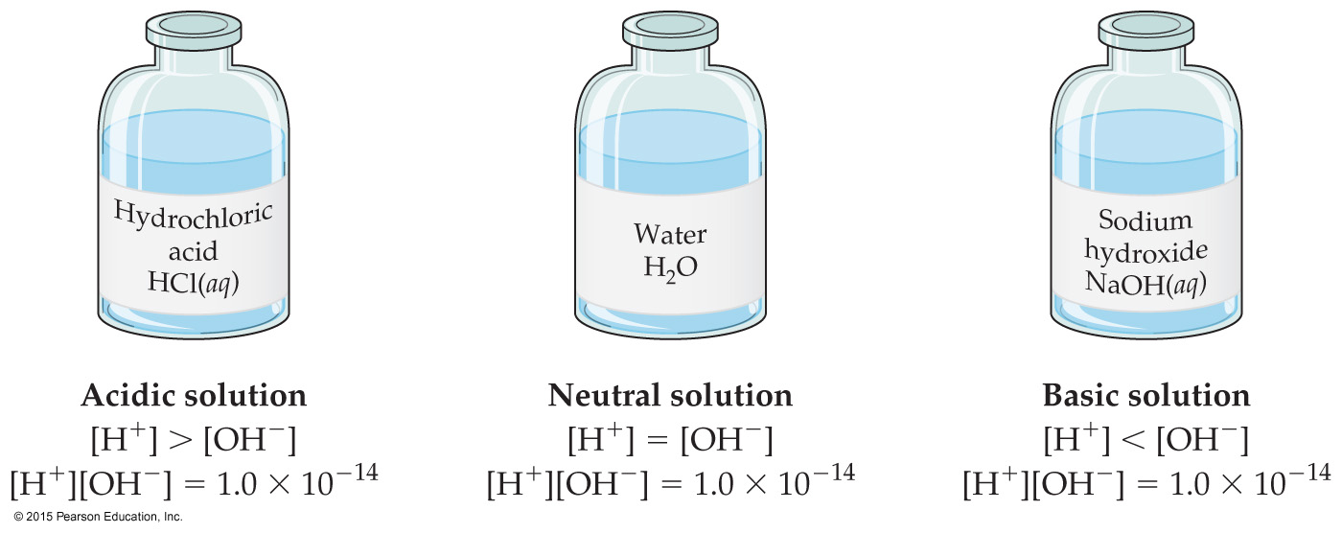
Aqueous Solutions Can Be Acidic, Basic, or Neutral
If a solution is neutral, [H⁺] = [OH–].
If a solution is acidic, [H⁺] > [OH–].
If a solution is basic, [H⁺] < [OH–].

Slide 11
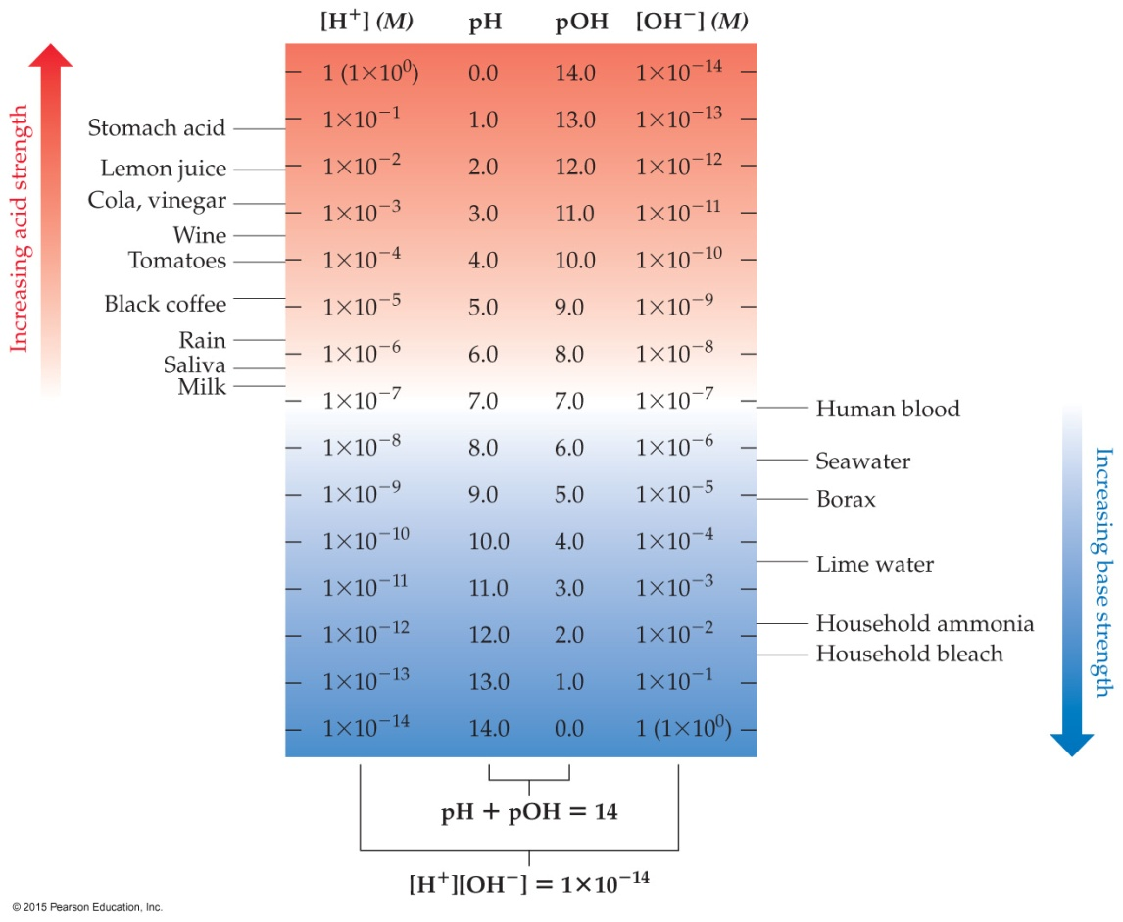
pH
pH is a method of reporting hydrogen ion concentration.
pH = –log[H⁺]
Neutral pH is 7.00.
Acidic pH is below 7.00.
Basic pH is above 7.00.

Slide 12
Other “p” Scales
The “p” in pH tells us to take the –log of a quantity (in this case, hydrogen ions).
Some other “p” systems are
pOH: –log[OH⁻]
pK_{w}: –log K_{w}

Slide 13
Relating pH and pOH
Because
[H₃O⁺][OH⁻] = K_{w} = 1.0 × 10⁻¹⁴
we can take the –log of the equation
–log[H₃O⁺] + –log[OH⁻] = –log K_{w} = 14.00
which results in
pH + pOH = pK_{w} = 14.00

Slide 14
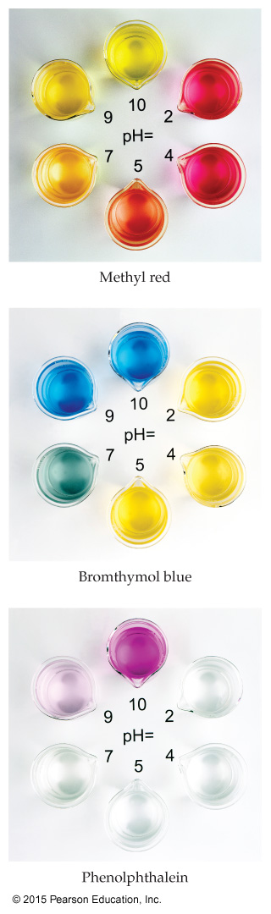
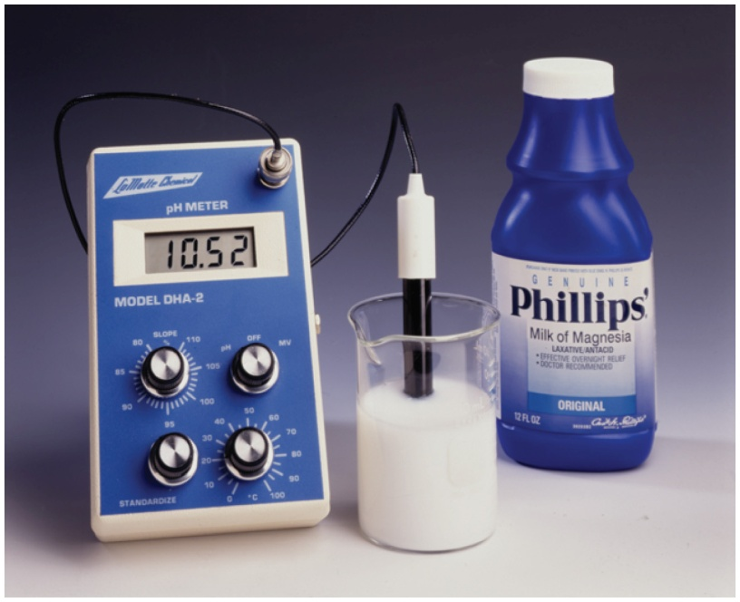
How Do We Measure pH?
Indicators, including litmus paper, are used for less accurate measurements; an indicator is one color in its acid form and another color in its basic form.
pH meters are used for accurate measurement of pH; electrodes indicate small changes in voltage to detect pH.

Slide 15
Strong Acids
You will recall that the seven strong acids are HCl, HBr, HI, HNO₃, H₂SO₄, HClO₃, and HClO₄.
These are, by definition, strong electrolytes and exist totally as ions in aqueous solution; e.g.,
HA + H₂O → H₃O⁺ + A–
So, for the monoprotic strong acids,
[H₃O⁺] = [acid]

Slide 16
Strong Bases
Strong bases are the soluble hydroxides, which are the alkali metal and heavier alkaline earth metal hydroxides (Ca²⁺, Sr²⁺, and Ba²⁺).
Again, these substances dissociate completely in aqueous solution; e.g.,
MOH(aq) → M⁺(aq) + OH–(aq) or
M(OH)₂(aq) → M²⁺(aq) + 2 OH–(aq)

Slide 17
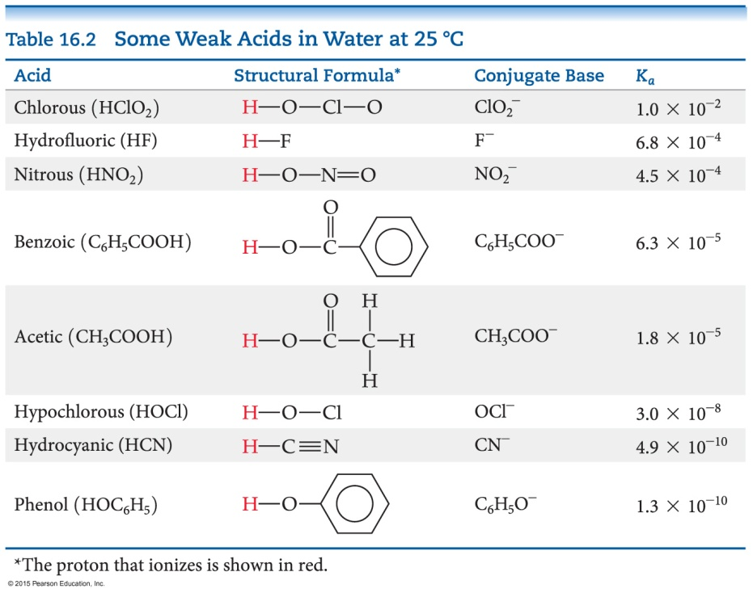
Weak Acids
For a weak acid, the equation for its dissociation is
HA(aq) + H₂O(l) ⇌ H₃O⁺(aq) + A–(aq)
Since it is an equilibrium, there is an equilibrium constant related to it, called the acid-dissociation constant, K_{a}:K_{a} = [H₃O⁺][A–] / [HA]
The greater the value of K_{a}, the stronger is the acid.

Slide 18
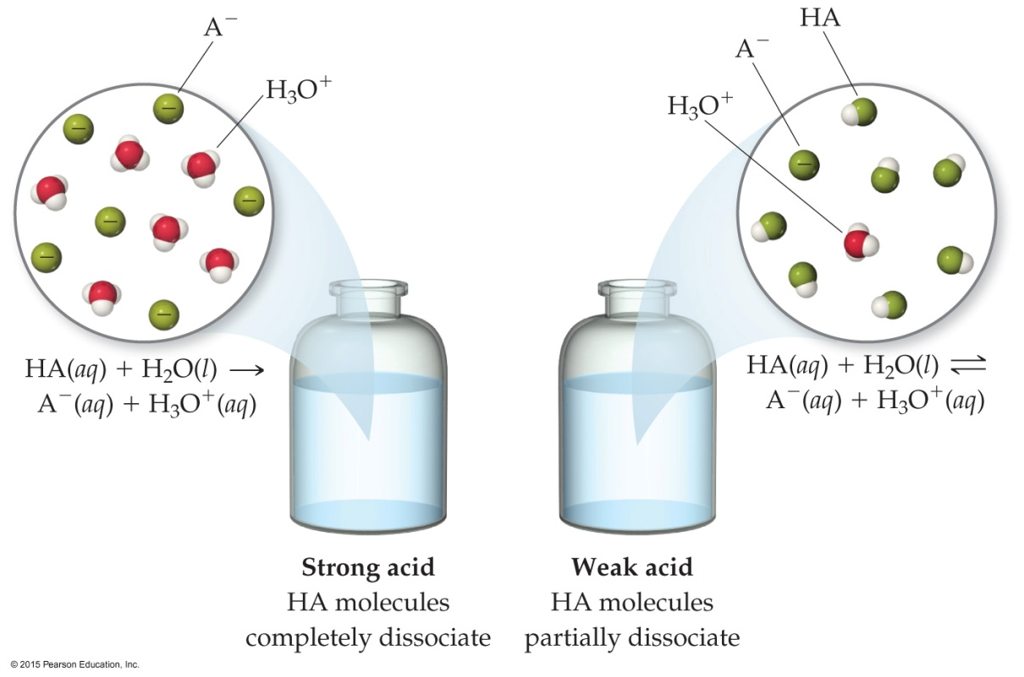
Comparing Strong and Weak Acids
What is present in solution for a strong acid versus a weak acid?
Strong acids completely dissociate to ions.
Weak acids only partially dissociate to ions.

Slide 19
Calculating K_{a} from the pH
The pH of a 0.10 M solution of formic acid, HCOOH, at 25 °C is 2.38. Calculate K_{a} for formic acid at this temperature.
We know that
[H₃O⁺][HCOO–]
[HCOOH]
K_{a} =
To calculate K_{a}, we need the equilibrium concentrations of all three things.
We can find [H₃O⁺], which is the same as [HCOO–], from the pH.
[H₃O⁺] = [HCOO–] = 10^{–2.38} = 4.2 × 10^{–3}

Slide 20
Calculating K_{a} from pH
Now we can set up a table for equilibrium concentrations. We know initial HCOOH (0.10 M) and ion concentrations (0 M); we found equilibrium ion concentrations (4.2 × 10^{–3} M); so we calculate the change, then the equilibrium HCOOH concentration.
 | [HCOOH], M | [H₃O⁺], M | [HCOO⁻], M
Initially | 0.10 | 0 | 0
Change | −4.2 × 10⁻³ | +4.2 × 10⁻³ | +4.2 × 10⁻³
At equilibrium | 0.10 − 4.2 × 10⁻³ = 0.0958 = 0.10 | 4.2 × 10⁻³ | 4.2 × 10⁻³

Slide 21
Calculating K_{a} from pH
This allows us to calculate K_{a} by putting in the equilibrium concentrations.
[4.2 × 10⁻³][4.2 × 10⁻³]
[0.10]
K_{a} =
= 1.8 × 10⁻⁴

Slide 22
Calculating Percent Ionization
[H₃O⁺]_{eq}
[HA]_{initial}
Percent ionization = × 100
In this example,
[H₃O⁺]_{eq} = 4.2 × 10⁻³ M
[HCOOH]_{initial} = 0.10 M
4.2 × 10⁻³
0.10
Percent ionization = × 100
= 4.2%

Slide 23
Method to Follow to Calculate pH Using K_{a}
Write the chemical equation for the ionization equilibrium.
Write the equilibrium constant expression.
Set up a table for Initial/Change in/Equilibrium Concentration to determine equilibrium concentrations as a function of change (x).
Substitute equilibrium concentrations into the equilibrium constant expression and solve for x. (Make assumptions if you can!)

Slide 24
Example
Calculate the pH of a 0.30 M solution of acetic acid, HC₂H₃O₂, at 25 °C.
HC₂H₃O₂ + H₂O ⇌ H₃O⁺ + C₂H₃O₂–
K_{a} = [H₃O⁺][C₂H₃O₂–] / [HC₂H₃O₂]
 | CH₃COOH (M) | H₃O⁺ (M) | CH₃COO– (M)
Initial Concentration (M) | 0.30 | 0 | 0
Change in Concentration (M) | –x | +x | +x
Equilibrium Concentration (M) | 0.30 – x | x | x

Slide 25
Example (concluded)
K_{a} = [H₃O⁺][C₂H₃O₂–] / [HC₂H₃O₂]
= (x)(x) / (0.30 – x)
If we assume that x << 0.30, then 0.30 – x becomes 0.30. The problem becomes easier, since we don’t have to use the quadratic formula to solve it.
K_{a} = 1.8 × 10^{–5} = x² / 0.30, so x = 2.3 × 10^{–3}
x = [H₃O⁺], so pH = –log(2.3 × 10^{–3}) = 2.64

Slide 26
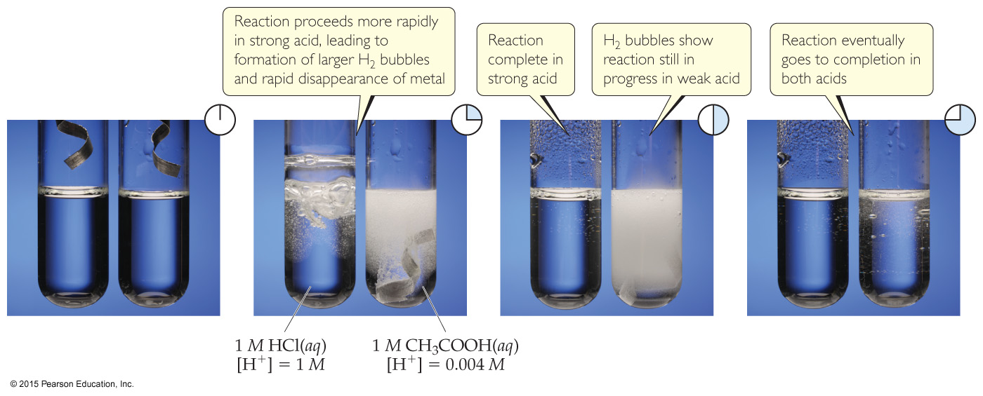
Strong vs. Weak Acids— Another Comparison
Strong Acid: [H⁺]_{eq} = [HA]_{init}
Weak Acid: [H⁺]_{eq} < [HA]_{init}
This creates a difference in conductivity and in rates of chemical reactions.

Slide 27
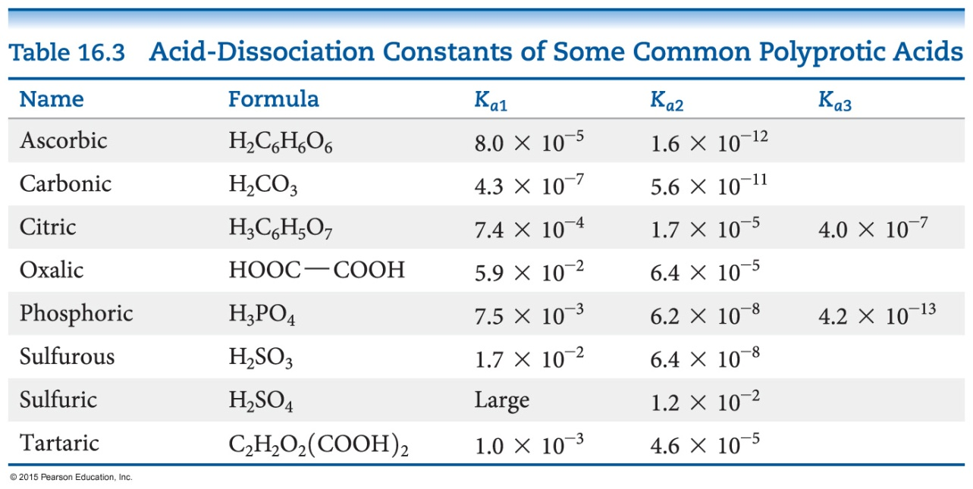
Polyprotic Acids
Polyprotic acids have more than one acidic proton.
It is always easier to remove the first proton than any successive proton.
If the factor in the K_{a} values for the first and second dissociation has a difference of 3 or greater, the pH generally depends only on the first dissociation.

Slide 28
Weak Bases
Ammonia, NH_{3,} is a weak base.
Like weak acids, weak bases have an equilibrium constant called the base dissociation constant.
Equilibrium calculations work the same as for acids, using the base dissociation constant instead.

Slide 29
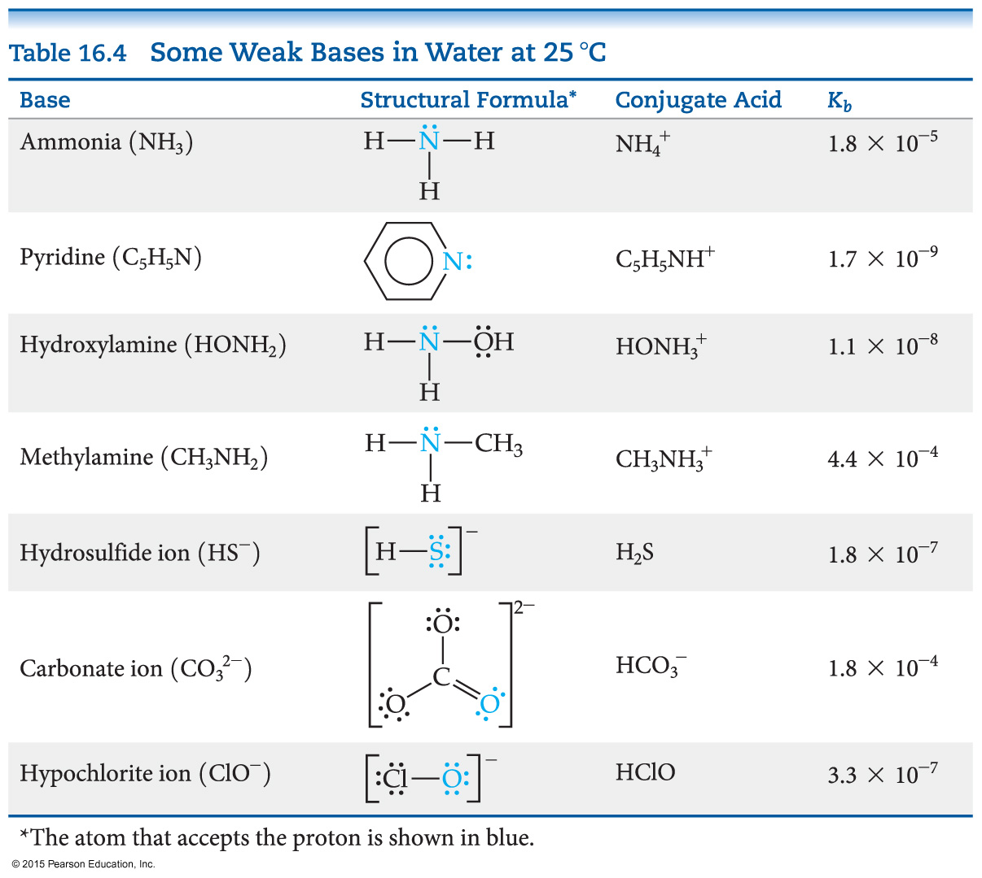
Base Dissociation Constants

Slide 30
Example
What is the pH of 0.15 M NH₃?
NH₃ + H₂O ⇌ NH₄⁺ + OH–
K_{b} = [NH₄⁺][OH–] / [NH₃] = 1.8 × 10^{–5}
 | NH₃ (M) | NH₄⁺ (M) | OH– (M)
Initial Concentration (M) | 0.15 | 0 | 0
Change in Concentration (M) | –x | +x | +x
Equilibrium Concentration (M) | 0.15 – x | x | x

Slide 31
Example (completed)
1.8 × 10 – 5 = x² / (0.15 – x)
If we assume that x << 0.15, 0.15 – x = 0.15.
Then: 1.8 × 10^{–5} = x² / 0.15
and: x = 1.6 × 10^{–3}
Note: x is the molarity of OH–, so –log(x) will be the pOH (pOH = 2.80) and [14.00 – pOH] is pH (pH = 11.20).

Slide 32
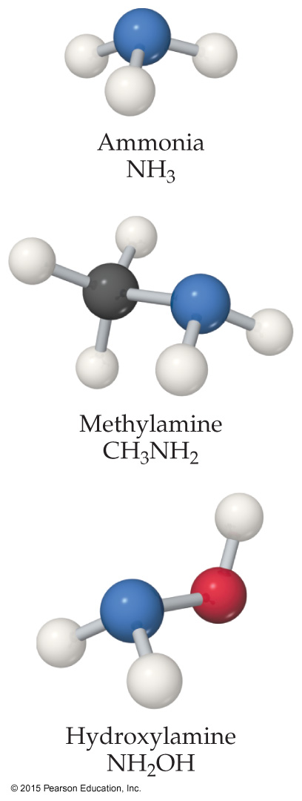
Types of Weak Bases
Two main categories
Neutral substances with an Atom that has a nonbonding pair of electrons that can accept H⁺ (like ammonia and the amines)
Anions of weak acids

Slide 33
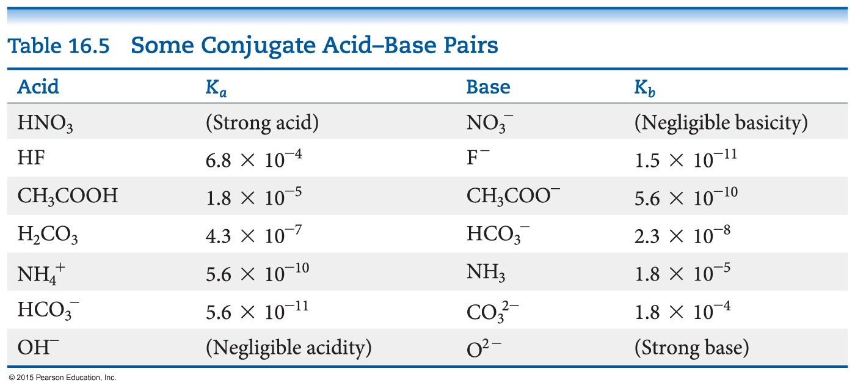
Relationship between K_{a} and K_{b}
For a conjugate acid–base pair, K_{a} and K_{b} are related in this way:
K_{a} × K_{b} = K_{w}
Therefore, if you know one of them, you can calculate the other.
© 2015 Pearson Education, Inc.

Slide 34
Acid–Base Properties of Salts
Many ions react with water to create H⁺ or OH–. The reaction with water is often called hydrolysis.
To determine whether a salt is an acid or a base, you need to look at the cation and anion separately.
The cation can be acidic or neutral.
The anion can be acidic, basic, or neutral.

Slide 35
Anions
Anions of strong acids are neutral. For example, Cl– will not react with water, so OH– can’t be formed.
Anions of weak acids are conjugate bases, so they create OH– in water; e.g., C₂H₃O₂– + H₂O ⇌ HC₂H₃O₂ + OH–
Protonated anions from polyprotic acids can be acids or bases: If K_{a} > K_{b,} the anion will be acidic; if K_{b} > K_{a}, the anion will be basic.

Slide 36
Cations
Group I or Group II (Ca²⁺, Sr²⁺, or Ba²⁺) metal cations are neutral.
Polyatomic cations are typically the conjugate acids of a weak base; e.g., NH₄⁺.
Transition and post-transition metal cations are acidic. Why? (There are no H atoms in these cations!)

Slide 37
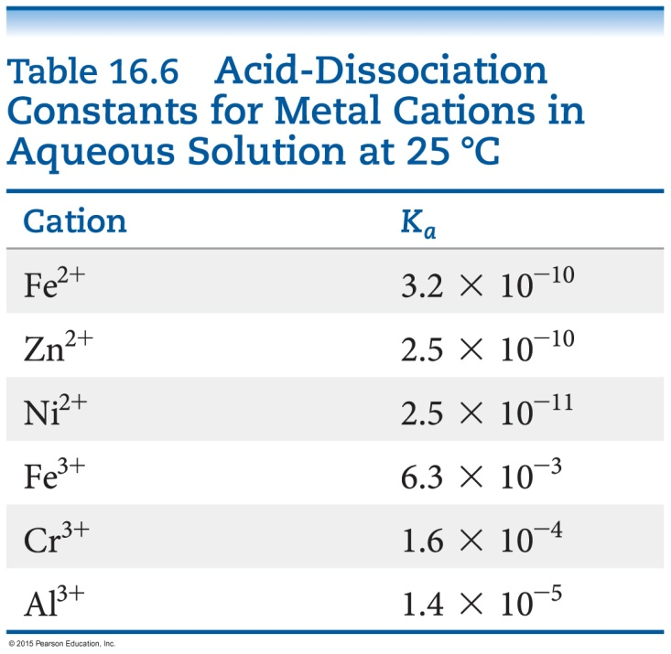
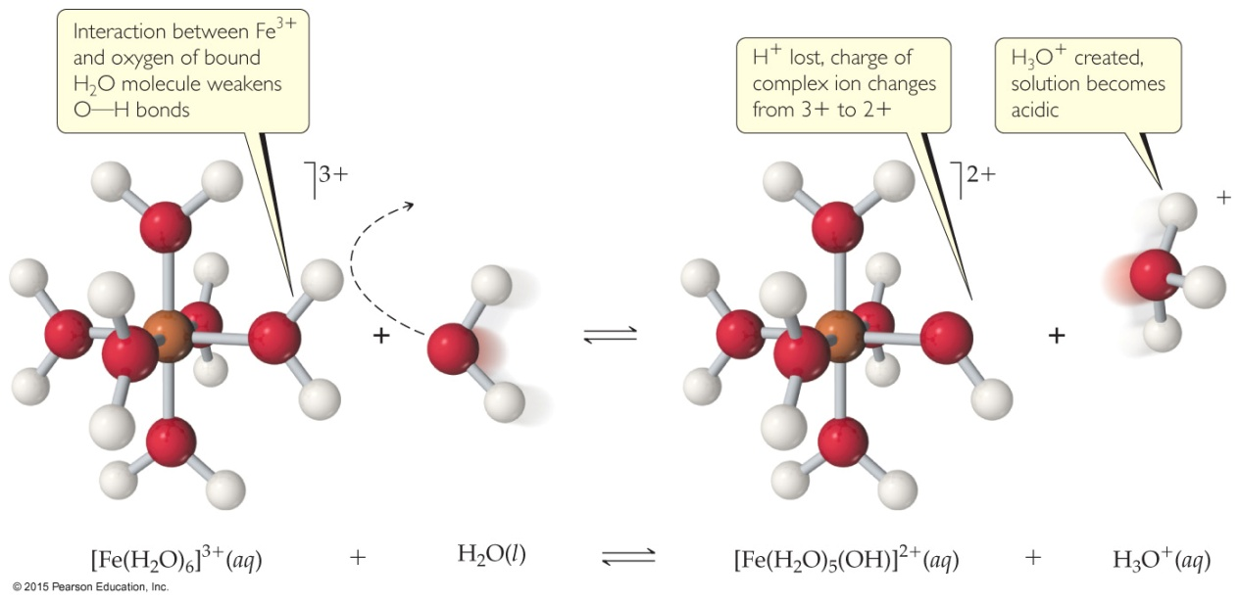
Hydrated Cations
Transition and post-transition metals form hydrated cations.
The water attached to the metal is more acidic than free water molecules, making the hydrated ions acidic.

Slide 38
Salt Solutions— Acidic, Basic, or Neutral?
Group I/II metal cation with anion of a strong acid: neutral
Group I/II metal cation with anion of a weak acid: basic (like the anion)
Transition/Post-transition metal cation or polyatomic cation with anion of a strong acid: acidic (like the cation)
Transition/Post-transition metal cation or polyatomic cation with anion of a weak acid: compare K_{a} and K_{b}; whichever is greater dictates what the salt is.

Slide 39
Factors that Affect Acid Strength
H—A bond must be polarized with δ+ on the H atom and δ– on the A atom
Bond strength: Weaker bonds can be broken more easily, making the acid stronger.
Stability of A–: More stable anion means stronger acid.

Slide 40
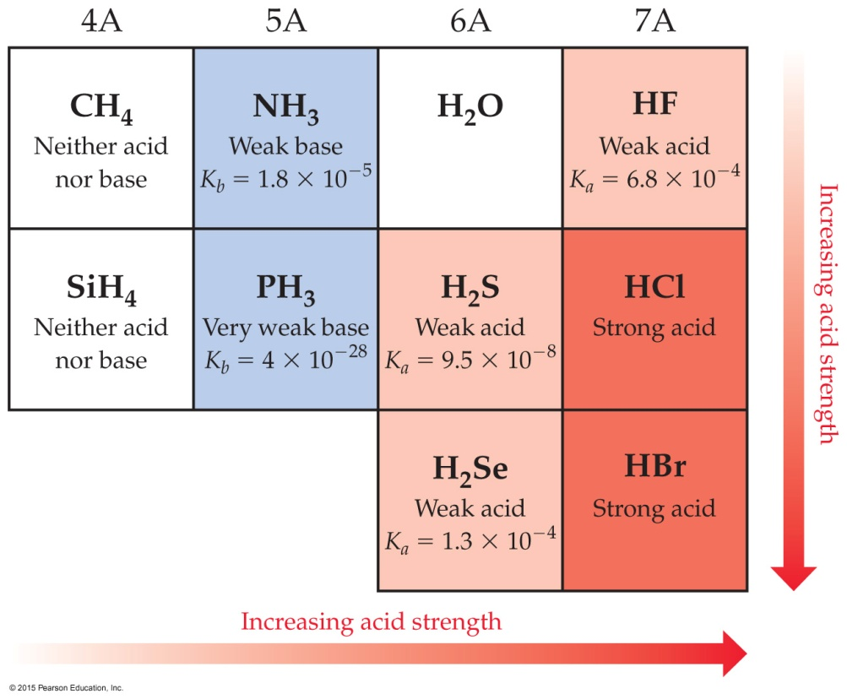
Binary Acids
Binary acids consist of H and one other element.
Within a group, H—A bond strength is generally the most important factor.
Within a period, bond polarity is the most important factor to determine acid strength.

Slide 41
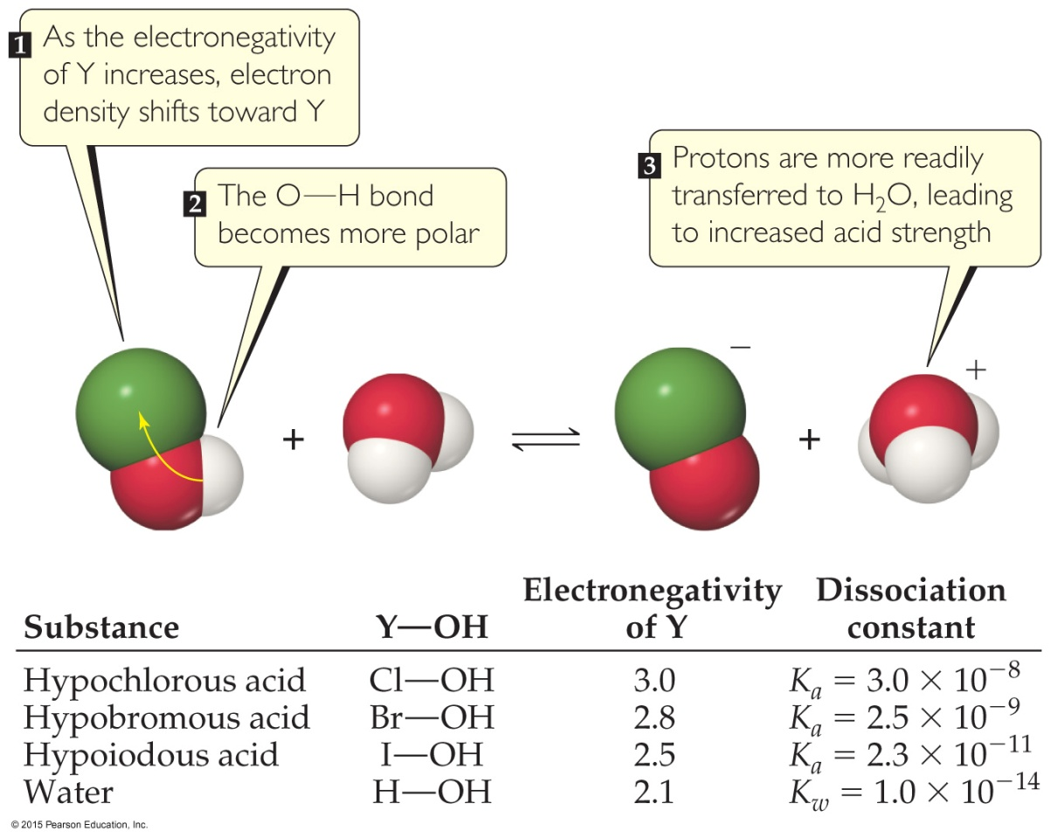
Oxyacids
Oxyacids consist of H, O, and one other element, which is a nonmetal.
Generally, as the electronegativity of the nonmetal increases, the acidity increases for acids with the same structure.

Slide 42
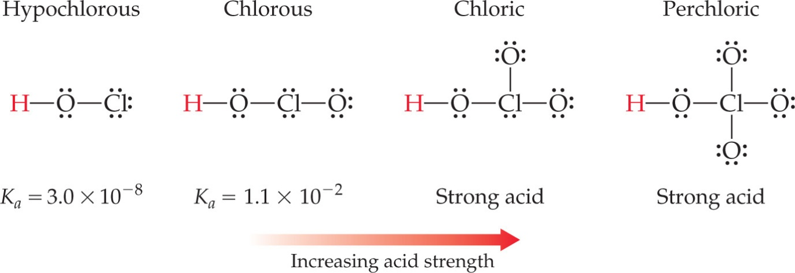
Oxyacids with Same “Other” Element
If an element can form more than one oxyacid, the oxyacid with more O atoms is more acidic; e.g., sulfuric acid versus sulfurous acid.
Another way of saying it: If the oxidation number increases, the acidity increases.

Slide 43
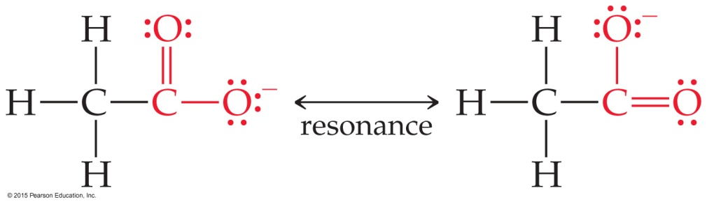
Carboxylic Acids
Carboxylic acids are organic acids containing the —COOH group.
Factors contributing to their acidic behavior:
Other O attached to C draws electron density from O—H bond, increasing polarity.
Its conjugate base (carboxylate anion) has resonance forms to stabilize the anion.

Slide 44
Lewis Acid/Base Chemistry
Lewis acids are electron pair acceptors.
Lewis bases are electron pair donors.
All Brønsted–Lowry acids and bases are also called Lewis acids and bases.
There are compounds which do not meet the Brønsted–Lowry definition which meet the Lewis definition.

Slide 45
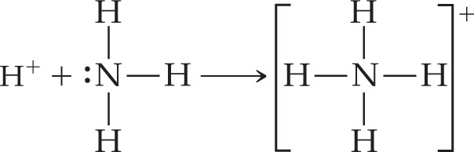
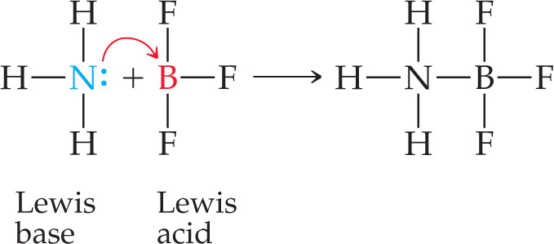
Comparing Ammonia’s Reaction with H⁺ and BF₃

