Slide 1
VE230 Mid1 Review Class
Shangquan

Slide 2
Announcement
Exam Time & Place: 2018/10/24, Wed. 10:00-12:00 Dong Xia Yuan 215
Cheating Sheet: May not be allowed
Calculator: May not be helpful
Topics: Vector Calculus, Gauss Law, Conductor, etc.
Review Materials: Slides, Books, HWs, etc.
Big Office Hour: 10/23, Tues. 18:20-20:00 326E JI Building

Slide 3
Concept
Charge, Charge Conversation
Electric Force (Coulomb Law)
Field, Field Line, Vector Field & Scalar Field
Conductor vs Insulator
Charge Induction & Polarization
Dipole
Work, Energy
Flux, Circulation

Slide 4
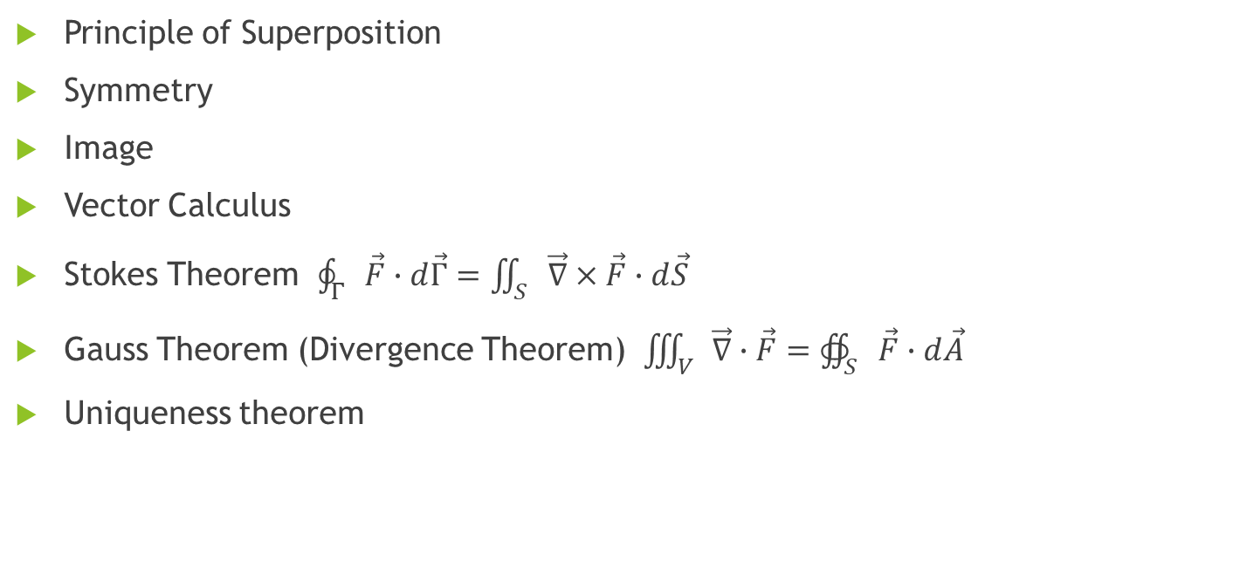
Tools & Methods
Principle of Superposition
Symmetry
Image
Vector Calculus
Stokes Theorem $\oint_{Γ}{\vec{F}∙ⅆ\vec{Γ}=\iint_{S}{\vec{∇}×\vec{F}∙ⅆ\vec{S}}}$
Gauss Theorem (Divergence Theorem) $\iiint_{V}{\vec{∇}∙\vec{F}=∯_{S}{\vec{F}∙ⅆ\vec{A}}}$
Uniqueness theorem

Slide 5

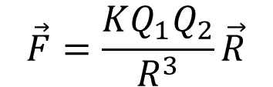
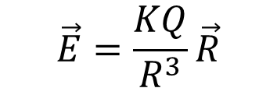
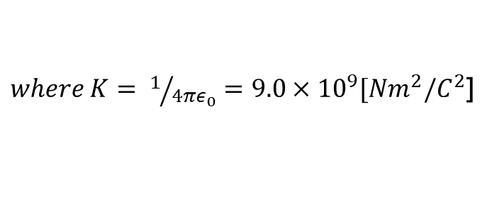
Coulomb Law (Electric Force)
$$\vec{F}=\frac{KQ_{1}Q_{2}}{R^{3}}\vec{R}$$
or $\vec{F}=\frac{KQ_{1}Q_{2}}{R^{2}}\hat{R}$
$where K= 1/{4πε_{0}}=9.0×{10}^{9}[Nm^{2}/C^{2}$]
$$\vec{E}=\frac{KQ}{R^{3}}\vec{R}$$

Slide 6
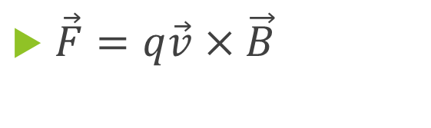
Lorentz Force (Magnetic Force)
$\vec{F}=q\vec{v}×\vec{B}$

Slide 7
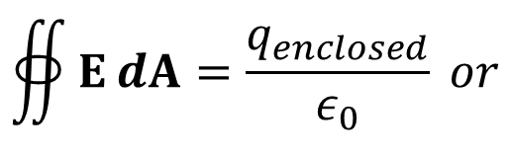
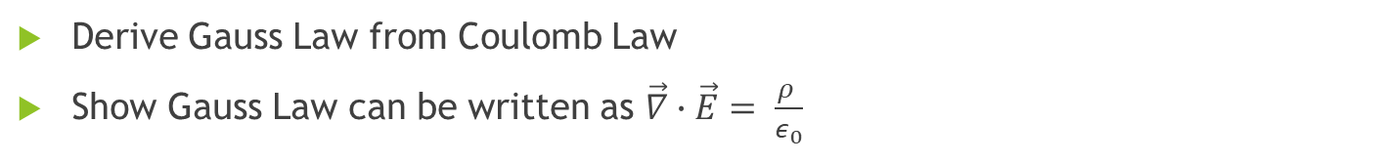
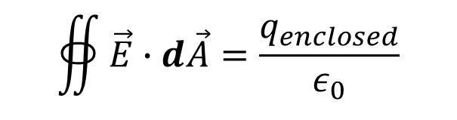
Gauss Law
$$∯{EⅆA}=\frac{q_{enclosed}}{ε_{0}} or$$
$$∯{\vec{E}∙ⅆ\vec{A}}=\frac{q_{enclosed}}{ε_{0}}$$
Derive Gauss Law from Coulomb Law
Show Gauss Law can be written as $\vec{∇}∙\vec{E}= \frac{ρ }{ε_{0}}$

Slide 8

Conductor in Electrostatic
$\vec{E}=\vec{0}$ everywhere inside a conductor, while on its surface $\vec{E}≠\vec{0} and$ $\vec{E}$ is perpendicular to surface
Conductor has equal potential
For an isolated conductor, all charges are distributed on its surface

Slide 9
Exercise (surface integral)
Fawwaz T. Ulaby Fundamentals of Applied Electromagnetics (http://em.eecs.umich.edu/pdf/ulaby_exercise_solutions.pdf)

Slide 10
Exercise (Gauss Law)
Calculate the electric field at a point with distance r from an infinitely long charged line.

Slide 11
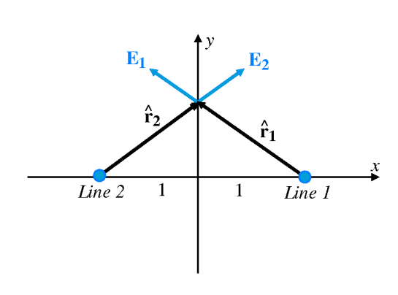
Exercise (Electric field)
Fawwaz T. Ulaby Fundamentals of Applied Electromagnetics (http://em.eecs.umich.edu/pdf/ulaby_exercise_solutions.pdf)

Slide 12
Exercise (Charge)
Fawwaz T. Ulaby Fundamentals of Applied Electromagnetics (http://em.eecs.umich.edu/pdf/ulaby_exercise_solutions.pdf)

Slide 13
Exercise (Dipole)
There is two charges, +q and –q, in vacuum, with distance l.
1. what is electric field at a point on the mid vertical plane?
2. what is electric field at a point in the extended line of l?

Slide 14
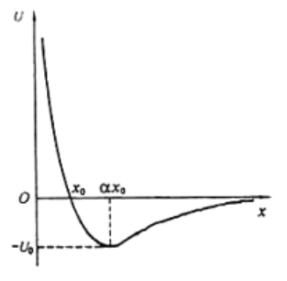
Exercise (Potential & Field)
Two unknown charges are in x axis. We set potential U = 0 when x is infinite far away, and U=infinite when x = 0. Also, when x = x0, U = 0, and when x = ax0 (a>2), U is the smallest –U0. What can we know about the charges?

Slide 15
Exercise (Conductor, potential )
There are two conductor spherical shells with radius R1 and R2 respectively as figure. Both shells have no charges. Now after we add +q to the inner shell, find
1. the charge and potential of the outer shell
2. we further ground the outer shell and then let it isolated again, find the charge and potential of the outer shell
3. Then we ground the inner shell, find its charge and the potential of the outer shell.
R2
R1
R2

