Slide 1
VE230 Mid2 Review Class
Shangquan

Slide 2
Announcement
Exam Time & Place: 2018/11/21 Wed.10:00-11:40 Dong Xia Yuan 215
Cheating Sheet: May not be allowed
Calculator: May not be helpful
Topics: G, H, I, J.
Review Materials: Slides, Books, HWs, Quizes, etc.
Big Office Hour: 11/20, Tues. 18:20-20:00 326E JI Building
Course Evaluation: https://theideaonline.org/cs/survey?S=3274470/X/F/F/1768736906

Slide 3
Concept
Charge Induction & Polarization
Dipole
Work, Energy
Electric displacement

Slide 4
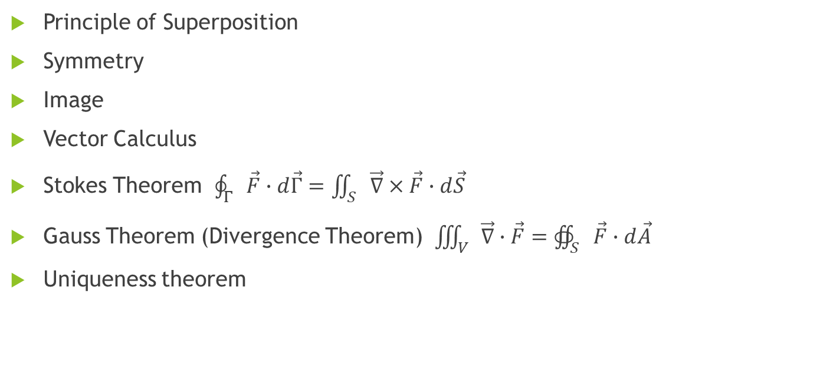
Tools & Methods
Principle of Superposition
Symmetry
Image
Vector Calculus
Stokes Theorem $\oint_{Γ}{\vec{F}∙ⅆ\vec{Γ}=\iint_{S}{\vec{∇}×\vec{F}∙ⅆ\vec{S}}}$
Gauss Theorem (Divergence Theorem) $\iiint_{V}{\vec{∇}∙\vec{F}=∯_{S}{\vec{F}∙ⅆ\vec{A}}}$
Uniqueness theorem

Slide 5




Polarization and electric displacement
$$σ=\overset{⃑}{P}∙\overset{⃑}{n}$$
$$χ=ε_{r}−1$$
$$\overset{⃑}{P}=χε_{0}\overset{⃑}{E}$$
$$\overset{⃑}{D}= ε_{r}ε_{0}\overset{⃑}{E}=ε_{0}\overset{⃑}{E}+\overset{⃑}{P}$$

Slide 6
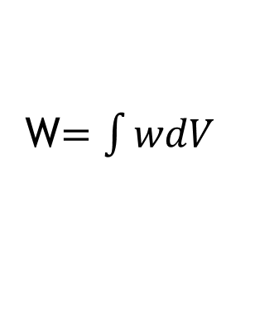
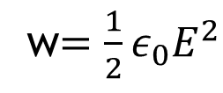
Potential Energy density
w$=\frac{1}{2}ε_{0}E^{2}$
W$=\int{wdV}$

Slide 7

Exercise (Polarization)
There is a dielectric sphere with radius R. Given its polarization P (along x axis), find its polarized surface charge.
(1). $P=P_{0}$; (2). $P=P_{0}\frac{x}{R}$

Slide 8

Exercise (Dielectric of Capacitor)
There is a parallel-plates capacitor with area A=100cm^2 and $Q=±8.9×{10}^{−7}C$. When there is dielectric filled fully between plates, the electric field is $1.4×{10}^{6}V/m$, Find:
(1). The relative dielectric constant of the dielectric.
(2). The polarized surface charge density of the dielectric.

Slide 9
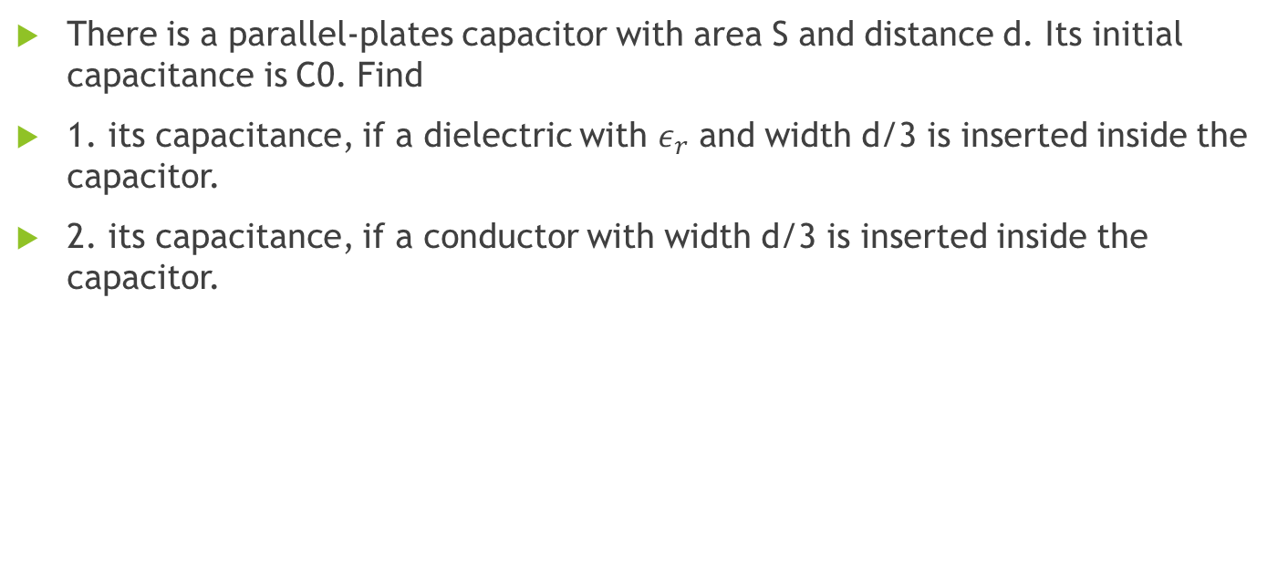
Exercise (Capacitance)
There is a parallel-plates capacitor with area S and distance d. Its initial capacitance is C0. Find
1. its capacitance, if a dielectric with $ε_{r}$ and width d/3 is inserted inside the capacitor.
2. its capacitance, if a conductor with width d/3 is inserted inside the capacitor.

Slide 10

Exercise (Energy of Capacitor)
There is a spherical capacitor with inner and outer radius R1 and R2 and charge Q. Find
The total energy of the electric field inside the capacitor.
Show the previous answer is the same as that derived from $W=\frac{1}{2}\frac{Q^{2}}{C}$

Slide 11

Exercise (Potential Energy)
At the center of an equilateral triangle, there is a point charge $\frac{−q}{\sqrt{3}}$. At three vertexes of the triangle, there are three point charges +q respectively. Find the system’s total potential energy.

