Slide 1
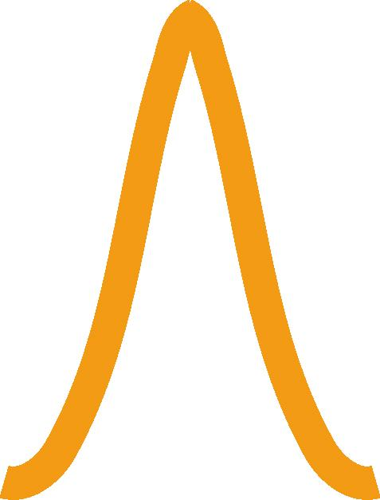
Waves, the Wave Equation, and Phase Velocity
Prof. Rick Trebino
Georgia Tech
f(x)
f(x-2)
f(x-1)
f(x-3)
What is a wave?
Forward [f(x-vt)] and
backward [f(x+vt)]
propagating waves
The one-dimensional wave equation
Harmonic waves
Wavelength, frequency, period, etc.
Phase velocity Complex numbers Plane waves and laser beams
Photons and photon statistics
0 1 2 3
x
Notes:
www.physics.gatech.edu/frog/lectures

Slide 2

What is a wave?
A wave is anything that moves.
To displace any function f(x) to the right, just change its argument from x to x-a, where a is a positive number.
If we let a = v t, where v is positive and t is time, then the displacement will increase with time.
So represents a rightward, or forward, propagating wave.
Similarly, represents a leftward, or backward, propagating wave.
v will be the velocity of the wave.
f(x)
f(x-2)
f(x-1)
f(x-3)
f(x - v t)
f(x + v t)
0 1 2 3
x
Notes:
Picture courtesy of the Consortium for Optics and Imaging Education

Slide 3
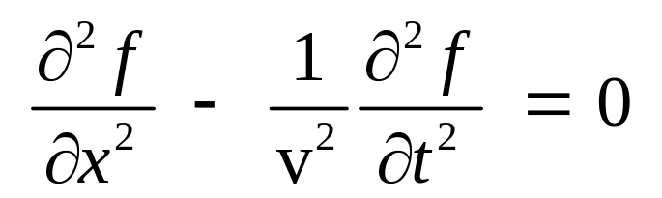
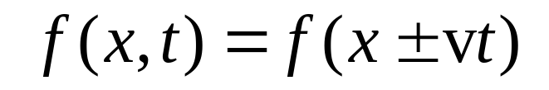
The one-dimensional wave equation and its solution
We’ll derive the wave equation from Maxwell’s equations next class.
Here it is in its one-dimensional form for scalar (i.e., non-vector) functions, f:
Light waves (actually the electric fields of light waves) will be a solution to this equation. And v will be the velocity of light.
The wave equation has the simple solution:
where f (u) can be any twice-differentiable function.

Slide 4
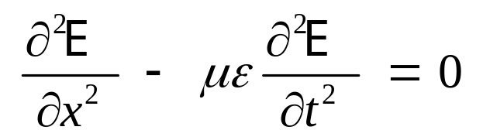

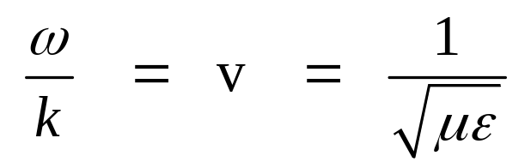
The 1D wave equation for light waves
where E is the light electric field
We’ll use cosine- and sine-wave solutions:
or
where:
The speed of light in vacuum, usually called “c”, is 3 x 10¹⁰ cm/s.

Slide 5
A simpler equation for a harmonic wave:
E (x,t) = A cos[(kx – ωt) – θ]
Use the trigonometric identity:
cos(z–y) = cos(z) cos(y) + sin(z) sin(y)
where z = k x – ω t and y = θ to obtain:
E (x,t) = A cos(kx – ωt) cos(θ) + A sin(kx – ωt) sin(θ)
which is the same result as before,
as long as:
A cos(θ) = B and A sin(θ) = C
For simplicity, we’ll just use the forward-propagating wave.

Slide 6
Amplitude and absolute phase
E (x,t) = A cos[(k x – ω t ) – θ ]
A = Amplitude
θ = Absolute phase (or initial phase)
Absolute phase = 0
Absolute phase = 2π/3
A
x
2π

Slide 7
Wavelength, etc.
Wavelength
λ
Spatial quantities:
x
k-vector magnitude: k = 2π/λ
wave number: κ = 1/λ
Period
τ
Temporal quantities:
Temporal quantities:
t
angular frequency: ω = 2π/τ
cyclical frequency: ν = 1/τ

Slide 8
The Phase Velocity
How fast is the wave traveling?
λ
The phase velocity is the
wavelength / period:
x
v = λ /τ
The wave moves one wavelength, λ, in one period, τ.
Since ν = 1/τ :
v = λ v
In terms of the k-vector, k = 2π /λ, and
the angular frequency, ω = 2π /τ, this is:
It’s also helpful to define a phase delay, T,
that a wave experiences after propagating
a distance, d:
v = ω / k
T = d / v

Slide 9
The Phase of a Wave
The phase is everything inside the cosine.
E (x,t) = A cos(ϕ), where ϕ = k x – ω t – θ
ϕ = ϕ(x,t) and is not a constant, like θ !
In terms of the phase,
ω = – ∂ϕ /∂t
k = ∂ϕ /∂x
And
– ∂ϕ /∂t
v = –––––––
∂ϕ /∂x
We’ll prove these results later.
This formula is useful when the wave is really complicated.

Slide 10

Complex numbers
y (Imaginary)
x = A cos(ϕ)
Consider a point,
P = (x,y), on a 2D
Cartesian grid.
P
y = A sin(ϕ)
ϕ
Let the x-coordinate be the real part
and the y-coordinate the imaginary part
of a complex number.
x (Real)
So, instead of using an ordered pair, (x,y), we can write:
The tilde under the P
means that P is complex.
P = x + i y
= A cos(ϕ) + i A sin(ϕ)
~
where

Slide 11
Euler's Formula
exp(iϕ) = cos(ϕ) + i sin(ϕ)
so the point, P = A cos(ϕ) + i A sin(ϕ), can be written:
P = A exp(iϕ)
where
A = Amplitude
ϕ = Phase
~
~

Slide 12

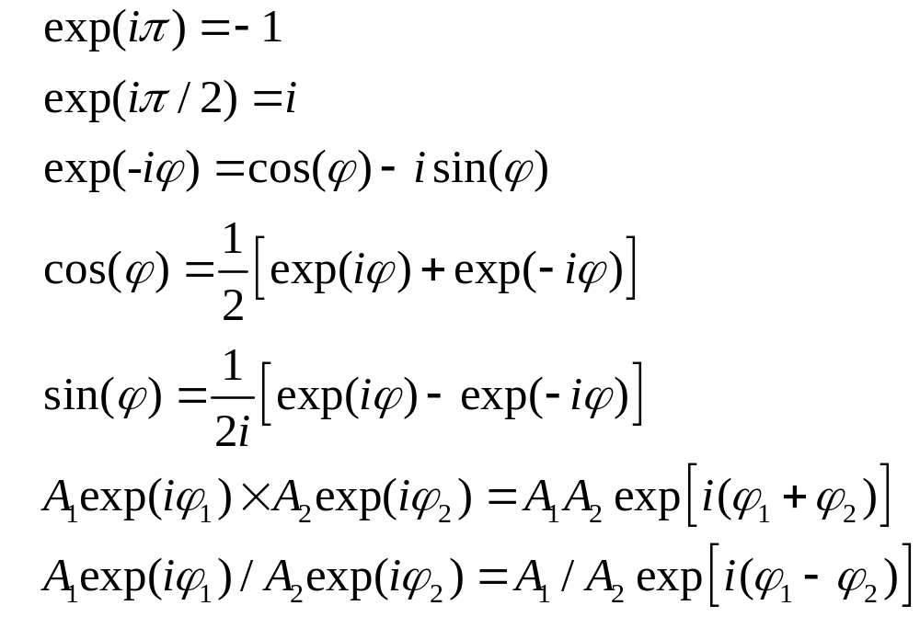
Complex number theorems

Slide 13
More complex number theorems
Omitting the tildes for simplicity.
Any complex number, z, can be written:
z = Re{ z } + i Im{ z }
So
Re{ z } = 1/2 ( z + z* )
and
Im{ z } = 1/2i ( z – z* )
where z* is the complex conjugate of z ( i → –i )
The "magnitude," | z |, of a complex number is:
| z |² = z z* = Re{ z }² + Im{ z }²
To convert z into polar form, A exp(iϕ):
A² = Re{ z }² + Im{ z }²
tan(ϕ) = Im{ z } / Re{ z }
y (Imaginary)
x = A cos(ϕ)
P
y = A sin(ϕ)
ϕ
x (Real)

Slide 14
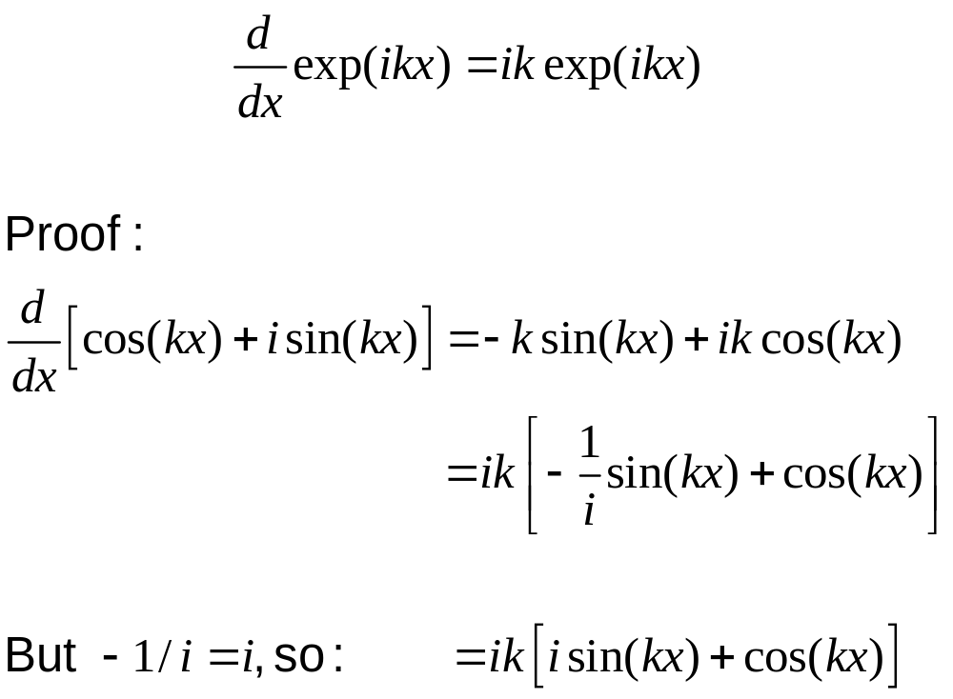
We can also differentiate exp(ikx) as if the argument were real.

Slide 15
Waves using complex numbers
The electric field of a light wave can be written:
E (x,t) = A cos(kx – ωt – θ)
Since exp(iϕ) = cos(ϕ) + i sin(ϕ), E(x,t) can also be written:
E (x,t) = Re { A exp[i(kx – ωt – θ)] }
We often write these expressions without the ½, Re, or +c.c.
or
E (x,t) = 1/2 A exp[i(kx – ωt – θ)] + c.c.
where "+ c.c." means "plus the complex conjugate of everything before the plus sign."

Slide 16
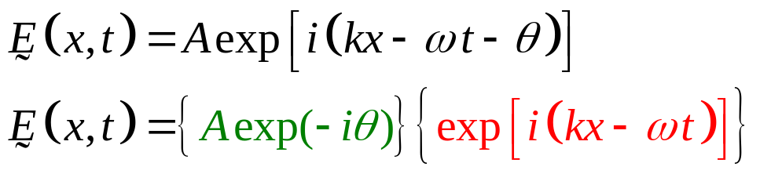

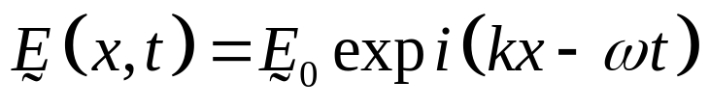
Waves using complex amplitudes
Define E(x,t) to be the complex field—without the Re:
~
where we've separated the constants from the rapidly changing stuff.
The resulting complex amplitude is:
As written, this field is complex!
So:
How do you know if E₀ is real or complex?
Sometimes people use the "~“ under the E’s, but not always.
So always assume it's complex.

Slide 17
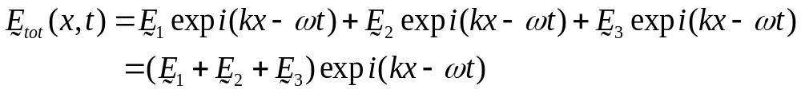




Complex numbers simplify optics!
Adding waves of the same frequency, but different initial phase, yields a wave of the same frequency.
This isn't so obvious using trigonometric functions, but it's easy
with complex exponentials:
where all initial phases are lumped into E₁, E₂, and E₃.
~
~
~
x or t

Slide 18
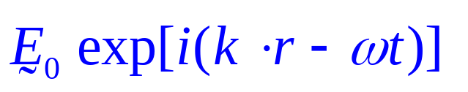
is called a plane wave.
A plane wave’s contours of maximum field, called wave-fronts or phase-fronts, are planes. They extend over all space.
Wave-fronts are helpful for drawing pictures of interfering waves.
A wave's wave-fronts sweep along at the speed of light.
A plane wave's wave-fronts are equally spaced, a wavelength apart.
They're perpendicular to the propagation direction.
Usually, we just draw lines; it’s easier.

Slide 19
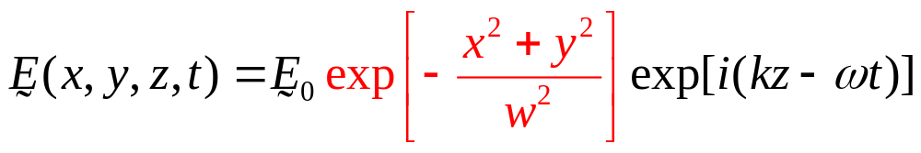
Laser beams vs. plane waves
A plane wave has flat wave-fronts throughout
all space. It also has infinite energy.
It doesn’t exist.
A laser beam is more localized. We can approximate a laser beam as a plane wave vs. z times a Gaussian in x and y:
exp(−x²/w²)
w
x
z
w
y
Localized wave-fronts
Laser beam spot on wall
x

Slide 20
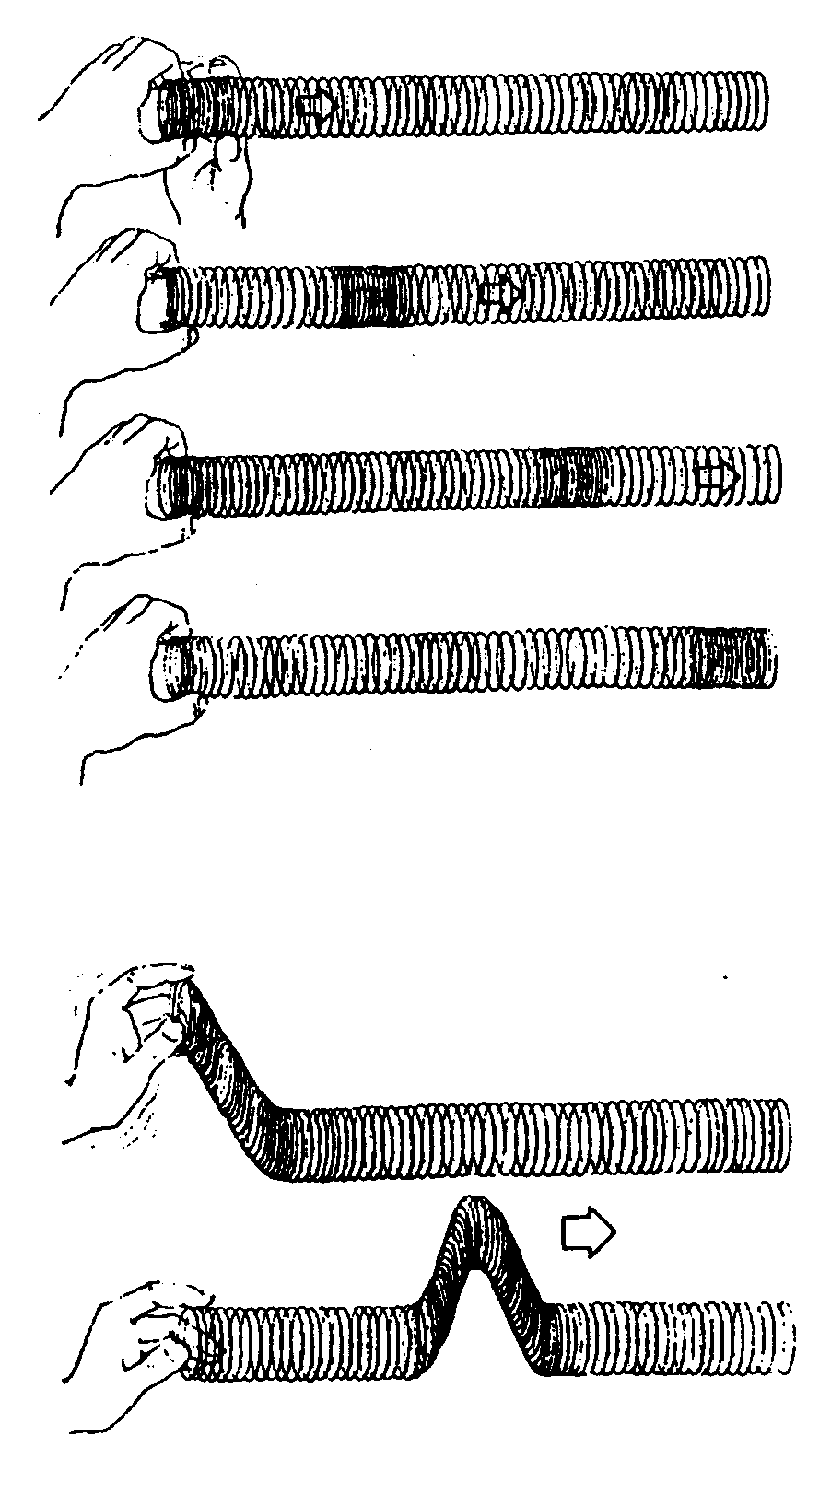
Longitudinal vs. Transverse waves
Motion is along the direction of propagation—longitudinal polarization
Longitudinal:
Motion is transverse to the direction of propagation—transverse polarization
Transverse:
Space has 3 dimensions, of which 2 are transverse to the propagation direction, so there are 2 transverse waves in addition to the potential longitudinal one.
The direction of the wave’s variations is called its polarization.

Slide 21


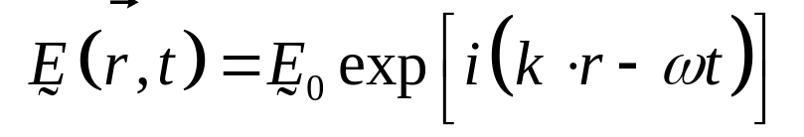
Waves using complex vector amplitudes
We must now allow the complex field and its amplitude to be vectors:
Note the arrows over the E ’s!
The complex vector amplitude has six numbers that must be
specified to completely determine it!
x-component
y-component
z-component

