Slide 2
Chapter 21
Zhang Yangtao

Slide 3
Electric Charge
Proton ——positive charge
Electron ——negative charge
e
Electric charge is conserved
Interaction
Notes:
Massive point with charge
Charge unit
You can’t create nor eliminate
Object with same sign charge will repulse each other while object with opposite sign charge will attract each other

Slide 4
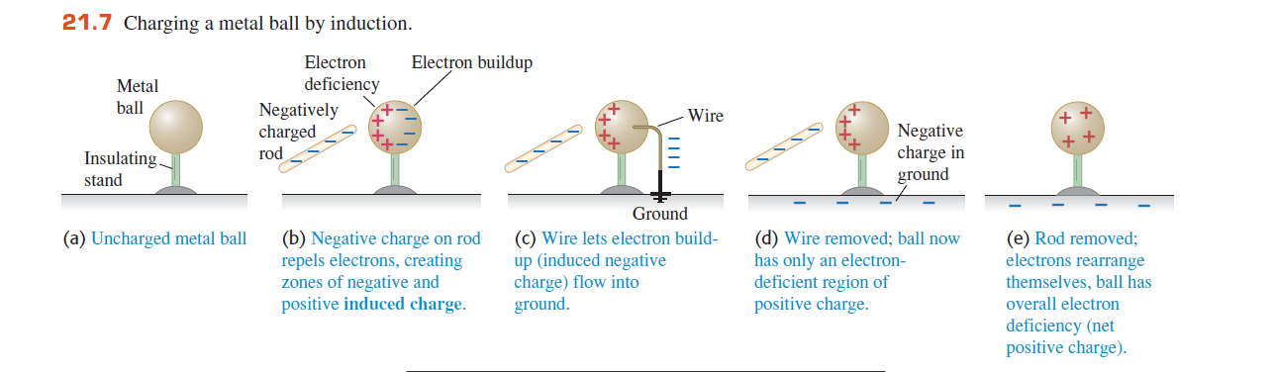
Conservation and interaction

Slide 5
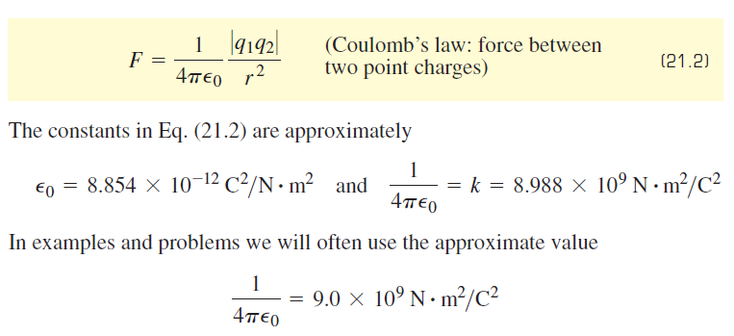
Coulomb’s law
Direction
Magnitude
Notes:
To calculate the exact force between charge points, we use

Slide 6


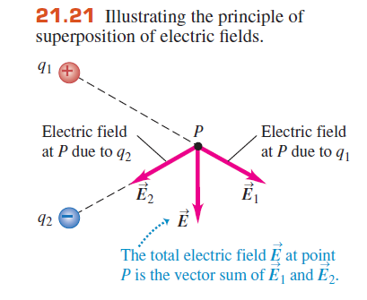
Electric Field
Superposition method
Notes:
Definition formula of electric field
Determinant formula of electric field
Once we know the magnitude and direction of charge point’s electric field, we can add these vectors independently.
So we can calculate the electric field of simple object
For superposition method, I think you will learn it in VE215 as well

Slide 7
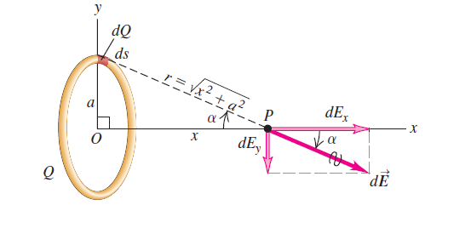
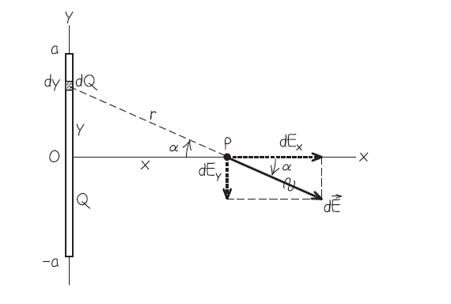
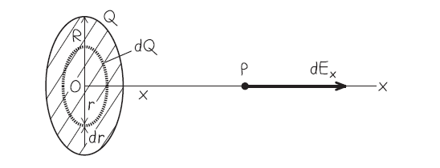
Notes:
Adopt the superposition method, the electric field of ring, rod and disk can be calculated through integration

Slide 8
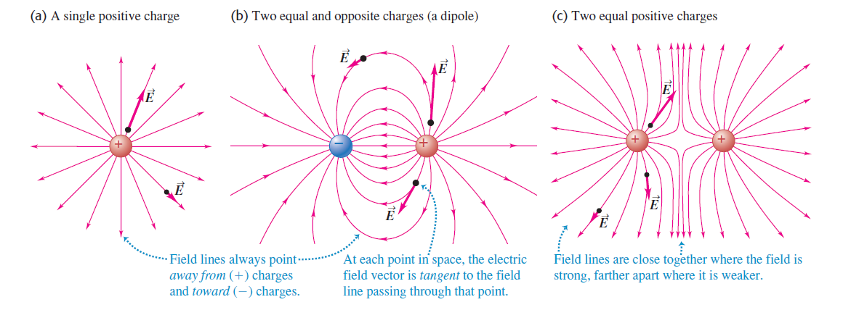
Electric Field line
Notes:
Three features of the electric field line

Slide 9
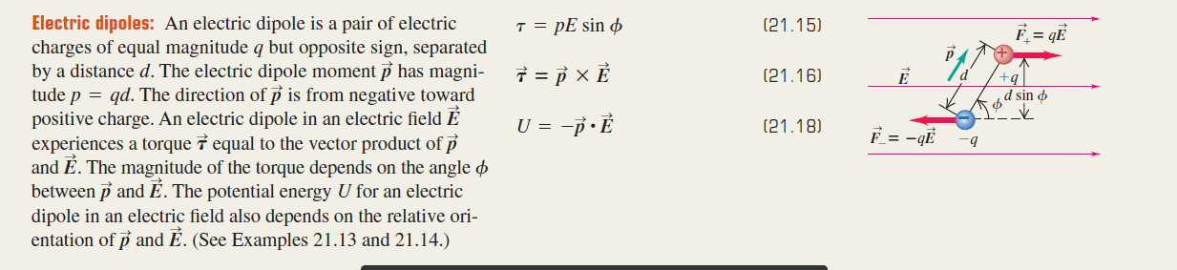
Electric Dipoles
Notes:
Regard electric dipoles simply as two charge points with opposite sign charge put in electric field E

Slide 10
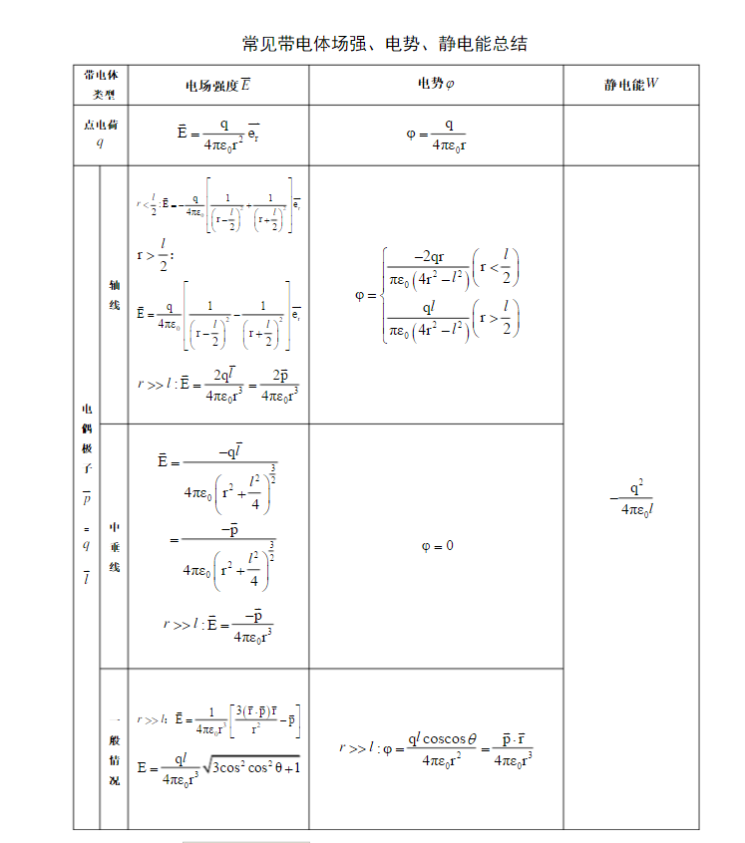
Notes:
Here is the summary of objects’ electric field, electric potential and electric energy
You will encounter these objects many times, we highly recommend you to prove these one by one by yourselves.

Slide 11
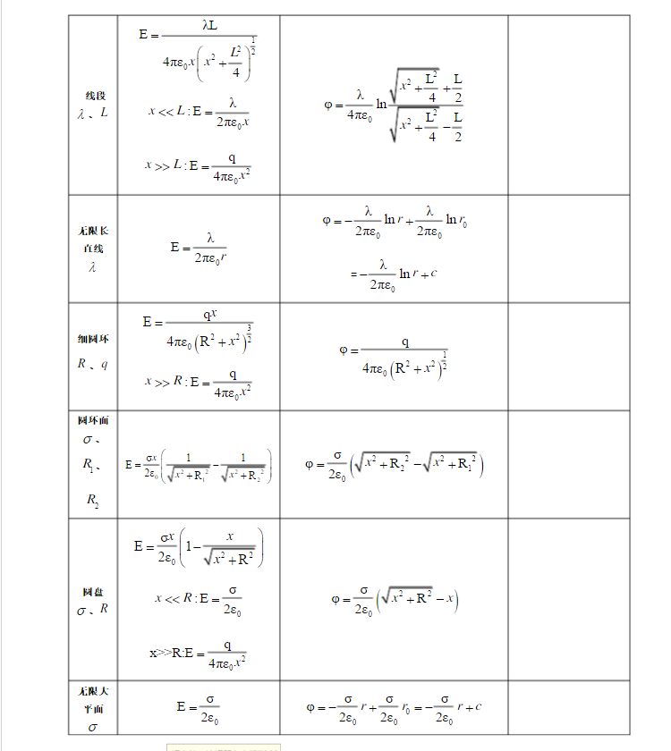

Slide 12
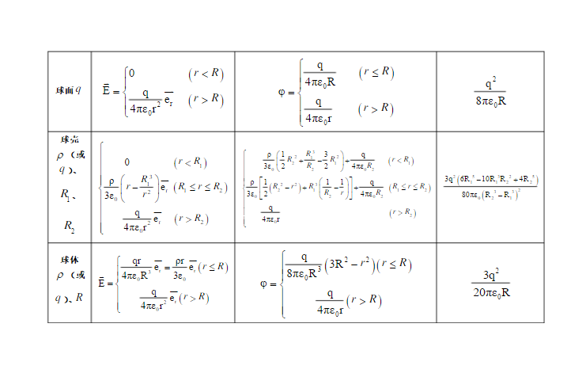

Slide 13
Chapter 22
Zhang Yangtao

Slide 14
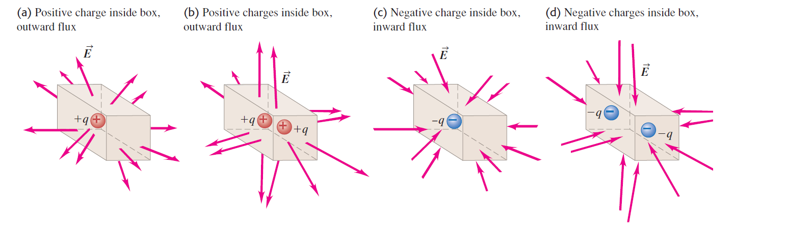
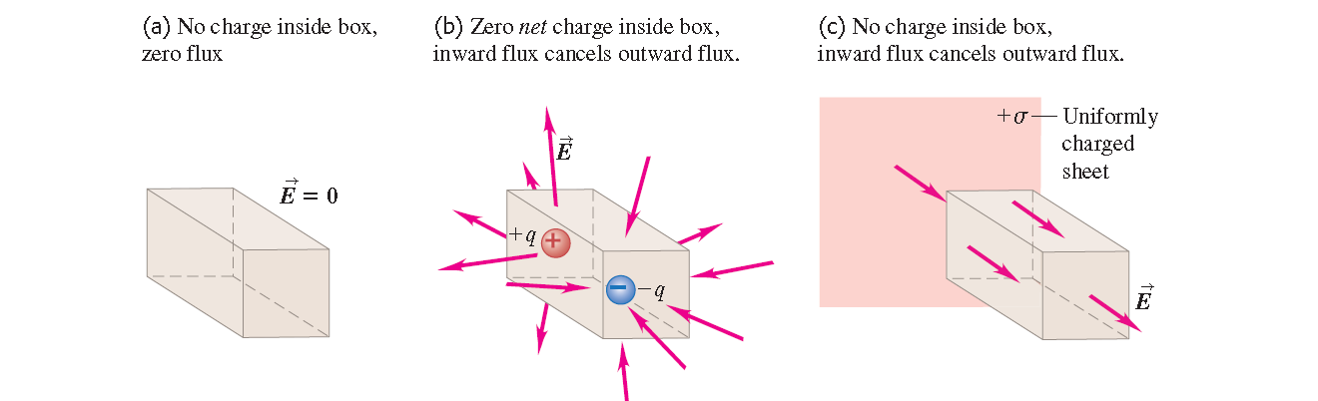
Electric flux ~ electric line

Slide 15
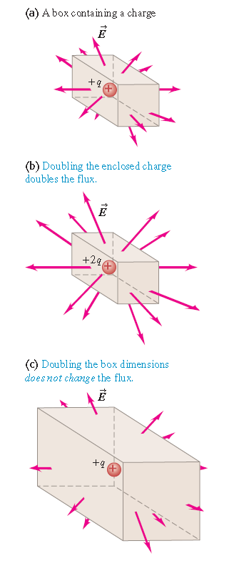
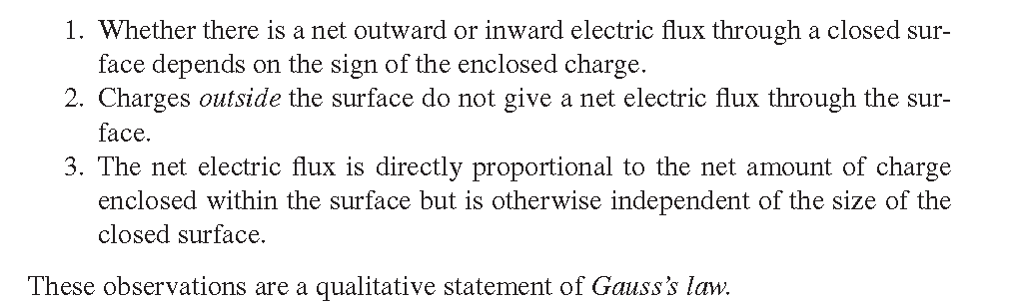

Slide 16
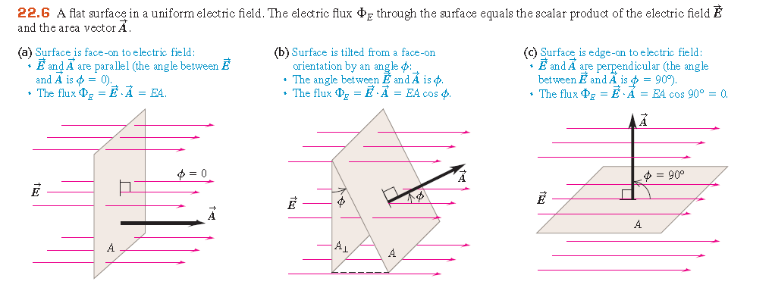

Electric flux

Slide 17
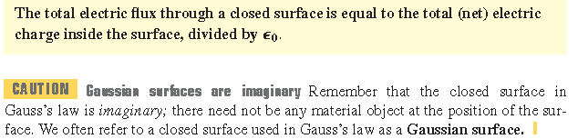
Gauss law

Slide 18
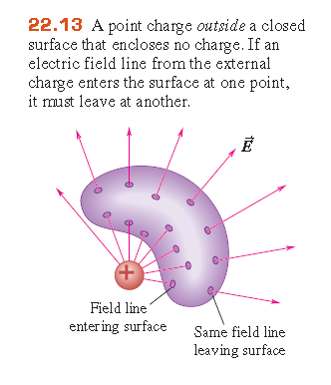

Slide 19
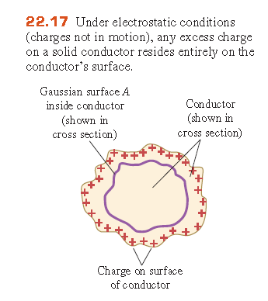
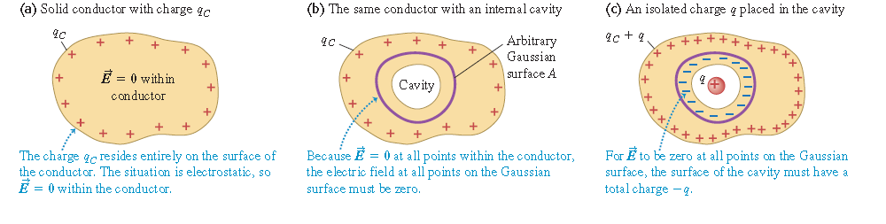
Electrostatic

Slide 20
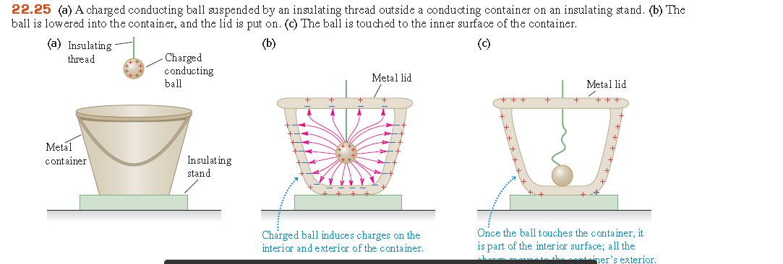

Slide 21
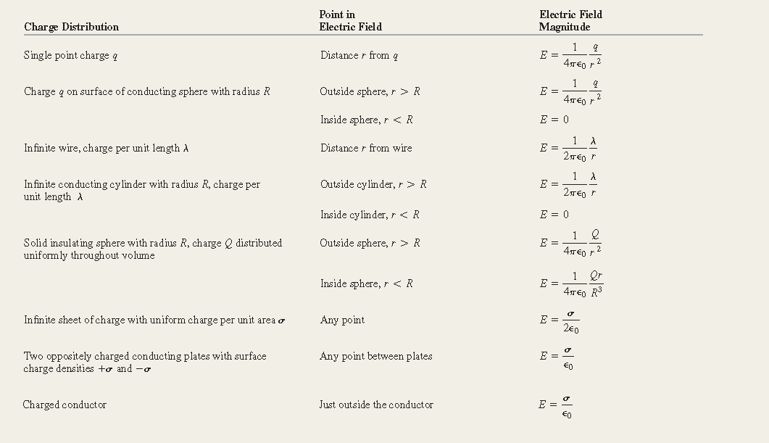

Slide 22
Chapter23
Zhang Yangtao

Slide 23
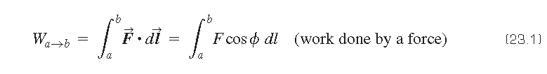
Electric potential energy

Slide 24
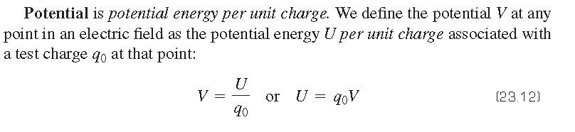


Slide 25

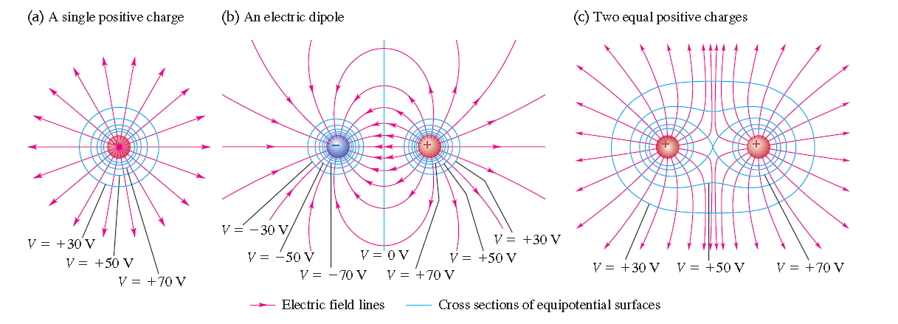

Slide 26
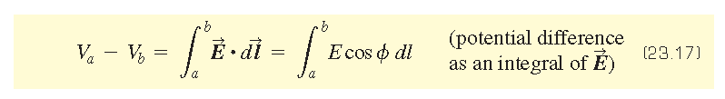

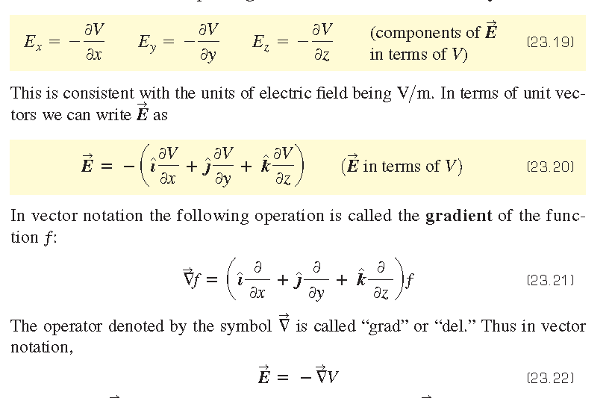

Slide 27
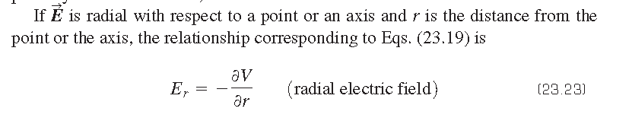

Slide 28
Chapter24
Zhang Yangtao

Slide 29
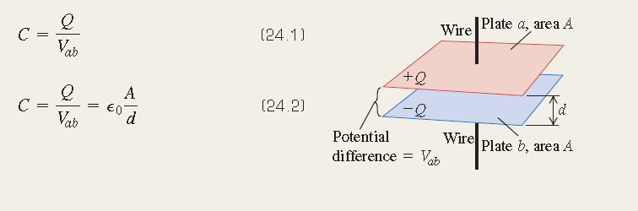



Slide 30
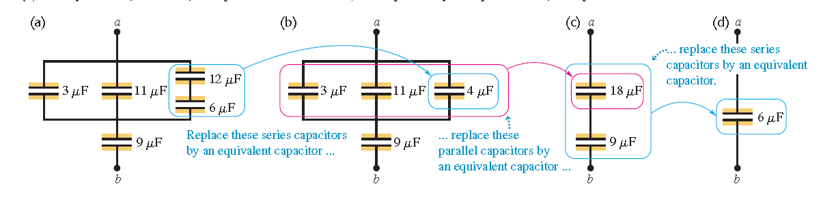

Slide 31




Slide 32
