Slide 1

Ve216 Spring 2018
Midterm 1 Review
Chapter 1 ~ 2
2018/3/14
Jing Dong
Yuhong Zhao

Slide 2
Chapter 1
Transformation of Signals
Signal Characteristics
Singularity Functions
Block Diagram
Classification of CT System

Slide 3
Transformation of Signals
1. Time:
folding (y(t)=x(-t)), time-scaling (y(t)=x(at)), time- shifting (y(t)=x(t-t0)), general time transformation (y(t)=x(at-b))
2. Amplitude:
reversal (y(t)=-x(t)), scaling (y(t)=ax(t)), shifting (y(t)=x(t)+b)

Slide 4
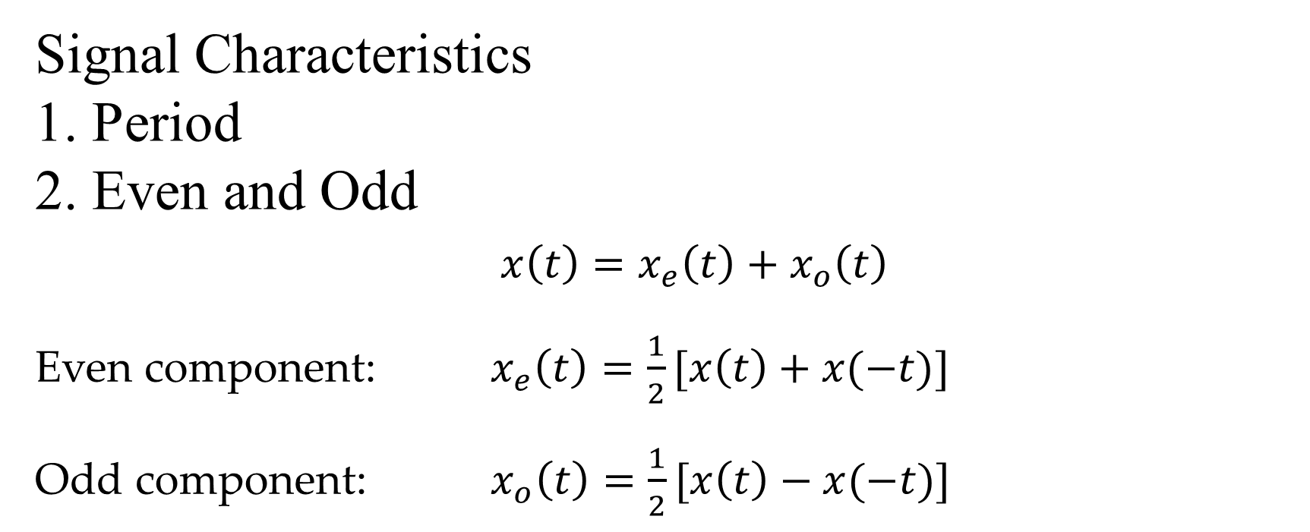
Signal Characteristics
1. Period
2. Even and Odd
$x\left(t\right)=x_{e}\left(t\right)+x_{o}\left(t\right)$
Even component: $x_{e}\left(t\right)=\frac{1}{2}[x\left(t\right)+x(−t)]$
Odd component: $x_{o}\left(t\right)=\frac{1}{2}[x\left(t\right)−x(−t)]$

Slide 5
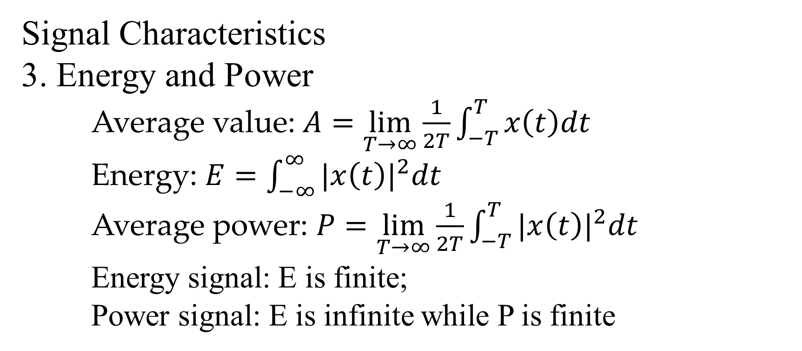
Signal Characteristics
3. Energy and Power
Average value: $A=\lim_{T→∞}{\frac{1}{2T}\int_{−T}^{T}{x\left(t\right)dt}}$
Energy: $E=\int_{−∞}^{∞}{{|x\left(t\right)|}^{2}dt}$
Average power: $P=\lim_{T→∞}{\frac{1}{2T}\int_{−T}^{T}{{|x\left(t\right)|}^{2}dt}}$
Energy signal: E is finite;
Power signal: E is infinite while P is finite

Slide 6
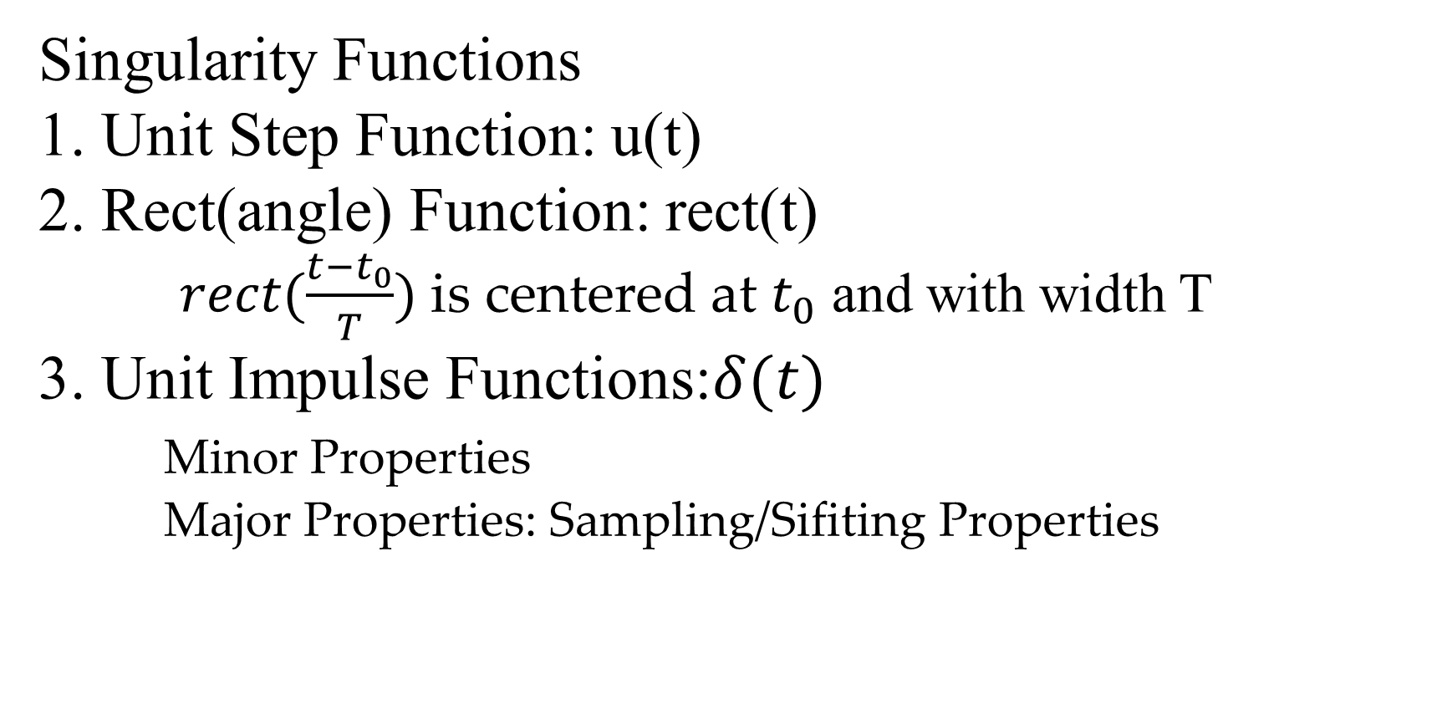
Singularity Functions
1. Unit Step Function: u(t)
2. Rect(angle) Function: rect(t)
$rect(\frac{t−t_{0}}{T})$ is centered at $t_{0}$ and with width T
3. Unit Impulse Functions:$δ(t)$
Minor Properties
Major Properties: Sampling/Sifiting Properties

Slide 7
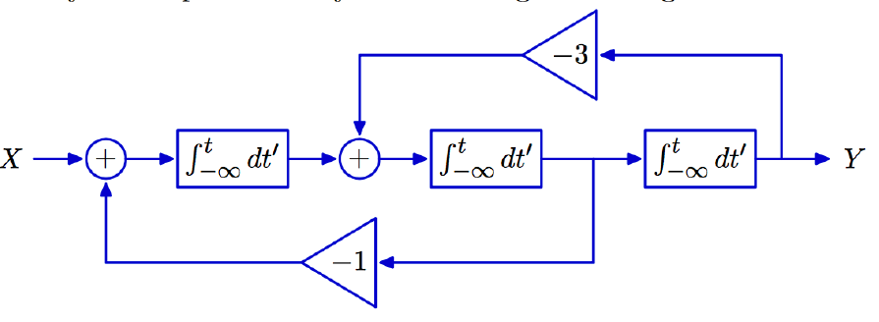
Block Diagram
It has several basic elements: adder, constant multiplier (amplifier), signal multiplier, differentiator and integrator
Use a linear differential equation with constant coefficients to represent this system

Slide 8
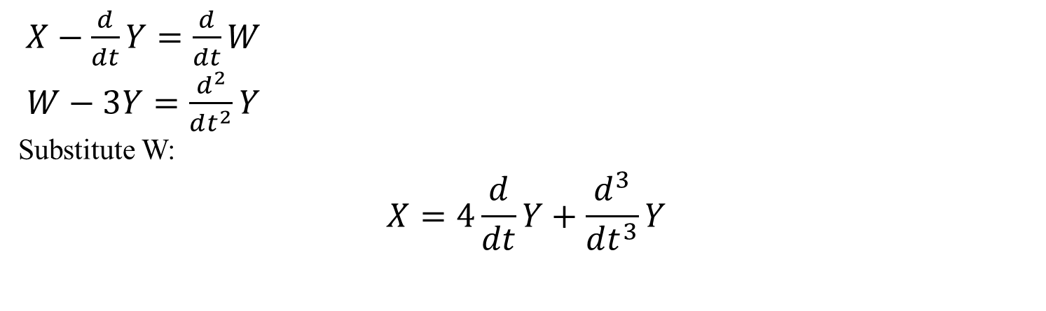
w
$X−\frac{d}{dt}Y=\frac{d}{dt}W$
$W−3Y=\frac{d^{2}}{dt^{2}}Y$
Substitute W:
$$X=4\frac{d}{dt}Y+\frac{d^{3}}{dt^{3}}Y$$

Slide 9
Classification of CT System
1. Amplitude properties
• Linearity • Stability • Invertibility
2. Time properties
• Causality • Memory • Time-invariance

Slide 10

Problems in Quiz
Quiz 2
y(t)=x(sin(t))
1. Where is –t0 when we judge time-invariance?
2. The definitions of causality and memory.
Quiz 3
Note: do not forget u(t-a) after convolution

Slide 11
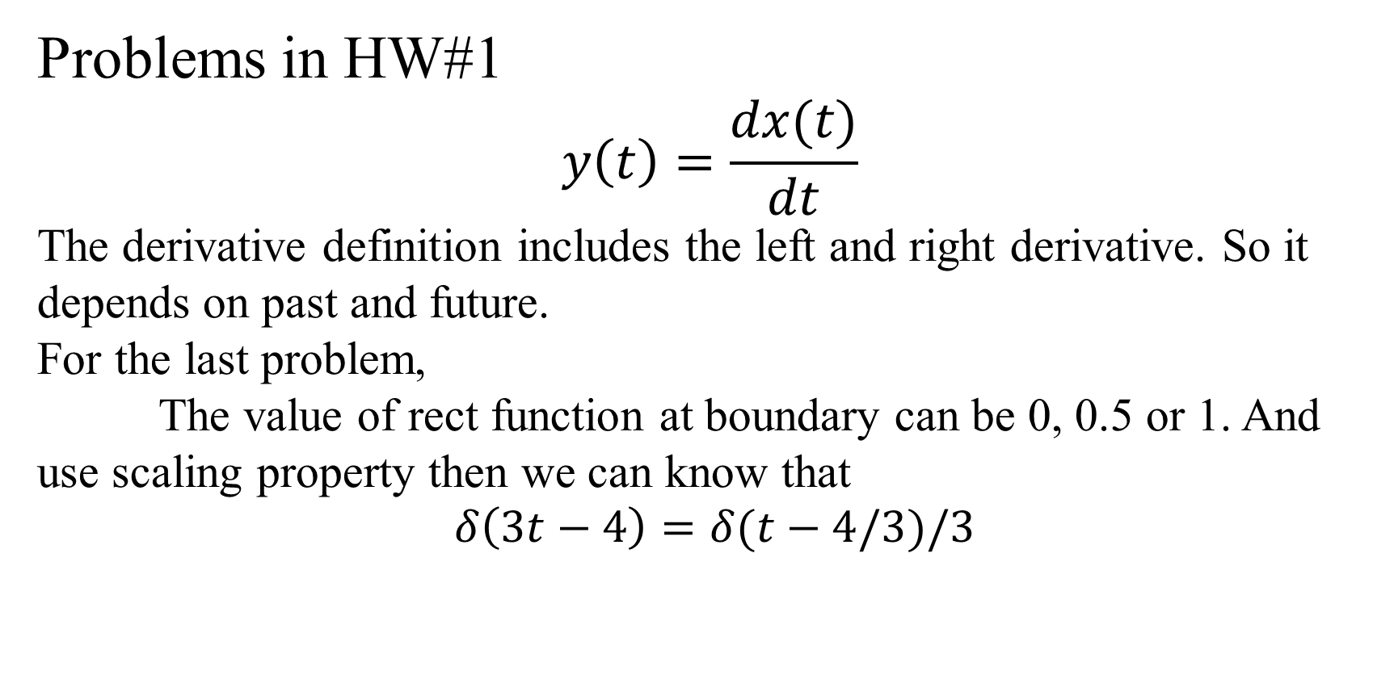
Problems in HW#1
$$y\left(t\right)=\frac{dx(t)}{dt}$$
The derivative definition includes the left and right derivative. So it depends on past and future.
For the last problem,
The value of rect function at boundary can be 0, 0.5 or 1. And use scaling property then we can know that
$$δ\left(3t−4\right)=δ(t−4/3)/3$$

Slide 12
Chapter 2
Impulse Response
Convolution Definition and Procedure
Properties of Convolution
LTI System Properties via Impulse Response
Step response

Slide 13
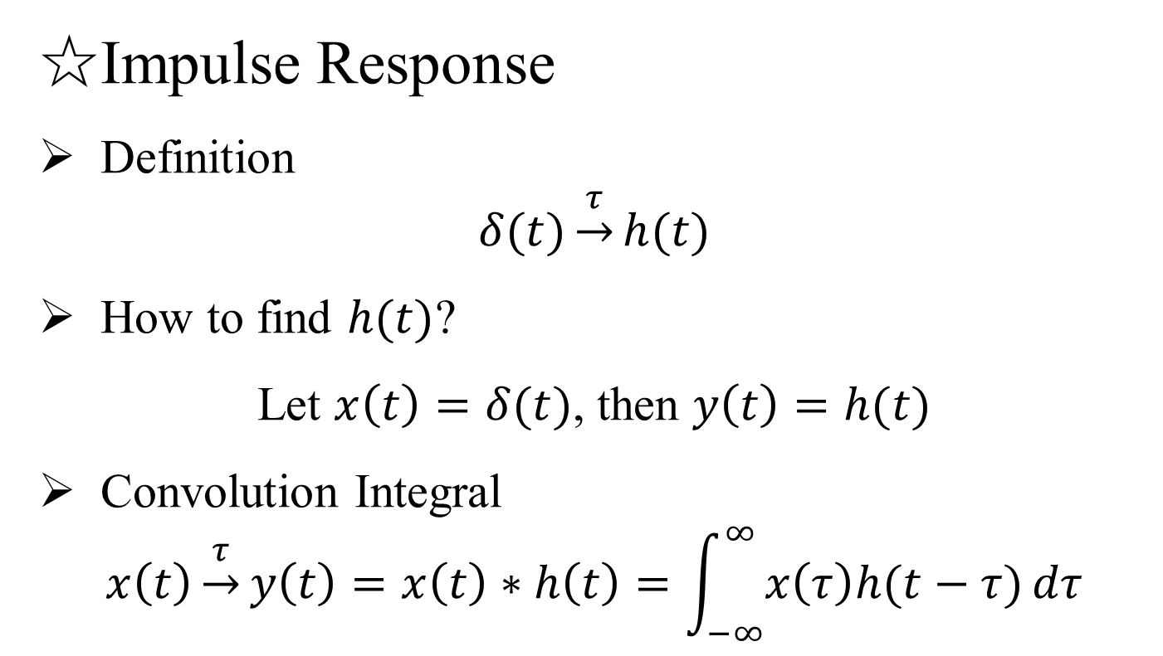
☆Impulse Response
Definition
$$δ(t)\underset{→}{τ}h(t)$$
How to find $h(t)$?
Let $x\left(t\right)=δ(t)$, then $y\left(t\right)=h(t)$
Convolution Integral
$$x\left(t\right)\underset{→}{τ}y\left(t\right)=x\left(t\right)∗h\left(t\right)=\int_{−∞}^{∞}{x\left(τ\right)h(t−τ)}dτ$$

Slide 14
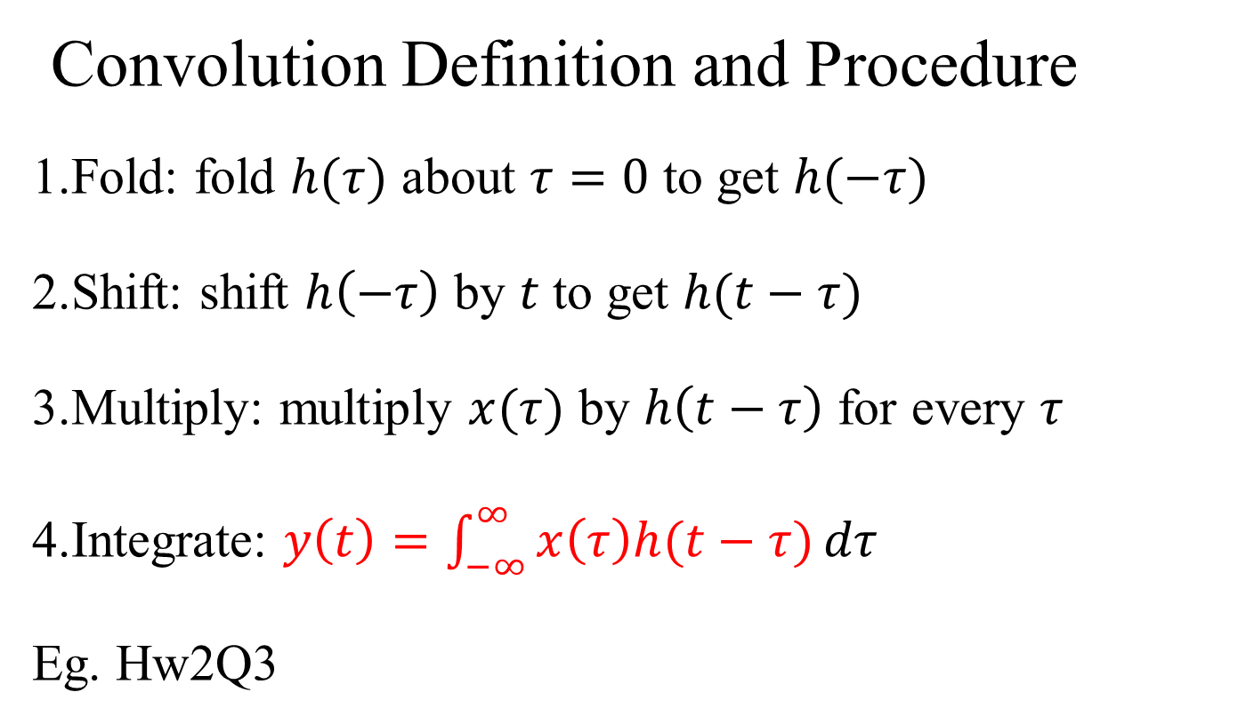
Convolution Definition and Procedure
1.Fold: fold $h(τ)$ about $τ=0$ to get $h(−τ)$
2.Shift: shift $h\left(−τ\right)$ by $t$ to get $h(t−τ)$
3.Multiply: multiply $x(τ)$ by $h\left(t−τ\right)$ for every $τ$
4.Integrate: $y\left(t\right)=\int_{−∞}^{∞}{x\left(τ\right)h(t−τ)}dτ$
Eg. Hw2Q3

Slide 15
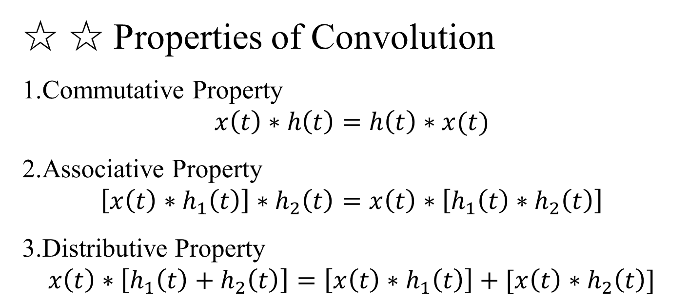
☆ ☆ Properties of Convolution
1.Commutative Property
$$x\left(t\right)∗h\left(t\right)=h\left(t\right)∗x(t)$$
2.Associative Property
$$\left[x\left(t\right)∗h_{1}\left(t\right)\right]∗h_{2}\left(t\right)=x\left(t\right)∗\left[h_{1}\left(t\right)∗h_{2}\left(t\right)\right]$$
3.Distributive Property
$$x\left(t\right)∗\left[h_{1}\left(t\right)+h_{2}\left(t\right)\right]=\left[x\left(t\right)∗h_{1}\left(t\right)\right]+[x\left(t\right)∗h_{2}\left(t\right)]$$

Slide 16
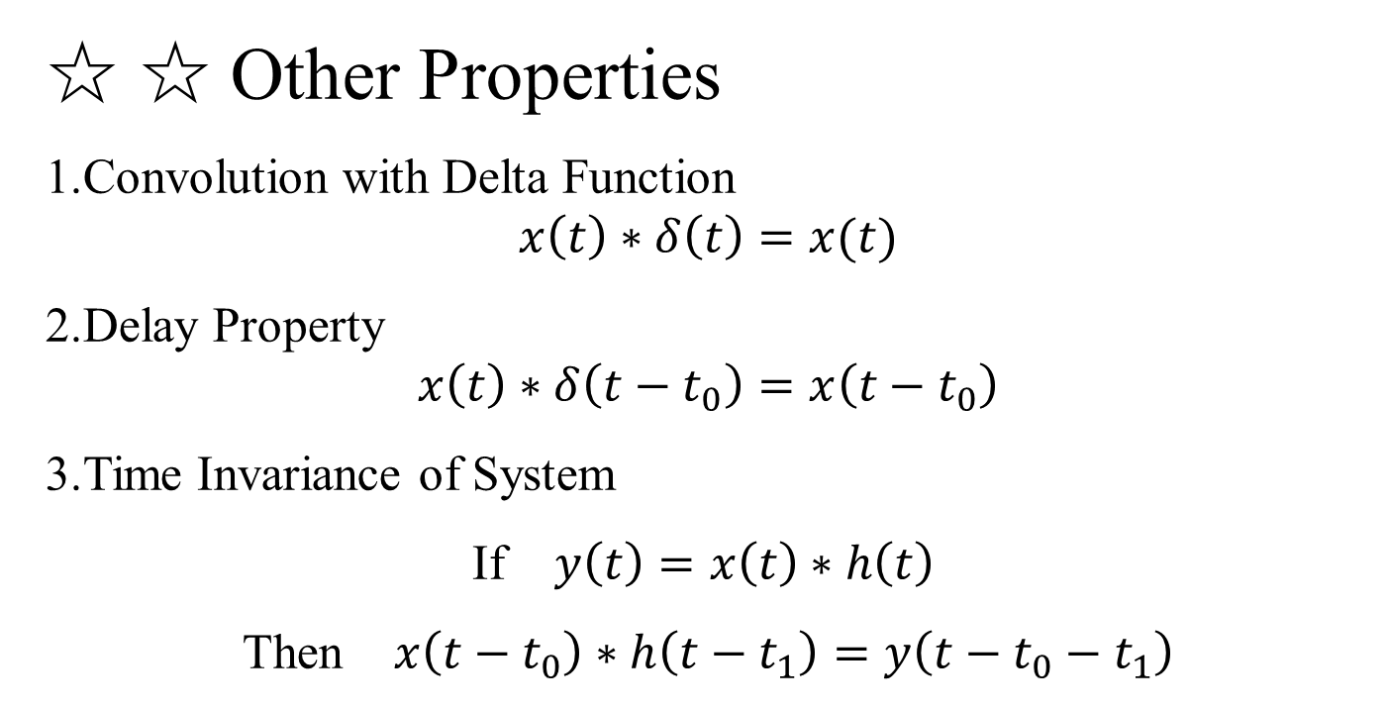
☆ ☆ Other Properties
1.Convolution with Delta Function
$$x\left(t\right)∗δ\left(t\right)=x(t)$$
2.Delay Property
$$x\left(t\right)∗δ\left(t−t_{0}\right)=x\left(t−t_{0}\right)$$
3.Time Invariance of System
If $y\left(t\right)=x\left(t\right)∗h\left(t\right)$
Then $x\left(t−t_{0}\right)∗h\left(t−t_{1}\right)=y\left(t−t_{0}−t_{1}\right)$

Slide 17
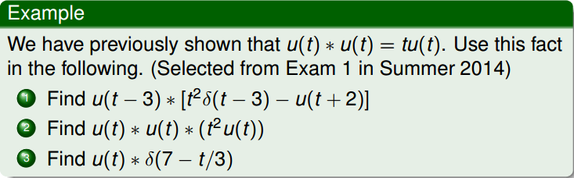
Ex.1

Slide 18
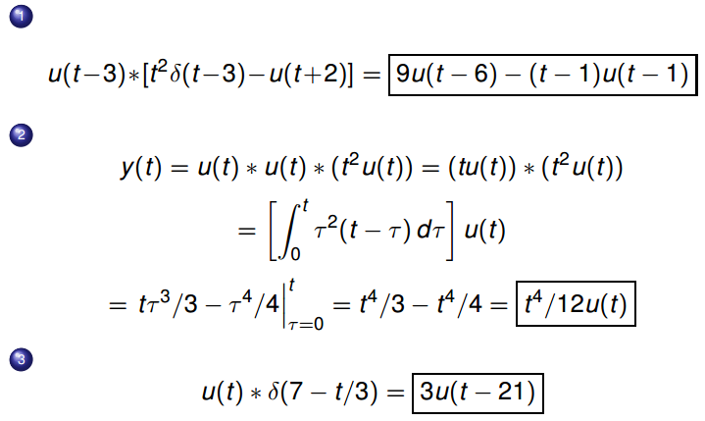
Sol.

Slide 19
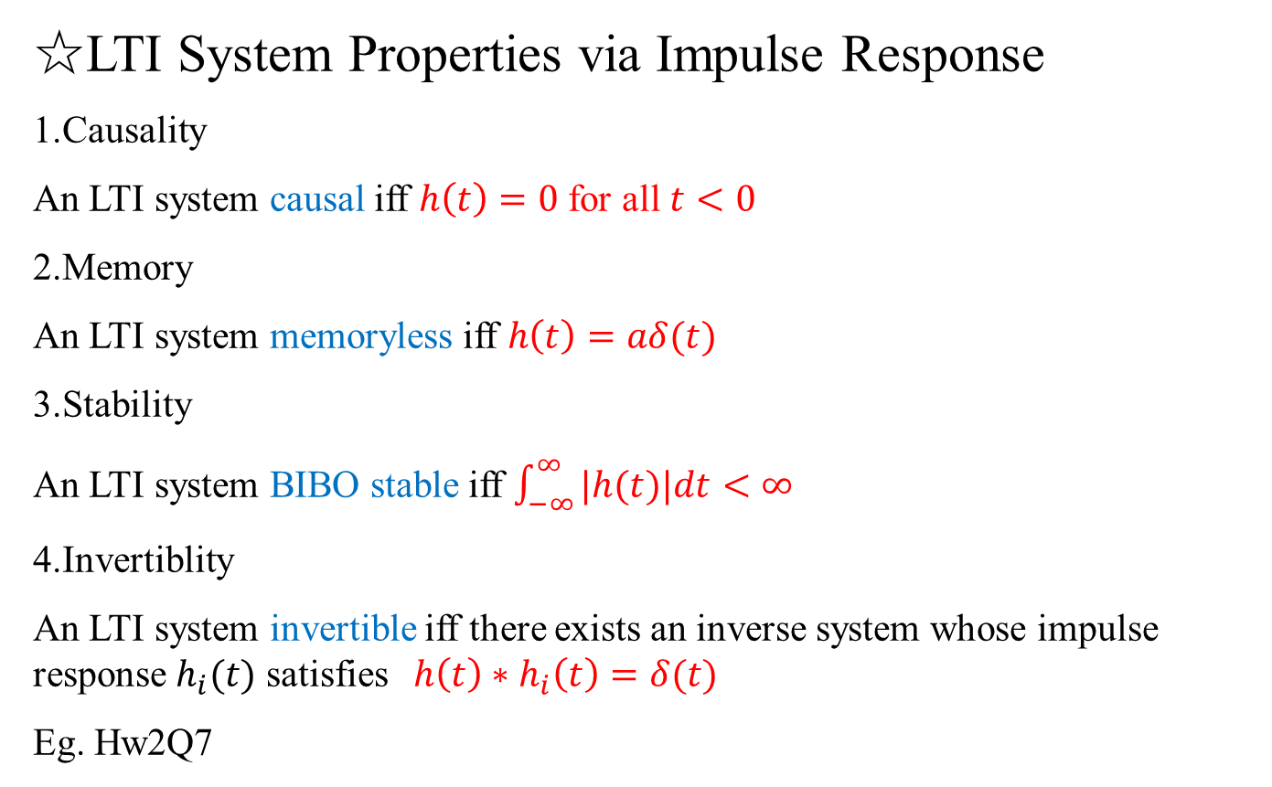
☆LTI System Properties via Impulse Response
1.Causality
An LTI system causal iff $h\left(t\right)=0$ for all $t<0$
2.Memory
An LTI system memoryless iff $h\left(t\right)=aδ(t)$
3.Stability
An LTI system BIBO stable iff $\int_{−∞}^{∞}{|h(t)|dt}<∞$
4.Invertiblity
An LTI system invertible iff there exists an inverse system whose impulse response $h_{i}(t)$ satisfies $h\left(t\right)∗h_{i}\left(t\right)=δ(t)$
Eg. Hw2Q7

Slide 20
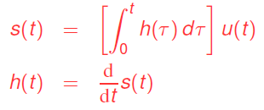
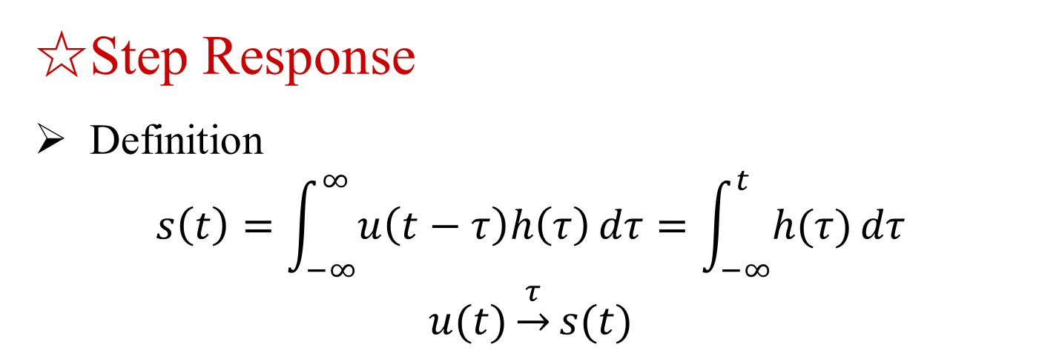
☆Step Response
Definition
$$s\left(t\right)=\int_{−∞}^{∞}{u\left(t−τ\right)h\left(τ\right)}dτ=\int_{−∞}^{t}{h(τ)}dτ$$
$$u(t)\underset{→}{τ}s(t)$$

