Slide 1
VE 216 RC
董靖
2018/3/7

Slide 2
Definition
Signal: “physical” quantity that varies with independent variable or variables
System: physical “device” that performs an operation on a signal

Slide 3
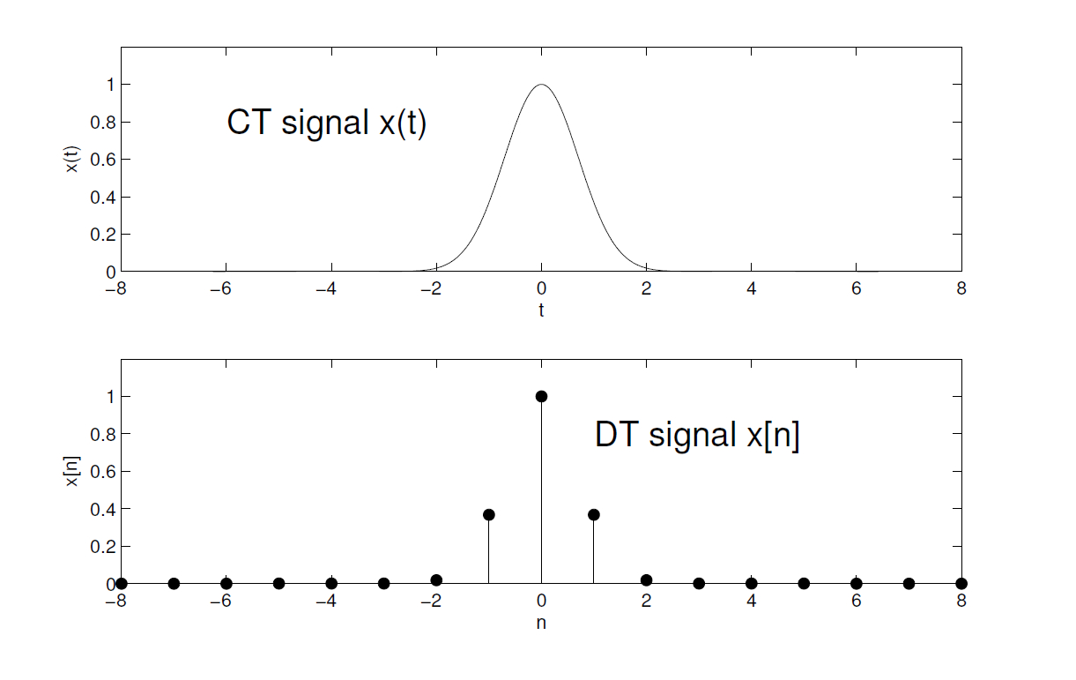
Signal can be classified by the dimension of the domain and dimension of the range.
Continuous-time signal( analog signal/CT): defined for all times
Discrete-time signal (DT): defined only at certain specific values of time

Slide 4
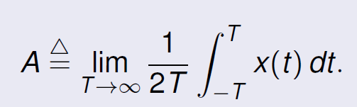
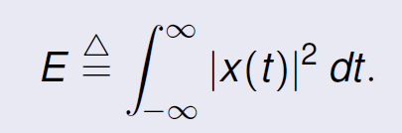
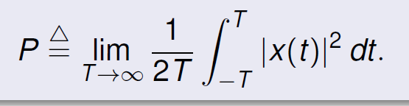
Characteristics
Period: x(t+T)=x(t)
Symmetry: even x(-t)=x(t) ; odd x(-t)=-x(t)
Average value
Energy
Average power
Energy signal: E is finite
Power signal: E is infinite and P is finite and nonzero

Slide 5
Unit step signal:
u(t)=0, when t<0
u(t)=1, when t>=0
Rect(angle) function
rect(t)=1, when -1/2<t<1/2
rect(t)=0, otherwise

Slide 6
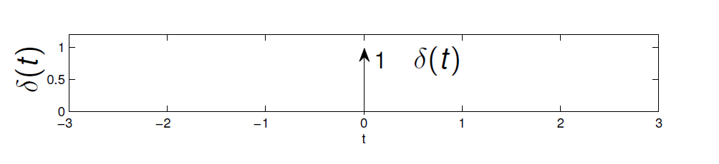
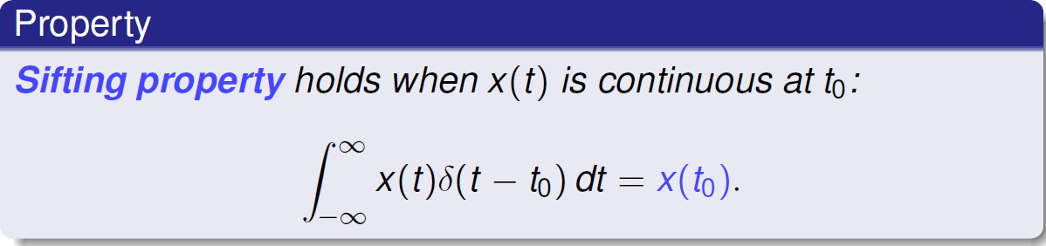
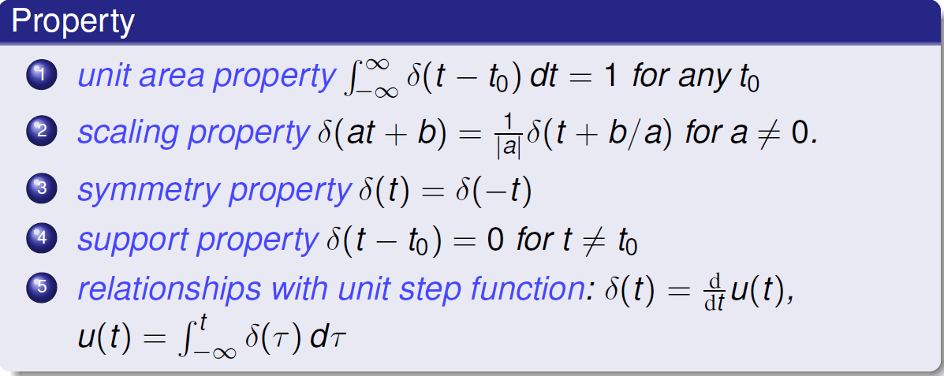
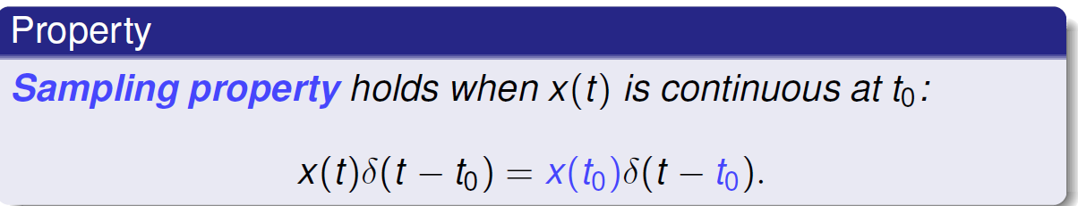
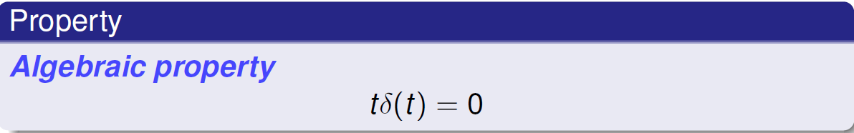
Unit impulse function δ(t)
Practical impulse function

Slide 7
A CT system transforms input signal or excitation into the output signal or response.
Input-output relationship
Block diagram

Slide 8
Determine the system functional H=Y/X for the following system, where A, B, C represent the system functionals for the boxed subsystem.
Answer: H=(A+B)/(1+BC)

Slide 9
Amplitude properties:
Linearity
Stability
Invertibility
Time properities:
Causality
Memory
Time-invariance

Slide 10
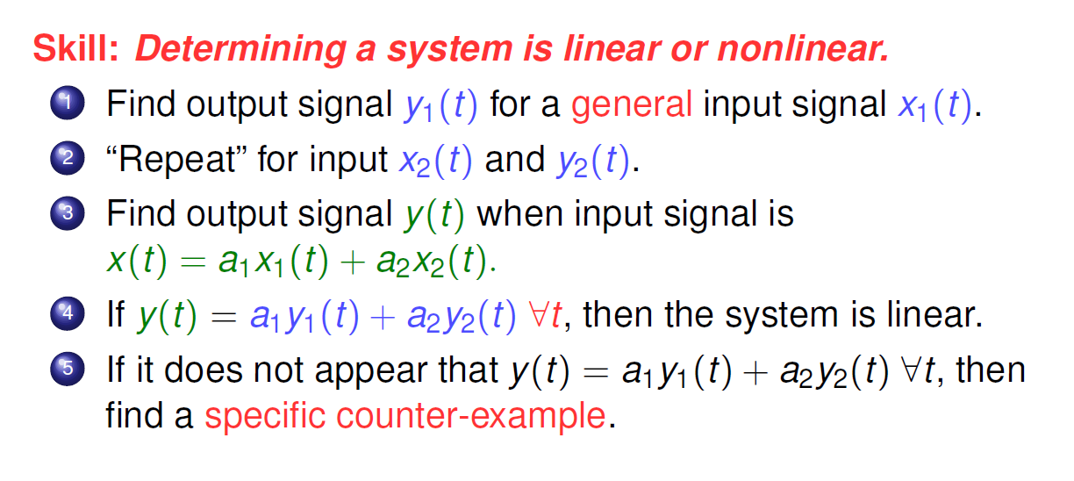

Slide 11
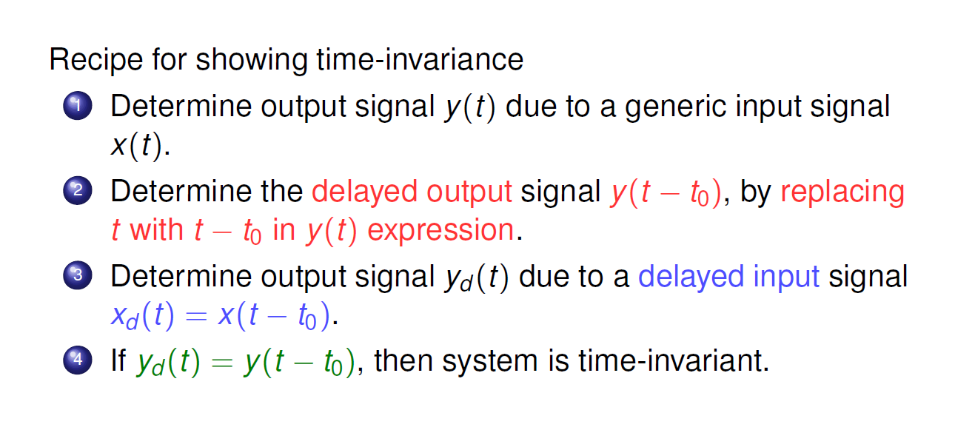

Slide 12
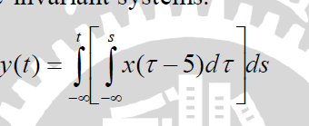
Exercise
Determine whether the following system is time-invariant or not and find the impulse response of the time-invariant system.
Note: impulse response is the response when unit impulse is input.

Slide 13
