Slide 1

Blockchain at Michigan
Session 2: Overview of smart contracts
Friday, July 16th, 2021

Slide 2
Outline
Solidity
Smart contract concepts & code
State variables
Functions
Function modifiers
Events
Struct types
Enum types
Notes:
Structure of a Contract — Solidity 0.6.8 documentation

Slide 3
Solidity Overview
Object-Oriented Programming (OOP) language for writing smart contracts
Video to help explain object oriented programming
Solidity is also a Turing-Complete language, meaning that it can computate any computable function if the code is written correctly
Contracts = classes
Classes are a specific aspect of OOP
Notes:
PwC blockchain expert pinpoints sources of ambiguity in smart contracts

Slide 4
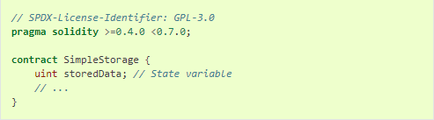
State variables
Variables that belong to a specific smart contract
Can be accessed by any function within the contract
Equivalent to member variables

Slide 5
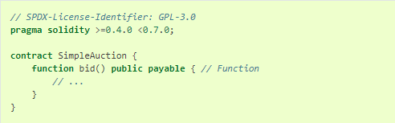
Functions
Performs a specific action for that smart contract
Equivalent to member functions for a class

Slide 6
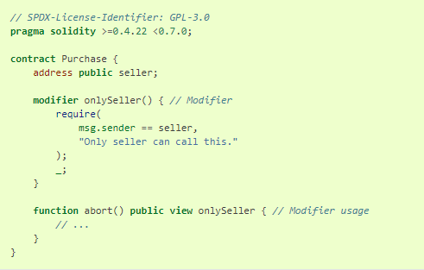
Function modifiers
Used to make sure that a function call is valid
Limit who can call the smart contract
Limit how much Ether must be sent to the function
Equivalent to an if() statement at the beginning of a function

Slide 7
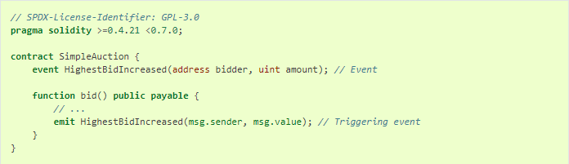
Events
Log certain info on the blockchain in an easily-accessible way
Like making a list of all the significant milestones in a project (but with events, the coder defines “significant”)
Info can be viewed later many different ways (easiest is through the Ethereum block explorer or an API)

Slide 8
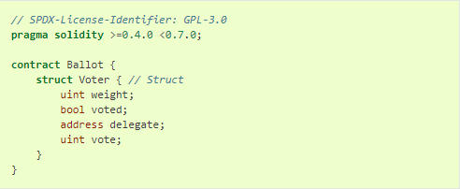
Struct Types
Structs are like mini-classes
They package variables together in a logical way for readability and structure
In some programming languages, structs can include functions, too
This tends to only happen in a highly OOP situation (apps and very large data structures)
For smart contracts, this is uncommon and there’s no need to worry about it

Slide 9
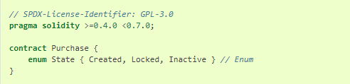
Enum Types
Enum types can only have one of a specific set of values
Ex: Color is an enum type with red, yellow, and purple being possible values of it
This concept is important when working with states, which is common in almost all applications because Ethereum is a state machine
Ex: A specific transaction can be Created but not confirmed yet, Locked and active, or Inactive and no longer useful

Slide 10
More resources
Solidity for Beginners (might help more for those of you who don’t spend much/any time coding)
Ethereum developer tools
How does Ethereum work? (a technical deep dive)
A more simple Ethereum deep dive (written by Alex and past President Nisreen!)
What is an API?
If you want to get ahead, a smart contract tutorial that will help you setup your machine for local development

