Slide 1
SI 608 Projects – Some Ideas & Suggestions
Ceren Budak

Slide 2
How to Pick a Topic
In general, a topic can fall into one or more of four categories:
Methodology: Propose new network metrics, network models, network analysis algorithms, and compare them with baseline metrics/models/algorithm using standard test sets.
Network Analysis: Analyze one or more real-world networks in order to better understand the properties of these networks and the underlining mechanism, and possibly discover novel phenomenon.
Application: Develop a novel application to offer a new function in real-world problems based on network analysis.
Experiments: Develop an experiment to test concepts of networks in a controlled setting (echo chambers effects, social influence etc.).

Slide 3
How to Pick a Topic
When picking a topic, try to ask yourself the following questions (important and solvable):
Is the topic addressing an important problem (or an important need, in the case of building an application) ? Would any one care about it, if you study the network, solve the problem, or build the application?
To what extent, has previous research work addressed this problem? And what remains unknown?
Do you have any idea at all about how to collect the data, solve the problem, or build the application? If not, can you reformulate the problem to make it easier?
For original studies, would you be able to evaluate your solution? That is, how can you demonstrate your solution is good and solves the problem well?

Slide 4
Projects (past years)
Network analysis of a multi-site survey of college students about their perceptions of LGBTQ harassment and discrimination on campus
Examining effects of friending behavior on smoking behavior in high schools
Ideological segregation on social media platforms
Online visualization of MSI networks
Network structure of comic book characters
Analysis of sports team interactions
Simulated information propagation on Twitter
Analysis of world war networks
…

Slide 5
Find Your Comfort Zone
Methodology: hard-core work, high impact, but usually difficult. Unless you have a good idea and enough skills
Analysis is generally easier to handle, but hard to be significant
New networks are usually interesting, but not always
Who will care about the analysis?
Are the results surprising, significant, or trivial?
Can the analysis broaden our knowledge about the domain?
Applications are likely to make high impact if there is a real system that people can use. Plus: they will provide you a platform to run controlled experiments!
e.g., facebook application (though this is a lot harder now given the privacy settings)
Experiments are great way of getting at causality.

Slide 6
Datasets
Examples
Emails (Enron; URV)
Scientific research (DBLP; ACL; co-authorship; grants; patents, …)
Biology networks (Cellular, metabolic, protein-interaction)
Text (e.g. supreme court cases)
Social Media (Twitter, Wikipedia; political blogs)
Example of dataset aggregators:
http://snap.stanford.edu/data/
http://www-personal.umich.edu/~mejn/netdata/
http://netwiki.amath.unc.edu/Main/HomePage
http://deim.urv.cat/~aarenas/data/welcome.htm
http://iv.slis.indiana.edu/db/index.html

Slide 7
Sample Topic 1: NetFlix and IMDB
Netflix is a good example of recommender systems in e-business
Data: user→movie→rating
A natural (bipartite) network
Nodes are users and movies, edges are ratings
Problem: recommend movies to users
Predict my ratings on movies that I haven’t seen
Similarity of movies plays a major role
Similarity of users is also important – collaborative filtering
But there are many reasons that I like a movie
Actor; actress; director; genre; topic; plot; …

Slide 8
Much Richer Information in IMDB
Various types of networks:
Actor/Actress – movie bipartite network
Director-movie bipartite network
Movie similarity network
Based on actors, director
Based on plot, context (country, time, religion, story, …)
How are they similar and how are they different?
Which IMDB network is the best indicator for movie similarity in Netflix data?
Can we leverage the information in these networks to help movie recommendation? => you can take things to the next level by building a system to provide recommendations!

Slide 9
Plan
Process Netflix network, build user-movie networks and movie-movie networks
Process IMDB data, build various networks
Analyze these networks, and compare IMDB network with Netflix network
* Build a recommender system taking multiple networks into consideration
Prerequisites
Someone who knows programming
Someone who knows data analysis

Slide 10
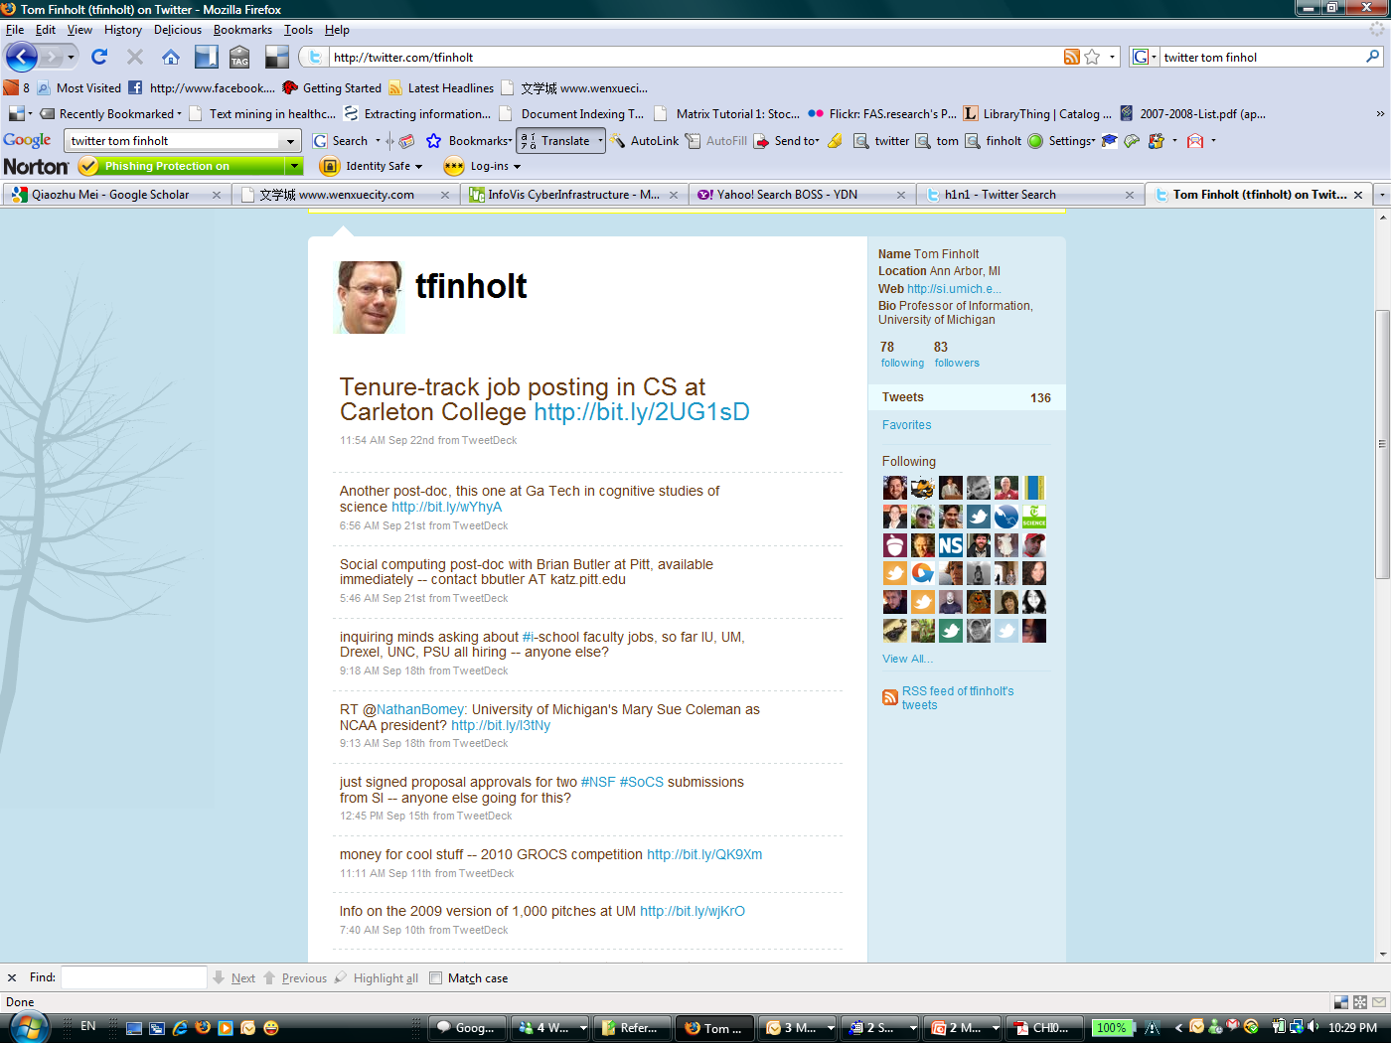
Sample Topics II: Twitter Network
Rich demographic information
Rich Content & Context Information
Social Networks (directed)
Social Networks (directed)

Slide 11
Distance between Users
Geographic distance?
Distance inferred from geographic location
Social distance?
Distance inferred from demographic data
e.g., bipartite graph → one-mode graph
Topical distance?
Distance inferred from the content they write
Network distance
Distance observed from the social network

Slide 12
Plan
Crawl the network, demographics and content from Twitter
Does social media make the world smaller?
Is geographic distance correlated with network distance
Is social distance a good predictor of network distance?
Is content distance a better predictor?
Do demographics & content effect the prestige?
Prerequisites
Someone who knows data manipulation (e.g., crawling, extraction)
Someone who knows programming (to compute the correlations)

Slide 13
Sample Topic 3: Experimental Study of Social Influence/Capital/Cost
Are people more/less likely to share sensitive (e.g. political) information when they know this information is visible to strong ties/weak ties/random people? How does that vary as a function of popularity of the opinion/information (e.g. pro- or anti-LGBTQ rights)?
This route would have the biggest challenge in developing the system to run the experiment.
You can answer these questions through a randomized/controlled experiment.
Create the system (probably need some knowledge of: databases, web programming)
Recruit people (if this is selected, we can have participation from within the class)
Perform analysis to test the effect you are interested in (e.g. if the individual was randomly assigned to the “will show your opinion/information to strong ties” group, are they more or less willing to share than the “will show your opinion/information to weak ties” group?)

Slide 14
Sample Topic 4: Focus on timely issues
Coronavirus?
There is rich data on prevalence of the disease
There is also rich data on discussions about it on social media platforms
Racial Inequality?
Rich data on BLM across different social media platforms (as well as the counter-movement)
These topics can be heavy but are important to understand for our society

Slide 15
Now – Breakout sessions for more project discussions
Use the slides shared to record your ideas
This time, I want you to take one more step:
Pick one of the ideas shared in your breakout session and ask the following question: What data do we need to address this problem? Do a quick search online to find an answer

