Slide 1
SI 608 Week 2 – Basic Concepts – Bonus content
Ceren Budak
09/08/20

Slide 2
Implementing Adjacency List
Solution 1. Using linked lists
Too much memory/time overhead
Uses dynamic allocated memory or pointers
Solution 2. Using an array of vectors
Easier to code, no bad memory issues – But very slow
Solution 3. Using arrays (!)
Assuming the total number of edges is known – Very fast and memory-efficient

Slide 3
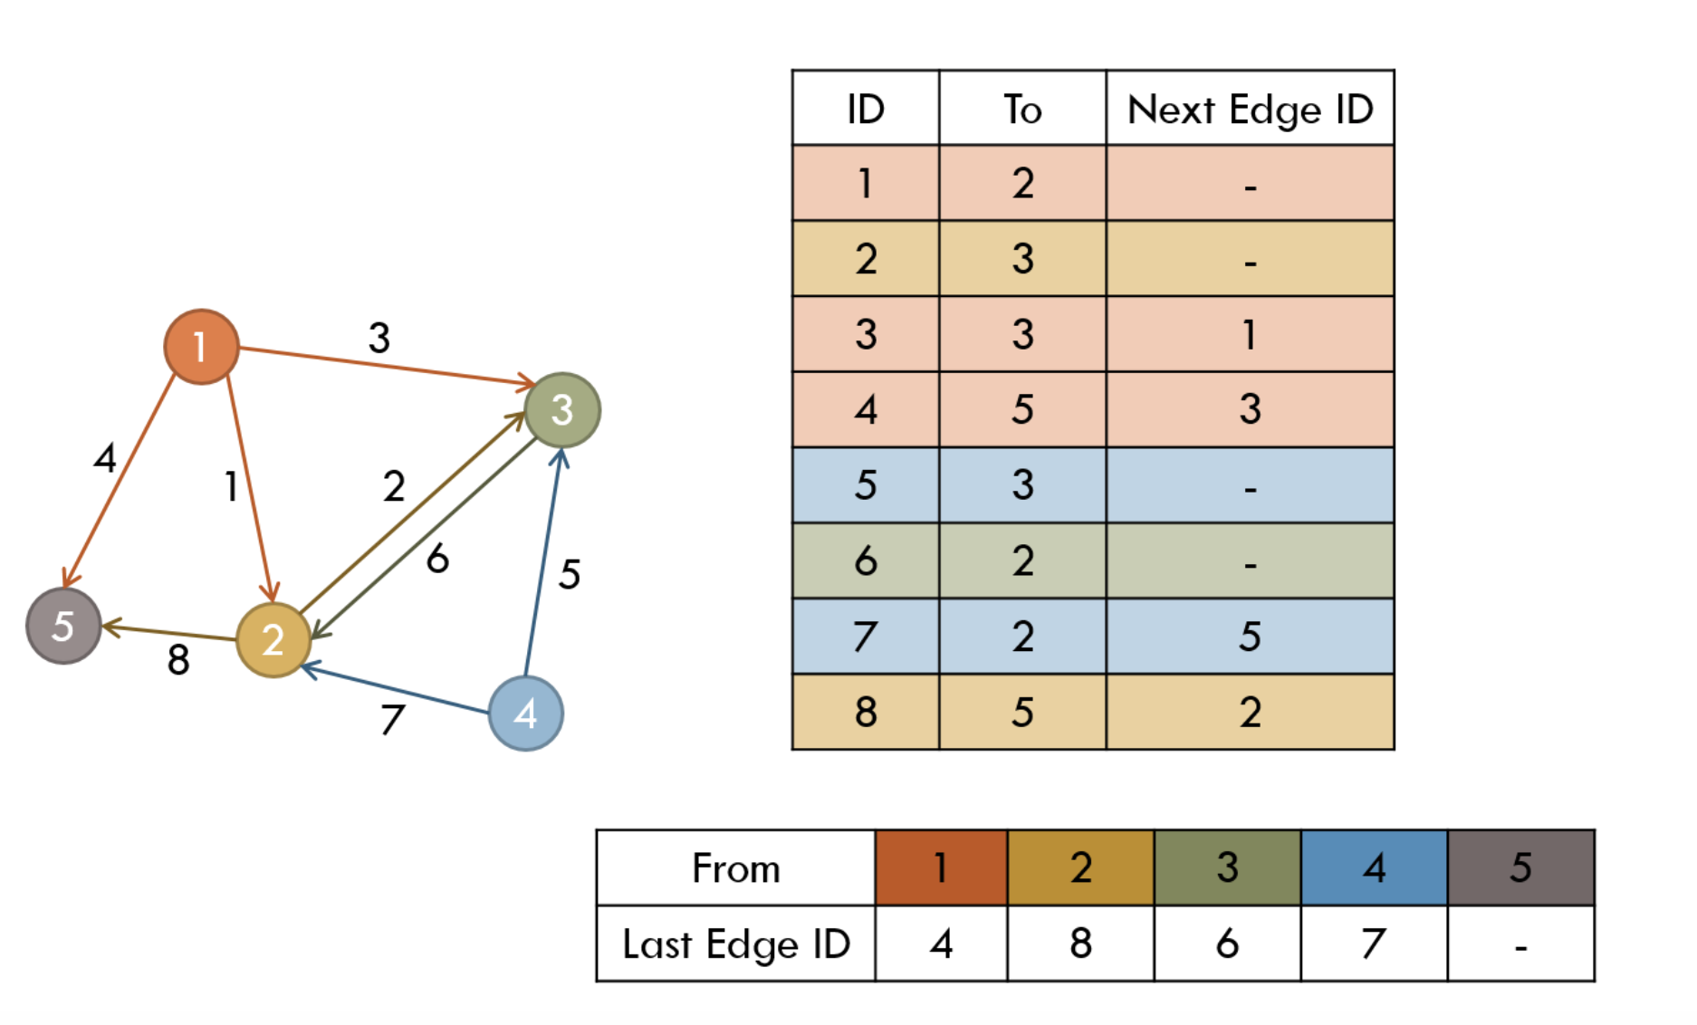

Slide 4
Array implementation
Have two arrays E of size m and LE of size n
E contains the edges
LE contains the starting pointers of the edge lists
Initialize LE[i] = -1 for all i
LE[i] = 0 is also fine if the arrays are 1-indexed
Inserting a new edge from u to v with ID k
E[k].to = v
E[k].nextID = LE[u]
LE[u] = k

Slide 5
Array implementation
Iterating over all edges starting at u:
for(ID = LE[u]; ID != -1; ID = E[ID].nextID)
// E[ID] is an edge starting from u
Once built, it’s hard to modify the edges
The graph better be static!
But adding more edges is easy

Slide 6
Types of graphs

Slide 7
Some we talked about last week

Slide 8
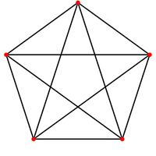
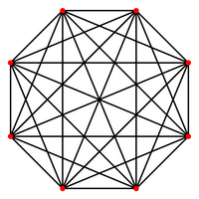
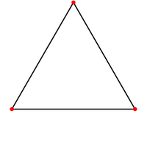
Cliques and Complete Graphs
K_{n} is the complete graph (clique) with K vertices
Every vertex is connected to every other vertex
there are n*(n-1)/2 undirected edges
K₃
K₅
K₈
Real world examples: peer review; NBA league; round-robin tournament;

Slide 9
Bipartite (Two-Mode) Networks
Edges occur only between two groups of nodes, not within those groups
For example, we may have individuals and events
directors and boards of directors
customers and the items they purchase
metabolites and the reactions they participate in
Real world examples: directors and boards; students and courses;

Slide 10
Projection to One-mode Network
group 1
Two-mode network
One mode projection
two nodes from the first group are connected if they link to the same node in the second group
some loss of information
naturally high occurrence of cliques
group 2

Slide 11
A few others

Slide 12
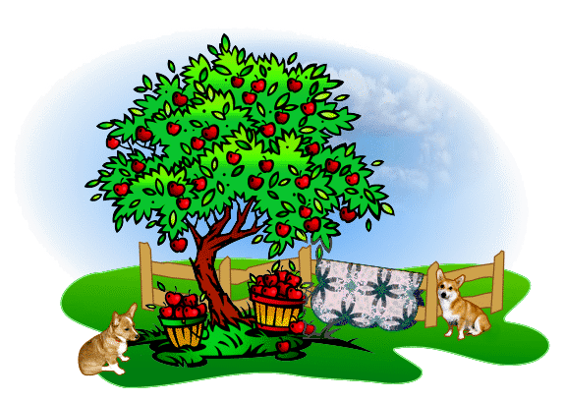
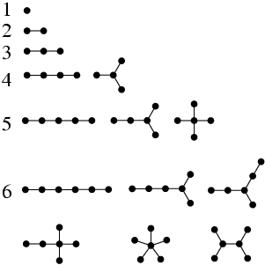
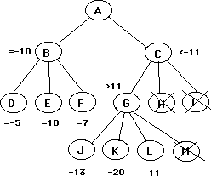
Trees
Trees are connected undirected graphs that contain no cycles
Very important in computer science and other fields

Slide 13
Properties of Trees
G is connected and has no cycles.
G has no cycles, and a cycle is formed if any edge is added to G.
G is connected, and it is not connected anymore if any edge is removed from G.
Any two vertices in G are connected by a unique path.
G is connected and has n vertices and n-1 edges

Slide 14
Generalized Trees
Directed Tree:
No universal definition
Directed tree = tree with directed edges
Forests:
a disjoint union of trees
(Unconnected) graph in which each connected component is a tree
Real world examples: family trees, company employee hierarchy

Slide 15
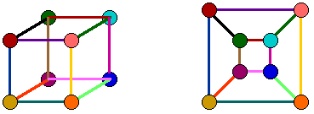
Planar Graphs
A graph is planar if it can be drawn on a plane without any edges crossing
Hah! Here is “Isomorphism” again!
Usage: design highway networks – avoid highway bridges
Real world example: circuits (avoiding crossing wires)

Slide 16
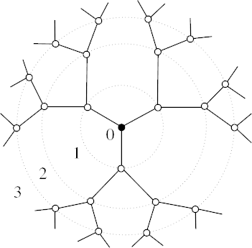
Lattice Graph
Lattice:
A graph which can be drawn like a grid/mesh/lattice
Every vertex has the same degree, and connects to its k nearest neighbors
Bethe lattice (Cayley tree):
A connected, undirected, acyclic graph where each node is connected to z neighbors
Real world examples: spider web, nets, rings

Slide 17
More on graph theory

Slide 18
Graph Isomorphism
Map vertices from G to G’ w/o changing link relations
An isomorphism of graphs G and G’ is a bijection between the vertex sets of G and G’
G = (V, E), G’ = (V’, E’)
f: V → V’: one-to-one match between vertices in G and G’
An edge (u, v) in G if and only if there is an edge (u’ ,v’) in G’
f(1) = a
f(2) = b
f(3) = c
f(4) = d
d
1
4
a
2
b
3
c

Slide 19
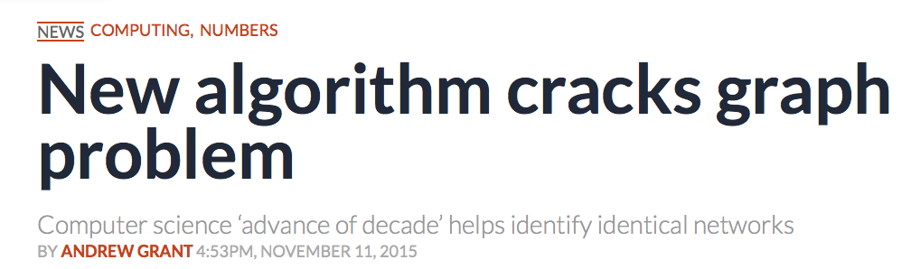
Quiz: Isomorphism?
?
?
The 2015 proof was retracted and edited, the new proof is not fully reviewed yet
Notes:
The graph isomorphism problem is one of few standard problems in computational complexity theory belonging to NP, but not known to belong to either of its well-known (and, if P ≠ NP, disjoint) subsets: P and NP-complete. It is one of only two, out of 12 total, problems listed in Garey & Johnson (1979) whose complexity remains unresolved, the other being integer factorization. It is however known that if the problem is NP-complete then the polynomial hierarchy collapses to a finite level.^{[6]}
In November 2015, László Babai, a mathematician and computer scientist at the University of Chicago, claimed to have proven that the graph isomorphism problem is solvable in quasi-polynomial time. This work has not yet been vetted.^{[7][8]}

Slide 20
Subgraph
A graph G’ = (V’, E’) is a subgraph of G = (V, E), if and .
Vertices of G’ is a subset of vertices of G
Edges of G’ is a subset of edges of G
G is called the super-graph of G’
B
B
C
F
A
C
G
H
E
D
G
E
D
Real world examples:
Network of a department → network of a university
Road system of a state → road system of the country

