Slide 1
SI 608 Week 5 – Scale Free Networks
Ceren Budak

Slide 2
Distribution of Discrete Outcomes
In these distributions, the output are continuous values;
That’s how you plot those values on the x-axis.
In many cases, the outcomes are discrete values
There is no natural order of the x values
e.g., cities in the world, students in the classroom
How to plot the distribution of discrete outcomes?
Rank the outcomes with their “frequency of occurrences,” then plot the ranks on x-axis
x ~ rank of the outcome
p(x) ~ frequency of the item ranked at the x-th position

Slide 3
Zipf’s Law: Special Case of Power Law
Zipf
George Kingsley Zipf, a Harvard linguistics professor, sought to determine the 'size' of the 3rd or 8th or 100th most common word.
Size here denotes the frequency of use of the word in English text, and not the length of the word itself.
Zipf's law states that the size of the r'th largest occurrence of the event is inversely proportional to its rank: y ~ r ^{-β} , with β close to unity.

Slide 4
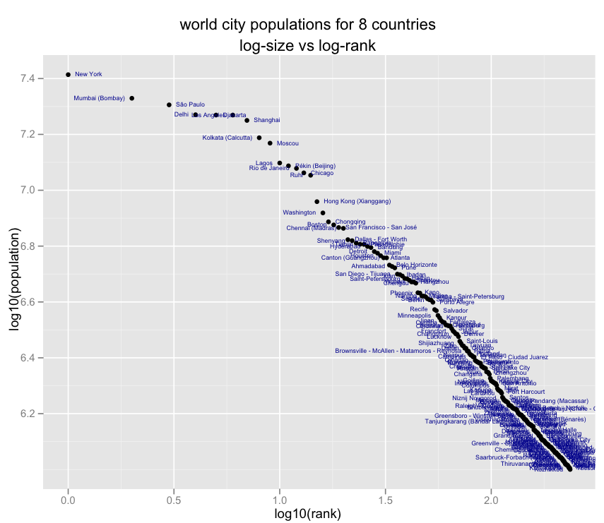
Example: Zipf’s Distribution
Outcomes: cities;
p(x): population of cities
x-axis is log(rank of city)
y-axis is log(population)
p(k) ~ k^{-α}
k: rank of the city
http://anyall.org/blog/2009/05/zipfs-law-and-world-city-populations/

Slide 5
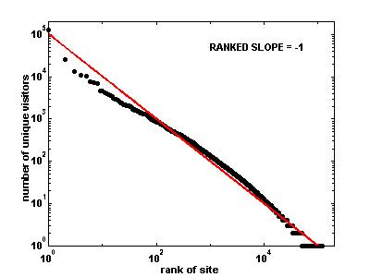
Zipf’s Law & AOL Site Visits
Deviation from Zipf’s law
(1) the most popular sites would have to be slightly more popular, and (2) the less popular sites slightly more numerous

Slide 6
Optional: Alternative models
Pennock Model
D.M. Pennock et al. (2002) Winners don’t take all, PNAS, 99/8, 5207-5211.
Differs from the BA model primarily in that:
New vertices are not automatically assigned edges
Probability of attaching is partially independent of degree
BA Extended model
Albert R., Barabasi A.L.: Topology of evolving networks: local events and universality
Differs from the simple BA model in that:
Edges are added between existing nodes, not only the newcomer
Edges are rewired between existing nodes

Slide 7
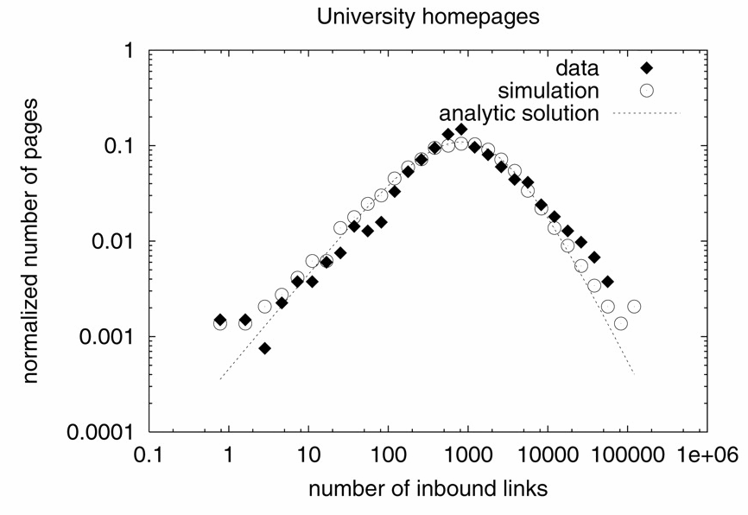
Pennock model
Example: It is reasonable to assume that some webpages will be linked to in part because of what they are rather than the number of links they already have

Slide 8
Pennock model
The probability that an endpoint of a new edge connects to vertex i is
α = probability of preferential attachment
Total nodes at time t
Connectivity at t
(my popularity)

Slide 9
Alternative model (directed)
Network starts with m₀ vertices, which link to each other with probability p₀ (as in an Erdos-Renyi random graph)
At each time step t, one vertex and m edges are added to the network
Instead of attaching one end point of each edge to the newly introduced vertex, choose both end points according to the probability:
fraction of edges in the graph that start at v
fraction of edges in the graph that end at v
the credit v
gets just for being
one of the vertices

Slide 10
‘Scale free’ network
Observations:
α + β + γ = 1, so can vary the relative importance of indegree, outdegree, and independent probability
in an undirected network α = β, since indegree and outdegree are the same
Not all vertices will be connected, since they are not ‘born’ with an edge
The larger γ is, the less scale-free the degree distribution
edges are added without regard to degree
Original BA paper showed that in that case the degree distribution P(k) ~ exp(-βk) , an exponential distribution

Slide 11
Extended BA model (undirected network)
Start with m₀ isolated nodes
At each timestep perform one of the following operations:
With prob. p add m (m≤ m₀) new links
For each link
Select ‘from’ vertex at random
Select ‘to’ vertex in proportion to its degree (+1 so that isolated vertices have a chance of getting links)
With prob. q where 0 < q < 1 – p
rewire m links
select node i at random and one of i’s links
rewire the endpoint of i’s link to another node j randomly chosen with probability Π(k_{j})
With prob. 1 – p - q
add a new node with m links
connect endpoints of the m links to vertices in proportion to their degree (Π(k_{j})

Slide 12
Extended BA model – cont’d
In the p=q=0 limit, reduces to the simple BA model
In the high q (q -> 1) limit, extended model produces a network with an exponential tail because growth is very slow (only rewiring is occurring)

Slide 13
Thoughts
BA networks are not clustered.
Can you think of a growth model of having preferential attachment and high clustering coefficient at the same time?
BA networks are undirected.
Can you make it directed?
What would the network look like if nodes are added over time, but not attached preferentially?
What other processes might give rise to power law networks?

Slide 14
You Should Know
power law distributions are everywhere
there are good and bad ways of fitting them
some distributions are not power-law
preferential attachment leads to power law networks…
… but it’s not the whole story, and not the only way of generating them

