Slide 1
SI 608 Week 5 – Scale Free Networks
Ceren Budak

Slide 2
Outline
Power law distributions
Fitting
What kinds of processes generate power laws?
Barabasi-Albert model for scale-free graphs

Slide 3
Power Law Distributions

Slide 4
What is a Heavy Tailed-Distribution?
Skew:
Normal distribution (not heavy tailed)
e.g. heights of human males: centered around 180cm (5’11’’)
Zipf’s or power-law distribution (heavy tailed)
e.g. city population sizes: NYC 8 million, but many, many small towns
Ratio of max to min:
Human heights
tallest man: 272cm (8’11”), shortest man: (1’10”) ratio: 4.8 from the Guinness Book of world records
City sizes
NYC: pop. 8 million, Duffield, Virginia pop. 52, ratio: 150,000
Notes:
A heavy tailed distribution tends to have very large values with many outliers (very high values). The heavier the tail, the larger the probability that you’ll get one or more very large values in a sample.
If you take a random sample from the distribution, you’re likely to end up with a sample made up from mostly small values

Slide 5
Power-law Distribution - the Long Tails
Many cities with a small population
A few cities with a very large population
high skew (asymmetry)
Comparing to a normal distribution:
Many people with a mediate height
Almost nobody with a very high or very low height
symmetry
Percentage of city
Population of city

Slide 6
We can Manipulate the Shape of the Tail by Scaling the Axes
Linear scale
Log-log scale
Long-tail on a linear scale straight line on a log-log plot

Slide 7
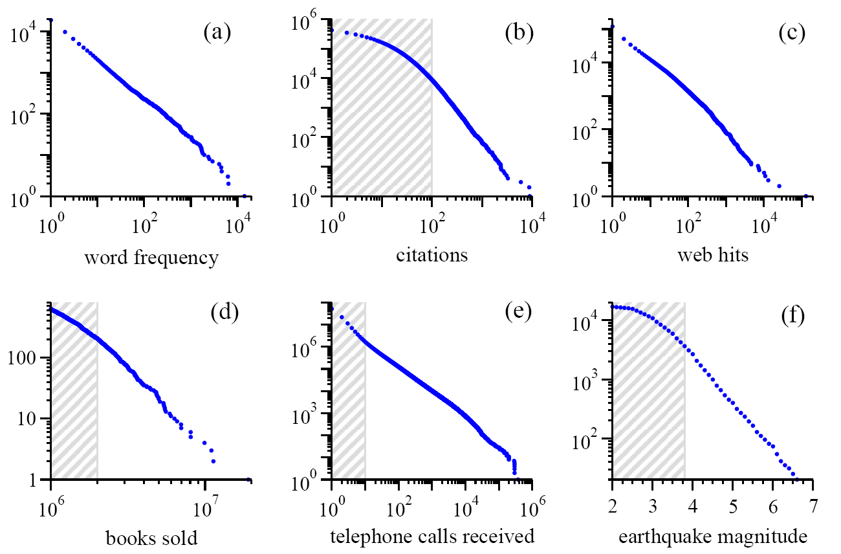
Power Laws are Seemingly Everywhere *these are cumulative distributions
Moby Dick
scientific papers 1981-1997
AOL users visiting sites ‘97
bestsellers 1895-1965
AT&T customers on 1 day
California 1910-1992
Source:MEJ Newman, ’Power laws, Pareto distributions and Zipf’s law’, Contemporary Physics 46, 323–351 (2005)

Slide 8
Yet More Power Laws
Moon
Solar flares
wars (1816-1980)
richest individuals 2003
US family names 1990
US cities 2003
Source:MEJ Newman, ’Power laws, Pareto distributions and Zipf’s law’, Contemporary Physics 46, 323–351 (2005)

Slide 9
Power Law Distribution
The probability of observing an item of size ‘x’ is given by
Straight line on a log-log plot
normalization constant (probabilities over all x must sum to 1)
α : scaling exponent, or power law exponent

Slide 10
Logarithmic Axes
Powers of a number will be uniformly spaced
2⁰=1, 2¹=2, 2²=4, 2³=8, 2⁴=16, 2⁵=32, 2⁶=64,….
1
2
3
10
20
30
100
200

Slide 11
More Properties of Power Law
The (complementary) cumulative distribution is still power law
with a smaller scaling exponent (α - 1)
The cumulative distribution also presents a straight line on a log-log plot.

Slide 12
Fitting Power-law Distributions
Assume we know a distribution is power-law
How can we find the scale exponent α ?

Slide 13
Linear Scale Plot – Difficult to fit
The shape of the curve depends on the range of the value
Requires a deeper look at the smallest bins
whole range
first few bins of values

Slide 14
Log-log Plot – Find the Slope
Bin the different values of x and create a frequency histogram in log-log scale; find a straight line to fit
ln(# of times x occurred)
-α: slope of the straight line
ln(x)
x can represent various quantities, the in-degree of a node, the magnitude of an earthquake, the frequency of a word in text, etc.

Slide 15
Log-log Plot – Find the Slope
Bin the different values of x and create a frequency histogram in log-log scale; find a straight line to fit
ln(# of times x occurred)
-α: slope of the straight line
ln(x)
x can represent various quantities, the in-degree of a node, the magnitude of an earthquake, the frequency of a word in text, etc.

Slide 16
Problem of Log-log Plot: Noise in the Tail
Here we have tens of thousands of observations when x < 10
Noise in the tail:
Here we have 0, 1 or 2 observations
of values of x when x > 500
Actually don’t see all the zero
values because log(0) is undef.

Slide 17
Effect of the Noise in the Tail
Fitting a straight line to it via least squares regression will give values of the exponent a that are too low
fitted α
true α

Slide 18
What Goes Wrong ?
Have few values here
Have many more values here

Slide 19
First Solution: Binning the Data
Bin data into exponentially wider bins: 1, 2, 4, 8, 16, 32, …
Normalize by the width of the bin
evenly
spaced
datapoints
less noise
in the tail
of the
distribution
?
Disadvantage: binning smoothes out data but also loses information
Notes:
so long as α > 1, the number of samples per bin goes down as k increases and the bins in the tail will have more statistical noise than those that precede them.

Slide 20
Better Solution: Cumulative Distribution
No loss of information
No need to bin, has value at each observed value of x
But now have cumulative distribution
i.e. how many of the values of x are at least X
The cumulative probability of a power law probability distribution is also power law but with an exponent α - 1

Slide 21
Fitting Via Regression to the Cumulative Distribution
Cumulative distribution smoothes the noise out
Now the tail is much
smoother
Now the slope is
1 - α

Slide 22
Where to Start Fitting?
Some data exhibit a power law only in the tail
After binning or taking the cumulative distribution you can fit to the tail
So need to select an x_{min} the value of x where you think the power-law starts
Certainly x_{min} needs to be greater than 0, because x^{−α} is infinite at x = 0

Slide 23
Example
Distribution of citations to papers
Power law is evident only in the tail (x_{min} > 100 citations)
x_{min}
Source: MEJ Newman, ’Power laws, Pareto distributions and Zipf’s law’, Contemporary Physics 46, 323–351 (2005)

Slide 24
Maximum Likelihood Fitting – Best
You have to be sure you have a power-law distribution
Without looking at the shape, compute α directly
x_{i} are all your data points, and you have n of them
Want to know how to derive alpha? Check out MEJ Newman, ’Power laws, Pareto distributions and Zipf’s law’, Contemporary Physics 46, 323–351 (2005)

Slide 25
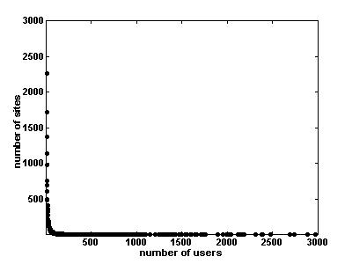
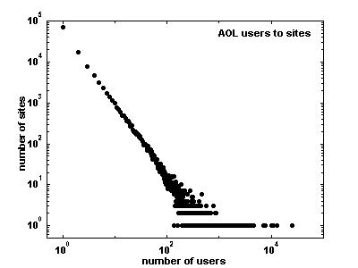
Example on a Real Data set: Number of AOL Visitors to Different Websites in 1997
simple binning on a linear
scale
simple binning on a log-log scale

Slide 26

Trying to Fit Directly…
Direct fit is too shallow: α = 1.17…

Slide 27
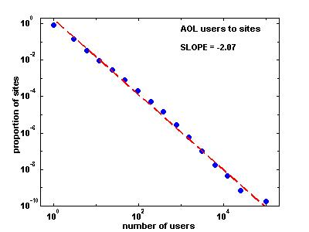
Binning the Data Logarithmically Helps
Select exponentially wider bins
1, 2, 4, 8, 16, 32, ….

Slide 28
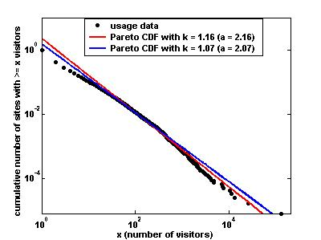
Fitting the Cumulative Distribution
Fitting the cumulative distribution, we find an exponent of a = 2.16, quite close to the a=2.07 found with the logarithmic binning procedure (both fits are shown in the Figure)

Slide 29
Some Exponents for Real World Data
 | x_{min} | exponent α
frequency of use of words | 1 | 2.20
number of citations to papers | 100 | 3.04
number of hits on web sites | 1 | 2.40
copies of books sold in the US | 2 000 000 | 3.51
telephone calls received | 10 | 2.22
magnitude of earthquakes | 3.8 | 3.04
diameter of moon craters | 0.01 | 3.14
intensity of solar flares | 200 | 1.83
intensity of wars | 3 | 1.80
net worth of Americans | $600m | 2.09
frequency of family names | 10 000 | 1.94
population of US cities | 40 000 | 2.30

Slide 30
Hey, Not Everything is a Power Law
Number of sightings of 591 bird species in the North American Bird survey in 2003. This distribution is log-normal
Another example: size of wildfires (in acres). This distribution is power law with exponential cutoff
cumulative
distribution
Source: MEJ Newman, ’Power laws, Pareto distributions and Zipf’s law’, Contemporary Physics 46, 323–351 (2005)
Notes:
Things that are not lower law:
The abundance of North American bird species, which spans over five orders of magnitude but is probably distributed according to a log-normal. A log-normally distributed quantity is one whose logarithm is normally distributed; see Section IV.G and Ref. [32] for further discussions The number of entries in people’s email addressbooks, which spans about three orders of magni- tude but seems to follow a stretched exponential. A stretched exponential is curve of the form e−axb for some constants a, b. The distribution of the sizes of forest fires, which spans six orders of magnitude and could follow a power law but with an exponential cutoff.

Slide 31
The Long Tail
Selling less of more
Unit profit of the big-fat head is low; unit profit of the long tail is high => A boost of the long tail means huge profits
Size of the tail matters
Say goodbye to Pareto (80-20 rule)
Only holds when α ~ 2.1
popularity
traditional market:
focus on the big fat head
new markets:
focus on the long tail
Rank of popularity
"The Long Tail" by Chris Anderson, Wired, Oct. 2004
Notes:
The theory of the Long Tail is that our culture and economy is increasingly shifting away from a focus on a relatively small number of "hits" (mainstream products and markets) at the head of the demand curve and toward a huge number of niches in the tail. As the costs of production and distribution fall, especially online, there is now less need to lump products and consumers into one-size-fits-all containers. In an era without the constraints of physical shelf space and other bottlenecks of distribution, narrowly-targeted goods and services can be as economically attractive as mainstream fare.
One example of this is the theory's prediction that demand for products not available in traditional bricks and mortar stores is potentially as big as for those that are. But the same is true for video not available on broadcast TV on any given day, and songs not played on radio. In other words, the potential aggregate size of the many small markets in goods that don't individually sell well enough for traditional retail and broadcast distribution may someday rival that of the existing large market in goods that do cross that economic bar.
The term refers specifically to the orange part of the sales chart above, which shows a standard demand curve that could apply to any industry, from entertainment to hard goods. The vertical axis is sales; the horizontal is products. The red part of the curve is the hits, which have dominated our markets and culture for most of the last century. The orange part is the non-hits, or niches, which is where the new growth is coming from now and in the future.
Traditional retail economics dictate that stores only stock the likely hits, because shelf space is expensive. But online retailers (from Amazon to iTunes) can stock virtually everything, and the number of available niche products outnumber the hits by several orders of magnitude. Those millions of niches are the Long Tail, which had been largely neglected until recently in favor of the Short Head of hits.
When consumers are offered infinite choice, the true shape of demand is revealed. And it turns out to be less hit-centric than we thought. People gravitate towards niches because they satisfy narrow interests better, and in one aspect of our life or another we all have some narrow interest (whether we think of it that way or not).
Our research project has attempted to quantify the Long Tail in three ways, comparing data from online and offline retailers in music, movies, and books.
1) What's the size of the Long Tail (defined as inventory typically not available offline)?
2) How does the availability of so many niche products change the shape of demand? Does it shift it away from hits?
3) What tools and techniques drive that shift, and which are most effective?
The Long Tail book is about the big-picture consequence of this: how our economy and culture is shifting from mass markets to million of niches. It chronicles the effect of the technologies that have made it easier for consumers to find and buy niche products, thanks to the "infinite shelf-space effect"--the new distribution mechanisms, from digital downloading to peer-to-peer markets, that break through the bottlenecks of broadcast and traditional bricks and mortar retail.
The Wikipedia entry on the Long Tail does an excellent job of expanding on this.

Slide 32
Preferential Attachment in Networks
What generates power law distributions?
First considered by [Price 65] as a model for citation networks
Each new paper is generated with m citations (mean)
New papers cite previous papers with probability proportional to their indegree (citations)
What about papers without any citations?
Each paper is considered to have a “default” citation
Probability of citing a paper with degree k, proportional to k+1
Power law with exponent α = 2+1/m

Slide 33
Barabasi-Albert Model
Undirected model: each node connects to other nodes with probability proportional to their degree
The process starts with some initial sub-graph
Each node comes with m edges
Results in power-law with exponent α = 3

Slide 34
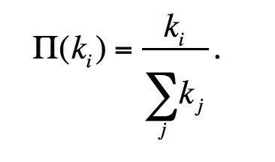
Basic BA-model
Initialization:
We start with m0 nodes, the links between which are chosen
arbitrarily, as long as each node has at least one link.
Growth:
Add new vertices one by one, each one with exactly m (<= m0) edges
Each new edge connects to an existing vertex in proportion to the number of edges that vertex already has → preferential attachment
The probability π(k) that one of the links of the new node connects to node i depends on the degree ki of node i as:
After t timesteps the Barabási-Albert model generates a network with N = t + m0 nodes and m0 + mt links.
3
e.g. m₀ = 3
1
2
Notes:
Preferential attachment is a probabilistic rule: a new node is free to connect to any node in the network, whether it is a hub or has a single link. Eq. 5.1 implies, however, that if a new node has a choice between a degree-two and a degree-four node, it is twice as likely that it connects to the degree-four node. The model defined by steps (A) and (B) is called the Barabási-Albert model after the authors of the paper that introduced it in 1999 [1]. One may also encounter it in the literature as the BA model or the scale-free model. After t timesteps the Barabási-Albert model generates a network with N = t + m0 nodes and m0 + mt links. A

Slide 35
Basic BA-model
Each new edge connects to an existing vertex in proportion to the number of edges that vertex already has → preferential attachment
Easiest way to conceptualize: if you keep track of edge endpoints in one large array and select an element from this array at random
The probability of selecting any one vertex will be proportional to the number of times it appears in the array – which corresponds to its degree

Slide 36
Generating BA Graphs – Cont’d
To start, each vertex has an equal number of edges (2)
the probability of choosing any vertex is 1/3
We add a new vertex, and it will have m=2 edges
draw 2 random elements from the array – suppose they are 2 and 3, and back
Now the probabilities of selecting 1,2,3,or 4 are 1/5, 3/10, 3/10, 1/5
Add a new vertex, draw a vertex for it to connect from the array
3
1 1 2 2 3 3
1
2
3
4
1 1 2 2 2 3 3 3 4 4
1
2
What are the probabilities of selecting 1,2,3, and 4?
5
1 1 2 2 2 3 3 3 3 4 4 4 5 5
3
4
1
2

Slide 37
Properties of the BA graph
The distribution is scale free with exponent α = 3 (P(k) = 2 m²/k³⁾
The graph is connected
Every vertex is born with a link (m= 1) or several links (m > 1)
It connects to older vertices, which are part of the giant component
The older are richer
Nodes accumulate links as time goes on
preferential attachment will prefer wealthier nodes, who tend to be older and had a head start

Slide 38
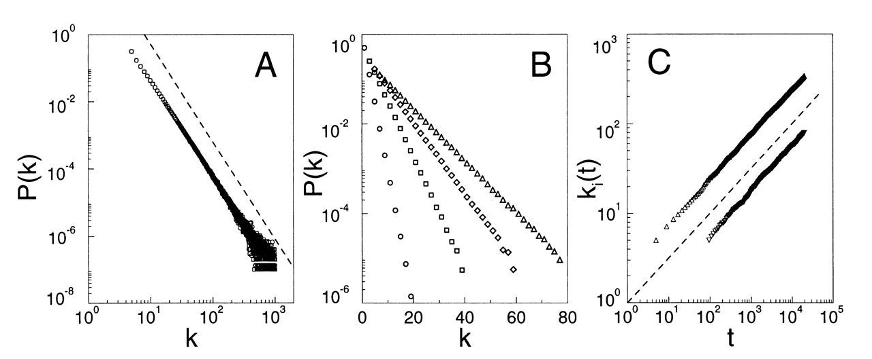
Time Evolution of the Degree of two Vertices in the BA Model
vertex introduced at t=5
Younger vertex does not stand a chance:
At t=95 older vertex has ~ 20 edges, and younger vertex is starting out with 5
At t ~ 10,000 older vertex has 200 edges and younger vertex has 50
vertex introduced at t=95
Source: Barabasi and Albert, 'Emergence of scaling in random networks’, Science 1999.

Slide 39
Many Real World Networks are Power Law
 | exponent α (in/out degree)
film actors | 2.3
telephone call graph | 2.1
email networks | 1.5/2.0
sexual contacts | 3.2
WWW | 2.3/2.7
internet | 2.5
peer-to-peer | 2.1
metabolic network | 2.2
protein interactions | 2.4

Slide 40
Not Every Network is Power Law Distributed
Reciprocal, frequent email communication
Power grid
Company directors
…
A great new papers here by Broido and Clauset will be presented next week.
Here is a popular piece covering some of the controversy: https://www.quantamagazine.org/scant-evidence-of-power-laws-found-in-real-world-networks-20180215/

Slide 41
Thoughts
BA networks are not clustered.
Can you think of a growth model of having preferential attachment and high clustering coefficient at the same time?
BA networks are undirected.
Can you make it directed?
What would the network look like if nodes are added over time, but not attached preferentially?
What other processes might give rise to power law networks?

Slide 42
You Should Know
power law distributions are everywhere
there are good and bad ways of fitting them
some distributions are not power-law
preferential attachment leads to power law networks…
… but it’s not the whole story, and not the only way of generating them

