Slide 1
Preferential Attachment in Networks
What generates power law distributions?
First considered by [Price 65] as a model for citation networks
Each new paper is generated with m citations (mean)
New papers cite previous papers with probability proportional to their indegree (citations)
What about papers without any citations?
Each paper is considered to have a “default” citation
Probability of citing a paper with degree k, proportional to k+1
Power law with exponent α = 2+1/m

Slide 2
Barabasi-Albert Model
Undirected model: each node connects to other nodes with probability proportional to their degree
The process starts with some initial sub-graph
Each node comes with m edges
Results in power-law with exponent α = 3

Slide 3
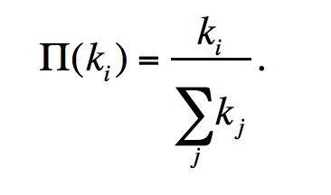
Basic BA-model
Initialization:
We start with m0 nodes, the links between which are chosen
arbitrarily, as long as each node has at least one link.
Growth:
Add new vertices one by one, each one with exactly m (<= m0) edges
Each new edge connects to an existing vertex in proportion to the number of edges that vertex already has → preferential attachment
The probability π(k) that one of the links of the new node connects to node i depends on the degree ki of node i as:
After t timesteps the Barabási-Albert model generates a network with N = t + m0 nodes and m0 + mt links.
3
e.g. m₀ = 3
1
2
Notes:
Preferential attachment is a probabilistic rule: a new node is free to connect to any node in the network, whether it is a hub or has a single link. Eq. 5.1 implies, however, that if a new node has a choice between a degree-two and a degree-four node, it is twice as likely that it connects to the degree-four node. The model defined by steps (A) and (B) is called the Barabási-Albert model after the authors of the paper that introduced it in 1999 [1]. One may also encounter it in the literature as the BA model or the scale-free model. After t timesteps the Barabási-Albert model generates a network with N = t + m0 nodes and m0 + mt links. A

Slide 4
Basic BA-model
Each new edge connects to an existing vertex in proportion to the number of edges that vertex already has → preferential attachment
Easiest way to conceptualize: if you keep track of edge endpoints in one large array and select an element from this array at random
The probability of selecting any one vertex will be proportional to the number of times it appears in the array – which corresponds to its degree

Slide 5
Generating BA Graphs – Cont’d
To start, each vertex has an equal number of edges (2)
the probability of choosing any vertex is 1/3
We add a new vertex, and it will have m=2 edges
draw 2 random elements from the array – suppose they are 2 and 3, and back
Now the probabilities of selecting 1,2,3,or 4 are 1/5, 3/10, 3/10, 1/5
Add a new vertex, draw a vertex for it to connect from the array
3
1 1 2 2 3 3
1
2
3
4
1 1 2 2 2 3 3 3 4 4
1
2
What are the probabilities of selecting 1,2,3, and 4?
5
1 1 2 2 2 3 3 3 3 4 4 4 5 5
3
4
1
2

Slide 6
Properties of the BA graph
The distribution is scale free with exponent α = 3 (P(k) = 2 m²/k³⁾
The graph is connected
Every vertex is born with a link (m= 1) or several links (m > 1)
It connects to older vertices, which are part of the giant component
The older are richer
Nodes accumulate links as time goes on
preferential attachment will prefer wealthier nodes, who tend to be older and had a head start

Slide 7
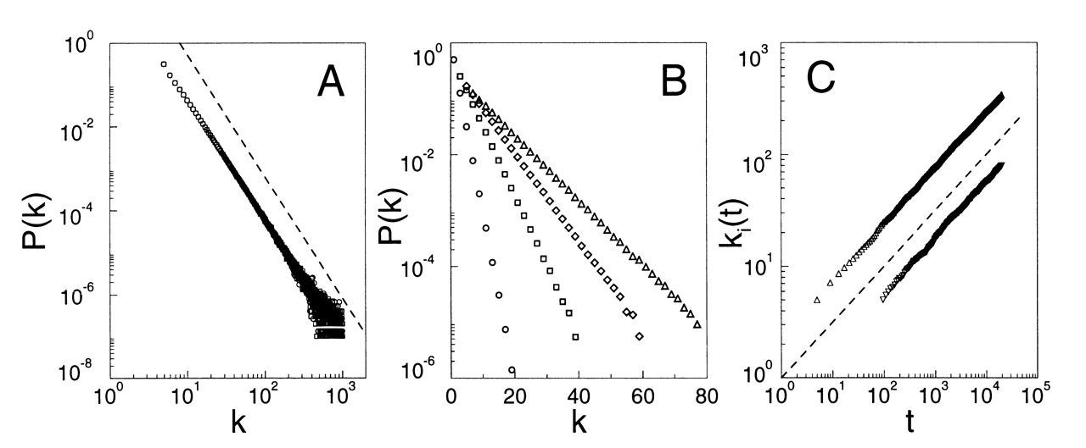
Time Evolution of the Degree of two Vertices in the BA Model
vertex introduced at t=5
Younger vertex does not stand a chance:
At t=95 older vertex has ~ 20 edges, and younger vertex is starting out with 5
At t ~ 10,000 older vertex has 200 edges and younger vertex has 50
vertex introduced at t=95
Source: Barabasi and Albert, 'Emergence of scaling in random networks’, Science 1999.

Slide 8
Many Real World Networks are Power Law
 | exponent α (in/out degree)
film actors | 2.3
telephone call graph | 2.1
email networks | 1.5/2.0
sexual contacts | 3.2
WWW | 2.3/2.7
internet | 2.5
peer-to-peer | 2.1
metabolic network | 2.2
protein interactions | 2.4

Slide 9
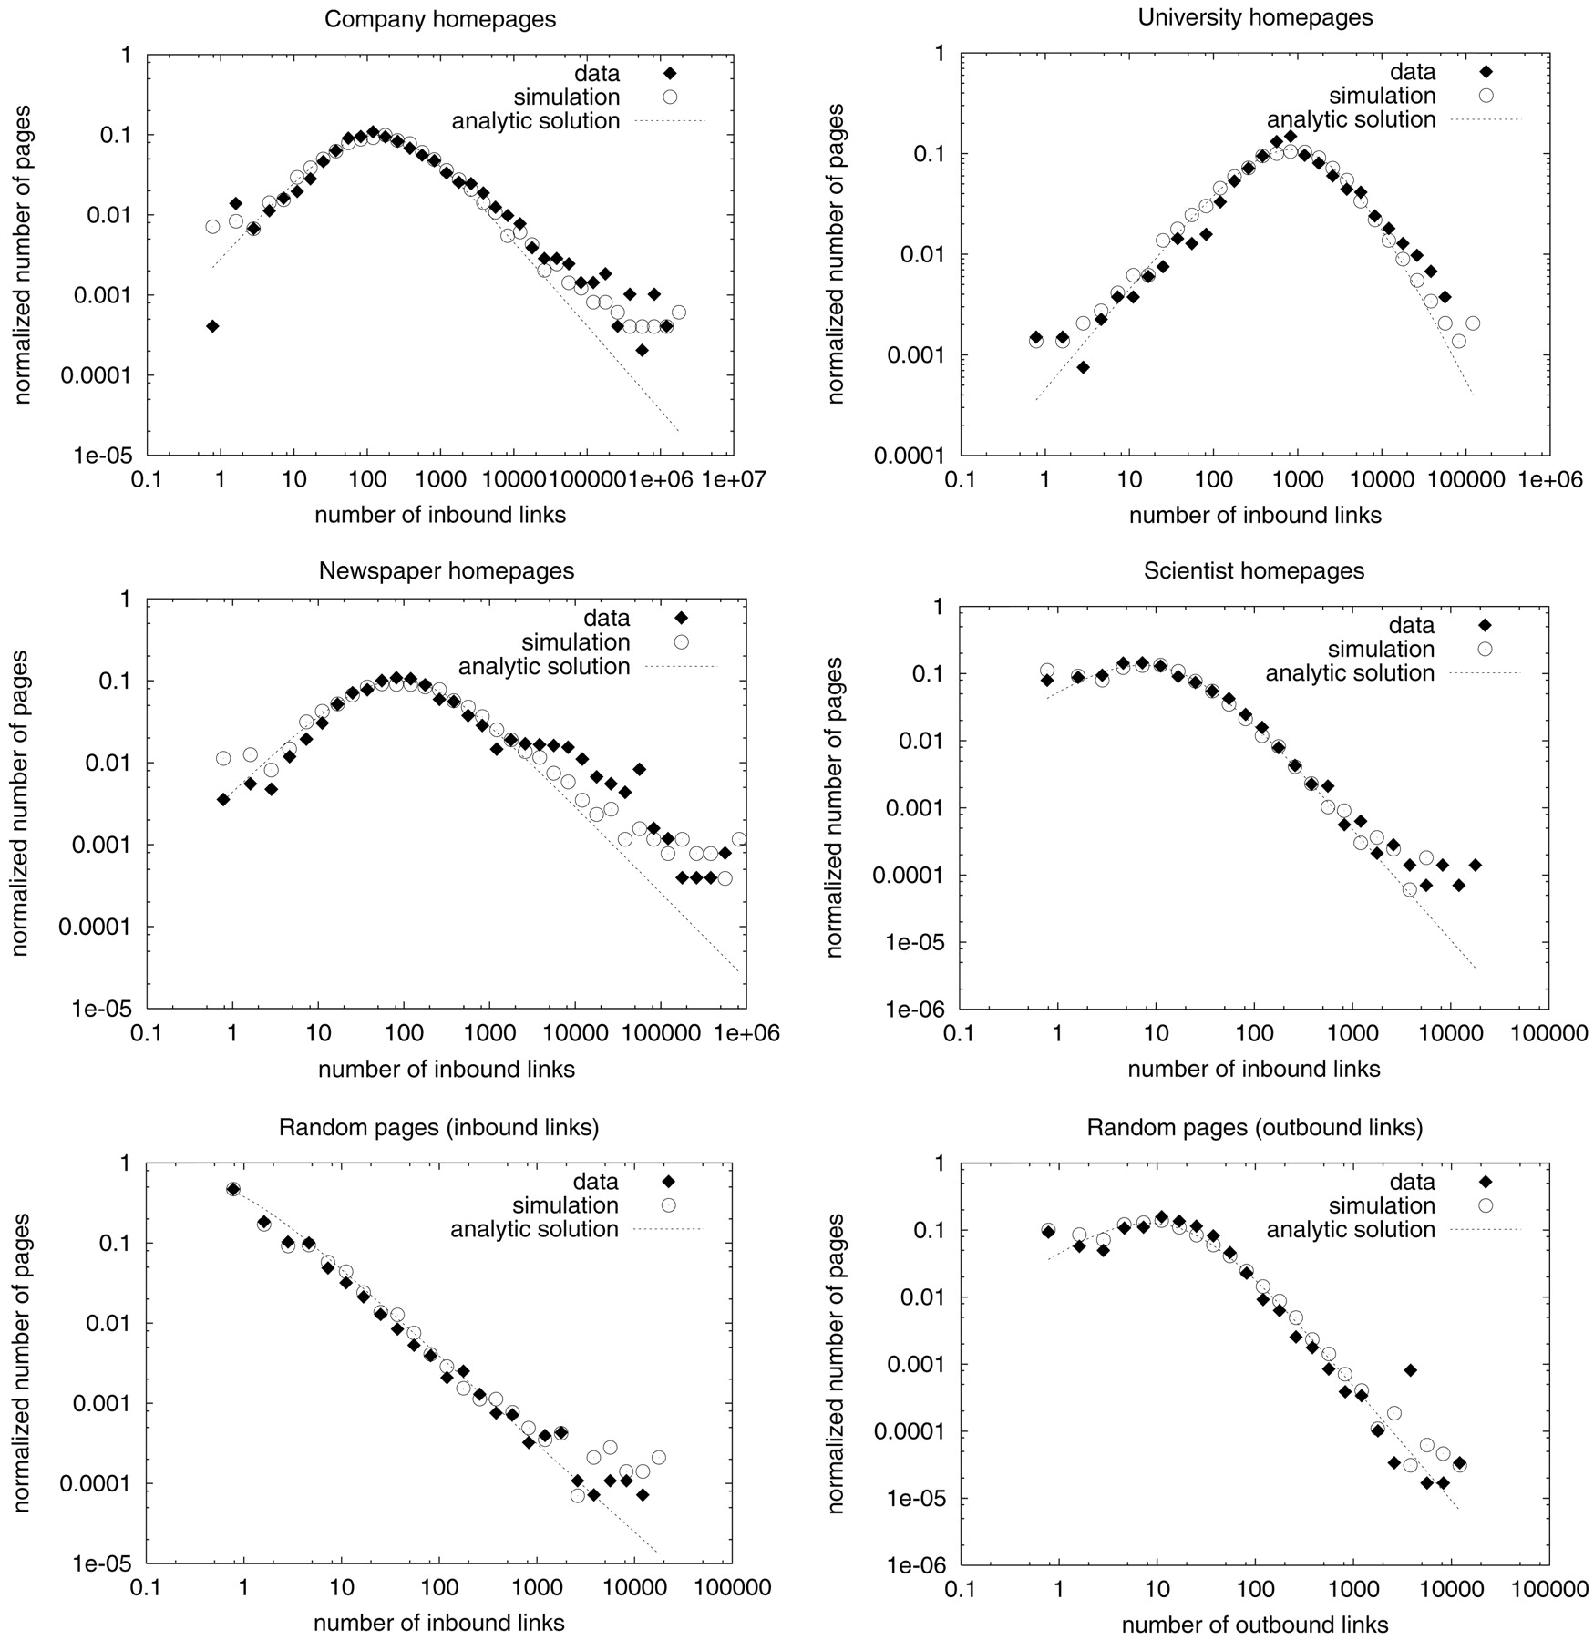
Power-laws on the Web

Slide 10
Not Every Network is Power Law Distributed
Reciprocal, frequent email communication
Power grid
Company directors
…
A great new papers here by Broido and Clauset will be presented next week.
Here is a popular piece covering some of the controversy: https://www.quantamagazine.org/scant-evidence-of-power-laws-found-in-real-world-networks-20180215/

Slide 11
Optional: Alternative models
Pennock Model
D.M. Pennock et al. (2002) Winners don’t take all, PNAS, 99/8, 5207-5211.
Differs from the BA model primarily in that:
New vertices are not automatically assigned edges
Probability of attaching is partially independent of degree
BA Extended model
Albert R., Barabasi A.L.: Topology of evolving networks: local events and universality
Differs from the simple BA model in that:
Edges are added between existing nodes, not only the newcomer
Edges are rewired between existing nodes

Slide 12
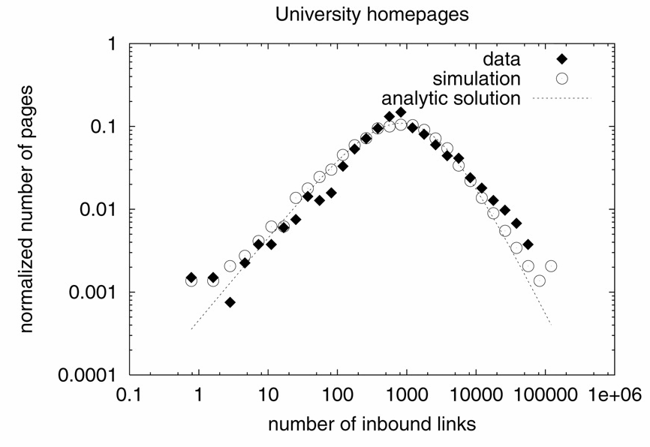
Pennock model
Example: It is reasonable to assume that some webpages will be linked to in part because of what they are rather than the number of links they already have

Slide 13
Pennock model
The probability that an endpoint of a new edge connects to vertex i is
α = probability of preferential attachment
Total nodes at time t
Connectivity at t
(my popularity)

Slide 14
Alternative model (directed)
Network starts with m₀ vertices, which link to each other with probability p₀ (as in an Erdos-Renyi random graph)
At each time step t, one vertex and m edges are added to the network
Instead of attaching one end point of each edge to the newly introduced vertex, choose both end points according to the probability:
fraction of edges in the graph that start at v
fraction of edges in the graph that end at v
the credit v
gets just for being
one of the vertices

Slide 15
‘Scale free’ network
Observations:
α + β + γ = 1, so can vary the relative importance of indegree, outdegree, and independent probability
in an undirected network α = β, since indegree and outdegree are the same
Not all vertices will be connected, since they are not ‘born’ with an edge
The larger γ is, the less scale-free the degree distribution
edges are added without regard to degree
Original BA paper showed that in that case the degree distribution P(k) ~ exp(-βk) , an exponential distribution

Slide 16
Extended BA model (undirected network)
Start with m₀ isolated nodes
At each timestep perform one of the following operations:
With prob. p add m (m≤ m₀) new links
For each link
Select ‘from’ vertex at random
Select ‘to’ vertex in proportion to its degree (+1 so that isolated vertices have a chance of getting links)
With prob. q where 0 < q < 1 – p
rewire m links
select node i at random and one of i’s links
rewire the endpoint of i’s link to another node j randomly chosen with probability Π(k_{j})
With prob. 1 – p - q
add a new node with m links
connect endpoints of the m links to vertices in proportion to their degree (Π(k_{j})

Slide 17
Extended BA model – cont’d
In the p=q=0 limit, reduces to the simple BA model
In the high q (q -> 1) limit, extended model produces a network with an exponential tail because growth is very slow (only rewiring is occurring)

Slide 18
Thoughts
BA networks are not clustered.
Can you think of a growth model of having preferential attachment and high clustering coefficient at the same time?
BA networks are undirected.
Can you make it directed?
What would the network look like if nodes are added over time, but not attached preferentially?
What other processes might give rise to power law networks?

Slide 19
You Should Know
power law distributions are everywhere
there are good and bad ways of fitting them
some distributions are not power-law
preferential attachment leads to power law networks…
… but it’s not the whole story, and not the only way of generating them

