Slide 1
SI 608 Week 5 – Scale Free Networks
Ceren Budak

Slide 2
Preferential Attachment in Networks
What generates power law distributions?
First considered by [Price 65] as a model for citation networks
Each new paper is generated with m citations (mean)
New papers cite previous papers with probability proportional to their indegree (citations)
What about papers without any citations?
Each paper is considered to have a “default” citation
Probability of citing a paper with degree k, proportional to k+1
Power law with exponent α = 2+1/m

Slide 3
Barabasi-Albert Model
Undirected model: each node connects to other nodes with probability proportional to their degree
The process starts with some initial sub-graph
Each node comes with m edges
Results in power-law with exponent α = 3

Slide 4
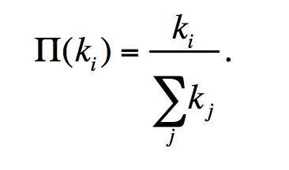
Basic BA-model
Initialization:
We start with m0 nodes, the links between which are chosen
arbitrarily, as long as each node has at least one link.
Growth:
Add new vertices one by one, each one with exactly m (<= m0) edges
Each new edge connects to an existing vertex in proportion to the number of edges that vertex already has → preferential attachment
The probability π(k) that one of the links of the new node connects to node i depends on the degree ki of node i as:
After t timesteps the Barabási-Albert model generates a network with N = t + m0 nodes and m0 + mt links.
3
e.g. m₀ = 3
1
2
Notes:
Preferential attachment is a probabilistic rule: a new node is free to connect to any node in the network, whether it is a hub or has a single link. Eq. 5.1 implies, however, that if a new node has a choice between a degree-two and a degree-four node, it is twice as likely that it connects to the degree-four node. The model defined by steps (A) and (B) is called the Barabási-Albert model after the authors of the paper that introduced it in 1999 [1]. One may also encounter it in the literature as the BA model or the scale-free model. After t timesteps the Barabási-Albert model generates a network with N = t + m0 nodes and m0 + mt links. A

Slide 5
Basic BA-model
Each new edge connects to an existing vertex in proportion to the number of edges that vertex already has → preferential attachment
Easiest way to conceptualize: if you keep track of edge endpoints in one large array and select an element from this array at random
The probability of selecting any one vertex will be proportional to the number of times it appears in the array – which corresponds to its degree

Slide 6
Generating BA Graphs – Cont’d
To start, each vertex has an equal number of edges (2)
the probability of choosing any vertex is 1/3
We add a new vertex, and it will have m=2 edges
draw 2 random elements from the array – suppose they are 2 and 3, and back
Now the probabilities of selecting 1,2,3,or 4 are 1/5, 3/10, 3/10, 1/5
Add a new vertex, draw a vertex for it to connect from the array
3
1 1 2 2 3 3
1
2
3
4
1 1 2 2 2 3 3 3 4 4
1
2
What are the probabilities of selecting 1,2,3, and 4?
5
1 1 2 2 2 3 3 3 3 4 4 4 5 5
3
4
1
2

Slide 7
Properties of the BA graph
The distribution is scale free with exponent α = 3 (P(k) = 2 m²/k³⁾
The graph is connected
Every vertex is born with a link (m= 1) or several links (m > 1)
It connects to older vertices, which are part of the giant component
The older are richer
Nodes accumulate links as time goes on
preferential attachment will prefer wealthier nodes, who tend to be older and had a head start

Slide 8
Breakout rooms
What aspects of this model do you think reflect real-world behavior?
And which properties?
What aspects/properties are not?

Slide 9
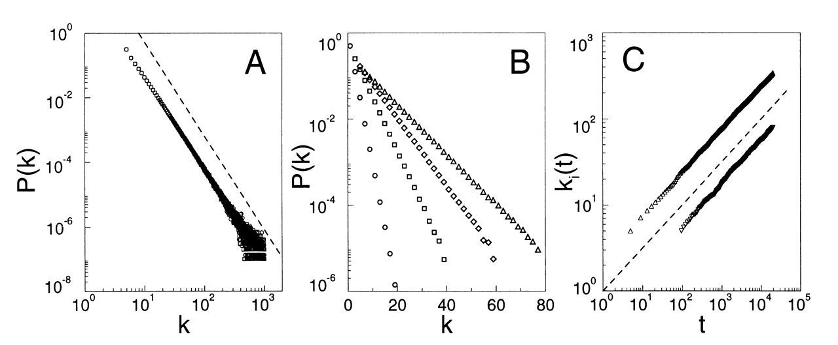
Time Evolution of the Degree of two Vertices in the BA Model
vertex introduced at t=5
Younger vertex does not stand a chance:
At t=95 older vertex has ~ 20 edges, and younger vertex is starting out with 5
At t ~ 10,000 older vertex has 200 edges and younger vertex has 50
vertex introduced at t=95
Source: Barabasi and Albert, 'Emergence of scaling in random networks’, Science 1999.

Slide 10
Many Real World Networks are Power Law
 | exponent α (in/out degree)
film actors | 2.3
telephone call graph | 2.1
email networks | 1.5/2.0
sexual contacts | 3.2
WWW | 2.3/2.7
internet | 2.5
peer-to-peer | 2.1
metabolic network | 2.2
protein interactions | 2.4

Slide 11
Not Every Network is Power Law Distributed
Reciprocal, frequent email communication
Power grid
Company directors
…
A great new papers here by Broido and Clauset will be discussed next week.
Here is a popular piece covering some of the controversy: https://www.quantamagazine.org/scant-evidence-of-power-laws-found-in-real-world-networks-20180215/

Slide 12
You Should Know
power law distributions are everywhere
there are good and bad ways of fitting them
some distributions are not power-law
preferential attachment leads to power law networks…
… but it’s not the whole story, and not the only way of generating them

