Slide 1
SI618 Project 2
Chongdan Pan
pandapcd
Notes:
Hello, welcome to my project 2 video.

Slide 2






Research Question
1. Does Bitcoin blockchain work as it as supposed?
Difficulty
Transaction
2. How are people's activities on Bitcoin's blockchain?
Users
Miners
3. Can we make profit through cryptocurrencies investment?
Trade
Mine
Notes:
My first question is whether Bitcoin network works as it supposed?
In details, my project investigate whether it controlls the mining difficulty well and if its provide a good way for transaction.
Second, I want to know how are peoples' activities on the blockchain?
I'll looking into uesr's activities and miners' revenue
Last, I run investment simulation on Bitcoin historical data.
Investors may directly buy the tokens or buy a miner machine.

Slide 3





Data Set
Schema
Time Stamp
BTC/ETH Price
BTC/ETH Trade Counts
BTC/ETH Trade Volume
BTC Network Difficulty
BTC Miner Revenue
BTC Total Hash Rate
BTC Market Value
BTC Transaction Number
BTC Transaction Fee
BTC Unique Address
Blockchain.com
Table
Join on Timestamp
Binance
Rest API

Slide 4
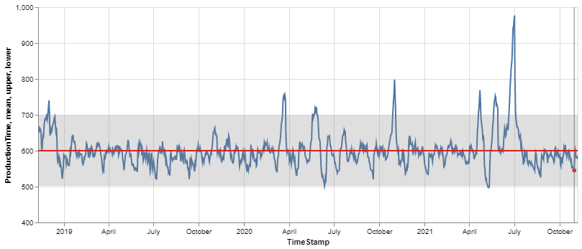
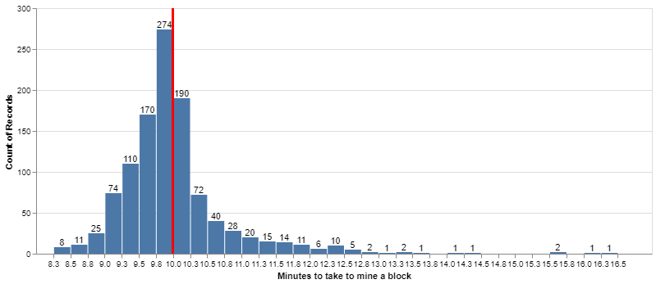
Question 1 Key Finding
Bitcoin’s blockchain does a good job at control the production time to be 10 minutes
Production Time
Production Time Distribution

Slide 5
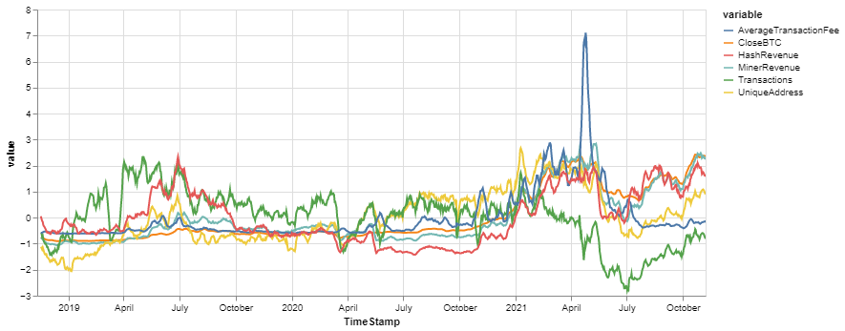
Question 2 Key Finding
Variables have similar pattern in long and short periods

Slide 6
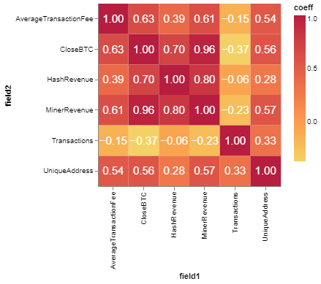
Question 2 Key Finding
Miner revenue is closely related to the BTC price because it’s counted in BTC

Slide 7
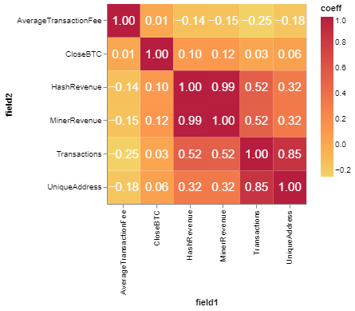
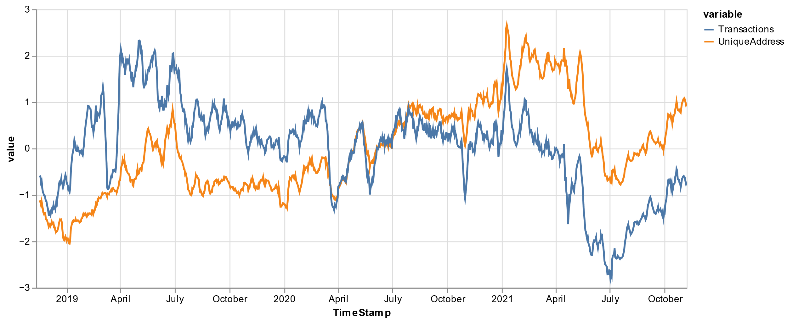
Question 2 Key Finding
User Number and transactions are close related after difference calculation
Unique Address change in the similar way as Transactions

Slide 8
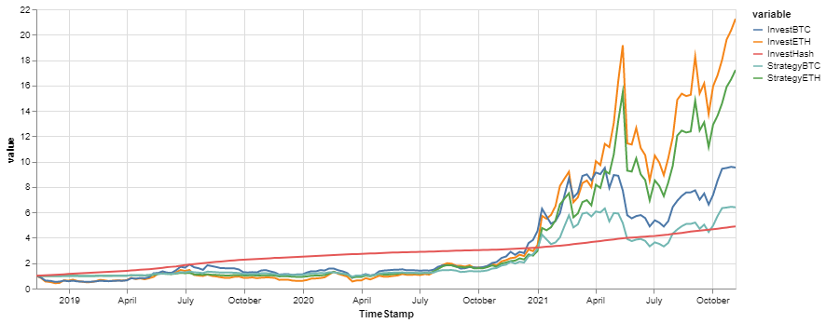
Question 3 Key Finding
Crypto assets? ETH
How to Investment? Same amount of money Periodically
Mining? Stable but low return

Slide 9
Thank You !

