Slide 1
SI630 Project
—— Cryptocurrency Investment using Text on Twitter
Chongdan Pan, Xinyi Ye
Notes:
Hello everyone, welcome to our presentation, our topic is about using text data to invest cryptos

Slide 2


Project Topic
Crypto has been the most hottest topic recently with lots of discussion. Although it looks tempting, it’s challenging to make a big fortune from crypto due to high volatility, unpredictability and risk. To construct a profitable investment strategy, we want to train NLP model based on Twitter text data and predict the return.
Crypto
NLP
Notes:
Cryptos is the most popular topic for now. There are lots of discussion and opportunities through crypto investment. However, due to the high volatility, the risk and revenue are both very high. Out of curiosity, we want to know how these discussions can be used to construct a profitable investing strategy.

Slide 3

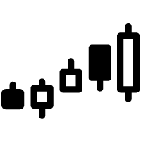





Data Source
Binance
Market Data
Return
Join by TimeStamp
Twitter
API
Hashtag
Notes:
We have two data source. First is binance, the largest crypto exchange, where we get market data and calculate the return. Then we use twitter api to search all tweets with hashtag to be the crypto of interest. Then we join the text and market data by timestamp.

Slide 4




Method
Lemma Extraction
Word Embedding
Data Split
Training
Use regular expression for tokenization
Use Spacy to remove stopwords and extract lemma
Use word2vec to embed word in 50 dimension
Negative Sampling
Use 2021 data for training, 2022 data for validation
Aggregate by data frequency
Use NLP model to predict the return
Make investment decision based on predicted return
Notes:
Our method include 4 stages. First we use regular expression and pos tagging to extract the key text of the tweets. Second, we train a word2vec to generate distributional representation. Third, we split the data, the data in 2021 will be used for training, and 2022 will be used for prediction. At last, we train different models and look into their performance.

Slide 5
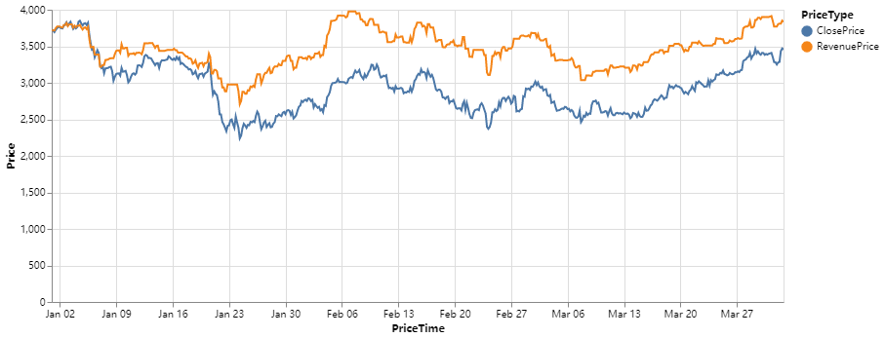
LSTM Performance
Buy when prediction is positive and sell vice versa
No bidirectional structure due to limitation of future information
MSE: 1.9e-3
Excess Return: 12%
Notes:
This is the result of LSTM. Our model aims to predict the return of next four hour by the text we got in the interval. At each timestamp, if we have a positive prediction, we’ll buy the crypto and hold it until it’s negative. As shown in the plot, the model can help make decision with extra profit.

Slide 6
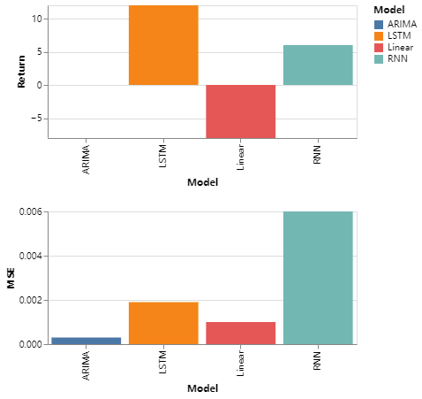
Comparison
ARIMA
Less parameters but can’t fit the heavy tail
Linear Regression
Don’t take the order into consideration
RNN
Forget information quickly
Notes:
Besides LSTM, we also tried three other models, which are ARIMA, linear regression and RNN. We calculated MSE and the final return rate for each model and compare the results. From the plot we can see that LSTM has the best performance. Each model has their own problems. For ARIMA model, too less parameters can’t fit the heavy tail. For linear regression, it does not take the time series pattern into consideration. For RNN, it forgets information quickly compared to LSTM.

Slide 7
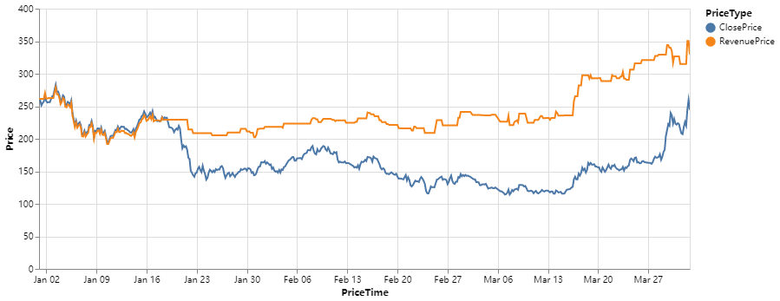
Insights
ETH
Different Cryptos
Richness of information
Big news and major events
Asset characteristics
AAVE
Notes:
We also tried models on different datasets. They perform quite differently. We can conclude that there are many factors influence the performance, such as the richness of the information, big news and major events and asset characteristics.

Slide 8
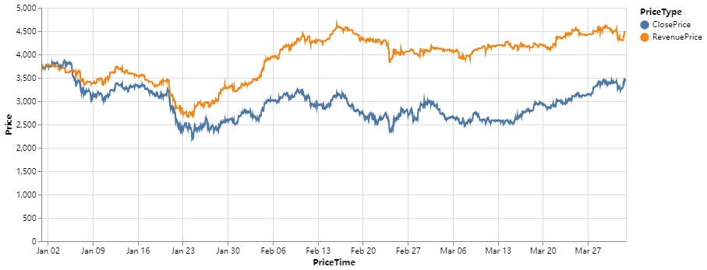
Insights
4-Hour
Different Frequency
Signal-noise ratio
More opportunities for investment
1-Hour
Notes:
We also used datasets of different frequencies. From the plot we can find that data collected with 1-hour frequency performs better. There are two reasons, firstly, higher frequency means more data, secondly, higher frequency enables us to have more opportunities to invest.

Slide 9
Improvements
More Data
Get text by multiple searching patterns and keywords
Better Model
May use attention to focus on specific text during each period
Integration
Embed market data and text together as input
Higher Frequency
More samples, less impact from major events
Notes:
For improvements, there are four aspects. First is to increase the datasets. Second is to integrate more information. Third is to use data with higher frequency. Forth is to use more advanced model, such as adding attention layer.

Slide 10
Thank you
Q&A

