Slide 1
Transforms Cookbook
Eytan Adar

Slide 2
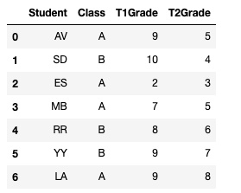
Starting data (this is your ‘df’).
A bunch of students in two different classes (A and B) that have taken two tests (T1 and T2)

Slide 3
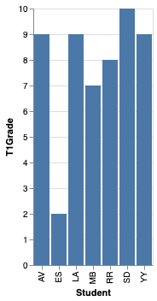
So you want this….
Generate a basic plot (e.g., each student’s T1 Grade)

Slide 4
So you want this….
Generate a basic plot (no transformation needed: each student’s T1 Grade)
What we’re starting from
What we need

Slide 5
So you want this….
Generate a basic plot (no transformation needed: each student’s T1 Grade)
What we’re starting from
What we need

Slide 6
First: describe what you see in GoG terms
Mark: rectangle
Student: Nominal
T1Grade: Quantitative
Student: x-axis
T1Ggrade: y-axis (bar length)
2 variables
2 encodings

Slide 7
In English:
I have a database of grades.
For each row, which uniquely identifies a student, make a rectangle.
Each rectangle (i.e., student) should be at a different place on the x-axis.
The height of the rectangle should be proportional to the T1Grade.

Slide 8

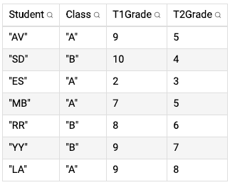
We could also do: Student:N and T1Grade:Q to be explicit about the types (nominal and quant.)
What we generate
What Altair sees (this is “df”):
Columns we are encoding
Columns we are not using

Slide 9
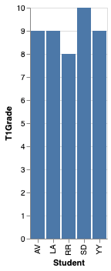
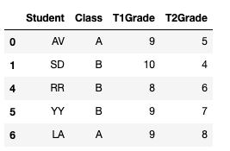
So you want this….
Plot some filtered subset of the data (e.g., Students who earned more than 7 points on T1)
What we need
What we’re starting from

Slide 10


What Pandas starts with (df)
df.T1Grade > 7 creates a “mask”
“True” if the row passes the test, false otherwise
We then select only those rows that are True for the mask (df[…mask…]).

Slide 11
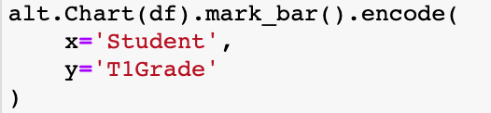
What Altair sees:

Slide 12
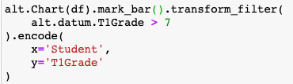
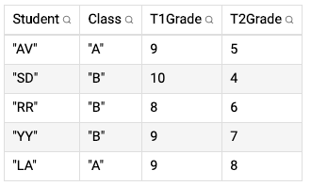
transform_filter
alt.datum roughly means ”check the row”
All lines with T1Grade > 7 kept
What Altair starts with (df)
What Altair sees *after* filter

Slide 13

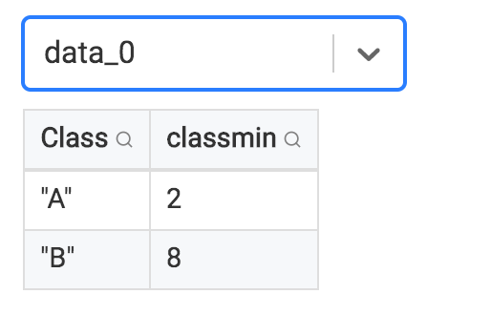
So you want to….
Plot data based on grouping by some value and calculate an aggregate property of that group. (e.g., group by class and find the minimum grade earned on test 1)
What we need
What we’re starting from

Slide 14
Mark: rectangle
Class: Nominal
Min(T1Grade): Quantitative
Class: x-axis
Min(T1Ggrade): y-axis (bar length)
2 variables
2 encodings

Slide 15
Aggregate
Creates groups
Creates the function (applied to each group)
Creates the variables
min
min
What Pandas now has
What Pandas starts with (df)

Slide 16
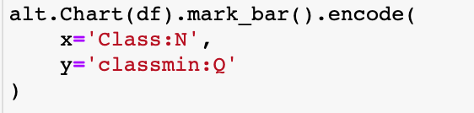
We can wrap up now with Altair…

Slide 17
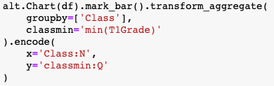
create the column to put the result into
min
min
What Altair did internally
What Altair starts with
transform_aggregate

Slide 18
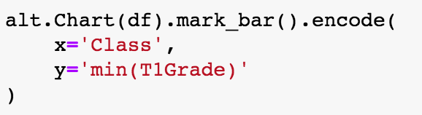

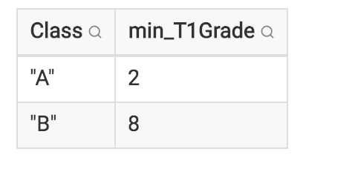
Automatically names column
min
min
What Altair did internally
What Altair starts with
transform_aggregate shortcut
(shortcut—more limited)

Slide 19
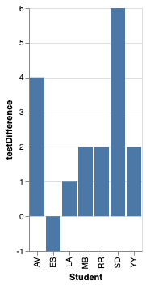
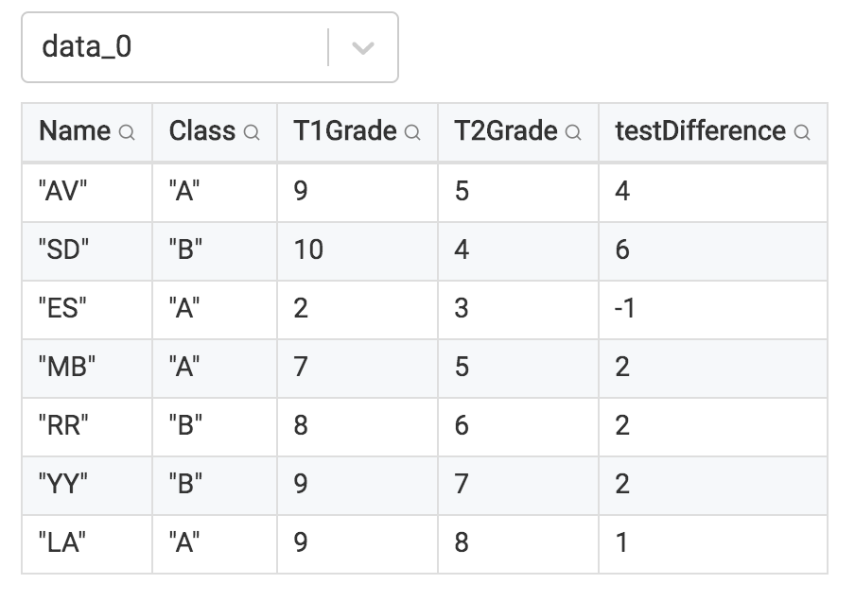
So you want this….
Difference between T1 Grade and T2 Grade
(something calculated for each student)
What we’re starting from
What we need

Slide 20
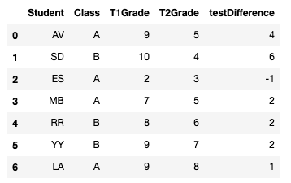
Generate the function
Make the column to put the result into
What Pandas starts with
T1Grade - T2Grade = …

Slide 21

We can wrap up now with Altair…

Slide 22
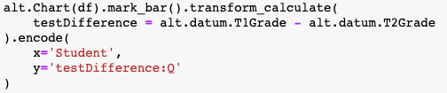
Make the column to put the result into
What Altair starts with
T1Grade - T2Grade = …
What Altair did internally
transform_calculate

Slide 23
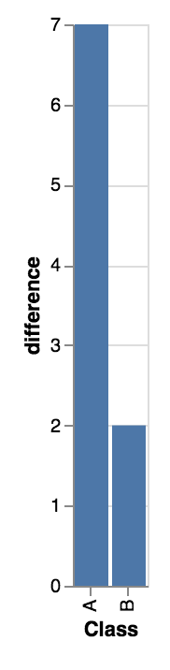
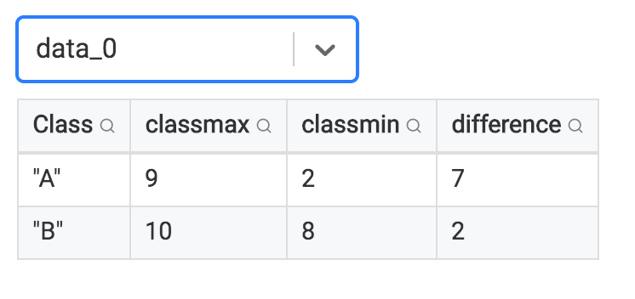
So you want this….
Difference between the minimum and maximum grade for each class on T1
What we need
What we’re starting from

Slide 24
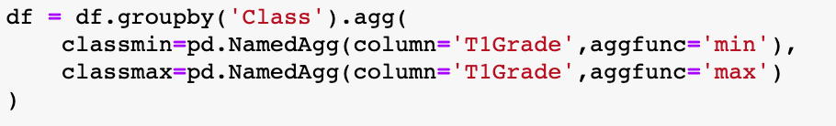
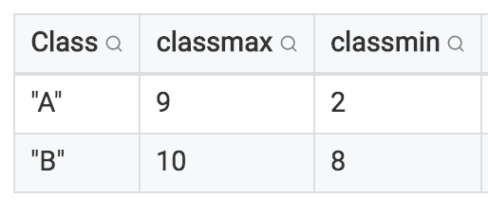
Makes 2 new columns (classmin, classmax)
Calculates difference and adds another column (difference)
After calculate
What Pandas starts with
After aggregate

Slide 25
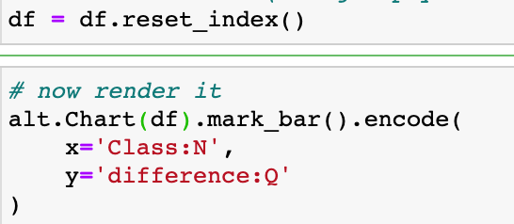
We can wrap up now with Altair…

Slide 26
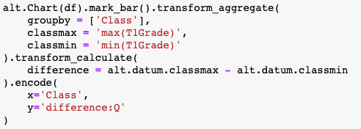
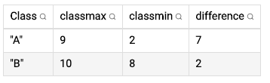
transform_aggregate
+
transform_calculate
After transform_calculate
What Altair starts with
After transform_aggregate

Slide 27
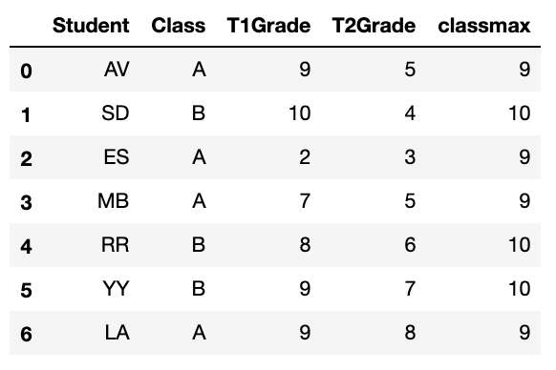
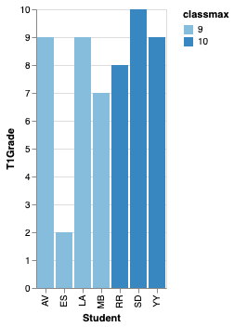
So you want this….
Student’s grade in T1 with each bar showing the max grade in the class with color
(something calculated for each student and contrasted to class-level value)
What we’re starting from
What we need

Slide 28
Mark: rectangle
Student: Nominal
T1Grade: Quantitative
Classmax: Quantitative
Student: x-axis
T1Grade: y-axis (bar length)
Classmax: color
3 variables
3 encodings

Slide 29
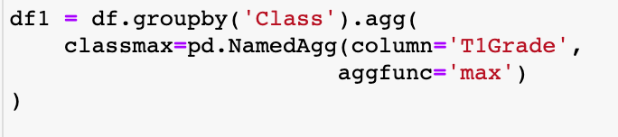

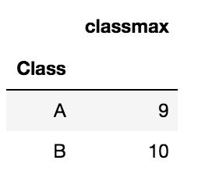
max
max
This is df1
What Pandas starts with (df)
This is new df, the “join” of the original (df) with the aggregate classmax

Slide 30
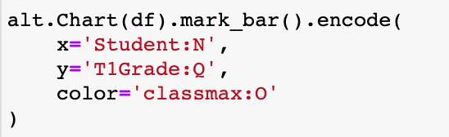
We can wrap up now with Altair…

Slide 31
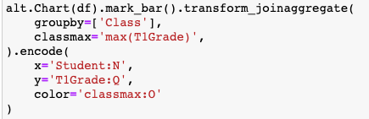
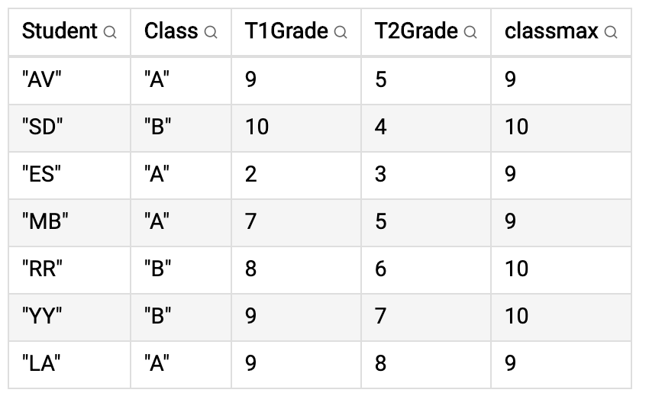
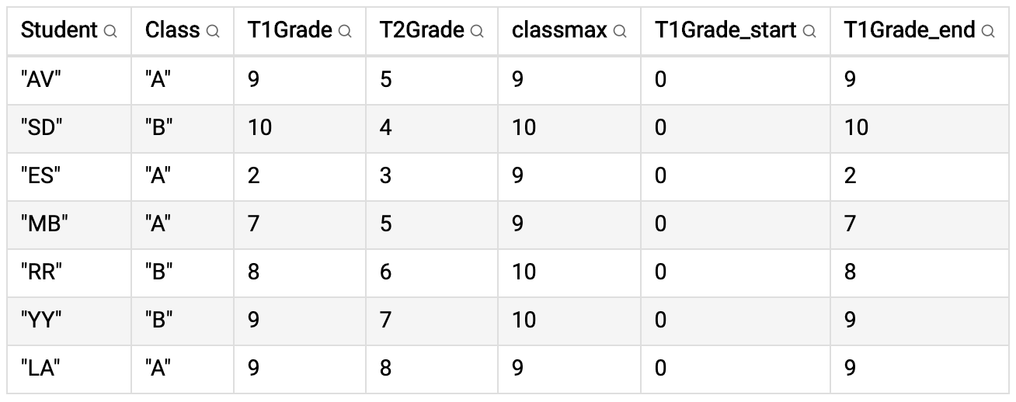
max
max
What Altair starts with
transform_joinaggregate
Columns Altair auto-creates to know where to start/stop the gradient

Slide 32
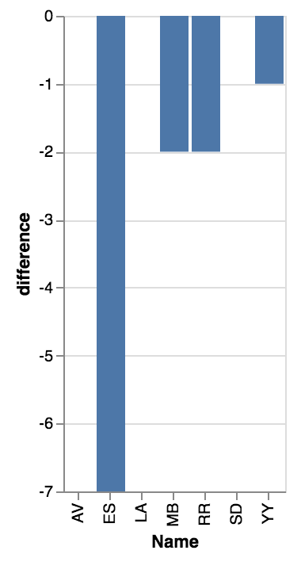
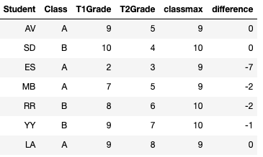
So you want this….
Difference between a student’s T1 Grade and the max grade in the class using a calculated field
(something calculated for each student and used in a formula with an aggregate value)
What we’re starting from
What we need

Slide 33
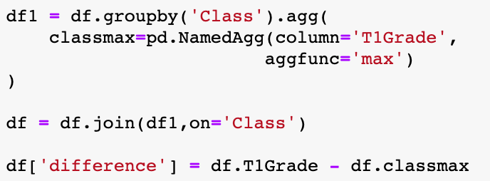
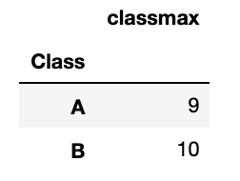
join + calculate
max
What Pandas starts with

Slide 34
join + calculate
+
T1Grade – classmax=…
What Pandas starts with
After join
After calculate

Slide 35

We can wrap up now with Altair…

Slide 36
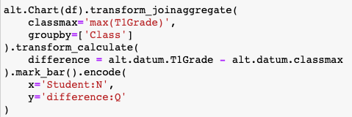
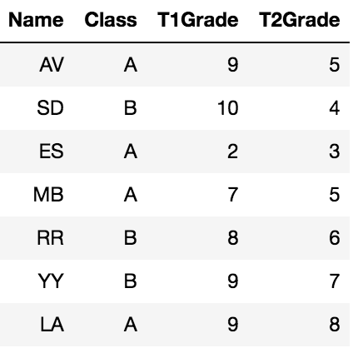
T1Grade – classmax=…
max
What Altair starts with
After joinaggreagate
After calculate

Slide 37
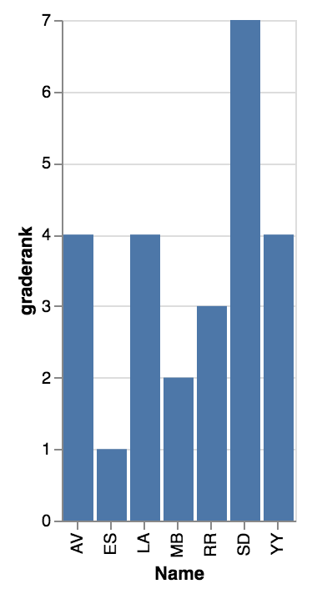
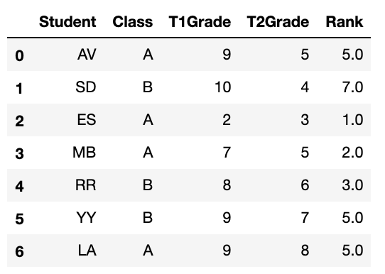
So you want this….
The rank of each student based on their grade in T1 (regardless of class)
(rank, like running average, depends on known the last person’s rank/value… hence we’ll use a window)
What we’re starting from
What we need

Slide 38
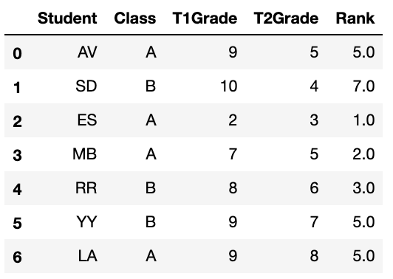
Create column
Column to sort on
Highest T1 grade, rank =7
Lowest T1 grade, rank =1
What Pandas starts with

Slide 39
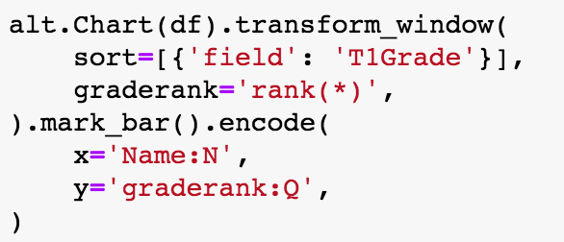
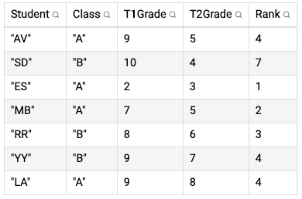
transform_window
Create column
Column to sort on
Highest T1 grade, rank =7
Lowest T1 grade, rank =1
What Altair starts with
“window” because we need to consider all rows inside a window. In this case it’s everyone. SD’s rank depends on the rank of everyone with a lower grade!

Slide 40
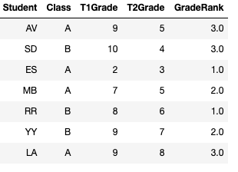
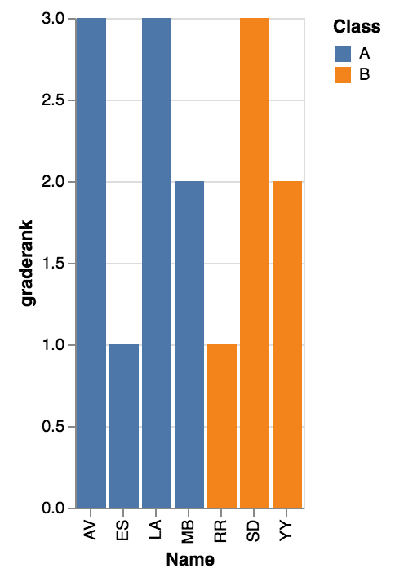
So you want this….
The rank of each student based on their grade in T1 in their class
What we’re starting from
What we need

Slide 41
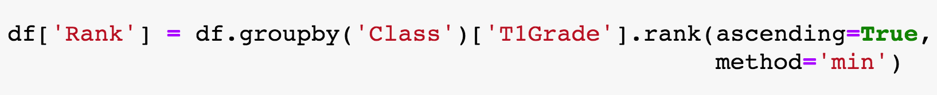
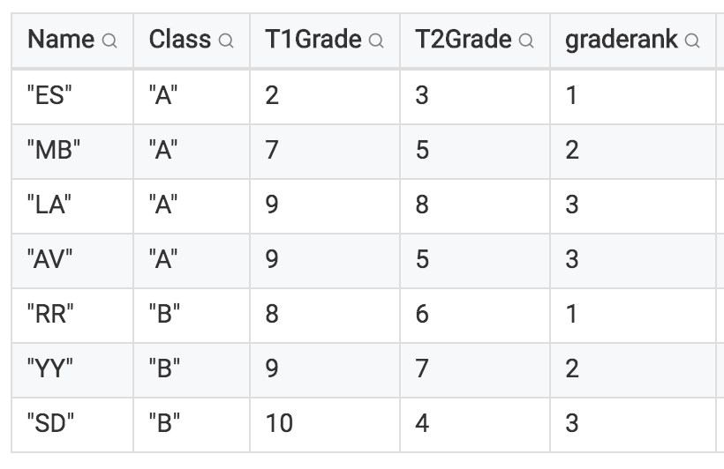
Lowest T1 grade in class A, rank =1
Window 1 (class A)
Highest T1 grade in A, rank =3 (tie)
Lowest T1 grade in class B, rank =1
Window 2 (class B)
What Altair starts with
Highest T1 grade in B, rank =3
Sorted table, but grouped by class

Slide 42


Slide 43
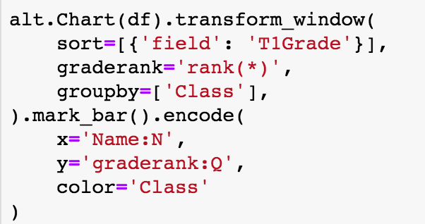
transform_window
Column to sort on
Lowest T1 grade in class A, rank =1
Window 1 (class A)
Highest T1 grade in A, rank =3 (tie)
Lowest T1 grade in class B, rank =1
Window 2 (class B)
What Altair starts with
Highest T1 grade in B, rank =3
Sorted table, but grouped by class

Slide 44
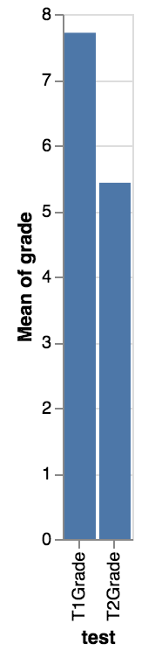

So you want this….
The mean T1 and T2 Grades (regardless of class)
What we need
What we’re starting from

Slide 45

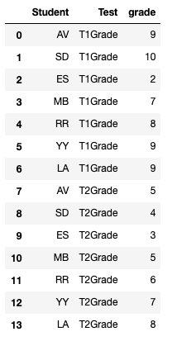

What we’re starting from
Filter the data
“Melt”

Slide 46
“Melt”

Slide 47



Slide 48


Columns get added
transform_fold
After transform_fold (“long format”)
What Altair starts with

Slide 49
Values get copied

Slide 50
Duplicate rows
1 for each “folded” column

Slide 51


Slide 52
Reasoning about transforms… Strategy: reverse engineer the transformation

Slide 53
Starting data (this is your ‘df’). A bunch of students in two different classes (A and B) that have taken two tests (T1 and T2)

Slide 54

To this…
How do we get from this…
?

Slide 55


Start at end. If we had this:
We’d be done:

Slide 56

?
So how do we do this?

Slide 57


?
We could also be done if we had this:
So how do we get two columns into one?

Slide 58


Slide 59

?

Slide 60
Transforms Cookbook
Eytan Adar

