Slide 1
Streamlit Introduction

Slide 2
Content
Install and run a streamlit server
Editing static elements (markdown, images)
Adding altair visualizations
Adding widgets

Slide 3
Get Started
Step 0
Set up virtual environment (optional – “conda create…”)
You’ll need Python 3.6+ and pip (type “pip” to check)
conda install pip
Install streamlit (the latest as of 9/30 is 0.67, so we’ll use that version)
pip install streamlit==0.67
Run the following command in the terminal:
streamlit hello
See the streamlit documentation:
https://docs.streamlit.io/en/stable/getting_started.html

Slide 4
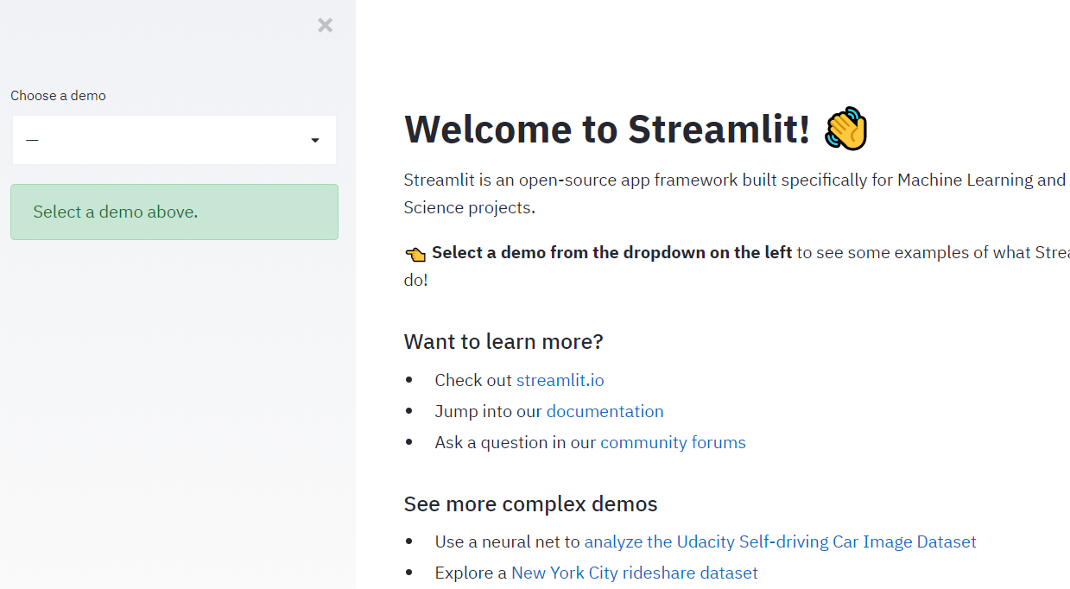
streamlit hello
Result of step 0
Sidebar
Main Section

Slide 5
Adding Static Elements

Slide 6
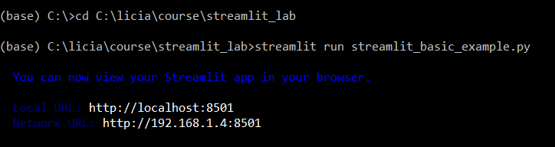
Start a server
Step 1
Make a new python script
Import streamlit
import streamlit as st
Open your terminal/anaconda prompt, move (use cd <dir path>) to the directory where you store your python script
Run the following command:
streamlit run <filename>
This is where we are storing our python script (you can put it anywhere)
This is the name of our script (you can name it anything)
Open your browser and navigate to this address

Slide 7
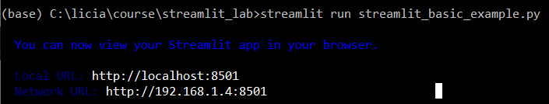
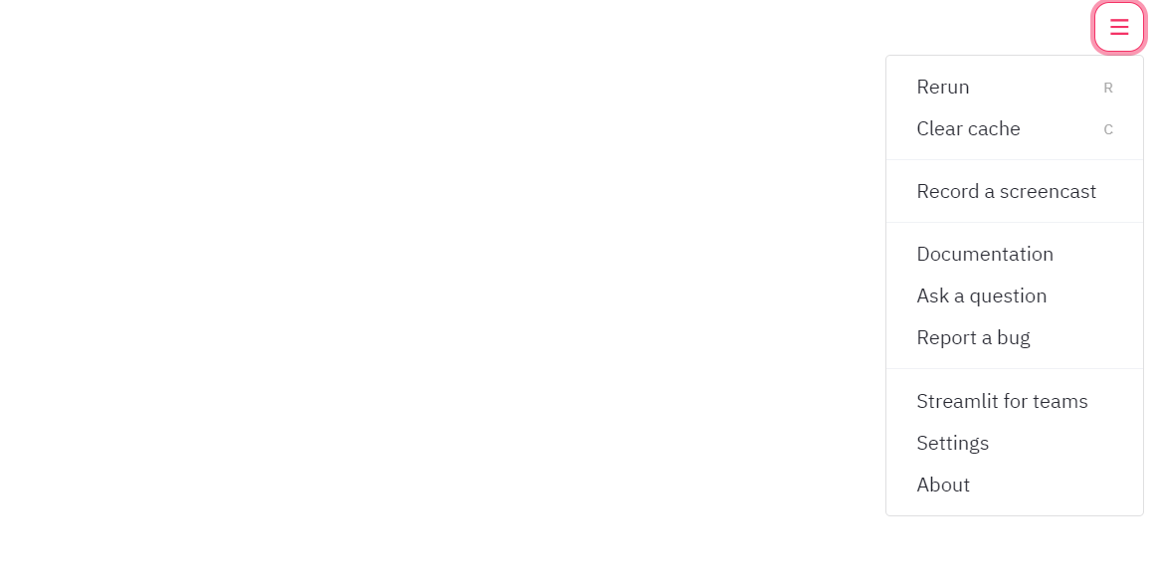
Result of step 1
After navigating to the address, you will see a blank page with only a menu button on the top right

Slide 8
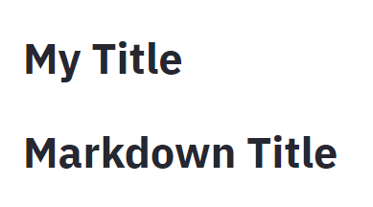

Adding a Title
Step 2
Method 1:
st.title(“My Title”)
Method 2:
st.write("# Markdown Title")
Whenever you change the script, you will see the following content on your webpage
Two methods that generate identical results
Select this so that it automatically reruns for you.

Slide 9
Using st.write() to add markdown
Step 3
Paste the following lines to your script and see what happens
st.write("I can format text content into different styles such as **bold**, *italics*, and ~~strikethrough~~")
st.write("I am writing a link [to the streamlit documentation page](https://docs.streamlit.io/en/stable/api.html)")
st.write('![alt text](https://upload.wikimedia.org/wikipedia/commons/thumb/3/3e/Irises-Vincent_van_Gogh.jpg/314px-Irises-Vincent_van_Gogh.jpg)')
st.write() is a powerful command. You can read more about it here:
https://docs.streamlit.io/en/stable/api.html#streamlit.write

Slide 10
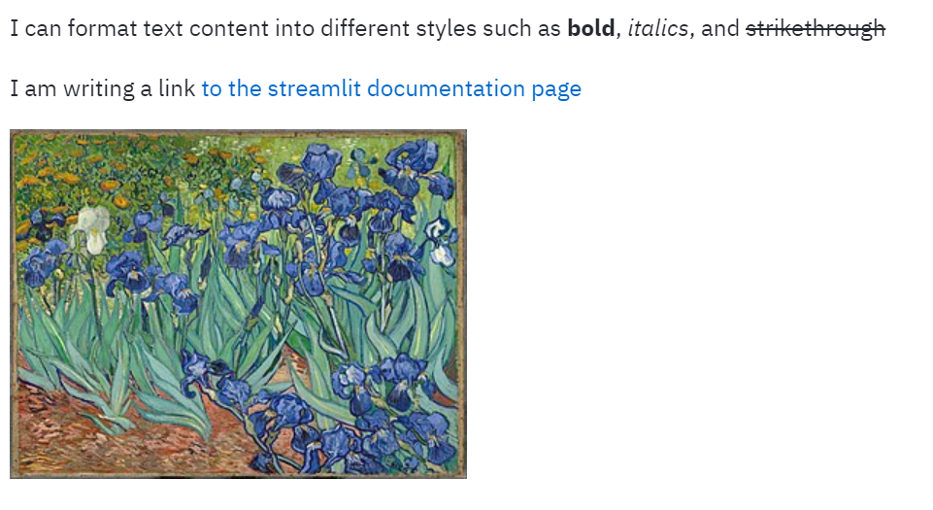
Result of step 3
Markdown is a language to format plain-text content. You can take a look at this cheatsheet: https://github.com/adam-p/markdown-here/wiki/Markdown-Cheatsheet

Slide 11
Making and displaying an altair visualization
Step 4
import pandas as pd
import altair as alt
car_url = "https://raw.githubusercontent.com/altair-viz/vega_datasets/master/vega_datasets/_data/cars.json"
cars = pd.read_json(car_url)
hp_mpg=alt.Chart(cars).mark_circle(size=80,opacity=0.5).encode(
x='Horsepower:Q',
y='Miles_per_Gallon:Q',
color="Origin"
)
st.write(hp_mpg)

Slide 12
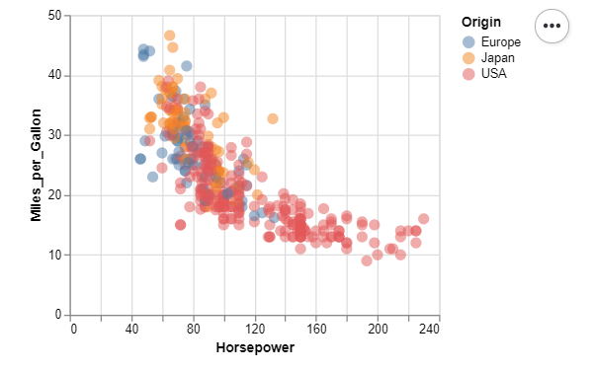
Result of step 4

Slide 13
Magic Command
Step 5
Delete all the st.write () commands and leave the command parameters in your script. It still works!
E.g., instead of
st.write("I can format text content into different styles such as **bold**, *italics*, and ~~strikethrough~~")
st.write(hp_mpg)
Simply use
"I can format text content into different styles such as **bold**, *italics*, and ~~strikethrough~~"
hp_mpg
Write data and markdown without the “st.write()”
Read more here: https://docs.streamlit.io/en/stable/api.html#magic-commands

Slide 14
Add a button to toggle the display of the chart
Step 6
#initialize a button
btn=st.button("display hp_mpg")
#if the button is clicked
if btn:
#display the chart
hp_mpg
else:
#display the following text
"click the button to display the hp_mpg chart"
Widgets hold users’ inputs
Streamlit offers a number of built-in widgets such as button, checkbox, radio, selectbox. Read more here:
https://docs.streamlit.io/en/stable/api.html#display-interactive-widgets

Slide 15
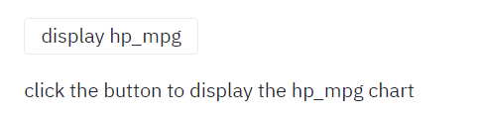
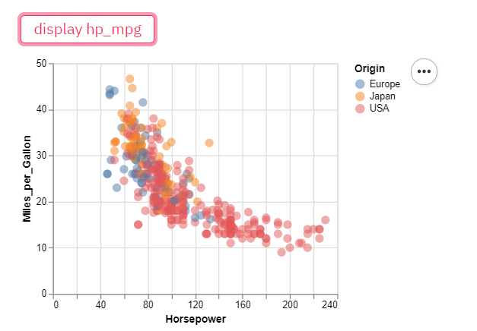
Before clicking
After clicking
Result of step 6

Slide 16
Make a select widget and use user input in a chart
Step 7
#step 8: make a select widget
##create a list of options
y_axis_options=["Acceleration","Miles_per_Gallon","Displacement"]
##create a select box
y_axis_selectbox=st.selectbox(
label="Select the column to plot for the y-axis",
options=y_axis_options
)
## create a chart that uses the select box
chart=alt.Chart(cars).mark_circle(size=80,opacity=0.5).encode(
x='Horsepower:Q',
y=y_axis_selectbox,
color="Origin"
)
#render the chart
chart
The select widget creates a dropdown menu. Read more here:
https://docs.streamlit.io/en/stable/api.html#display-interactive-widgets
Widgets hold users’ inputs

Slide 17
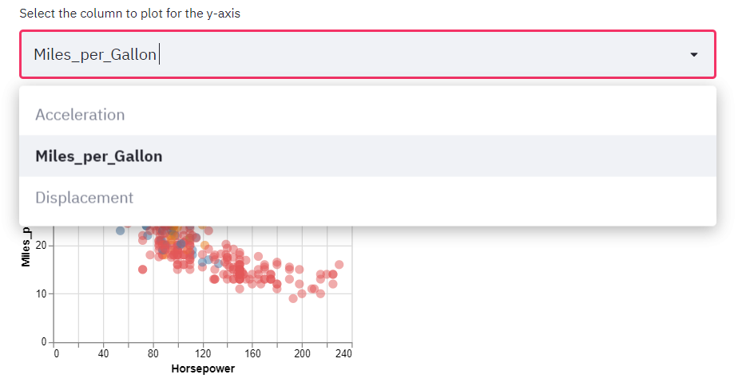
Result of step 7

Slide 18
Using the sidebar
Step 8
E.g., instead of
st.title(“My Title”)
Write
st.sidebar.title(“My Title”)
Instead of
st.write("# Markdown Title")
Write
st.sidebar.markdown("# Markdown Title")
Almost everything we have covered so far can be displayed in the sidebar by changing st.[element] to st.sidebar.[element] with the exception of st.write()
Read more:
https://docs.streamlit.io/en/stable/api.html#add-widgets-to-sidebar

Slide 19
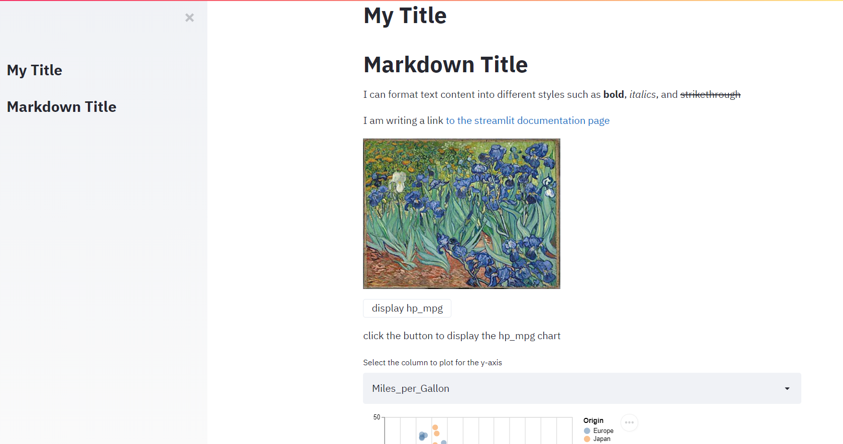
Result of step 8
You can add almost any element to the sidebar: try moving your visualization and interactive widgets to the sidebar.

Slide 20
Getting from Jupyter to Streamlit
Step 9
import streamlit as st
Then:
just save your notebook as a .py file! Should work (more or less)

