Slide 1
Lab: Wednesday
Team #2
Members:
Designer 1: Lydia Rogers
Designer 2: Chongdan Pan
Designer 3: Chris Pena
Designer 4: Yash Kamat

Slide 2
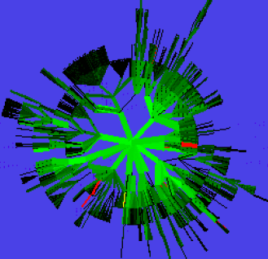
Professional Solution: Domain Tasks and Benefits
Visualize the website hierarchy
Disk tree visualization to show layout of website
Used color coding to denote page additions, deletions, and visit frequency
Notes:
The total number of leaves in the tree is calculated first, then a first-breadth traversal is used.
Using multiple colors allows for addition information to be shown concurrently in the visualization.

Slide 3
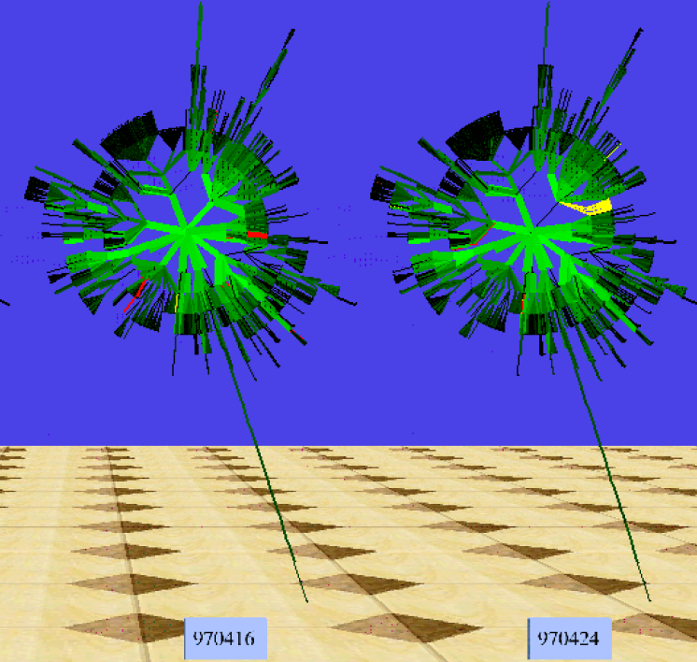
Professional Solution: Domain Tasks and Benefits
Show differences over time
Utilized time tube visualizations to give a spatial dimension
Snapshots of time are easily represented in one visualization
Notes:
Multiple disk trees with time tubes were implemented to show changes over time.
Each tree is a weekly representation of the site.

Slide 4

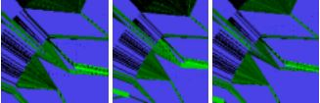
Professional Solution: Domain Tasks and Benefits
Create interactive visualizations
Allow the end user to determine which aspects to focus on
Notes:
Developers wanted to give users the ability to focus in on subsections of the disk tree.

Slide 5
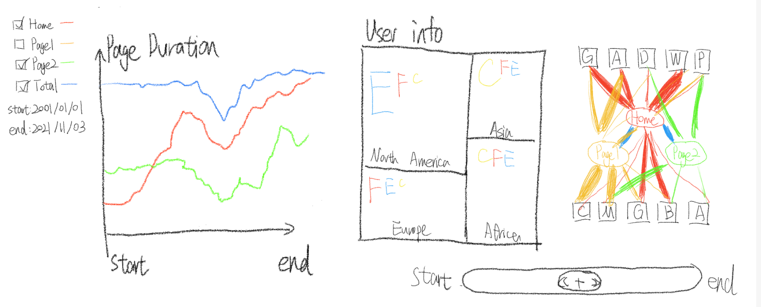
Our Solution
We use three visualizations to address the problem.
Notes:
We use three visualizations to address the problems with three domains

Slide 6
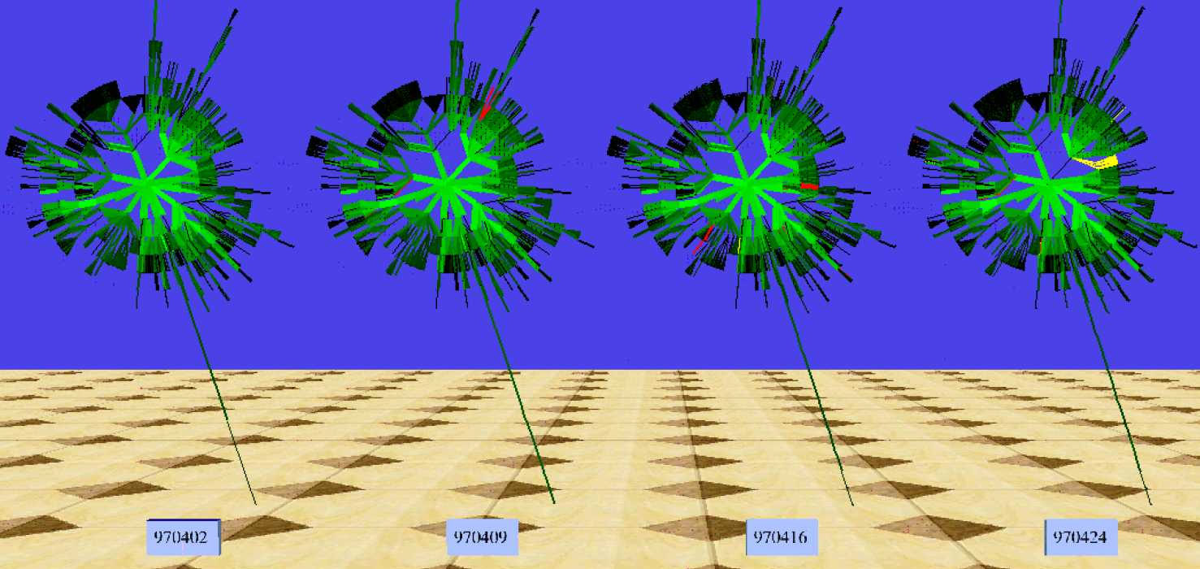
Domain Comparison
Both
Get each page’s insight in certain time period
Ours
Provides information in more aspects
Doesn’t integrate all information densely
Professional
Gives details and relationship within the website
Only focus on the website itself.
Notes:
Both of our solution are going to get each page’s insight in certain time period.
We have more domains about how long the users spend on each page, the information about users of different pages, and how the pages related to other websites. However, we don’t integrate them densely, so we need more visualizations.
The professional solution focus more on the details and relationship within the website but doesn’t take external information into account.

Slide 7
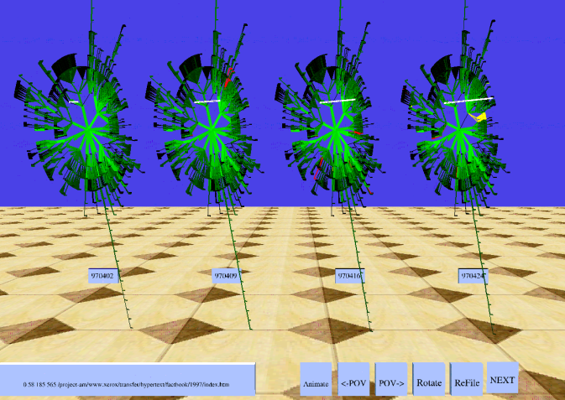
Interaction Comparison
Both
Enable interactive filtering of data
Ours
Allows for whole and sub-page detail while defining a timeframe
Professional
Focuses on whole website hierarchy details
Notes:
We both wanted to focus on allowing a filtering of the data. The professional solution enabled a click-to-view option for subsections of the disk trees. Our solution adds a dynamic slider for users to select and view data for a desired timeframe.

Slide 8
Algorithm Comparison
Both
Covers all the data of interest
Ours
Simple and fast
Needs to rerun when user make interaction
Professional
A breadth first approach has a higher time complexity
Only needs to run once
Notes:
Given the time the professional solution was developed, it is very likely they would of opted for something similar to our solution. Unfortunately for them, they were limited by the processing power we can utilize today.

Slide 9
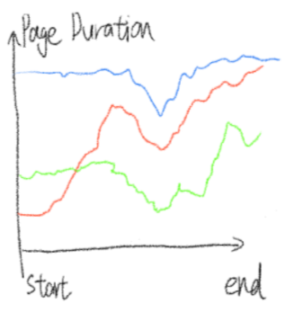
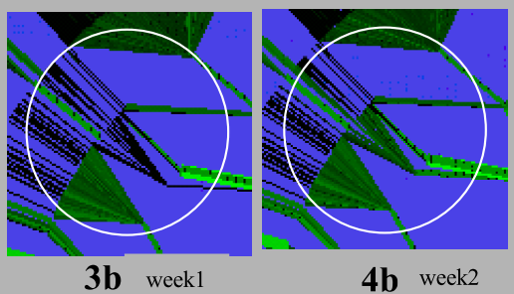
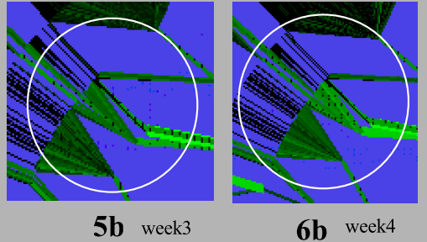
First Comparison
Ours
Compare each page with itself
Have a longer time range
Hard to find a causality between each pages’ trend.
Professional
Generate an overall temporal trend within all pages
A long time range will use too much space
Notes:
Our first visualization is a line chart, focusing the temporal behavior of each page, but it’s hard to find a collective trend or causality. The professional one enables us to find an overall trend on the hierarchy, but it can’t cover a long timer period because it requires too much visualizations.

Slide 10
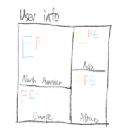
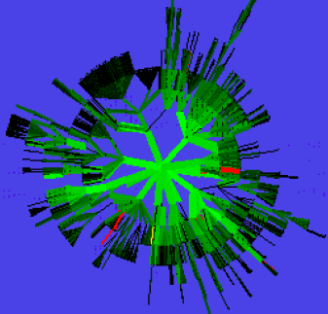
Second Comparison
Ours
Shows more information about users’ location and browsers
Be intuitive and easy to read
Doesn’t relate the users info the pages
Professional
Shows how frequently the pages are visited
Hard to tell the subtle difference when there are many pages
Notes:
Our second visualization is a heatmap, providing information about users and external websites intuitively. However, it’s hard to find the pattern within the user info against the pages. For professional, it’s helpful to find the how frequently the pages are visited, and the pattern is clear. But when there are too many pages, they’ll be squeezed together, so it requires more interactivity to tell the subtle difference or details.

Slide 11
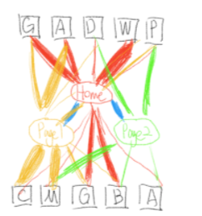
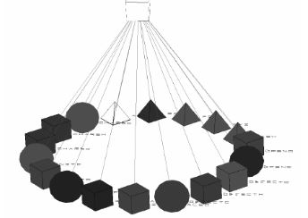
Third Comparison
Ours
Show how users entered, navigated, and exited the website.
Professional
Used cone trees to visualize similar log data.
Source: https://www.researchgate.net/publication/232630306_Interacting_with_huge_hierarchies_Beyond_cone_trees
Notes:
One domain task we wanted to focus on was how users visited and exited the website. The professional solution mentioned tracking similar information, but they referred to cone trees. Our design by comparison is very similar to a cone tree, only we allow for multiple entry points to any given page.

