Slide 1
ADMI X Avalanche X UMSI
Panda | Eva | Joseph | Nina | Vennie
Avalanche

Slide 2




1
Introduction
2
Project Overview
Agenda
3
Brief Interview
4
Q & A

Slide 3

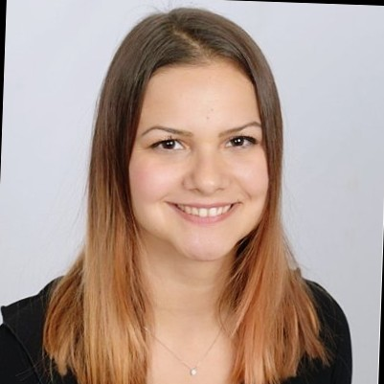



Team Background
Eva
Psychology & human factors
Vennie
Psychology
Nina
Psychology & Interaction design
Panda
Electrical & Computer Engineering
Joe
Psychology &
Web Development

Slide 4
About ADMI
Now it is time to hear from you ...

Slide 5
Project Methodology
Contextual inquiry
Focusing interaction between users and system
Conduct at least 6 interviews
More than 3 types of stakeholder groups to interview
Qualitive Analysis
Get qualitive data from interviews
Analyze workflow from data
Identify critical issues and brainstorm solutions

Slide 6
Project Plan
Interview 3 different types of people all of whom have interaction with the cloud shifting or working with cloud
Make analysis based on interview and research about cloud technology
Provide reasonable recommendations for cloud transition of ADMI

Slide 7
Project Timeline
Oct. 4 - Nov. 5 | Schedule and conduct interviews
Nov. 6 - Dec. 6: | Analyze interview data and compile a report
Late Nov - Mid Dec | Present results and recommendations Collect feedbacks
Dec. 6 - Dec. 10 | Submit the final report

Slide 8

Brief Interview
Progress so far
Hybrid model Status
Greatest Challenge
Transition Progress

Slide 9

Brief Interview
Data Security
High efficiency during remote
meeting and coding
Emergency protocal
Cloud Tech

Slide 10

Brief Interview
Your anticipation
Relevant Documents
Further touch
Collaboration

Slide 11
Q & A

Slide 12
Thank you

