Slide 1
The Effect of Dimensionality in Affinity Choice for Agglomerative Hierarchical Clustering
Xichen Liu
Jeff Turgeon
CS5100 - Introduction to Artificial Intelligence

Slide 2
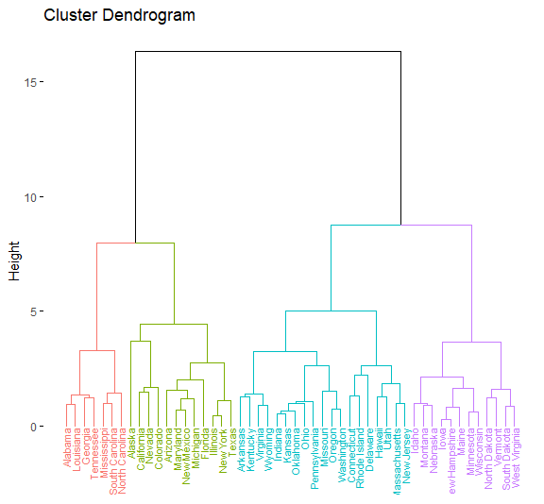
Project Aim
Agglomerative Hierarchical Clustering is a bottom up approach to clustering data. There are two primary variables that can affect the clusters that are generated. Different combinations of these variables will generate different clusters.
Linkage - A method for building the clusters based on how close the observations are.
Affinity - The distance metric used to determine how close the elements are to each other.
The aim of this project is to see if the dimension of the dataset affects which affinity should be used in the clustering algorithm.

Slide 3
Project Objectives
Are there any affinities consistently better as the dimensions increase or decrease?
Are there any affinities that are relatively consistent across dimensions?
Are there any combinations of linkage and affinity that perform better as the dimension increases?
We will use a combination of existing measures and observations to explore these questions.

Slide 4
Literature Review
In 2010, Erisoglu and Sakallioglu explored different combinations of distance metrics and linkages in hierarchical clustering, and determined that the distance metric is impactful.
In 2011, Rajalingam and Ranjini explored clustering with different data types, and determined that the run time for datasets of the same type of data, and with comparable record counts is relatively equal. The used a single distance metric for each data type.
In 2014, Kumar, Chhabra, and Kumar explored 10 distance measures against 8 clustering algorithms, and determined that the performance and quality of the clusters varied based on the distance, clustering technique, and the nature of the data.
In 2016, Irani, Pise, and Phatak explored distance metrics further, and determined that the metrics can tell you the distance between points, but do not consider the behavior of the data. They also note that negative data can be a challenge to clustering.
In 2018, Ogbuabor, and Ugwoke explored a healthcare dataset using K-Means and DBSCAN with varying distance metrics, and evaluated the results using the Silhouette Score value.

Slide 5
Project Requirements
Obtain Clean Datasets
Vary the Dimensions of the Datasets
Vary the Linkage Parameter
Vary the Affinity Parameter (Including Standard and PreComputed)
Calculate the Measures
Analyze the Results

Slide 6
Datasets
* https://www.kaggle.com/
** https://archive.ics.uci.edu/ml/index.php
Dataset | Description | Attributes | Records
CC General * | Credit Card Data | 16 | 8,950
COVID * | COVID Statistics by Country | 7 | 225
Credit Card Customer Data ** | Credit Card Summary Data | 6 | 660
Mall Customers * | Mall Customer Summary Data | 5 | 200
Sales Transaction ** | Sales Transaction Information | 53 | 811
Wholesale ** | Sales Summary Information | 8 | 440

Slide 7
Variables Part 1
Dimensions: 2, 3, 4
Linkage | Definition
Average | Average inter-cluster distance
Centroid | Distance between the two mean vectors of the clusters
Complete | The farthest distance between elements in each cluster
Single | The smallest distance between elements in each cluster
Ward | Creates new clusters that minimize the variance

Slide 8
Variables Part 2
* https://scikit-learn.org/stable/modules/generated/sklearn.metrics.DistanceMetric.html
Affinity | Definition | Formula *
Euclidean | Straight Line Distance | sqrt(sum((x-y)^2))
Manhattan | City Block Distance | sum(|x -y|)
Cosine | 1 - Cosine Similarity | 1 - (x * y)/(|x||y|)
Chebyshev | The maximum distance between vectors | max(|x - y|)
Minkowski | A generalization of the Euclidean and Manhattan distance | sum(w * |x-y|^p)^(1/p)
Mahalanobis | A measure of the number of standard deviations a point is from the mean distribution | sqrt((x-y)’ V^-1 (x-y)

Slide 9
Measures
Measure | Definition | Interpretation
Silhouette Score | A measure of similarity between items in the same cluster | -1 to 1 0 means overlap Higher values are better
Calinski Harabasz Score | A measure of the variance in cluster dispersion | Higher values are better
Davies-Bouldin Index | A measure of the average similarity between clusters focusing on the size of the clusters and the distance between the clusters | 0 and above Closer to 0 is better
https://scikit-learn.org/stable/modules/classes.html#module-sklearn.metrics

Slide 10
Prior Works
Datasets
Numerical data
Clean datasets
Normalization
Number of dimensions
Embedding space

Slide 11
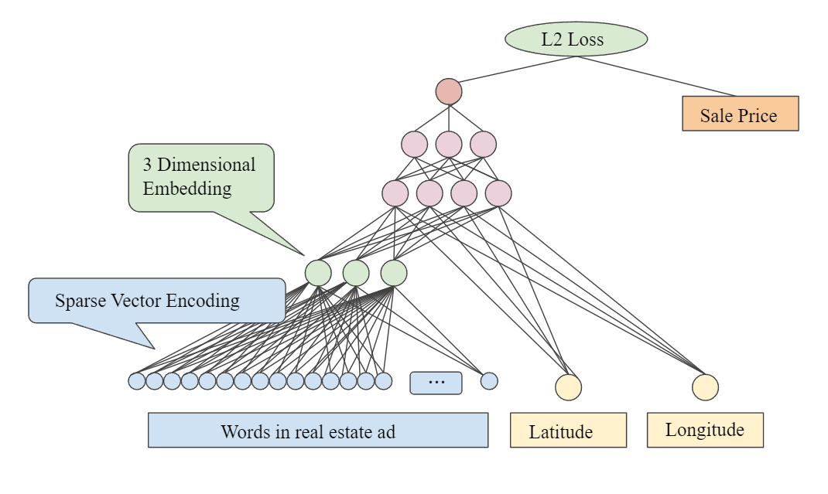
Embedding space
Embedding is a kind of dimension reduction technique
Neural network
Generally , it means to project the higher dimension values into lower dimension space
Proportionally

Slide 12
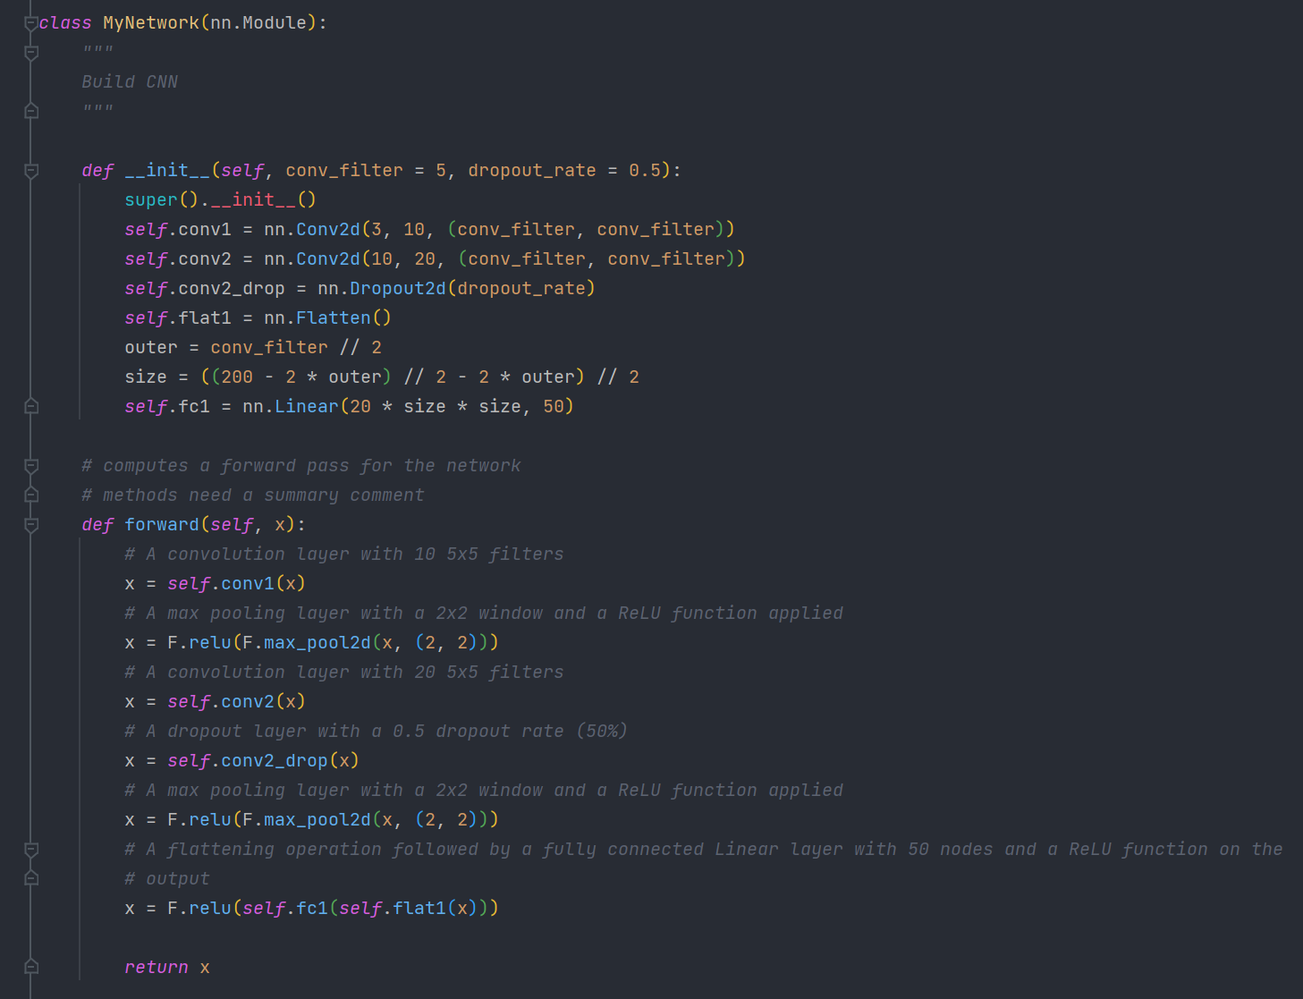
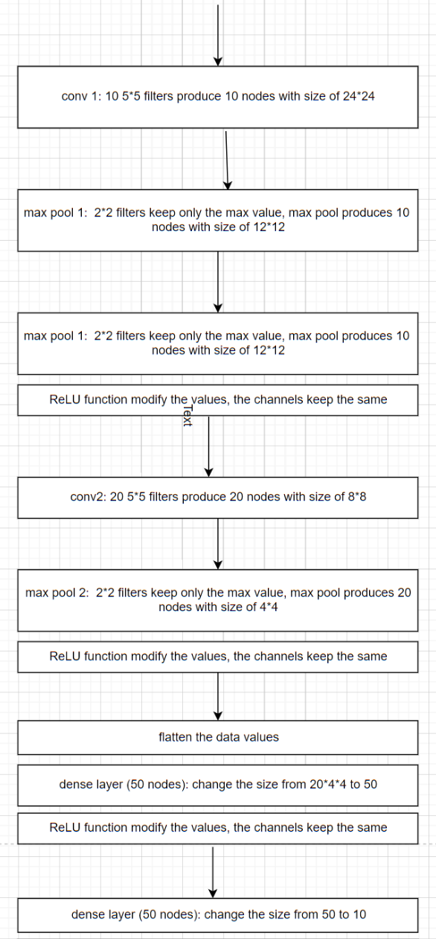
Demo of projection in to Embedding space

Slide 13
Code Demo

Slide 14
Analysis Approach
Generated 342 records that included the dataset name, linkage, affinity, dimension, Silhouette Score, Calinkski Harabasz Score, Davies-Bouldin Index and the number of clusters
Discarded any records with a single cluster
Calculated the range between the fourth and second dimension for each measure for each linkage and affinity combination
Averaged the results across the datasets
Tabulated the data in separate tables for each measure for interpretation

Slide 15
Results - Change in Silhouette Score
The dimension changed from 2 to 4
Average change in Silhouette Score was 0.18
Largest increase in Silhouette Score was 0.91
Largest decrease in Silhouette Score was -0.24
Linkage | Chebyshev | Cosine | Euclidean | Mahalanobis | Manhattan | Minkowski
Average | 0.07 | 0.18 | 0.31 | -0.01 | 0.42 | 0.07
Centroid | - | - | - | - | - | -
Complete | 0.30 | 0.08 | 0.36 | -0.24 | 0.25 | 0.11
Single | -0.10 | -0.17 | 0.91 | -0.10 | 0.47 | 0.37
Ward | - | - | 0.19 | - | - | -

Slide 16
Results - Change in Calinski Harabasz Score
The dimension changed from 2 to 4
Average change in Calinski Harabasz Score was 576.73
Largest increase in Calinski Harabasz Score was 15199.21
Largest decrease in Calinski Harabasz Score was -10770.77
Linkage | Chebyshev | Cosine | Euclidean | Mahalanobis | Manhattan | Minkowski
Average | 210.69 | -362.5 | 109.18 | 15199.21 | 284.02 | -5.77
Centroid | - | - | - | - | - | -
Complete | 379.27 | 172.63 | 296.97 | 642.46 | -3407.30 | 55.20
Single | -159.80 | -102.41 | 90.21 | 7519.38 | 90.59 | -10770.77
Ward | - | - | 716.52 | - | - | -

Slide 17
Results - Change in Davies-Bouldin Index
The dimension changed from 2 to 4
Average change in Davies-Bouldin Index was 0.17
Largest increase in Davies-Bouldin Index was 1.09
Largest decrease in Davies-Bouldin Index was -0.91
Linkage | Chebyshev | Cosine | Euclidean | Mahalanobis | Manhattan | Minkowski
Average | 0.11 | 0.16 | -0.19 | -0.08 | 0.44 | -0.05
Centroid | - | - | - | - | - | -
Complete | 0.33 | -0.27 | 0.51 | -0.32 | 0.53 | -0.10
Single | 0.90 | 0 | -0.91 | -0.04 | 1.09 | 1.02
Ward | - | - | 0.16 | - | - | -

Slide 18
Results Summary
Are there any affinities consistently better as the dimensions increase or decrease?
Euclidean, Manhattan, and Minkowski improved the Silhouette Score across linkages
Euclidean and Mahalanobis improved the Calinski Harabasz Score across linkages
Mahalanobis improved the Davies-Bouldin index across linkages
Are there any affinities that are relatively consistent across dimensions?
We saw fluctuations in all measures as the dimension changed across all affinities
Are there any combinations of linkage and affinity that perform better as the dimension increases?
Single Linkage with Euclidean improved by 0.91 in Silhouette Score
Average Linkage with Mahalanobis improved by 15199.21 in Calinski Harabasz Score
Since with Euclidean improved by -0.91 in Davies-Bouldin Index

Slide 19
Future Work
Are there other measures that give additional insight?
Evaluating the cluster statistics against a dataset Ground Truth
Is there an upper threshold on the number of dimensions an affinity improves with?
Do any of the newer affinities, like Geometric Distance, perform better at higher dimensions?

Slide 20
Conclusion
There appears to be some affinities that perform better as the dataset dimension increases.
Some affinities performed better with specific linkages, while others were more universal.
Further research and findings in this area could be very impactful to future clustering efforts.

Slide 21
References
Bhasin, Arjun (2018). Credit Card Dataset for Clustering [Data set].
https://www.kaggle.com/datasets/arjunbhasin2013/ccdata
Bora, D. J., & Gupta, D. K. (2014). Effect of Different Distance Measures on the Performance of
K-Means Algorithm: An Experimental Study in Matlab. International Journal of Computer Science
and Information Technologies, 2501-2506.
Cardoso, Margarida G.M. S. (2014). Wholesale customers [Data set].
https://archive.ics.uci.edu/ml/datasets/Wholesale+customers
Chen, Dr. Daqing (2015). Online Retail [Data set].
https://archive.ics.uci.edu/ml/datasets/Online+Retail
Davidson, I., & Ravi, S. S. (2007). Using instance-level constraints in agglomerative hierarchical
clustering: theoretical and empirical results. Data Mining Knowledge Discovery, 257-282.
Devakumar, K. P. (2020). Covid-19 Dataset [Data set].
https://www.kaggle.com/datasets/imdevskp/corona-virus-report
Erisoglu, M., & Sakallioglu, S. (2010). An Investigation of Effects On Hierarchical Clustering of Distance
Measurements. Selcuk Journal of Applied Mathematics, 39-53.
Heller, K. A., & Ghabramani, Z. (2005). Bayesian Hierarchical Clustering. Proceedings of the 22nd
International Conference on Machine Learning, (pp. 297-304). Bonn, Germany.
Irani, J., Pise, N., & Phatak, M. (2016). Clustering Techniques and the Similarity Measures used in
Clustering: A Survey. International Journal of Computer Applications, 9-14.

Slide 22
References 2
Kassambara, A. (n.d.). Agglomerative Hierarchical Clustering. Retrieved from Data Novia:
https://www.datanovia.com/en/lessons/agglomerative-hierarchical-clustering/
Kumar, V., Chhabra, J. K., & Kumar, D. (2014, June). Performance Evaluation of Distance Metrics in the
Clustering Algorithms. INFOCOMP, 13(1), 38-51.
Ogbuabor, G., & Ugwoke, F. N. (2018). Clustering Algorithm for a Healthcare Dataset Using Silhouette Score
Value. International Journal of Computer Science & Information Technology, 27-37.
Pasupathi, S., Shanmuganathan, V., Madasamy, K., Yesudhas, H. R., & Kim, M. (2021). Trend Analysis using
agglomerative hierarchical clustering approach for time series big data. The Journal of Supercomputing, 6505 - 6524.
Rajalingam, D., & Ranjini, K. (2011). Hierarchical Clustering Algorithm - A Comparative Study. International
Journal of Computer Applications, 42-46.
Shwebabh (2018). Mall Customers [Data set].
https://www.kaggle.com/datasets/shwetabh123/mall-customers
Tan, James (2017). Sales Transactions Dataset Weekly [Data set].
https://archive.ics.uci.edu/ml/datasets/Sales_Transactions_Dataset_Weekly
Zhou, S., Xu, Z., & Liu, F. (2017). Method for Determining the Optimal Number of Clusters Based on Agglomerative
Hierarchical Clustering. IEEE Transactions On Neural Networks and Learning Systems, Vol. 28, No. 12, 3007 - 3017.

Slide 23
Questions?
Thank you!

