Slide 1

Enhancing image retrieval through contrastive learning with dual queries
School of Computer Science And Engineering
Presented By:
Pradeep Shet
(01FE23MCS005)
Co-Guide:
Dr. Vishwanath P Baligar
Under the guidance of:
Dr. Sujata C

Slide 2
Enhancing image retrieval through contrastive learning with dual queries
CONTENTS
Introduction
Literature Survey
Problem Statement
Objectives
High level design
Low level design
Implementation
Scope of Improvement
Conclusion
References

Slide 3
Introduction
Enhancing image retrieval through contrastive learning with dual queries
Content-based image retrieval is known as one of the upcoming procedural structure that will apply various techniques of computer vision for penetrating and organizing the huge image anthology in an effective manner.
At present, the existing visual search recommendation systems have been practically applied based on similarities between the user inputted image and products on sale.
The machine then concludes based on the inputs and the performance or the learning gets better with large datasets.
Based on efficiency and performance we are going to select the algorithm and machine learning model.

Slide 4
Enhancing image retrieval through contrastive learning with dual queries
Literature Survey
Composing Text and Image for Image Retrieval - An Empirical Odyssey
Nam Vo , Lu Jiang , Chen Sun , Kevin Murphy. "Composing Text and Image for Image Retrieval - an Empirical Odyssey," 2019 IEEE/CVF Conference on Computer Vision and Pattern Recognition (CVPR), Long Beach, CA, USA, 2019, pp. 6432-6441, doi: 10.1109/CVPR.2019.00660.
Proposed Methodology: TIRG (Text Image Residual Gating) - Combines image and text features for image retrieval using gated residual connections
Dataset: Fashion200k, MIT-States

Slide 5
Enhancing image retrieval through contrastive learning with dual queries
Literature Survey
2. Compositional Learning of Image-Text Query for Image Retrieval
M. U. Anwaar, E. Labintcev and M. Kleinsteuber, "Compositional Learning of Image-Text Query for Image Retrieval," 2019 IEEE Winter Conference on Applications of Computer Vision (WACV), Waikoloa, HI, USA, 2021, pp. 1139-1148, doi: 10.1109/WACV48630.2021.00118.
Proposed Methodology: ComposeAE - Autoencoder-based model that combines image and text for retrieval using deep metric learning, with a rotational symmetry constraint on optimization.
Dataset: MIT-States, Fashion200k, Fashion IQ

Slide 6
Enhancing image retrieval through contrastive learning with dual queries
Literature Survey
3. Dual Compositional Learning in Interactive Image Retrieval
M. U. Anwaar, E. Labintcev and M. Kleinsteuber, "Compositional Learning of Image-Text Query for Image Retrieval," 2021 IEEE Winter Conference on Applications of Computer Vision (WACV), Waikoloa, HI, USA, 2021, pp. 1139-1148, doi: 10.1109/WACV48630.2021.00118.
Proposed Methodology: Dual Composition Network (DCNet), with Composition Network and Correction Network; Fused Difference (FD) module, and joint training loss
Dataset: Fashion-IQ, Shoes, Fashion200K

Slide 7
Enhancing image retrieval through contrastive learning with dual queries
Literature Survey
4. Exploring Compositional Image Retrieval with Hybrid Compositional Learning and Heuristic Negative Mining
Chao Wang, Ehsan Nezhadarya, Tanmana Sadhu, Shengdong Zhang. Exploring Compositional Image Retrieval with Hybrid Compositional Learning and Heuristic Negative Mining. 2022 International Electronics Symposium (IES), Surabaya, Indonesia, 2022, pp. 430-437, doi: 10.1109/IES53407.2021.9593987
Proposed Methodology: Hybrid Compositional Learning (HyCoLe-HNM) model using CLIP, with a heuristic negative mining approach
Dataset: FashionIQ, Fashion200K, MIT-States

Slide 8
Enhancing image retrieval through contrastive learning with dual queries
Literature Survey
5. Cola: A Benchmark for Compositional Text-to-Image Retrieval
Chao Wang, Ehsan Nezhadarya, Tanmana Sadhu, Shengdong Zhang. Exploring Compositional Image Retrieval with Hybrid Compositional Learning and Heuristic Negative Mining. 2023 International Electronics Symposium (IES), Surabaya, Indonesia, 2023, pp. 430-437, doi: 10.1109/IES53407.2021.9593987
Proposed Methodology : CLIP and FLAVA models with multimodal adaptation
Dataset: Cola, CREPE, CLEVR, PACO, GQA

Slide 9
Literature Survey
Enhancing image retrieval through contrastive learning with dual queries
Title | Author | Year | Methodology
Composing Text and Image for Image Retrieval - An Empirical Odyssey | Nam Vo , Lu Jiang , Chen Sun , Kevin Murphy | 2019 | TIRG (Text Image Residual Gating) - Combines image and text features for image retrieval using gated residual connections
Compositional Learning of Image-Text Query for Image Retrieval | Muhammad Umer Anwaar, , Egor Labintcev , Martin Kleinsteuber | 2019 | ComposeAE - Autoencoder-based model that combines image and text for retrieval using deep metric learning, with a rotational symmetry constraint on optimization

Slide 10
Enhancing image retrieval through contrastive learning with dual queries
Title | Author | Year | Methodology
Dual Compositional Learning in Interactive Image Retrieval | Jongseok Kim , Youngjae Yu1, Hoeseong Kim , and Gunhee Kim | 2021 | Dual Composition Network (DCNet), with Composition Network and Correction Network; Fused Difference (FD) module, training loss
Exploring Compositional Image Retrieval with Hybrid Compositional Learning and Heuristic Negative Mining | Chao Wang, Ehsan Nezhadarya, Tanmana Sadhu, Shengdong Zhang | 2022 | Hybrid Compositional Learning (HyCoLe-HNM) model using CLIP, with a heuristic negative mining approach.
Cola: A Benchmark for Compositional Text-to-Image Retrieval | Arijit Ray, Filip Radenovic, Abhimanyu Dubey, Bryan A Plummer | 2023 | CLIP and FLAVA models with multimodal adaptation) involving multimodal transformer encoder-decoder approach for text-to-image retrieval.

Slide 11
Problem Statement
Enhancing image retrieval through contrastive learning with dual queries
Implement a system for image retrieval using image and text as query which can assist in developing search engines, recommendation systems.

Slide 12
Objectives
Enhancing image retrieval through contrastive learning with dual queries
Develop a system that integrates both text and image inputs for accurate image retrieval.
Design algorithms to link visual and textual features for hybrid search capabilities.
Evaluate the system's performance in terms of accuracy, speed, and scalability.

Slide 13
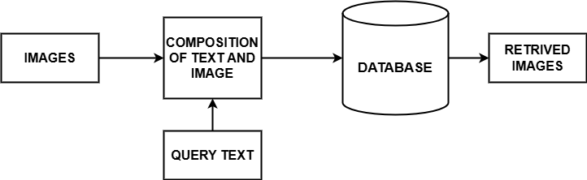
High Level Design Architecture
Enhancing image retrieval through contrastive learning with dual queries

Slide 14
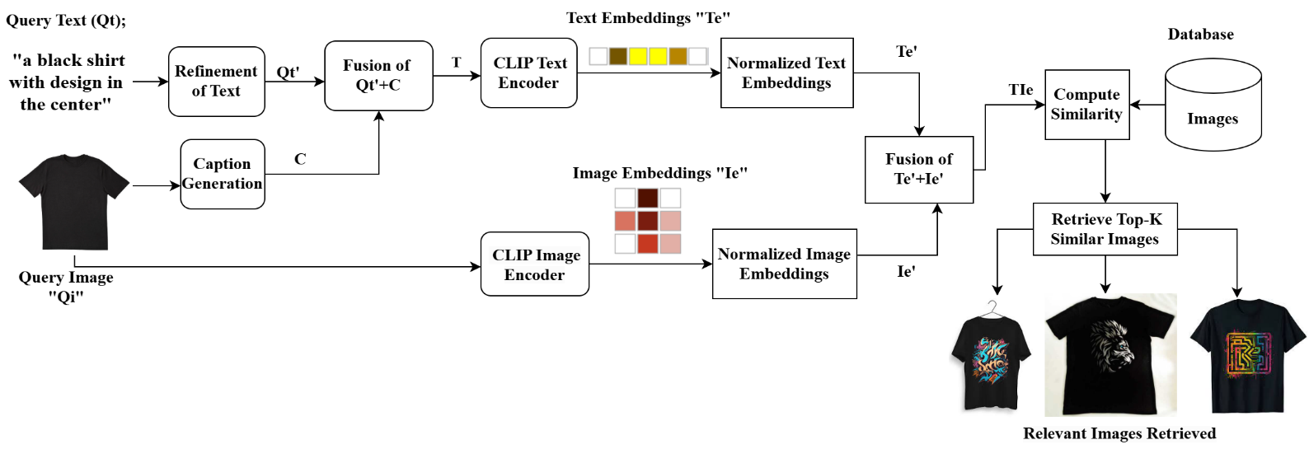
Low Level Design Architecture
Enhancing image retrieval through contrastive learning with dual queries

Slide 15

Scope of Improvement
Enhancing image retrieval through contrastive learning with dual queries
1.Dynamic Weight Adjustment
Instead of a fixed alpha(0.5), try learning or adapting it based on similarity scores
The embeddings are combined using a weighted sum fusion approach:
Alpha ‘α’ is a weight factor that balances the contributions of image and text embeddings.
Eimg​ is the normalized image embedding.
Etxt​ is the normalized text embedding.
If α=0.5, both image and text are equally weighted.
If α=0.7, the image embedding is given more importance.
If α=0.3, the text embedding is given more importance.

Slide 16
Scope of Improvement
Enhancing image retrieval through contrastive learning with dual queries
2. Combining different models
BLIP + CLIP fusion combines context (BLIP) and fine-grained image details (CLIP) for enhanced retrieval.
Efused​=α⋅EBLIP​+(1−α)⋅ECLIP​
Alpha α controls how much weight BLIP vs. CLIP gets.

Slide 17
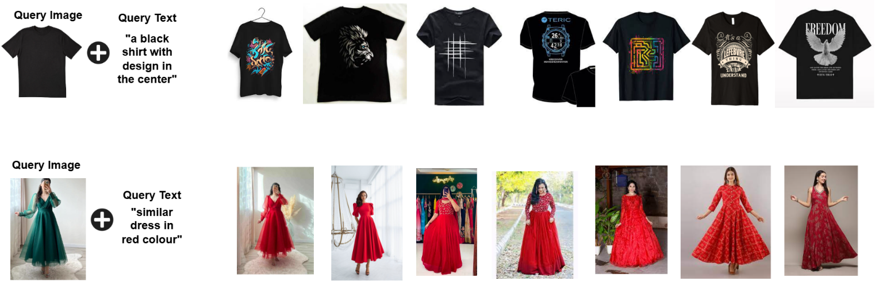
Implementation
Enhancing image retrieval through contrastive learning with dual queries

Slide 18
 | DRESS |  | SHIRT |  | AVERAGE
METHODS | R@10 | R@50 | R@10 | R@50 | R@10 | R@50
CIRR[30] | 17.45 | 40.41 | 17.53 | 68.81 | 17.49 | 54.61
VAL[5] | 22.53 | 44.00 | 22.38 | 44.15 | 22.45 | 44.07
CosMo[25] | 25.64 | 50.30 | 24.90 | 49.18 | 25.27 | 49.74
DCNet[22] | 28.95 | 56.70 | 23.95 | 47.3 | 26.45 | 52.00
FashionVLP[12] | 32.42 | 60.29 | 31.89 | 58.44 | 32.15 | 59.36
PROPOSED METHOD-1 USING CLIP(ViT-B/32) | 34.10 | 66.00 | 34.10 | 67.00 | 34.10 | 66.50
PROPOSED METHOD-2 DYNAMIC ALPHA | 35.00 | 69.00 | 36.25 | 67.00 | 36.625 | 68.00

Slide 19
Conclusion
Enhancing image retrieval through contrastive learning with dual queries
In this work, we propose to compose the representation of source image with the modification text in a complex space. By combining both image and text queries, the system demonstrated its ability to process multimodal inputs.
The embeddings of the image and text were averaged, which allowed the system to leverage the power of both inputs for improved image retrieval. The code was structured to visually display the top matching images based on the combined query, making it easy to interpret the results.
We implemented the system with alpha values dynamically adjusted based on the similarity score. This approach enhances adaptability and improves the model's overall performance in varying contexts.

Slide 20
References
Enhancing image retrieval through contrastive learning with dual queries
[1]Meenaakshi N. Munjal, Shaveta Bhatia. "A Novel Technique for Effective Image Gallery Search using Content Based Image Retrieval System," 2019 International Conference on Machine Learning, Big Data, Cloud and Parallel Computing (COMITCon), Faridabad, India, 2019, pp. 25-29, doi: 10.1109/COMITCon.2019.8862206.
[2] M. U. Anwaar, E. Labintcev and M. Kleinsteuber, "Compositional Learning of Image-Text Query for Image Retrieval," 2021 IEEE Winter Conference on Applications of Computer Vision (WACV), Waikoloa, HI, USA, 2021, pp. 1139-1148, doi: 10.1109/WACV48630.2021.00118.
[3] Jongseok Kim , Youngjae Yu1, Hoeseong Kim , and Gunhee Kim. Dual Compositional Learning in Interactive Image Retrieval. 2021 International Conference on Image Processing, Atlanta, GA, USA, 2006, pp. 3197-3200, doi: 10.1109/ICIP.2006.313067
[4] Chao Wang, Ehsan Nezhadarya, Tanmana Sadhu, Shengdong Zhang. Exploring Compositional Image Retrieval with Hybrid Compositional Learning and Heuristic Negative Mining. 2021 International Electronics Symposium (IES), Surabaya, Indonesia, 2021, pp. 430-437, doi: 10.1109/IES53407.2021.9593987.
.

Slide 21
References
Enhancing image retrieval through contrastive learning with dual queries
[5] Arijit Ray, Filip Radenovic, Abhimanyu Dubey, Bryan A Plummer. Cola: A Benchmark for Compositional Text-to-Image Retrieval. 2020 IEEE/CVF Conference on Computer Vision and Pattern Recognition (CVPR), Long Beach, CA, USA, 2019, pp. 6432-6441, doi: 10.1109/CVPR.2019.00660.
[6] Zhizhang Hu, Xinliang Zhu, Son Tran. ProVLA: Compositional Image Search with Progressive Vision-Language Alignment and Multimodal Fusion. " 2023 IEEE/CVF International Conference on Computer Vision Workshops (ICCVW), Paris, France, 2023, pp. 2764-2769, doi: 10.1109/ICCVW60793.2023.00293.
[7] Nam Vo , Lu Jiang , Chen Sun , Kevin Murphy. "Composing Text and Image for Image Retrieval - an Empirical Odyssey," 2019 IEEE/CVF Conference on Computer Vision and Pattern Recognition (CVPR), Long Beach, CA, USA, 2019, pp. 6432-6441, doi: 10.1109/CVPR.2019.00660
[8] Maria Anastassia Stefani, Vassilios Stefanis, John Garofalakis. CFRS: A Trends-Driven Collaborative Fashion Recommendation System. " 2019 10th International Conference on Information, Intelligence, Systems and Applications (IISA), Patras, Greece, 2019, pp. 1-4, doi: 10.1109/IISA.2019.8900681.
[9] Jongseok Kim , Youngjae Yu1, Hoeseong Kim , and Gunhee Kim. Dual Compositional Learning in Interactive Image Retrieval.

Slide 22
References
Enhancing image retrieval through contrastive learning with dual queries
[10] Jongseok Kim , Youngjae Yu1, Hoeseong Kim , and Gunhee Kim. Dual Compositional Learning in Interactive Image Retrieval. 2020 IEEE/CVF Conference on Computer Vision and Pattern Recognition (CVPR), Long Beach, CA, USA, 2019, pp. 6432-6441, doi: 10.1109/CVPR.2019.00660.
[11] Seyed Omid Mohammadi, Ahmad Kalhor. Single-Item Fashion Recommender: Towards CrossDomain Recommendations. 2021 IEEE Winter Conference on Applications of Computer Vision (WACV), Waikoloa, HI, USA, 2021, pp. 1139-1148, doi: 10.1109/WACV48630.2021.00118.
[12] WEI SUN , XIAOMING CAO. Privacy-Aware Content-of-Interest Search and Recommendation in Internet of Things for Cross-Dressers " in IEEE Access, vol. 9, pp. 125126-125133, 2021, doi: 10.1109/ACCESS.2021.3110815
[13] FARHAN ULLAH , BOFENG ZHANG , AND REHAN ULLAH KHAN. Image-Based Service Recommendation System: A JPEG-Coefficient RFs Approach " in IEEE Access, vol. 8, pp. 3308-3318, 2020, doi: 10.1109/ACCESS.2019.2962315

Slide 23
Enhancing image retrieval through contrastive learning with dual queries
Thank You

