Slide 1
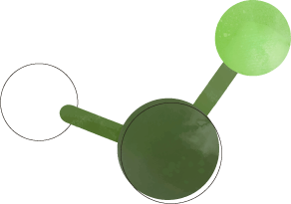
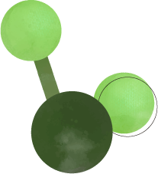
MS/MS Viewer
Project
Sonsoles Liria Veiga
Bioinformatics Computing-5240
12/20/2024

Slide 2
TABLE OF CONTENTS
01
02
03
Project requirements
Scientific modeling trade-offs
Tests for correctness
04
05
06
Bugs, difficulties and successes
Course experience
Packages and modules

Slide 3
HOW WELL DID I MEET THE REQUIREMENTS?
Scan number & peptide
Match peaks and Plot
m/z calculation for b and y ions
Peak extraction from xml file
Match b and y ions to spectrum peaks
Generate stem plot for visualization
Created a class and saved as a module
Peptide sequence given in command-line
Saved as a module
Scan number given in command-line
Intensity threshold and tolerance for correct matching
Labels to matched peaks, legend, x&y axes

Slide 4
m/z calculation for b and y ions
Peak extraction from xml file
Match b and y ions to spectrum peaks
Generate stem plot for visualization
Created a class and saved as a module
Peptide sequence given in command-line
Saved as a module
Scan number given in command-line
Intensity threshold and tolerance for correct matching
Labels to matched peaks, legend, x&y axes
b Ion m/z
(N-terminus): [M+H⁺]⁺
y Ion m/z
(C-terminus):
[M+H₂O+H⁺]+
Intensity threshold:
≥ 0.05 highest peak
Tolerance: 0.05 Da
WHY IMPORTANT?
b1
y1

Slide 5
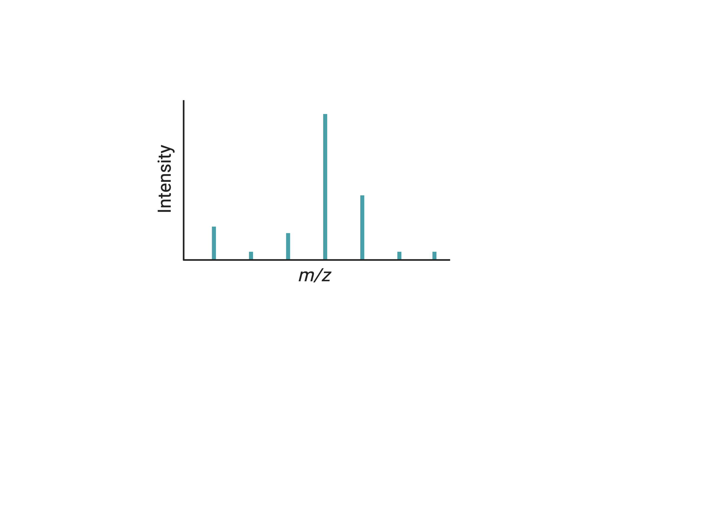
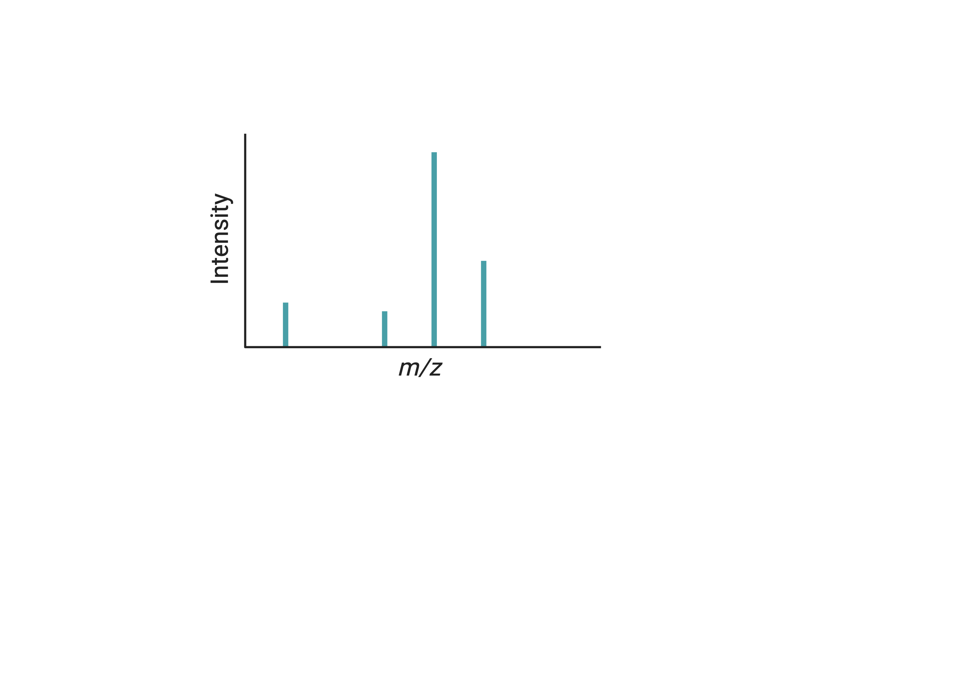
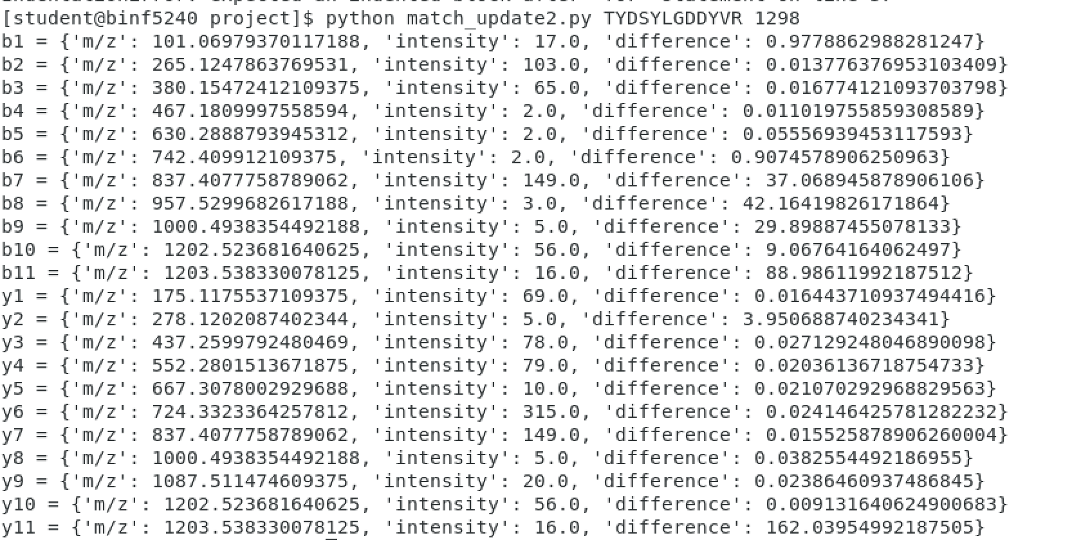
If not applying intensity threshold and tolerance…
If applying intensity threshold and tolerance…
Peak with a difference of 0.05Da or less?
Below 5%
SENSITIVITY AND SPECIFICITY

Slide 6
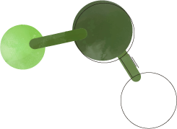
SCIENTIFIC MODELING TRADE-OFFS
IONS COMPUTATION
ION-PEAK MATCHING
Monoisotopic monoprotonated mass
Only the 20 essential amino acid are considered
Not counting for PTMs (Phosphorylation, ubiquitination…)
Tolerance and and intensity threshold may be dependent on the spectrometer, sample and conditions selected

Slide 7
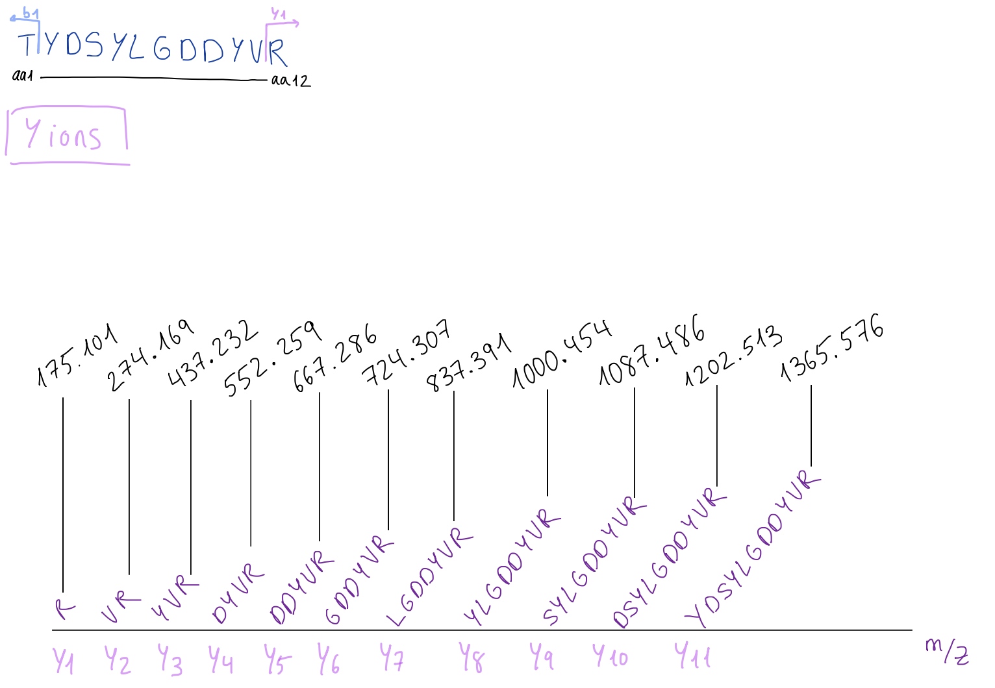
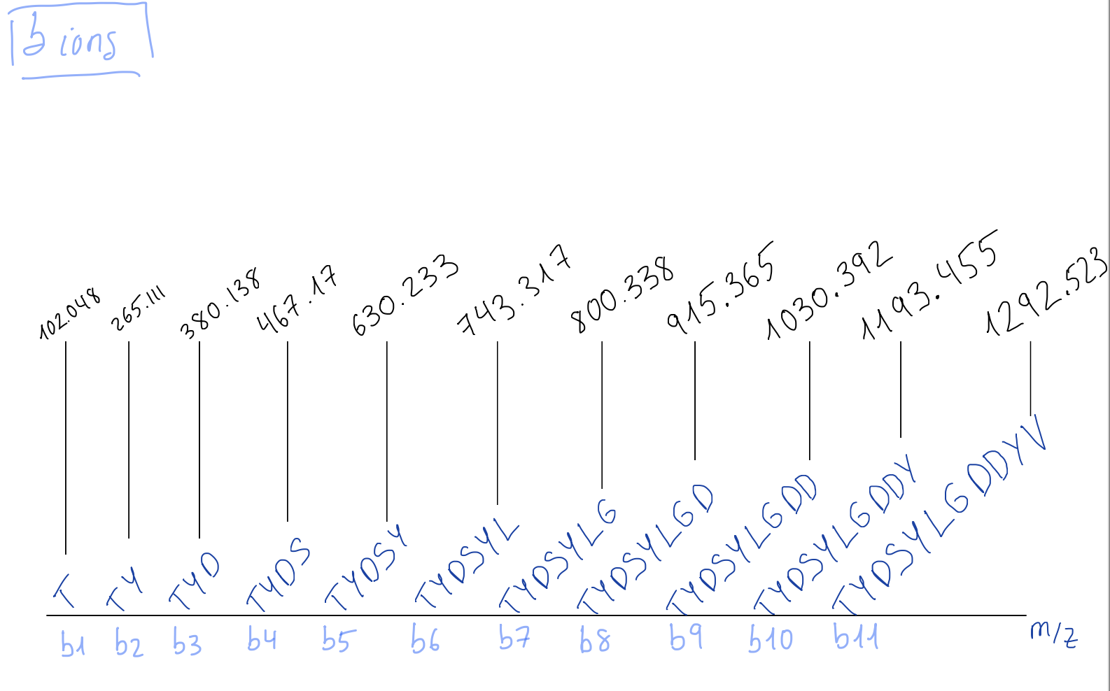
TESTS FOR CORRECTNESS
MANUAL CHECK
ION CALCULATOR
IONS M/Z CHECK
proteomicsToolkit
http://db.systemsbiology.net/proteomicsToolkit/FragIonServlet.html

Slide 8
TESTS FOR CORRECTNESS
MANUAL CHECK
COMMAND-LINE ARGUMENTS
ION CALCULATOR
EXCEPTIONS
IONS M/Z CHECK
CODE CHECK
Scan number and peptide sequence
proteomicsToolkit
http://db.systemsbiology.net/proteomicsToolkit/FragIonServlet.html
Peptide sequence, file opening, scan number, name space

Slide 9
PACKAGES & MODULES
base64→b64decode
matplotlib.pyplot
gzip
Encoding and decoding binary data
Strengths: b64decode is simple and fast
Weaknesses: data size increase with encoding
Plotting in Python
Strengths: a lot of different plots to do, integrates with Numpy and Pandas
Weaknesses: complex to get the desired output in the plot
Module that allows compressing files and reading .gz files
Strengths: reduces size of files
Weaknesses: only supports gzip, not other compression formats (zip files)
array→array
xml.etree.ElementTree
sys
Class that allows manipulation and storage of specific data types (‘f’:floating point numbers)
Strengths: good for large data sets compared to list
Weaknesses: less kinds of data types than list
Module for xml parsing
Strengths: fast and memory efficient (interparse, element.clear())
Weaknesses: the more complex the document the more difficult to parse and extract data. (lxml)
Module that allows interaction with the user
Strengths: access to command-line arguments
Weaknesses: just for interacting with the user and the system environment

Slide 10
BUGS, STRAIGHTFORWARD & DIFFICULT PARTS
Ion computation (backwards)
Peak-ion matching
- Select and apply tolerance and intensity threshold
Legend in the stem plot
Exceptions
- Raise different errors for scan number and name space issues
Xml parsing
Class and modules
DIFFICULTIES
SUCCESSES

Slide 11

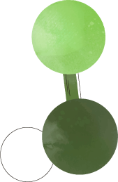
My experience
Bioinformatics
Translation from a DNA sequence, Blast, analyses of the data…
Computing
Python language, data-structures, modules, classes, xml parsing, relational databases…

Slide 12
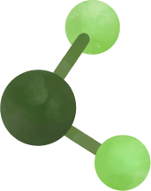
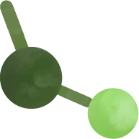
THANKS!

