Slide 1

Pacman game
Where our depression begins

Slide 2
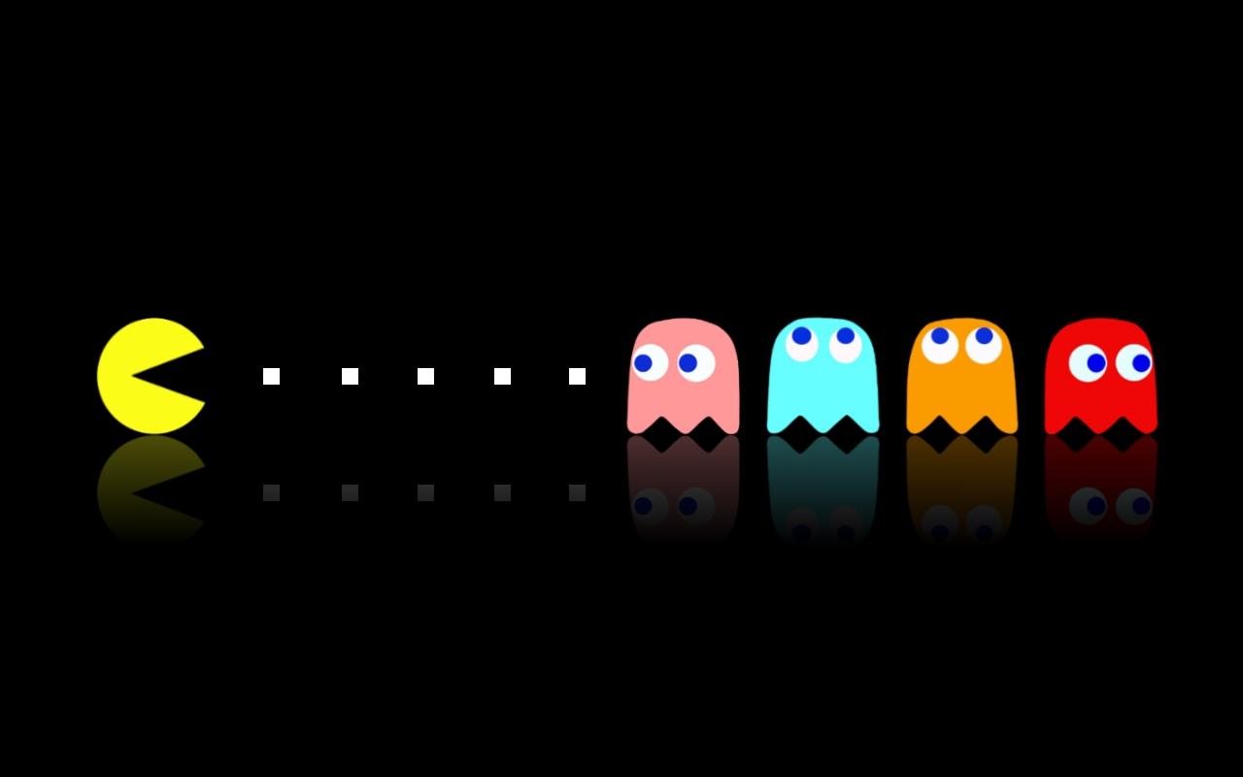

Slide 3
objectives
About this Project
Class diagram and code
Game Visual
Limitation
What is Pacman and how to play it.
Progress to make this game
part 1
Progress to make this game part 2

Slide 4

about the Game
Pac-Man is an arcade video game that was made by Namco and designed by Toru Iwatani. It was released in 1980, and became very popular in the history of games.

Slide 5
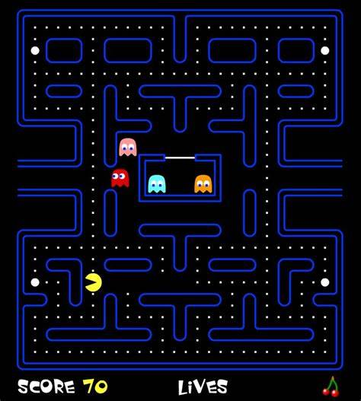

The orginal
Map
Map of the game, might changes when restart.
Ghosts
Will eat you, need to avoid.
Dot
Pacman’s food.
Pacman
This is us, move this to eat dots.
Lives
No life – End game.

Slide 6
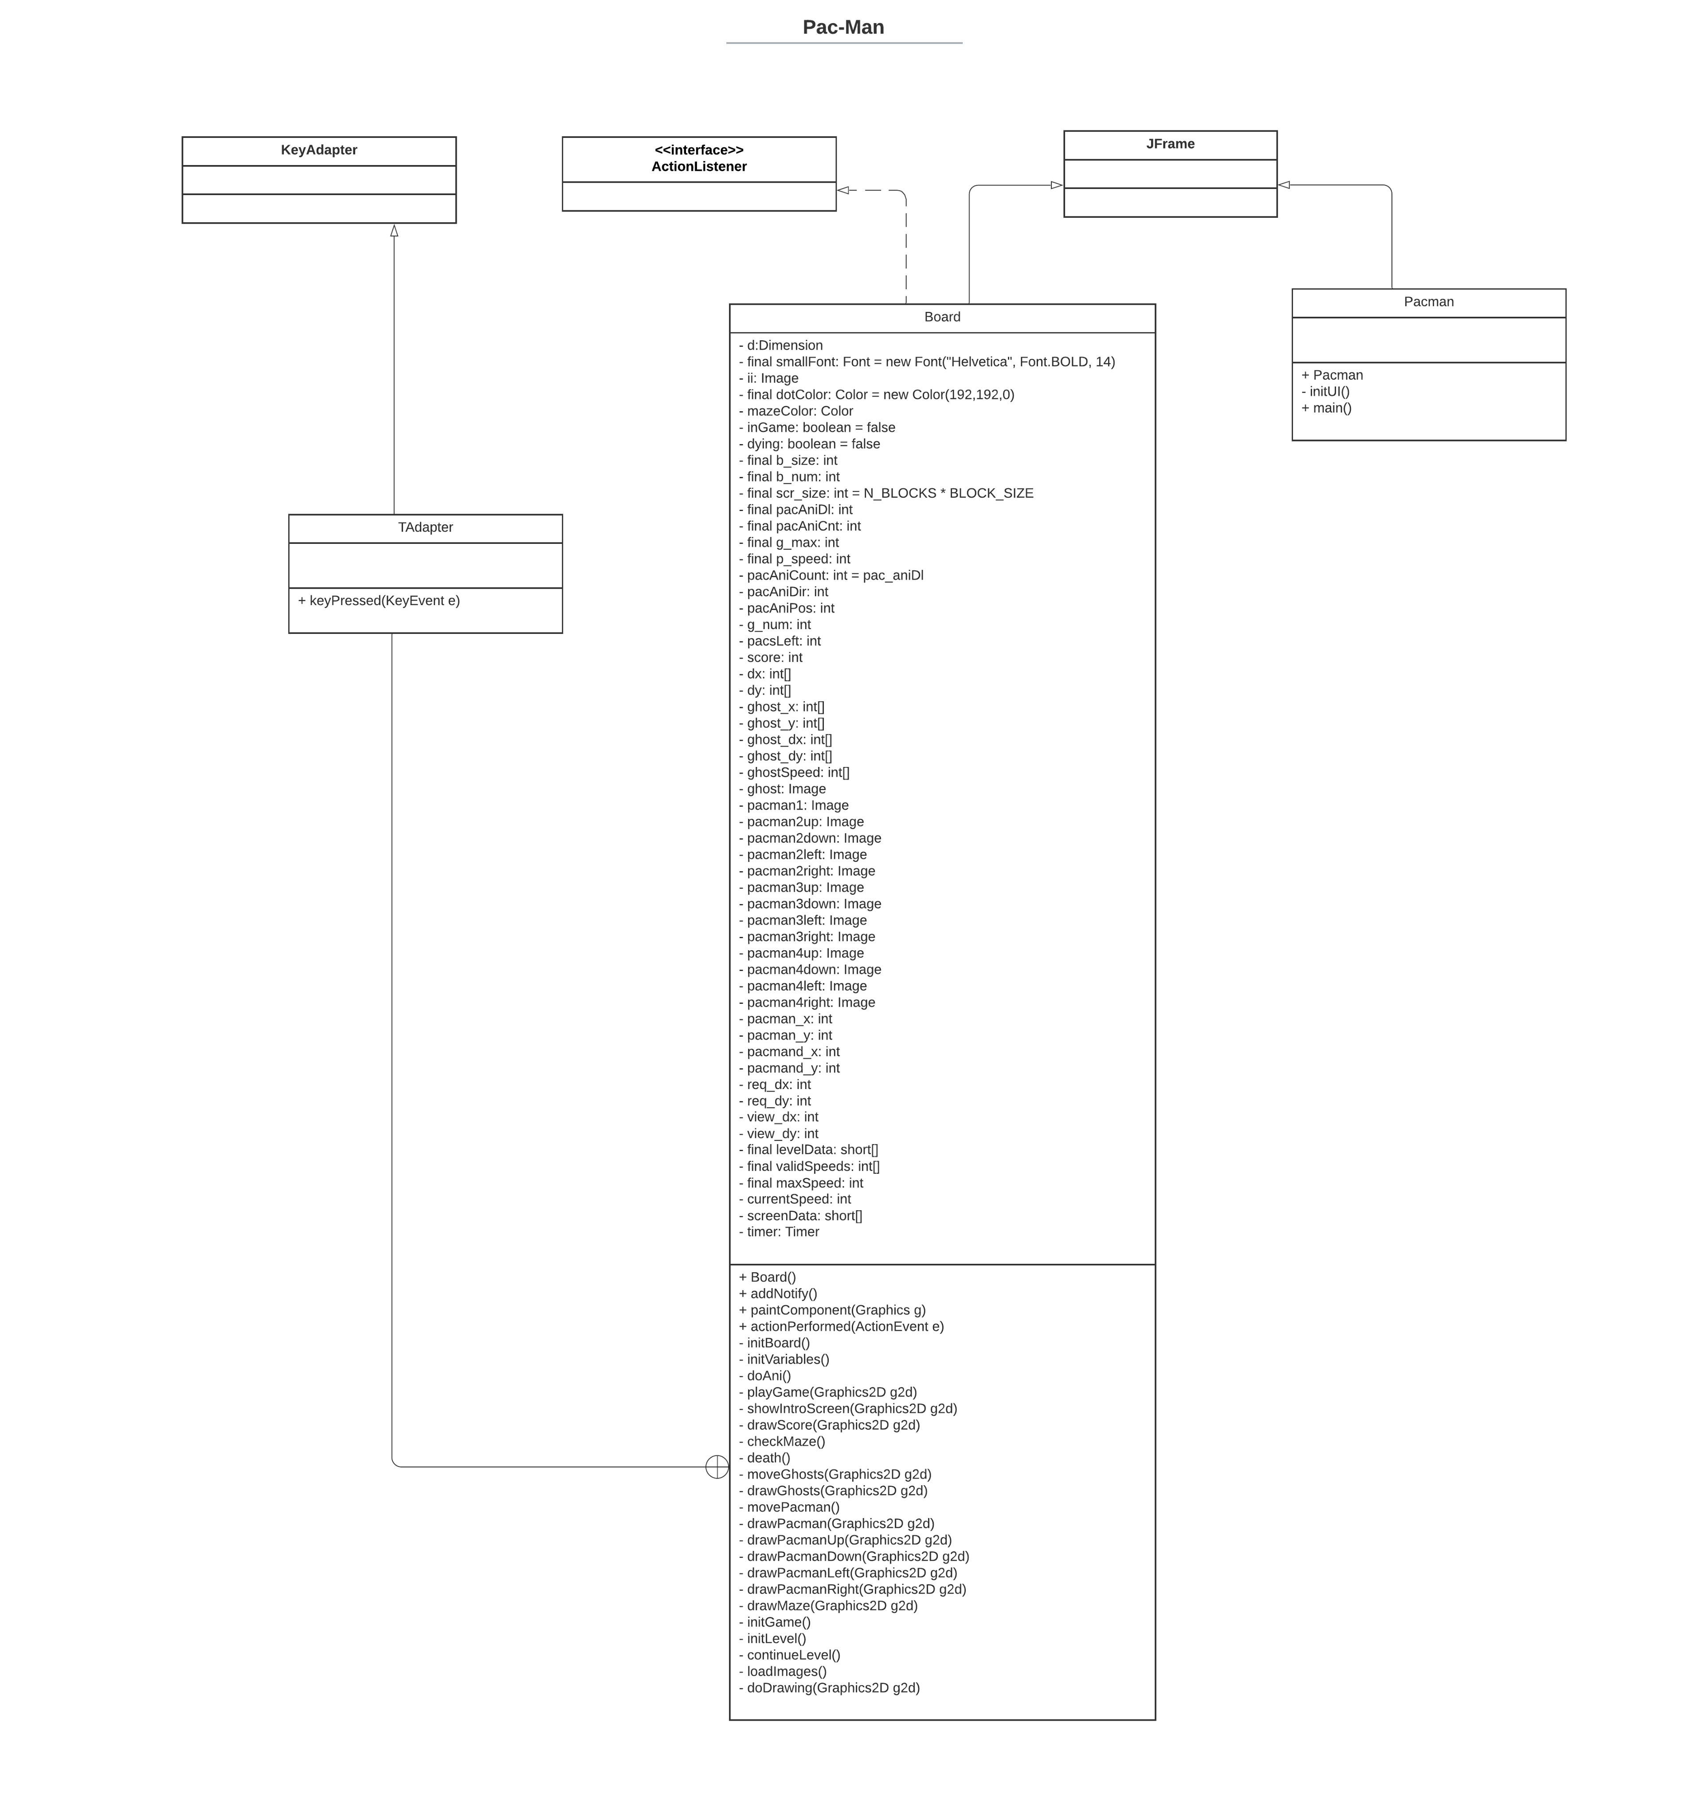

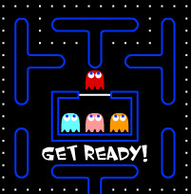
Class Diagram

Slide 7
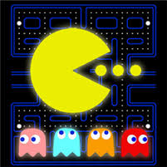
Game’s code
Link to the code:
https://bom.to/ekQFxKU9

Slide 8
Game Visual
Everyone likes game that has creative arts
Make it whatever you want
Simple or complicate
Just make sure that it will bring joy to our gamers
Here is how we make ours

Slide 9
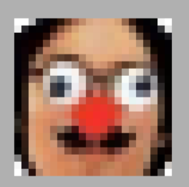
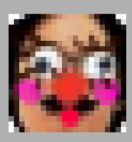




I. Create Characters
Our base panel
+ 22x22 pixel panel size (require).
+ 4800 Pi for a clear resolution (Optional).
+ APP using: PTSAI.
Or just Using your favorite friend picture
If they don’t mind
draw it out using magic your creative with drawing apps

Slide 10
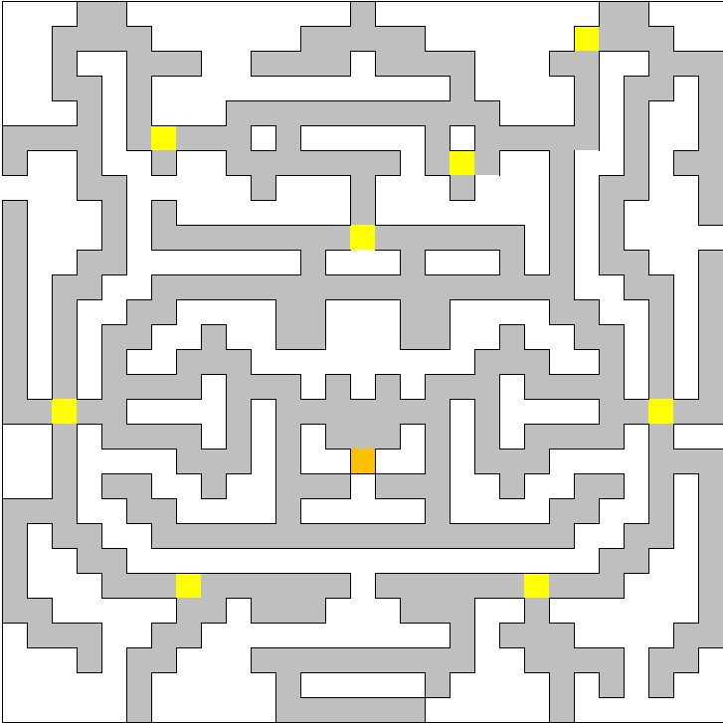
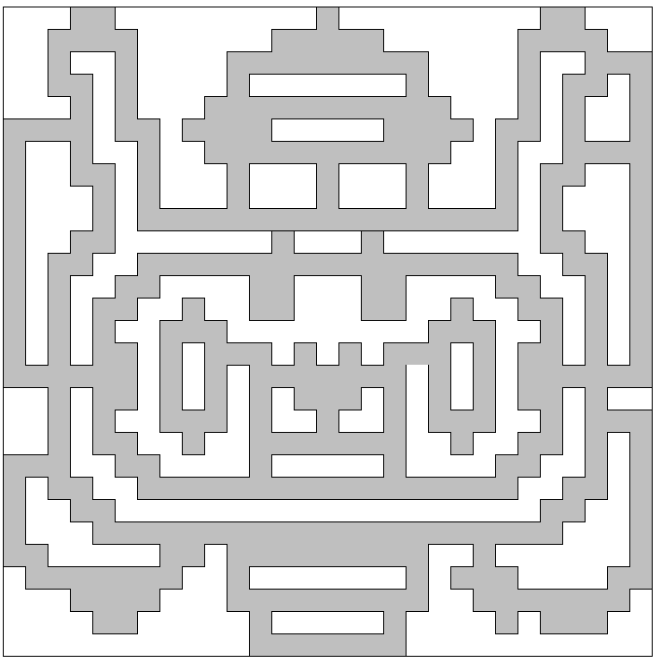
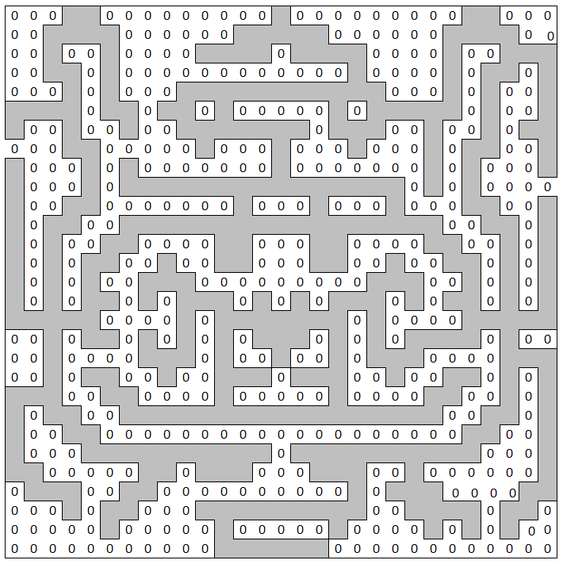
II. Create Maps
Using Excel to create Maps
From easy then upgrade it a tiny little bit. For more fun when playing!
Easy at the beginning
Finish!
full development of the map and adding ghosts and pacman placement
Upgrade a little bit

Slide 11
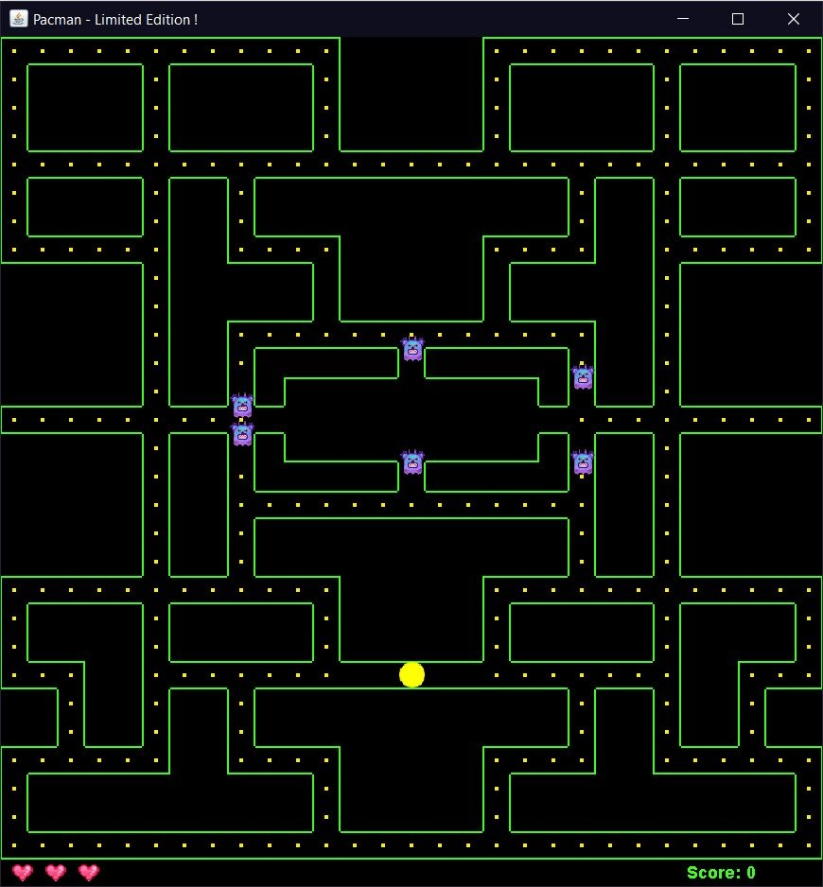
Map & Rules
Level 1: easy
+ Number of ghosts: 6
+ Ghost speed: 3
+ Pacman speed: 6
+ Lives: 3
+ Death penalty: None
+ Total score: 300p + 50p(Bonus)
+ Instruction: Eat all points to win. The map is in fact the initial map from the creator of the game.

Slide 12
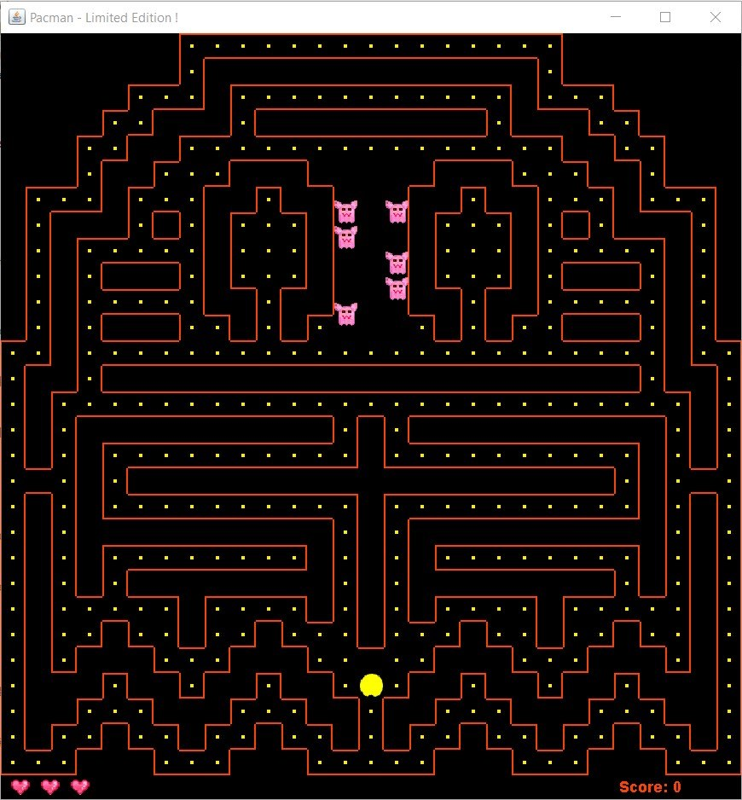
Level 2: Normal
+ Number of ghosts: 6
+ Ghost speed: 4
+ Pacman speed: 6
+ Lives: 3
+ Death penalty: No. of ghosts increases by 1, and ghost speed is set to 4(if death again, 6 instead).
+ Total score: 420p + 130p(Bonus)
+ Instruction: Eat all points to win. The map is a custom one which is inspired from the ghost image of the game
Map & Rules

Slide 13
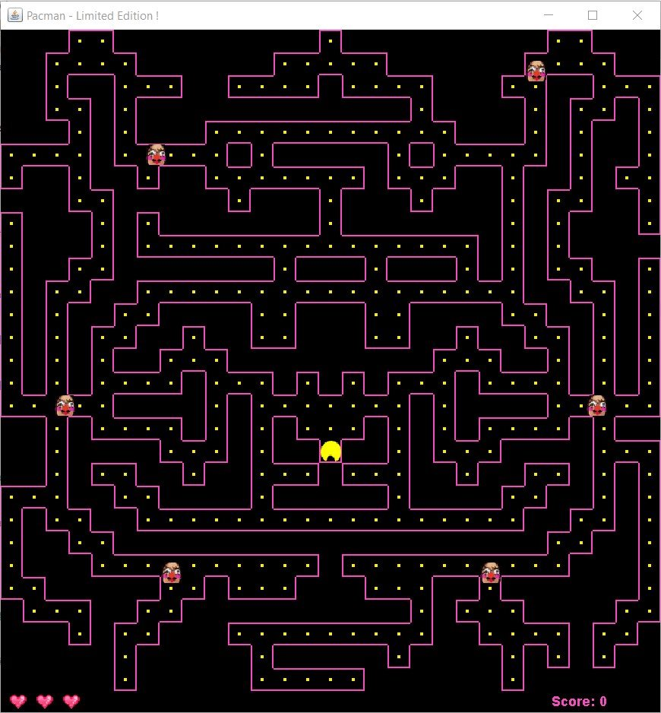
Map & Rules
Level 3: Super Easy ☺
+ Number of ghosts: 6
+ Ghost speed: 4
+ Pacman speed: 6
+ Lives: 3
+ Death penalty: No. of ghosts increases by 1, and ghost speed is set to 6.
+ Total score: 400p + 150p for each lives left(Bonus)
+ Instruction: Eat all points to win.

Slide 14
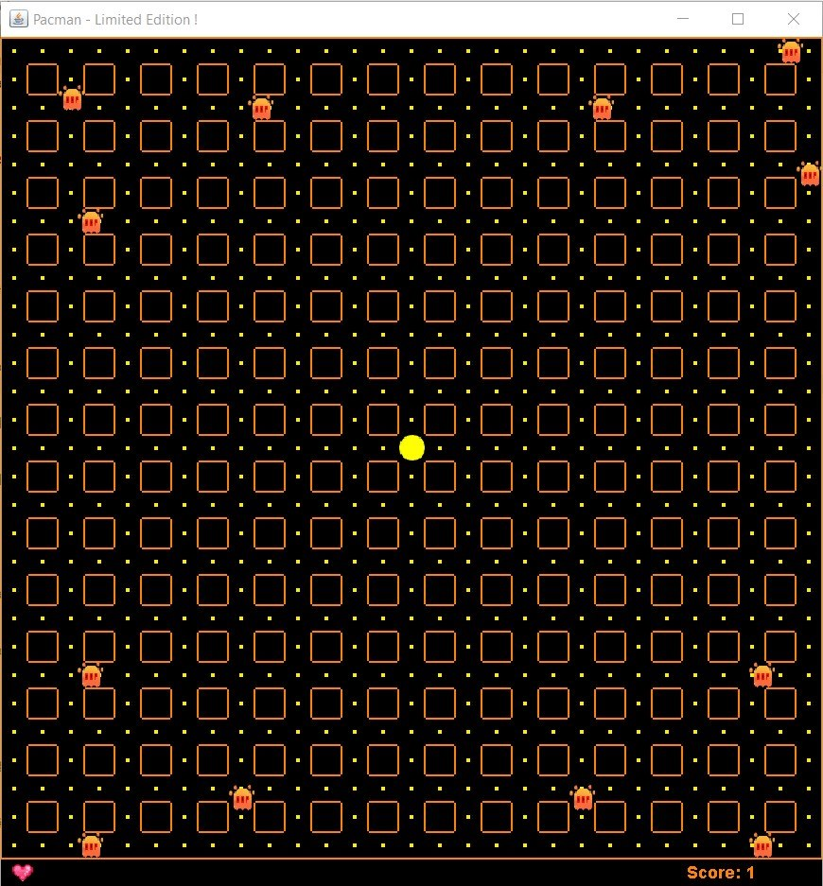
Map & Rules
Level 4: Bonus!
+ Number of ghosts: 12
+ Ghost speed: 8
+ Pacman speed: 6
+ Lives: 1
+ Score bonus: 1000p if win the level
+ Instruction: Eat as much points as possible while dodging all 12 ghosts. Try to win the game

Slide 15
Limitation
Compare to the Original, here are Things that we cannot do…yet:
+insert music to the game.
+ Create special dot that makes pacman eat back the ghosts in â limited time.
+ Making maps more portable (create tunnel for pacman to go through the map)

Slide 16


The part that you all waiting for
Let’s Try out the game
NOw
Good luck and have fun! ☺

Slide 17
Thanks!

